Slide 1

Onboarding & Governance of Consultants (Physicians and Surgeons) in Expanse
1st October 2025
Dr David Niland MB BCh BAO MIT

Slide 2


Are doctors special?
No….but it is useful understand the doctors’ perspective
Onboarding
Governance

Slide 3

At the Galway Clinic on MEDITECH over 15 years;
-1.6 million electronic drug orders
- 1 million electronic documents from doctors

Slide 4

Try to create a partnership
Onboarding

Slide 5
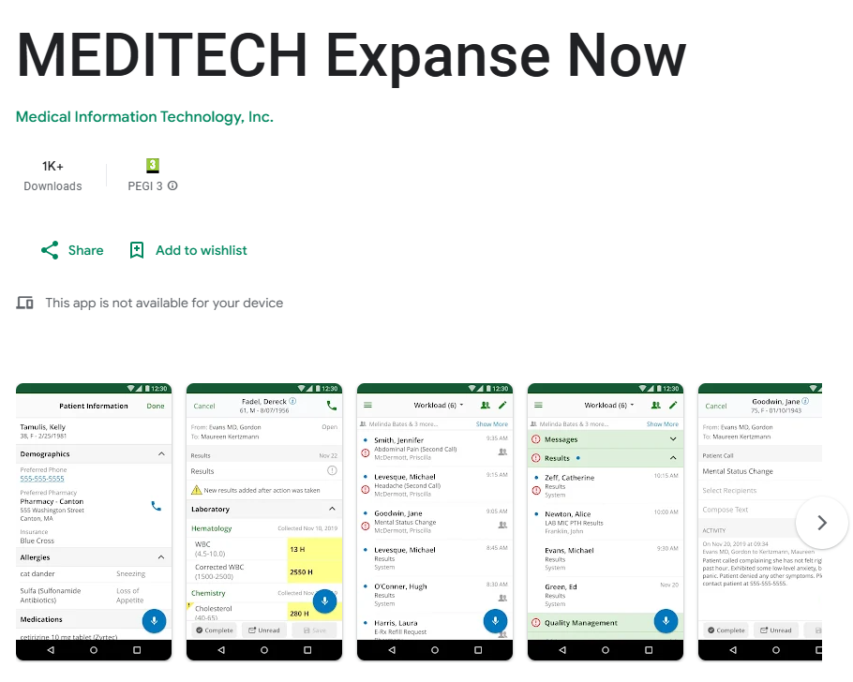


Solve a specific problem
Onboarding

Slide 6

Say no. Nicely.
Onboarding

Slide 7


"Is this faster than Edel?"
Usability- front and centre

Slide 8

Everybody wants a consultant on their committee
Governance

Slide 9
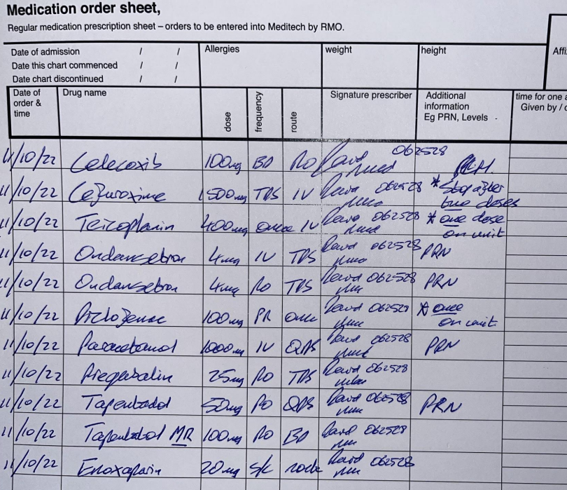
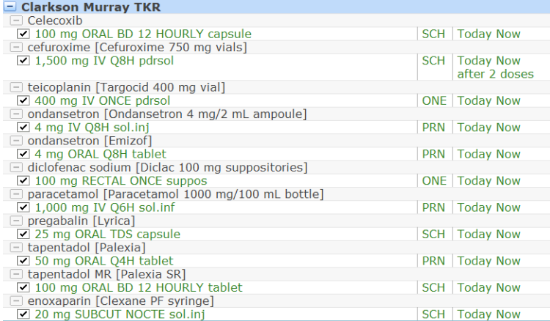
Order sets
Governance

Slide 10
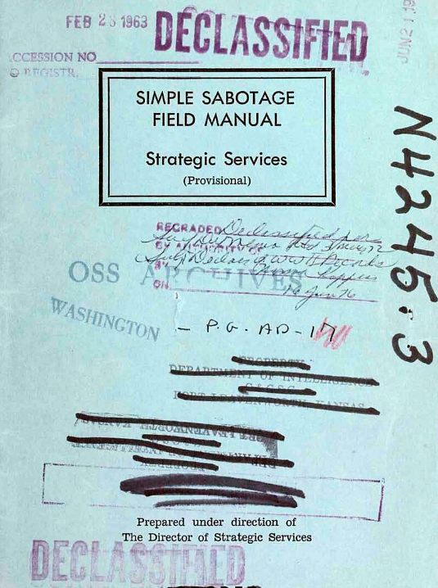
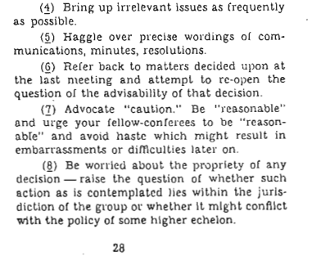
The CIA …… and governance of Irish consultant physicians and surgeons

Slide 11
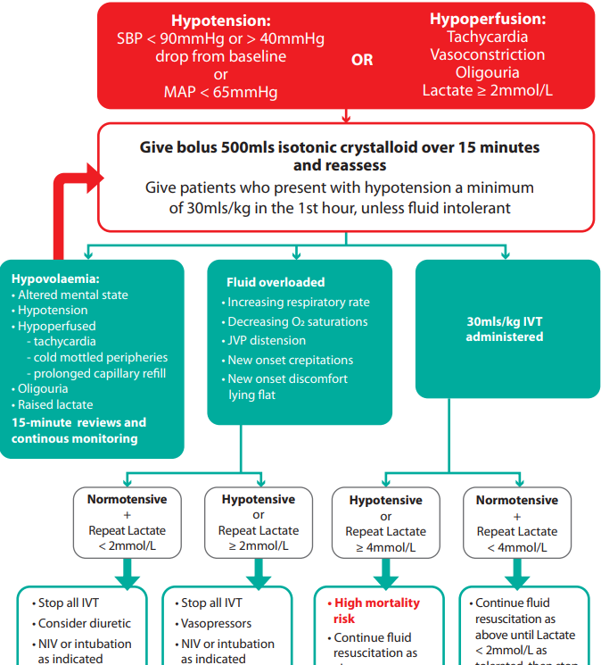

Communication
Governance

Slide 12
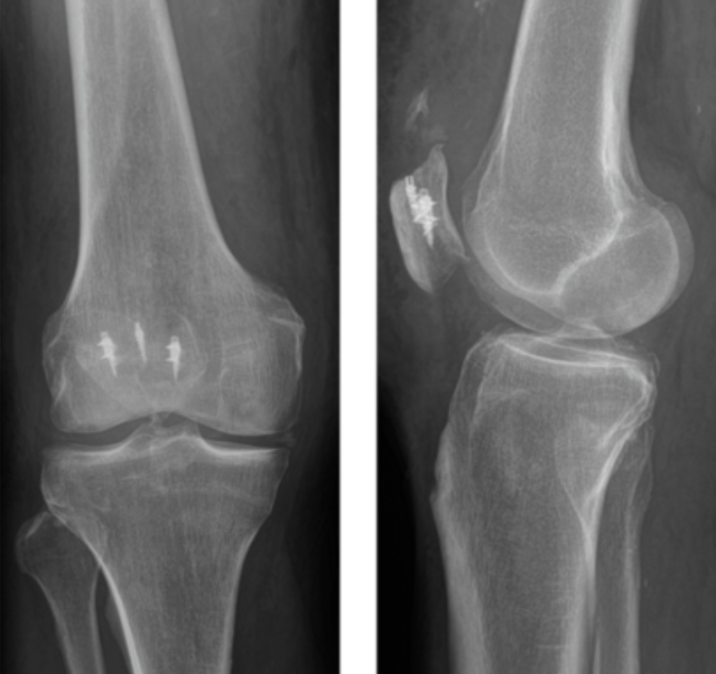
Outcomes
Thank you

