Slide 1



Kristen Martino, MSHM, BSN
Product Manager
kmartino@meditech.com
From Data to Decisions

Slide 2




Null Object - DO NOT DELETE
The INTELLIGENT EHR
Infrastructure
Future-proof
Platform
Data Driven
Ecosystem
Extensible
Notes:
Advanced analytics, data and interoperability tools are key features of Expanse because data is increasingly significant in improving care quality, patient outcomes, operational efficiency, and cost reduction for healthcare stakeholders.
Accessing and using healthcare data requires key functional components to enable the intelligent application of data.
With Expanse, MEDITECH supports Analytics, Interoperability, and the Data needs of health systems by:
Building an infrastructure based on modern technology
That powers intuitive and intelligent workflows
That enables a patient-centered Interoperable ecosystem
—------------------------------------------------------
Intelligent health of the future meets the needs of:
Clinicians for intuitive workflows that inherently operationalize data, unlocking new insights;
Patients for more personalized and person-centered by increasingly leveraging genomics;
Healthcare organization overall to be responsive and adaptable to evolving models of care delivery
Embracing that future requires an EHR partner that has reliably and consistently invested in creating a truly interoperable infrastructure
Infrastructure enables the EHR to function as an intelligent platform
Continuously data-driven
Connected to a broader ecosystem
MEDITECH’s commitment to data accessibility is what drives organizations’ capacity to innovate–today and tomorrow
2024.3.6_Gartner Intelligent Health: A vision for HCLS Industry , see especially the image on page 5 “Intelligent Health Characteristics” and page 8, “Four Foundational Industry Directions in Intelligent Health”:
"Embrace intelligent health as the foundation of your organizational strategy. This
industry vision uses advancements in technology and science to improve business
agility and clinical outcomes by being interoperable by default, relying on continuous
data to deliver experience through the unification of care delivery that is precise,
equitable and ethical."
“Intelligent health harnesses the ever-increasing volume, variety and velocity of data to anticipate and move interventions to a broader range of moments that matter as they unfold without time or location constraints — improving both business agility and clinical outcomes. Intelligent health is interoperable by default, relying on continuous data to deliver experience through the unification of digital and in-person care delivery that is precise, equitable and ethical.” Can tie what’s in bold into the throughline of the presentation going from individual clinical use cases to how that data is operationalized by the organization from a macro perspective (e.g., surveillance alerts to clinician, then back-end BCA surveillance dashboards)
“advancements in technology and science are demonstrating the power of moving beyond information to intelligence — bringing medicine closer to the patient.”
“Conquer Four Imperatives for Success in Intelligent Health…Precision… Equity…Ethics…Interoperability–This imperative elevates ubiquitous data as the cornerstone to successful digital transformation and reinforces the need to position interoperability as a strategic core competency. …the imperatives will be table stakes for high-performing organizations in the near future”

Slide 3





Null Object - DO NOT DELETE
Data Collection & Normalization Semantic Interoperability
An INTELLIGENT INFRASTRUCTURE
Meaningful Exchange Network-based exchange
FHIR APIs
SMART app launches
Industry Standard Data Structures
JSON
SQL
Cloud Based Flexible & Scalable
Ease of Deployment:
Apps & Platform
AI-Enabled
Mobile Native Smart Phones Tablets
Forward Looking Web-Based
Modern
Technology
Notes:
Here I want to show how data flows through the underlying infrastructure at zoomed-in level…
Initial focus is on codifying and normalizing data across the platform
We ensure there are the appropriate tools to do that, and to propagate value-bases and coding systems across the entirety of our data structures
Data is stored in an efficient manner that promotes interoperability, not just data-sharing with apps but extending access to operationalize ML and generative AI
As organizations’ need more advanced way to use applications– particularly those highly reliant on large volumes of data– scalability becomes increasingly important. [is this accurate? I added it on to your original HIMSS talking points]
Expanse is one of the first cloud-based EHRs
We leverage the cloud to ensure our platform is easily deployed and scalable
Use cloud functions to extend access to data and deploy apps within FHIR servers at scale
Our use of cloud database management tools enables access to data sets for AI use cases
The combination of all three–data, data structures, and cloud tools–ensures that Expanse is mobile-native
Meaning we can extend access to health apps, including Smart on FHIR and CDS hooks, that augment the experience of both patient and provider as well as offer additional sources of data capture [is this accurate? I added it on to your original HIMSS talking points].

Slide 4

Null OBject - Do not delete
Person-Centered Care
THE INTELLIGENT E H R P L A T F O R M
Deliver
Target
Deliver Personalized medicine
Target Strategic operational priorities
Data Access EHR Adaptability, Mobility, Validated from across integrated EHR
Data Operationalization Artificial Intelligence, Care Compass,
Business & Clinical Analytics
Data Access
Data Operationalization
Interoperable
Cloud-based
Cloud-Based
Interoperable
Notes:
Here I want to talk about how the infrastructure powers the intelligence of the platform
The Expanse platform addresses the increasing demand for data access and utilization in the healthcare industry
It emphasizes seamless flow of data between individuals and organizations, catering to diverse end-user needs across the care continuum.
The platform aims to enable better decision-making at:
both individual and organizational levels,
promoting person-centered care,
personalized medicine,
and strategic priority targeting.

Slide 5



DYNAMIC AND CONTINUOUS
Data Collection and Utilization
Beyond Data Retrieval to Dynamic Data Utilization
Notes:
A key feature about Expanse is that it integrates dynamic data collection and utilization through
user-friendly EHR interactions,
customizable analytics dashboards,
and AI capabilities.
Expanse helps organizations see big-picture insights by using data to find specific areas that need attention
It also lets users access and use data instantly, especially at the point where they're providing care.
This means they can make better decisions as they work, like when AI gives a clinician helpful information while they're looking at a patient's chart.

Slide 6


A Vision for the Practical Integration of AI
✔
Decrease clinician burden
✔
Enhance the patient experience
✔
Improve organizational efficiency
✔
Empower health systems to develop an AI strategy that is sustainable and safe
Notes:
MEDITECH aims to empower healthcare organizations with technology for safe, efficient, and impactful care
Our approach to integrating AI into EHR prioritizes the patient, the care team, and the health system experience
And our focus on AI applications are those that:
enhance trust and alleviate current burdens
such as meeting documentation requirements,
maximizing data utilization,
and optimizing resources for capacity management.

Slide 7

MEDITECH AI Solutions
Optimize resources
Appt DNA Prediction
Appointment Scheduling
Drive efficiency
Patient Connect
Tailor patient engagement
Ambient Listening
MEDITECH AI-Enabled Workflows
Patient Encounters
Expanse Navigator
Reduce cognitive load
Hospital Course Summary
Improve decision-making
Transfers of Care
Clinician Handover
Enhance communication
Notes:
The healthcare industry faces challenges with documentation burden and potential data overload.
AI introduces solutions to some of these challenges, like:
automated data collection,
dictation through virtual assistants,
and auto-generated clinical documentation.
It enables insights, predictions, and responses to patient needs, reducing administrative inefficiencies.
These AI solutions offer immediate benefits to end-users and organizations,
By enhancing patient engagement and throughput.
For example: Expanse search and summarization address information burden, by providing summarized and relevant information for various use cases.

Slide 8

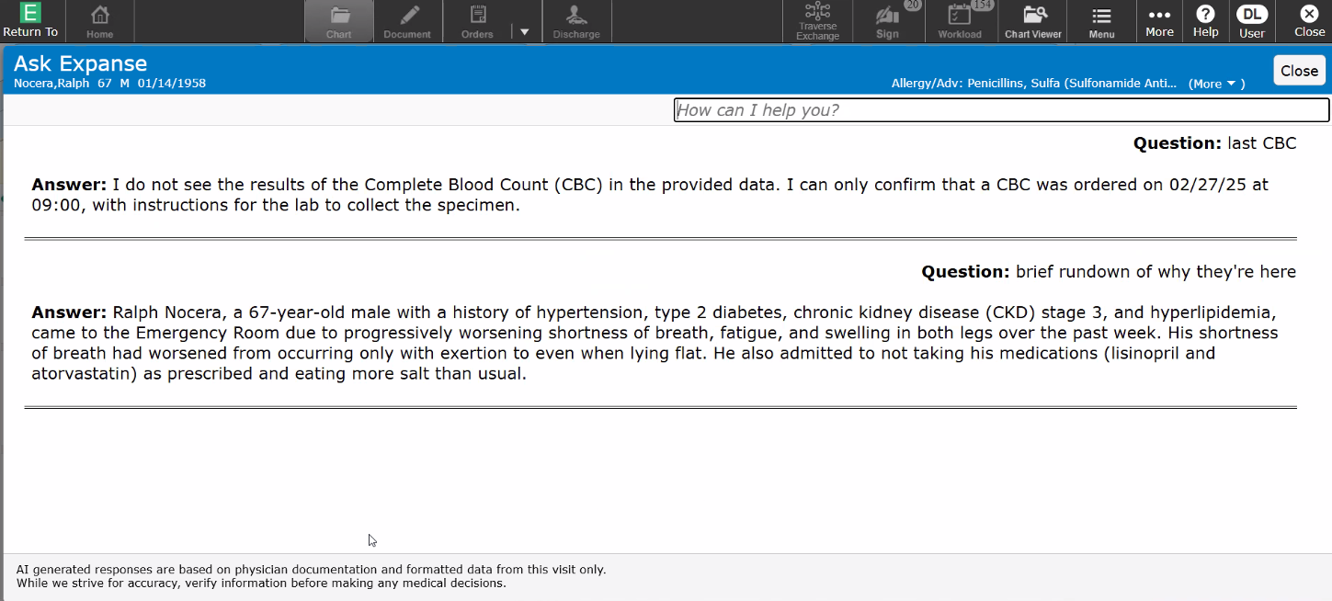
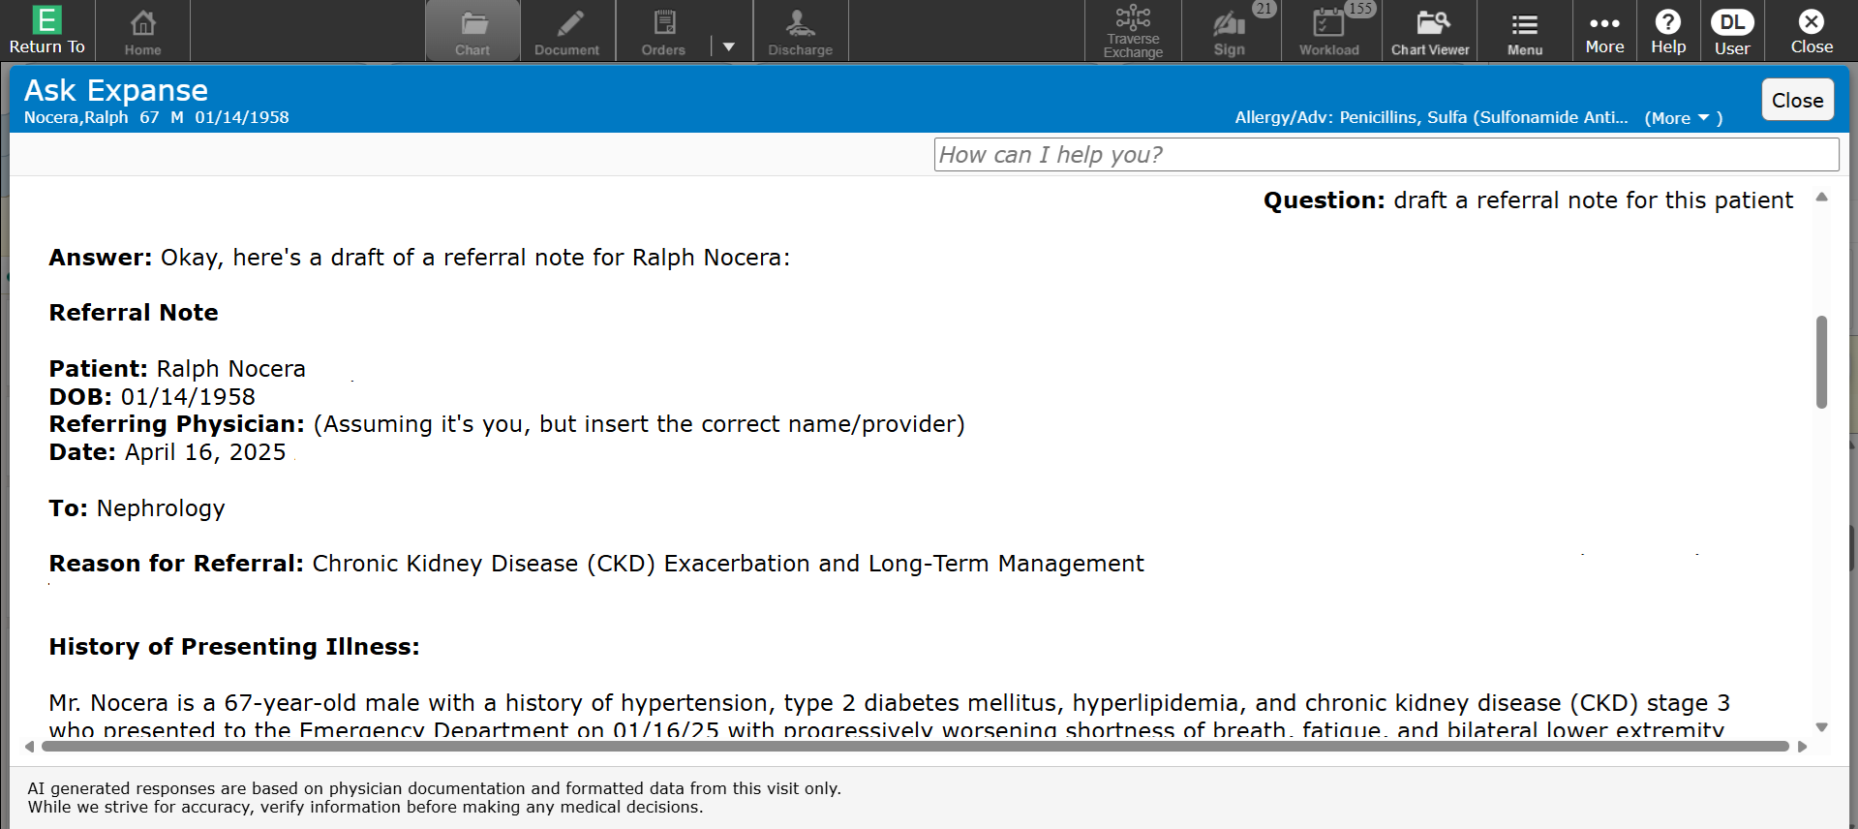
A Path to Agentic AI
Hospital Course Narrative- Chatbot
Generate specific content, on request
Ask questions to find relevant information about a patient’s course of stay
Enhancing decision making when it's needed most
Submit queries, receive context-aware summaries based on provider notes
This solution is in early conceptual phases; features and functionalities are preliminary and subject to change.
This solution is in early conceptual phases; features and functionalities are preliminary and subject to change.
Notes:
As we further to invest in this space and the various forms of AI within in Expanse and as we look toward agentic AI, we have enhanced some of the generative AI capabilities by including chatbot features which is a pathway to agentic
So When I ask expanse does the patient have an appropriate medications for the trip, the chatbot can take the action to place the orders

Slide 9


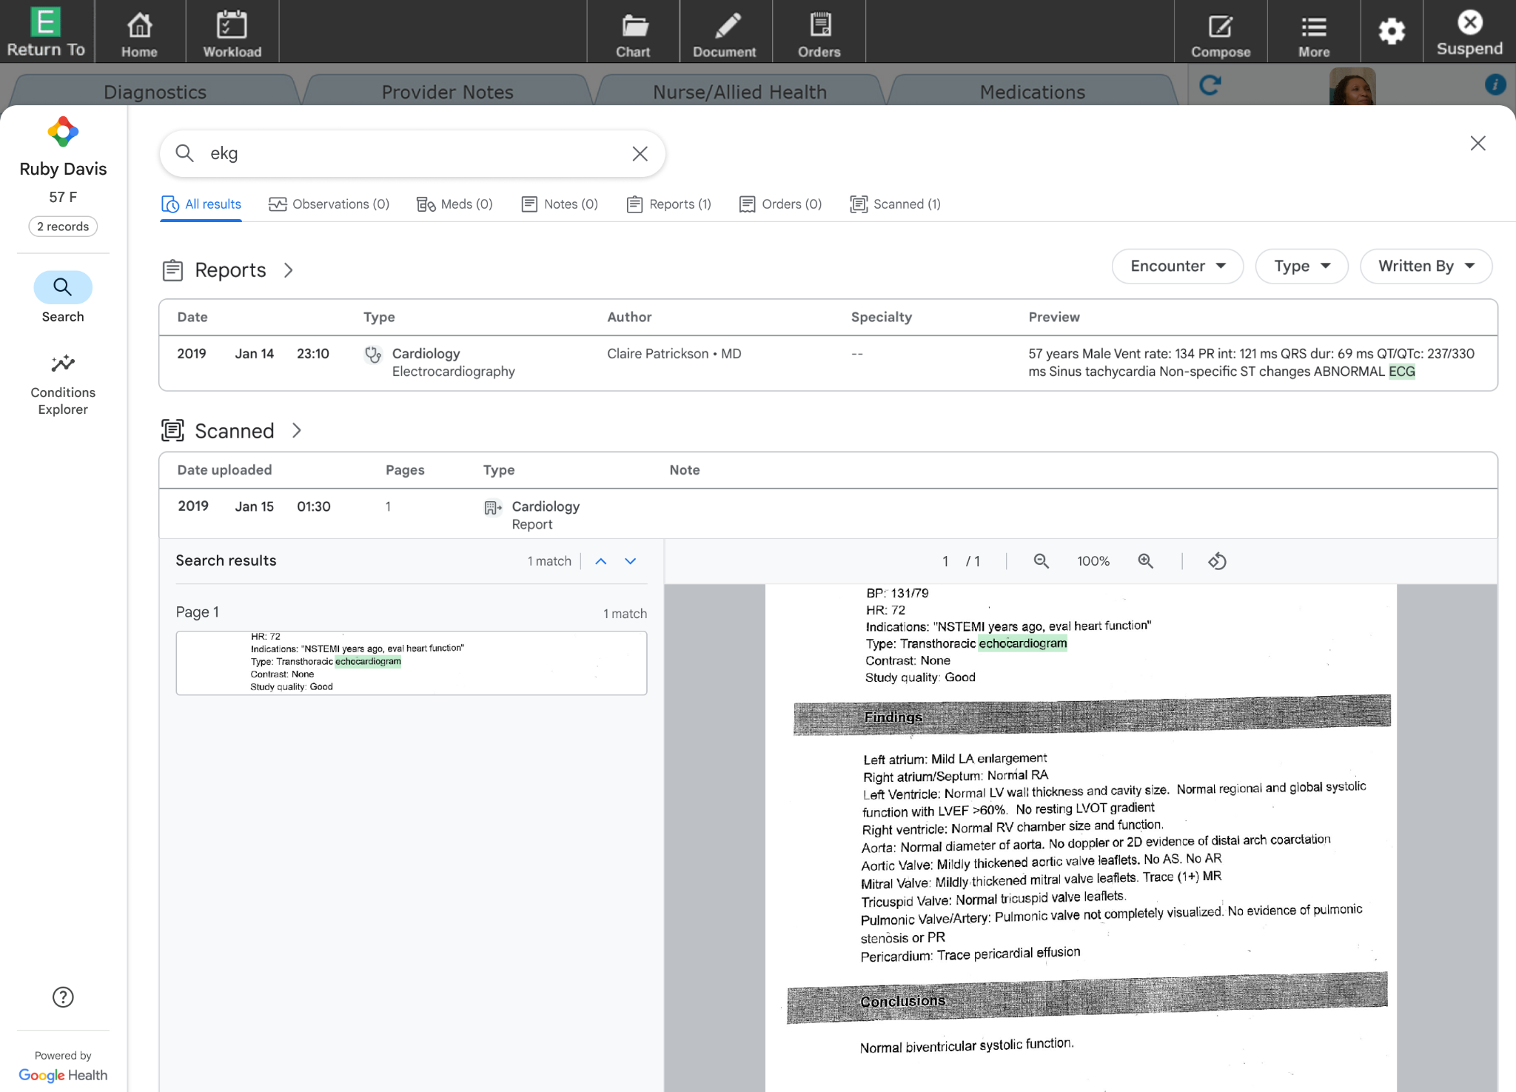
Search
The most relevant information is identified,
Intelligently organized, and presented, all within an easy-to-view format directly within Expanse highlighting meaningful data for immediate review and comparison.
Notes:
With search
users have the ability to search both structured data like
flowsheets, labs, medications
as well as unstructured data such as
notes and and even handwritten documents.
This aggregation of data creates a more unified view of the health record.

Slide 10

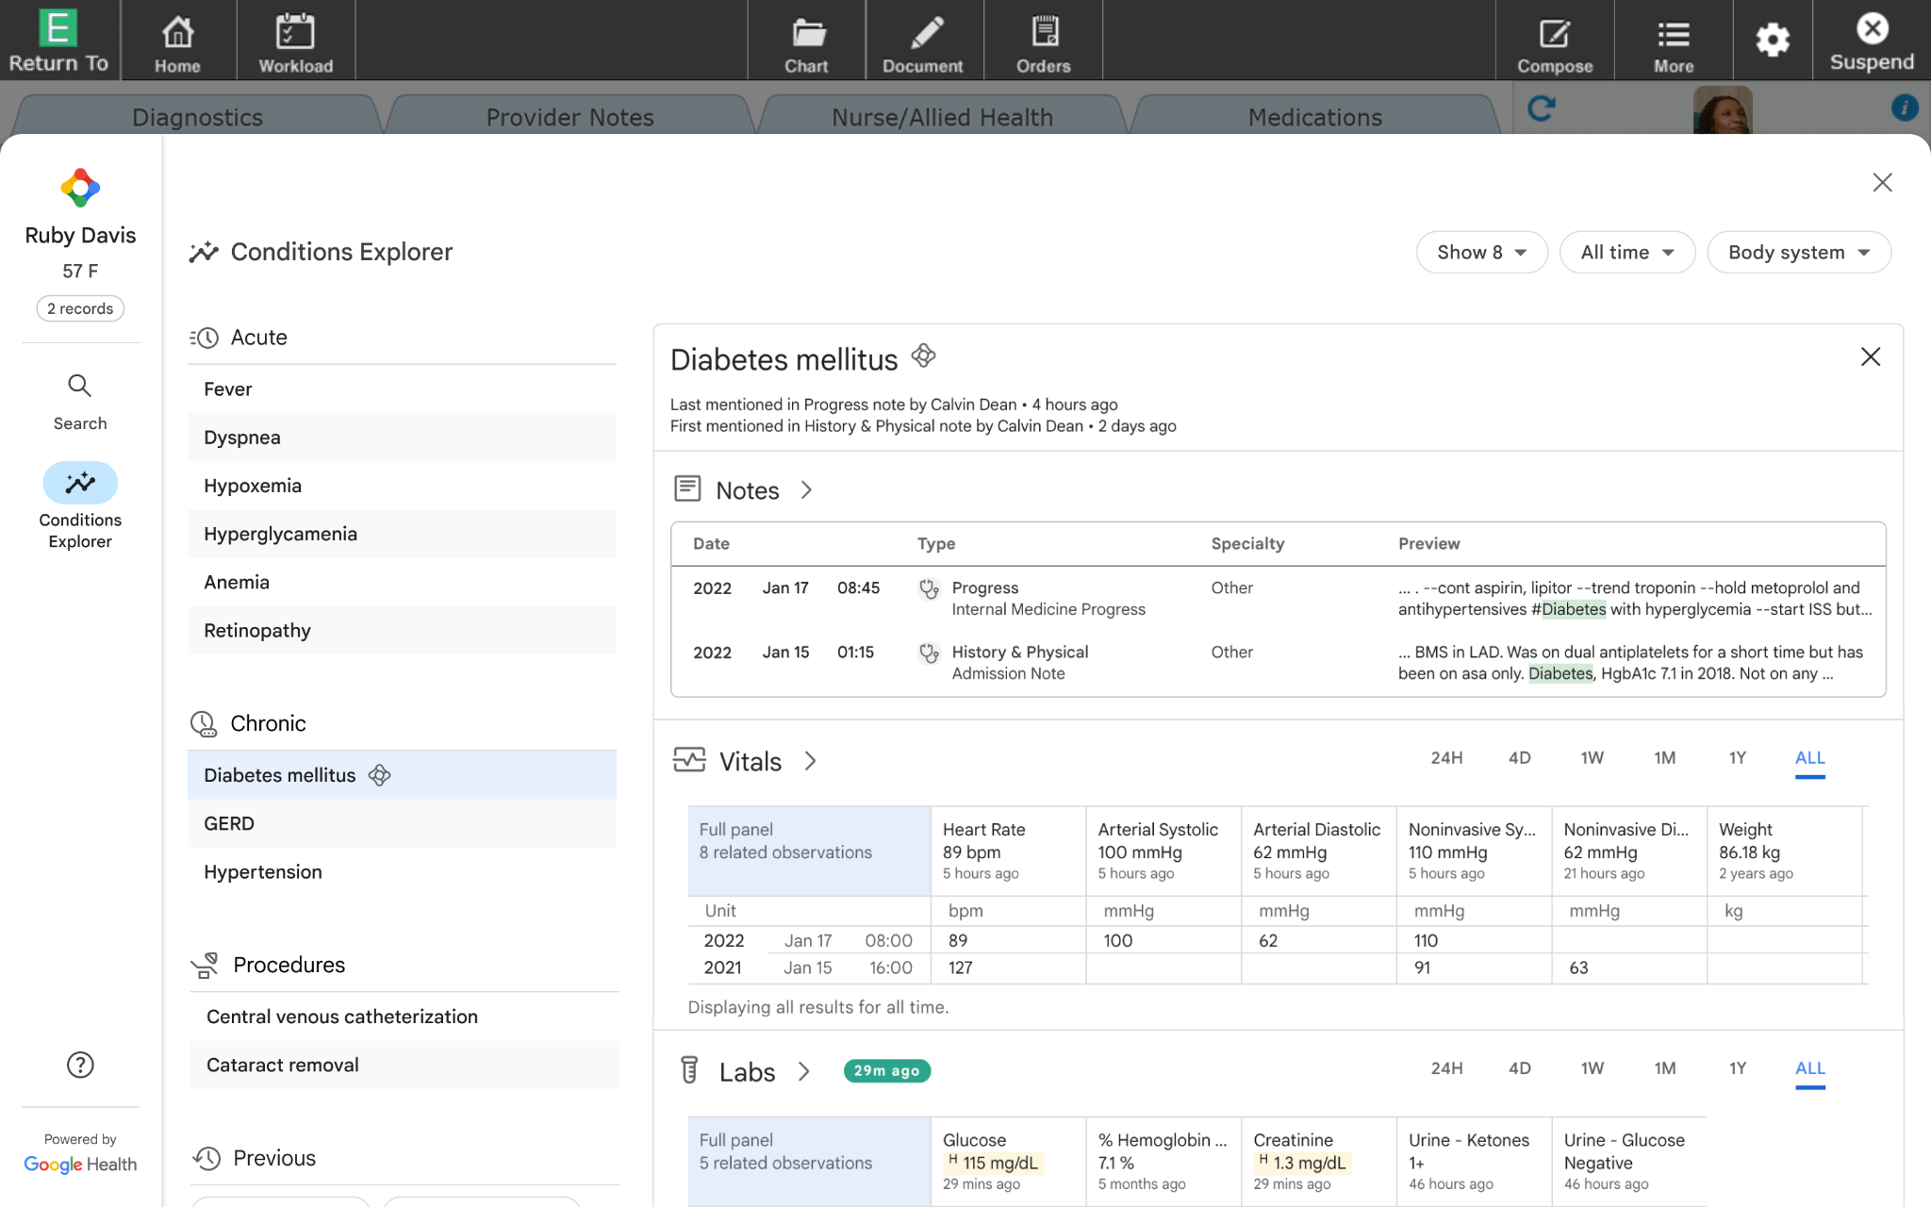
Conditions Summary
Intelligent summary with clinical context designed to save time and increase confidence. Make informed decisions to ensure positive patient outcomes.
Notes:
With Summarization
The Conditions feature incorporates Machine Learning to evaluate all the patient’s clinical notes and summarizes the patient's medical history to create an organized list of conditions into categories, those being:
Active, Historical, Procedures, and Signs & Symptoms.
A number of signals are used to determine if a condition is Active or Historical.
These include how recent the information was mentioned,
the frequency,
and the context of how a condition is referenced in clinical notes,
as well as the history of the individual conditions.
Users are able to select any of the conditions on the list to view the evidence of where it was mentioned in clinical notes.
To put this into perspective
A patient with a poorly managed chronic condition presents in the acute setting.
The ability for ED doctors and hospitalists to look across a longitudinal care record that spans the health system, including specialist
facilitates their decision-making at the point of care
So for example
A diabetic in crisis may not see their specialists regularly and is overdue for items like a foot exam.
The provider's ability to know if the exam exists in legacy or scanned documents eliminates the need to
rely on patient recall,
make calls to outside healthcare settings,
or perform a redundant exam because the information is unavailable.
The conditions explorer will also offer insights into comorbidities that should be considered during care.

Slide 11
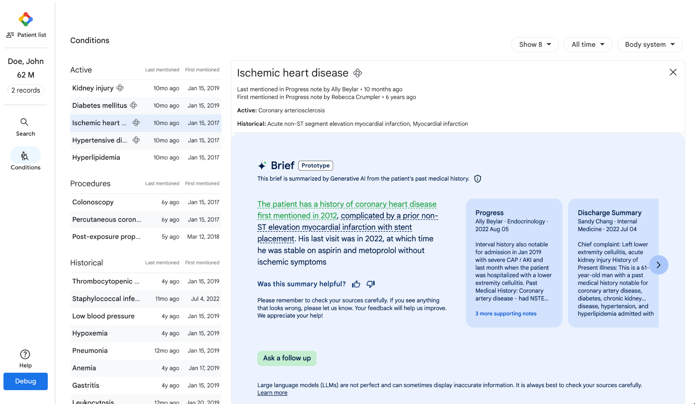

Navigator
Seach
Conditions Brief:
Grounded evidence in conditions brief, for clinician review.
Built on
Cloud
Notes:
As you saw in the demonstration, within Expanse Navigator the most relevant information is identified, intelligently organized, and presented, all within an easy-to-view format directly within Expanse, highlighting meaningful data for immediate review. This is an intelligent summary with clinical context designed to save time, make informed decisions to ensure positive patient outcomes.
Within Expanse Navigator, we’re further enhancing clinicians ability to efficiently access a summary of a patient’s condition through addition of the Conditions brief. This feature combs through all of the different data sources and keys up information about the patient’s conditions giving a longitudinal view of what’s happening with the patient. This was initially targeted at physician and nurse users to be able to look and find information at the point of care, but we found this is something that quickly spread in terms of interest and deployment across different departments. For example, our early adopter is up to 23 different departments who have found utility in being able to quickly search, surface, and present the conditions showing time savings in visit prep for the patients across a variety of different departments in primary care, sleep medicine, infection control, and health information management where users spend a lot of time searching charts, it has had a tremendous impact.

Slide 12

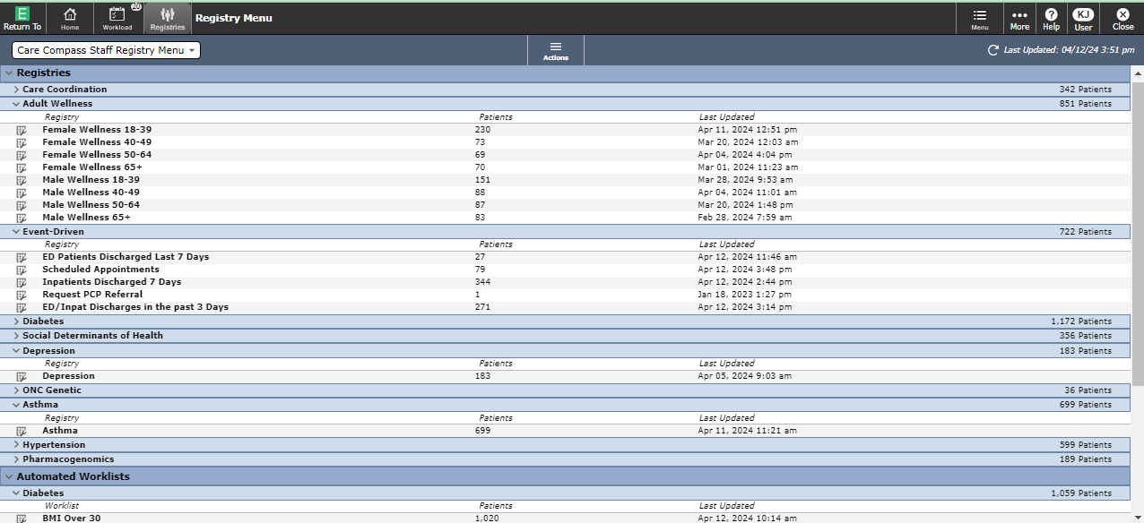
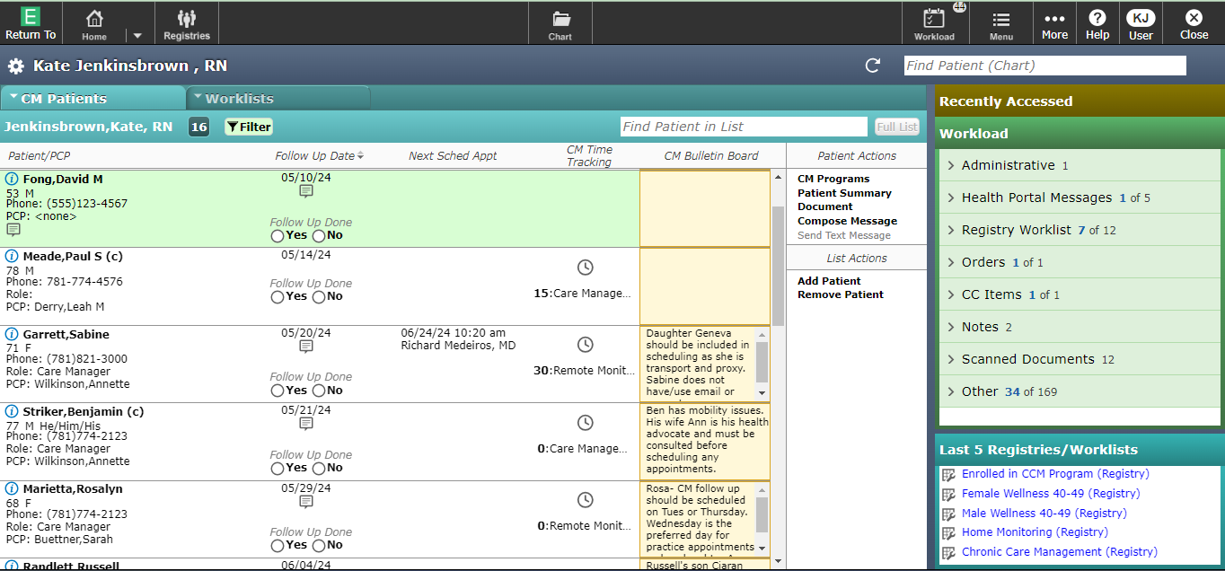
Registries and Care Compass
Capturing cohorts and identifying individual needs
Expanse Care Compass offers:
Dynamic criteria-based Registries to create operational patient worklists
An intuitive home screen with access to key features that facilitate care management
Single click launch to each patient’s chart.
User Preferences and filtering capabilities so each care manager can work through their patients and patient groups in the way that suits their role
Notes:
Population Health management is another example of how data is used at the point of care
There is a wealth of data that is available through the integrated Expanse EHR that can be leveraged
in dynamic criteria based Registries
and Worklists that enable a tailored approach to patient care.
For instance, cohorts of patients can be identified by common diagnoses, demographics,or social determinants, and disposition among other things.
This facilitates transitions of care
It also identifies populations for increased attention- to support Clinics, Education, Quality Programs
Diverse care management roles can then filter the cohorts, into user defined worklists, and populate their personalized Care Compass Home Screens.
The workflows of Pharmacy Care Managers, Chronic Care Managers and Social workers differ. We cater to their needs.
Efficient integration of primary care management tools enables clinicians to deliver:
patient-centered care, and
improved outcomes across the population.
This leads to enhanced performance on
quality measures,
optimized utilization of low acuity engagements,
and better outcomes for patients.

Slide 13
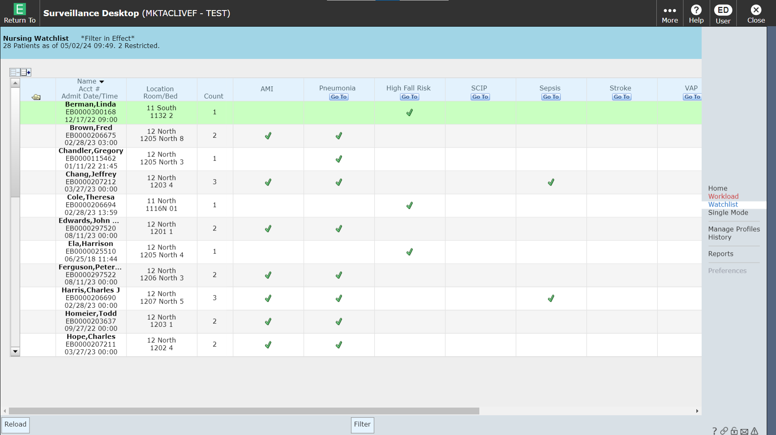
Predict Early, Act Fast SURVEILLANCE
Condition Specific
Quality Measures
Preventative Measures
Consults
Notes:
For patients who do require care in higher acuity settings,
MEDITECH Surveillance analyzes data in real time and automatically identifies patients who need attention,
whether they qualify for a potential Hospital Acquired Condition (HAC) or a clinical quality measure.
integrated toolset fits smoothly into clinical workflows, helping care teams to prioritize care, take action sooner, and improve outcomes.

Slide 14
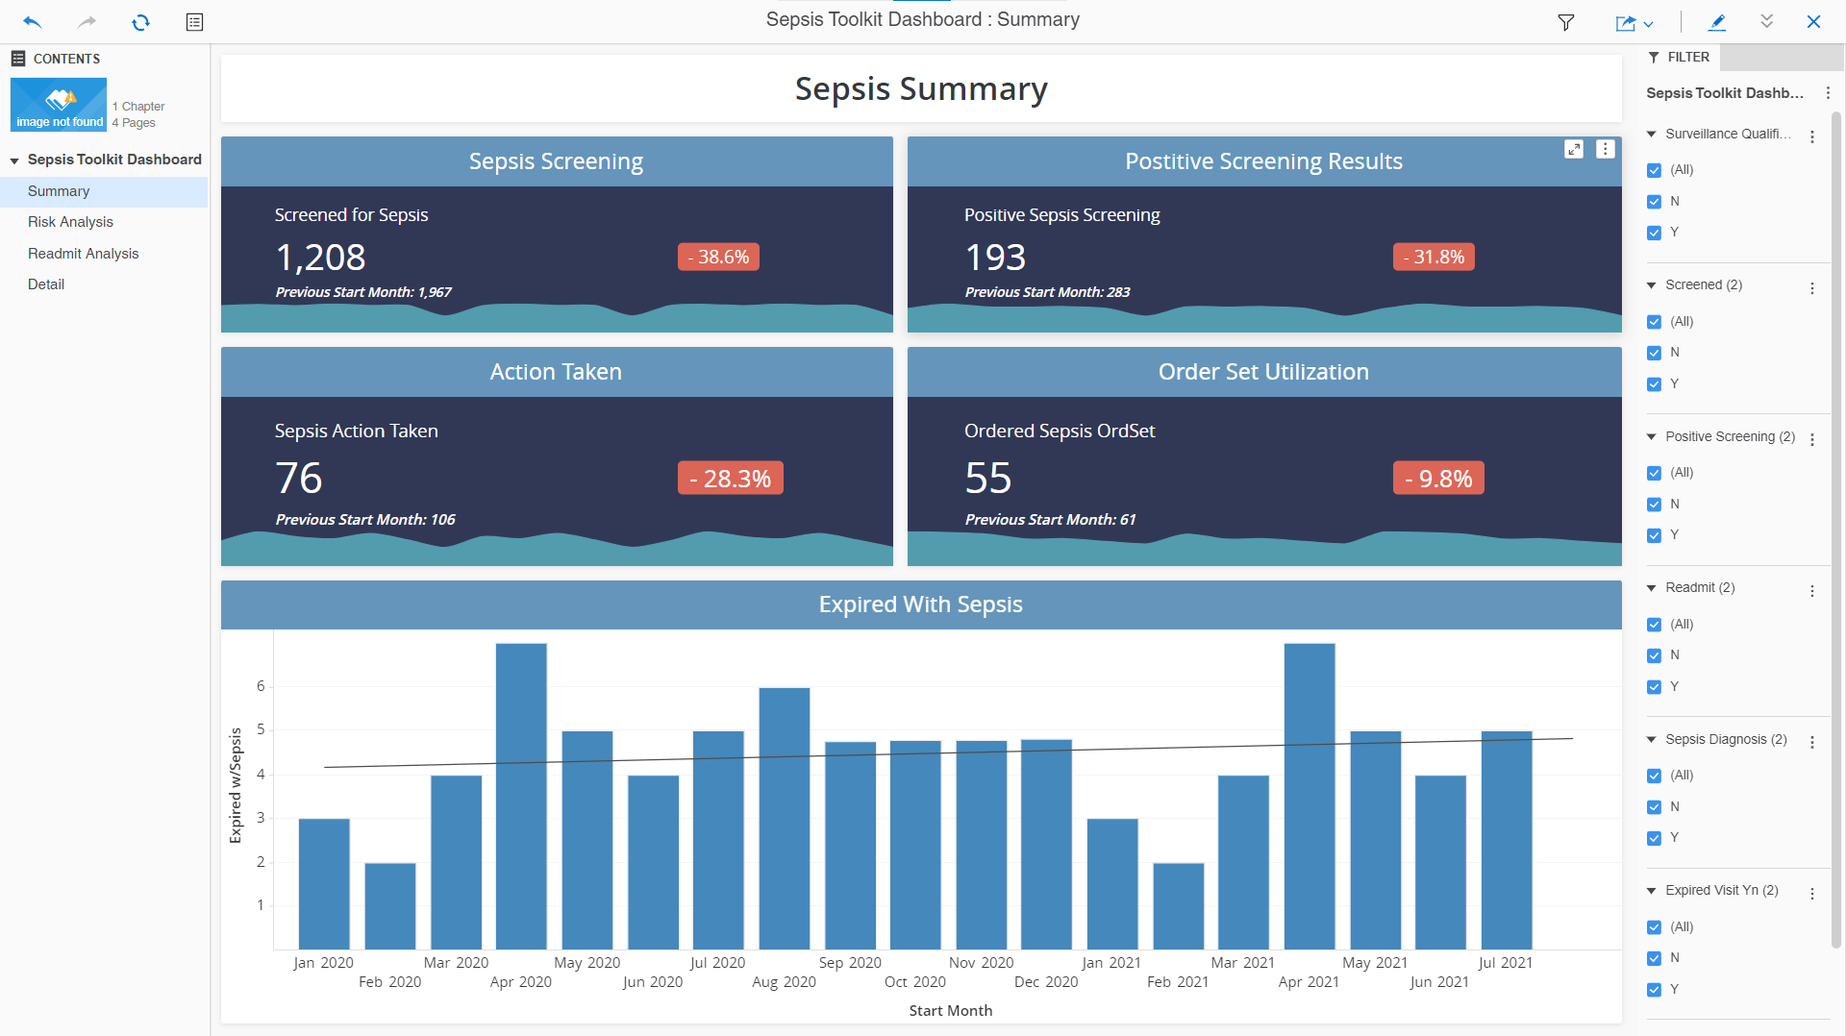
Notes:
Optimal workflows and system guidance help organizations improve outcomes, save time, and conserve resources.
Toolkit components also include Business and Clinical Analytics (BCA) Dashboards to monitor and measure performance improvement

Slide 15

Business & Clinical Analytics helps you make informed decisions with comprehensive information
Leading with Data
Requested By | Eric Bernsen
Created | 12/2/2020
Graphics Updated | 12/2/2020
Content Updated/Reviewed | 12/2/2020
Access & monitor optimized data from across the integrated Expanse EHR
Gain insight into performance with views of the data you need
Empower staff through increased transparency and a single source of truth
Notes:
In addition to data tools at the point of care, MEDITECH also offered Business and Clinical Analytics (BCA)
BCA is MTs web based Business Intelligence solution
BCA allows users to understand the patient populations that they serve and drill down all the way to the individual patient level
Single source of truth - everyone looking at the same data, with consistent metric definitions, this allows the organization to rally behind different organizational objectives.
MEDITECH's Data Repository, an SQL database, provides an open environment for powerful reporting and decision support across the continuum of care. Virtually all data captured in MEDITECH Expanse, as well as interfaced data from other vendors' systems, can be stored in the Data Repository for direct access using any ODBC-compliant reporting software or the self-service analytics tool in our Business and Clinical Analytics solution. Other vendor data can also be stored in a separate SQL database and combined with data stored in the Data Repository. To facilitate uninterrupted, longitudinal or research-based reporting, the Data Repository databases reside on a dedicated server separated from your LIVE system and is continuously fed with data, allowing for dynamic report and dashboard creation.

Slide 16
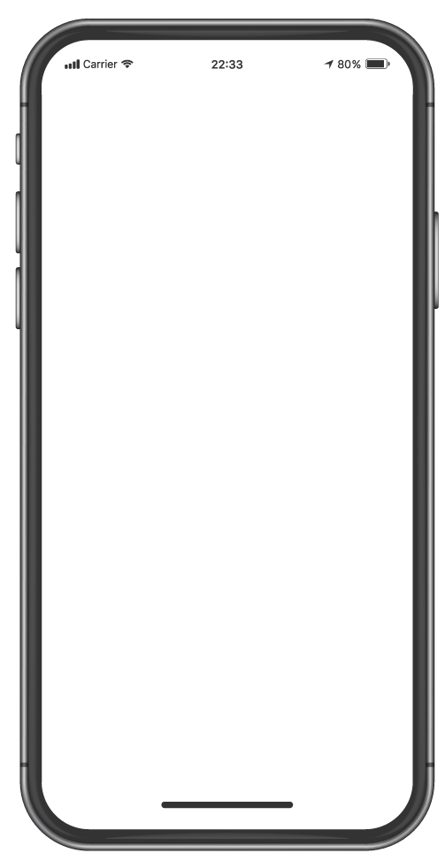
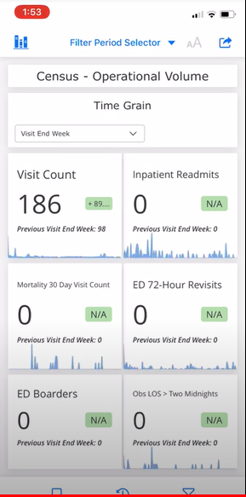
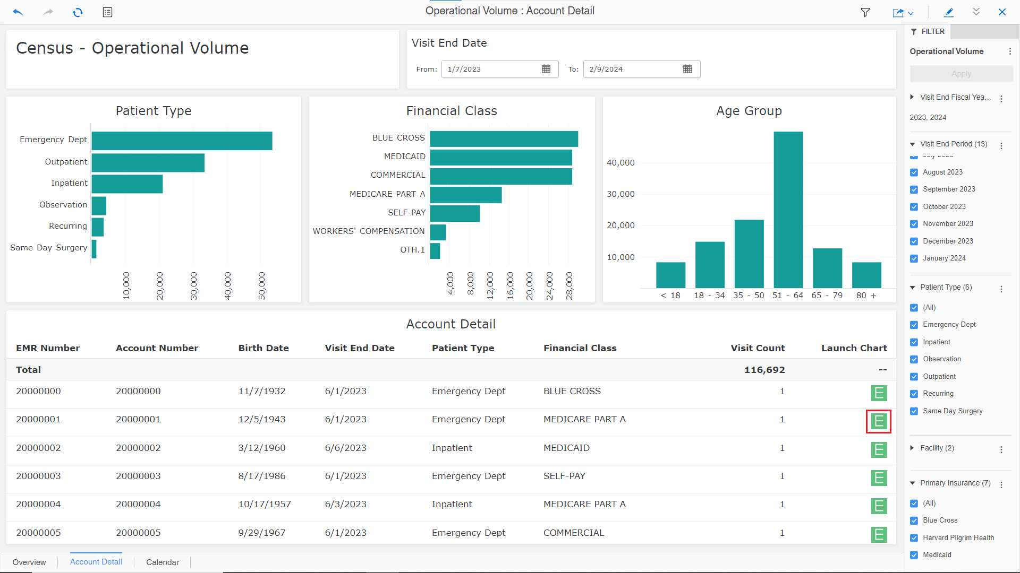
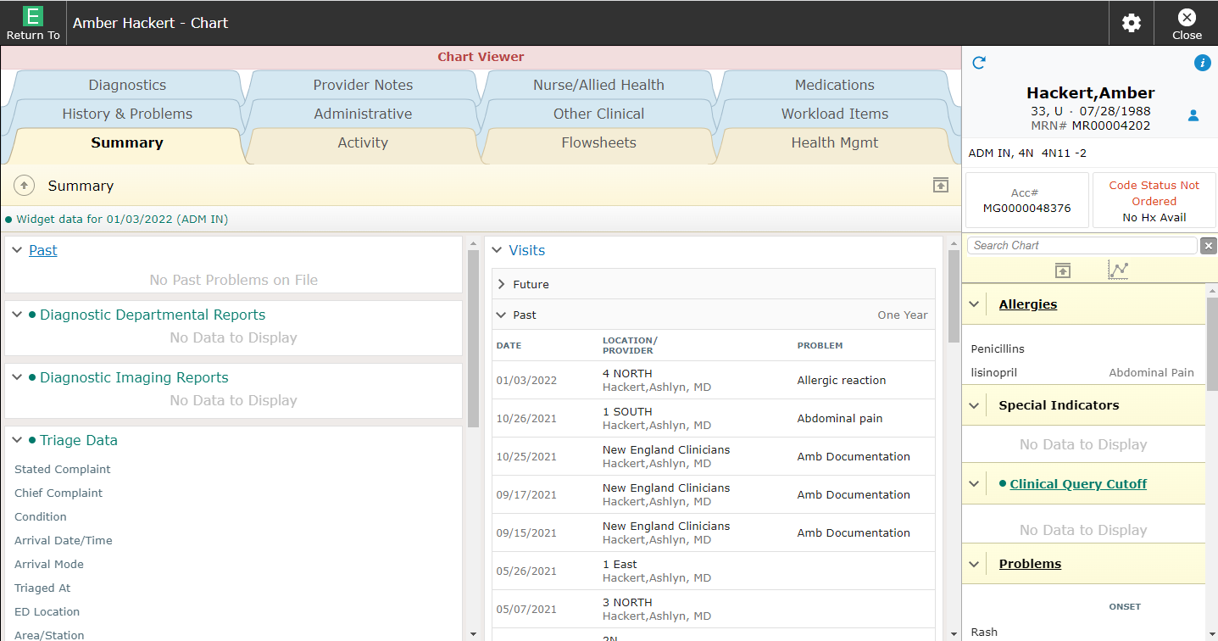
Actionable Data
Notes:
Our dashboards are mobile and our data is actionable allowing you to launch directly into the patient’s chart to inform your decisions, no matter where you are.

Slide 17

Measurable Insights: Strategy
Identify
Access
Analysis
Identify Use Cases &
Define Key Measurements
Standardized Data Extraction
Curated Data Sets
Interactive Dashboards
Actionable Insights
Notes:
I want to talk a little bit about how we got started with this project. AMIA, the American Medical Informatics Association, started an initiative called the 25x5 project with the goal to reduce provider documentation down to 25%, that’s a 75% reduction and a very aggressive goal. This is also a for us, MEDITECH, to reduce Documentation burden providers and thought this would be a great initiative to be apart of.
We joined an AMIA taskforce and have been participating in this initiative. As a result, we coded a robust set of documentation metrics and created visualizations, or dashboards so that we could analyze the data as well as provide it to healthcare organizations for their own analysis. And we will get more into those in just a moment.
With this project we defined a process:
We need to identify the Use Care or Questions you are looking to get answers to and the metrics that would be valuable to you and answer those questions
Identify the data needed and determine if it is available to retrieve or if we need development work
If development work is needed, we have a process to prioritize those requests
Using the dataset, dynamic Dashboards are created so that users can visualize and analyze the data

Slide 18
Time on Documentation
Work Outside of Work
Teamwork for Orders
Measurable Insights:
EHR Utilization
7 Core
Measures
Time on Prescriptions
Total EHR Time
Time on Inbox
Undivided
Patient
Attention
Notes:
Expanding upon the Documentation metrics, our current focus is on the 7 Core Measures of EHR Use,
These are industry standard metrics for healthcare organizations to use for benchmarking regardless of the EHR.
The 7 Core Measures Include
Time on Documentation
Work Outside of Work
Total EHR Time
Undivided Attention patients receive
Time on Inbox
Time on Prescriptions
And Teamwork for Orders
You will notice a green check mark indicating that work is complete for that area, and other are in active development
We are also taking it a step further by giving you more data for analysis, beyond the Core Measure
for example, Time on Documentation, while this specific metric is a measure, we are capturing much more than just time.
And this is true for all Core Measures

Slide 19
Measurable Insights for Documentation
Time to Document
Measuring the time spent on documentation to help identify inefficiencies
Length of Document
Document Template
Documentation Metrics
Identify outliers, users spending an excessive amount of time documenting
Tools Utilized
Work Outside of Work
Assess the impact of new documentation workflows or tools
Event
Count
Number of Documents

Slide 20
Measurable Insights for Chart Activity
Total Time
in EHR
Measuring the time spent on in Chart will help identify inefficiencies
Time in Chart
Time in Traverse Exchange
Chart Activity Metrics
Identify outliers, users spending an excessive amount in a given tab
Time in Chart Viewer
Traverse Exchange Launch Count
Assess the impact of new workflows or tools
Time per Chart Tab
Work Outside of Work

Slide 21
Key Differentiators
INTEROPERABILITY-FIRST
Foundational to our EHR
Dedicated to best practices
Ardent proponent of industry-standard APIs
INVESTMENT IN ACCELERATING INNOVATION
Cultivating an ecosystem of data-sharing
Industry standard data structures
Unlocking new possibilities
COMPREHENSIVE EHR DATASET
Versatile
Powers search and summarization
CLOUD-NATIVE
Supports scalability, flexibility and performance
Cost effective
Notes:
MEDITECH key differentiators are:
the accessibility, comprehensiveness, and versatility of its data sets
Its ability to access and utilize data at the point of care and organizationally
MEDITECH uses data to empower stakeholders with unprecedented insights, transcending the boundaries of clinical data and fostering informed decision-making for transformative outcomes.

Slide 22
THANK
YOU

