Slide 1
BMV - ENHANCING
SAFETY AND EFFICIENCY IN
MEDICATION ADMINISTRATION
Improving patient care
through precise medication practises

Slide 2
THE CHALLENGE
Medication Administration Errors
Manual verification in medication administration leads to common errors and poses risks to patient safety.
Barcode System Limitations
Existing barcode systems often face incompatibility with commercial packaging and lack seamless integration with health records.
Need for Robust Solutions
There is a critical need for reliable solutions to improve patient safety and streamline medication workflows.

Slide 3
BRIEF HISTORY
Alder Hey migrated to Expanse in September 2023.
BMV was introduced long before this in previous version 6.08
First pilot of BMV in January 2019 in ward 3C for a week, lots of issues
Took us a few months to fix and discuss workflows, a couple of pilots in September/October 2019 in the same ward.
More locations piloted Dec 2019
Functionality launched across the Trust 2020
Some locations recently added like Sunflower house (CAMHS inpatient unit)

Slide 4
GETTING THE BASICS RIGHT
-Wi-Fi
-Device Strategy
-Barcodes to scan
-Wristbands
-Meditech parameters

Slide 5

WiFi
-Black spots
-Ping Pong between access points
-Alder Hey is relatively a new hospital,
no major problems
-WiFi audit recommended

Slide 6
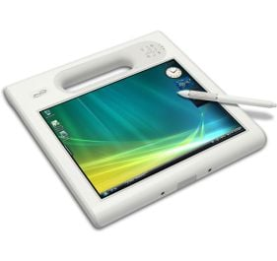
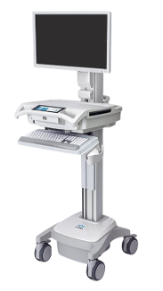
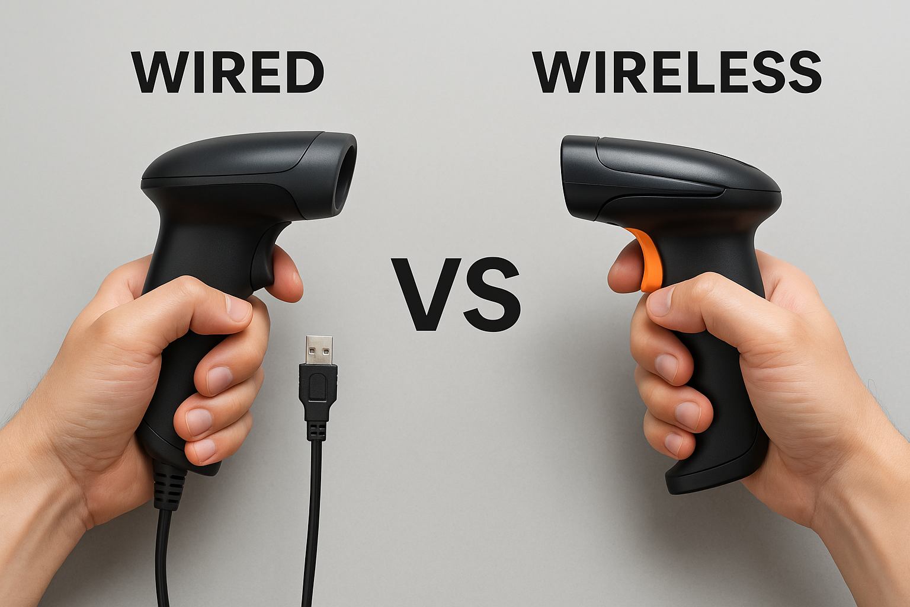
Device strategy
-GO SIMPLE
-COWs vs Laptops vs mobile devices
-Wired vs wireless scanners
-Configure devices properly and make sure that adapt nurse's workflows

Slide 7
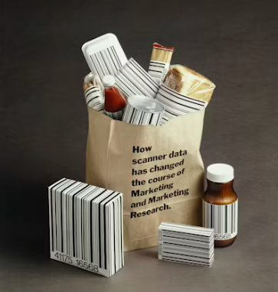
Barcodes to scan
-Over labelling vs Commercial barcode
-QR code, 2D barcode, FMD barcode
-Outer package vs blisters or bottles
-Types of medicines to scan (eye drops, inhalers, tablets, capsules, liquids,…)

Slide 8
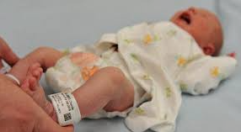
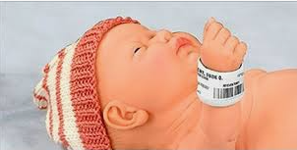
Wristbands
-AH number vs V number
-Rollover accounts from ED
-Allergy wristband, neonatal wristband, photo identification
-Mepitac

Slide 9
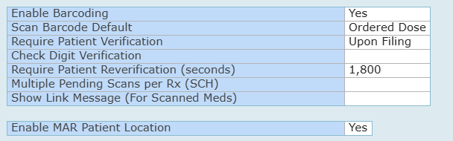
Meditech parameters
-Against Meditech recommendations we scan drug first and patient last
-Medication barcode optional, wristband barcode mandatory
-Don’t do dose scanning, defaults ordered dose

Slide 10
BARCODE Library
-Sources
-Methodology
-Examples

Slide 11
SOURCES for BARCODES
-FDB
-Dispensing system (CMM)
-DM+D
-Unscannable form

Slide 12
METHODOLOGY
-2 tables in Meditech.
PhaDrugData
PhaDrugDataGTIN
We map GTIN at upper level VMP/AMP
SQL queries,
-Load TRUD data
-Unmatched barcode table
-Upload unmatched codes
-Security checks, duplicated, expired or under the wrong products
-Some exceptions, sugar-free vs no sugar-free for some products
-Expired barcodes

Slide 13
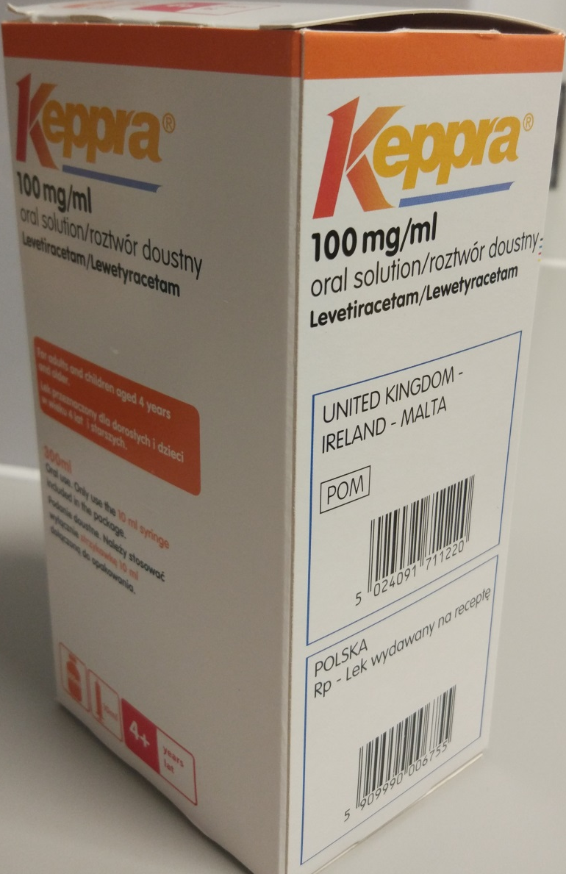
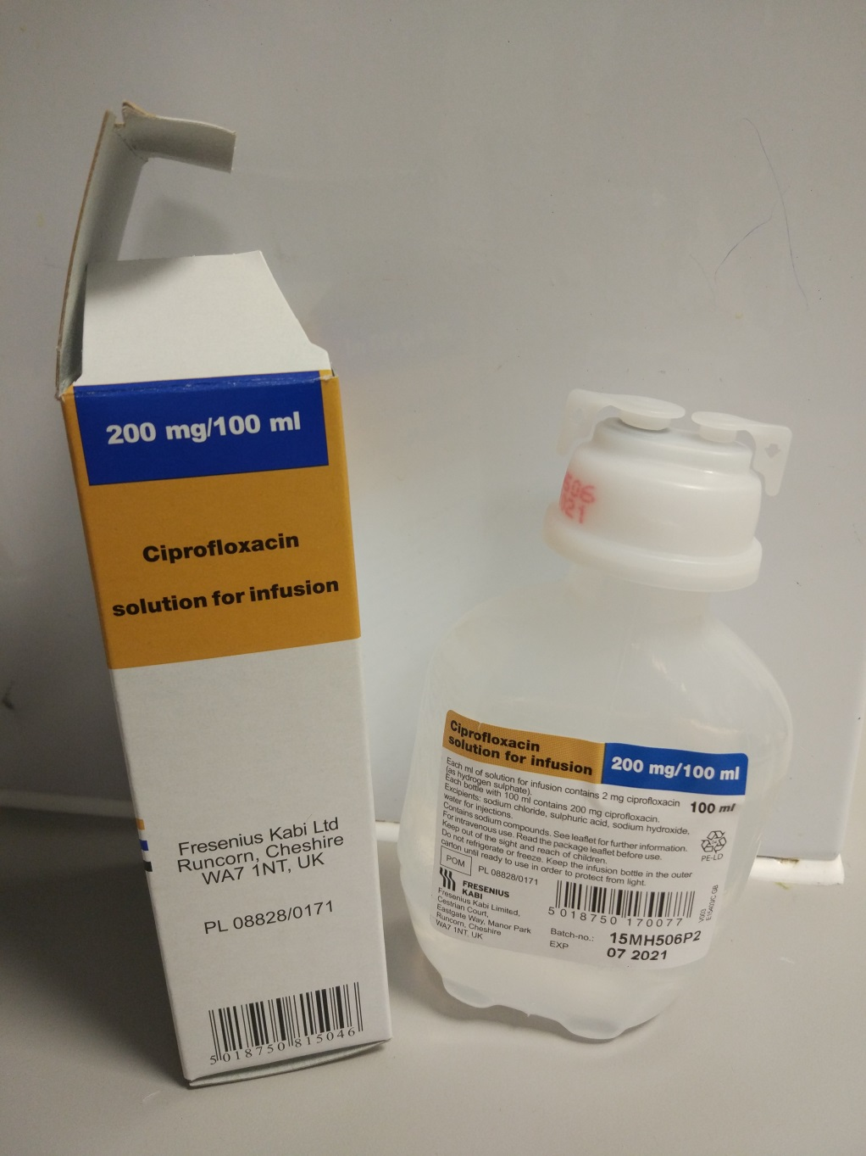
EXAMPLES
Challenges in outer packages

Slide 14
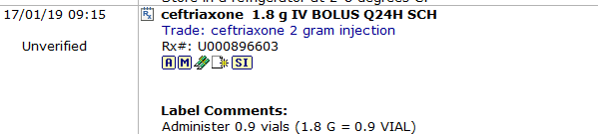
EXAMPLES
Meditech is a product based ePMA system,
A patient was on ceftriaxone 2g vial to administer 1.8g
There were not 2g vials in stock in the ward and nurses used
2 x 1g vials, these did not scan correctly as it is a different product
from the one stocked, this needed to be re-prescribed.

Slide 15
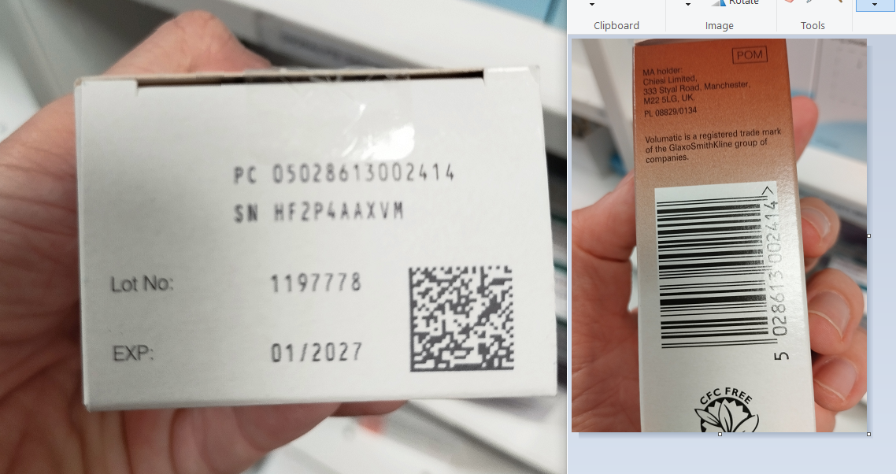
EXAMPLES
FMD barcodes to “0” vs not to “0”

Slide 16
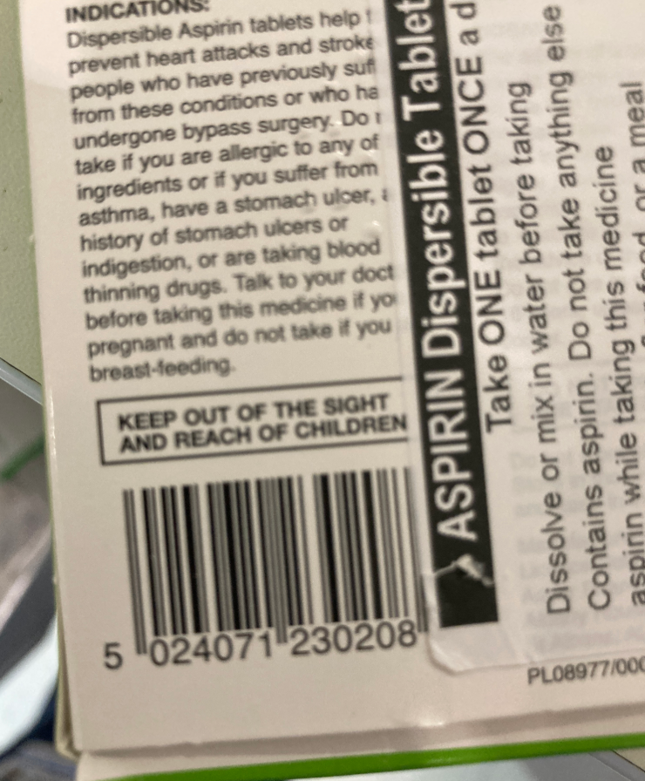
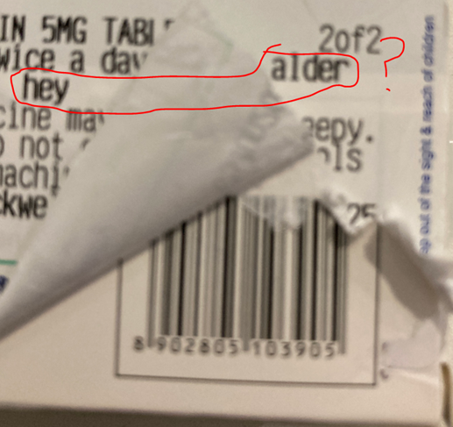
EXAMPLES
Don’t over label barcodes

Slide 17

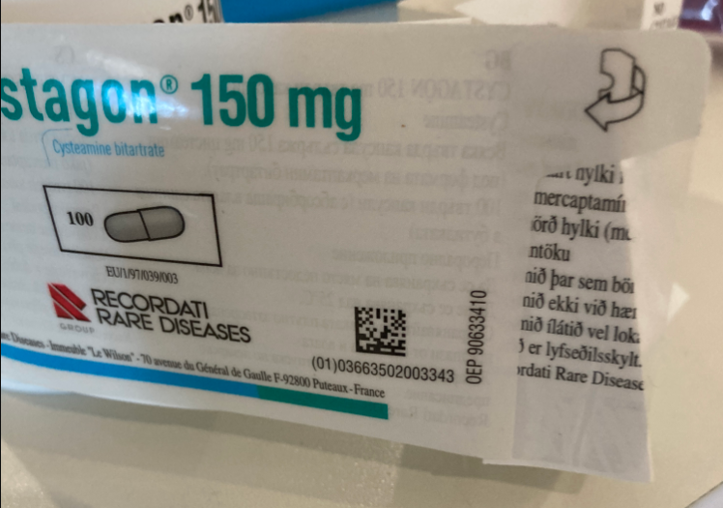
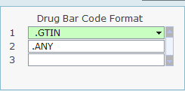
EXAMPLES
French barcodes starting (01) 03 extract wrong as if it was an EAN 128.
Ignore Meditech recommendations of GTIN + EAN and set everything to ANY

Slide 18
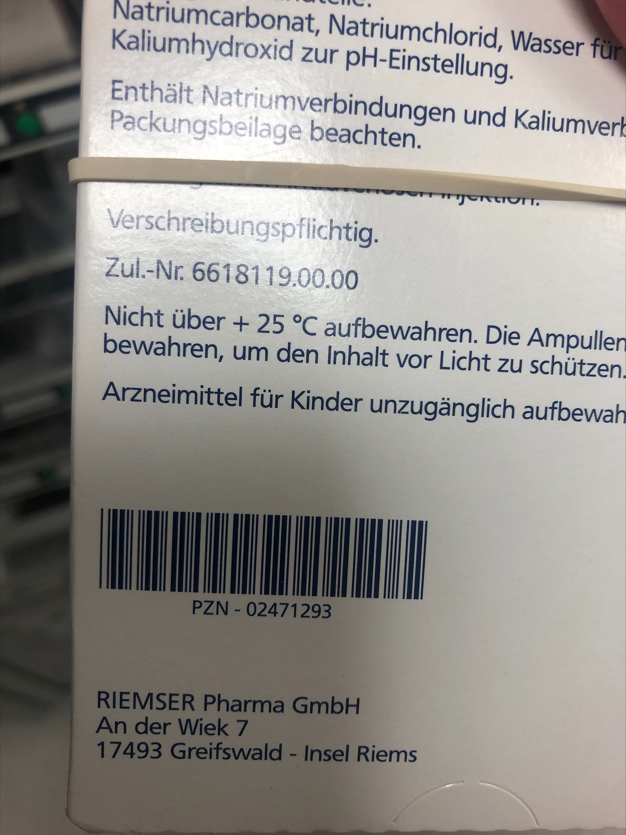
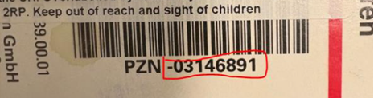
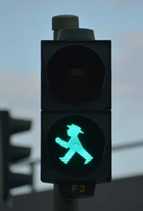
EXAMPLES
Some German barcodes have got letters in addition to numbers

Slide 19
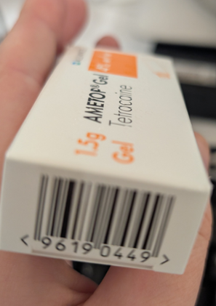
EXAMPLES
GTIN 8-
Some little packs with limited space
introduce small GTINs e.g. Ametop

Slide 20
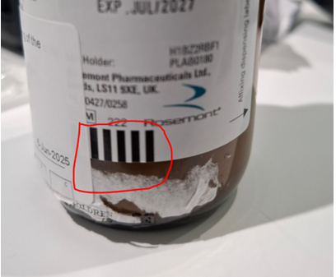
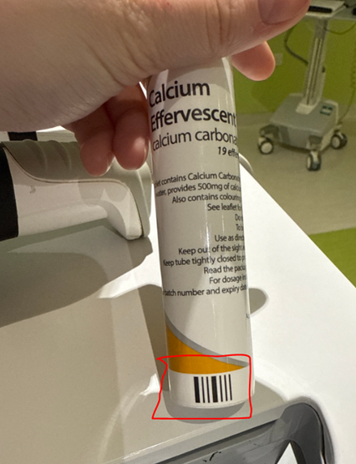
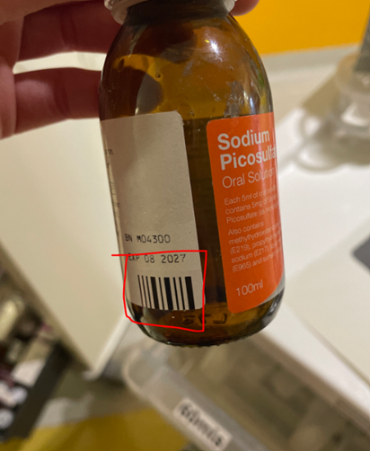
EXAMPLES
These are not BARCODES

Slide 21
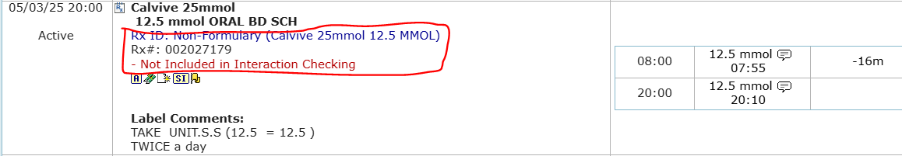
EXAMPLES
Non-formulary items WON’T SCAN

Slide 22
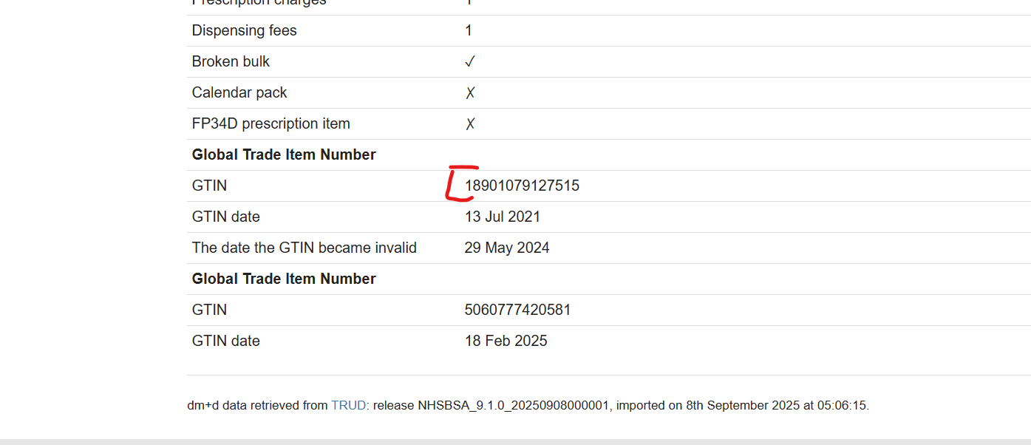
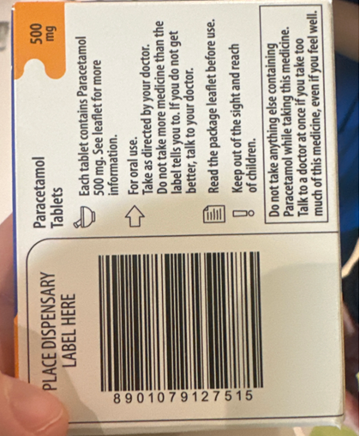
EXAMPLES
Sometimes DM+D is informed of one code and a slightly variant is printed

Slide 23
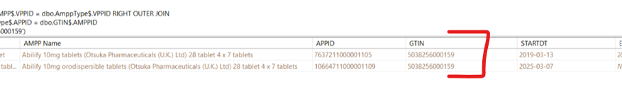
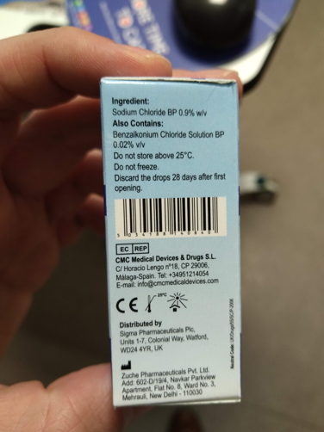
EXAMPLES
MHRA is clear, recycling of barcodes is NOT allowed
allopurinol 100mg tablets 28 tablets (RX farma)

Slide 24
Nurse engagement
-BMV steering group
-Healthy competition – Dashboard
-Quick wins – Breast milk
-Nurse feedback

Slide 25
BMV steering group
Monthly meeting with nurse stakeholders and nurse leads to discuss problems and strategies in how to improve BMV processes for bloods, medication and breast milk.
First Thursday of the month

Slide 26
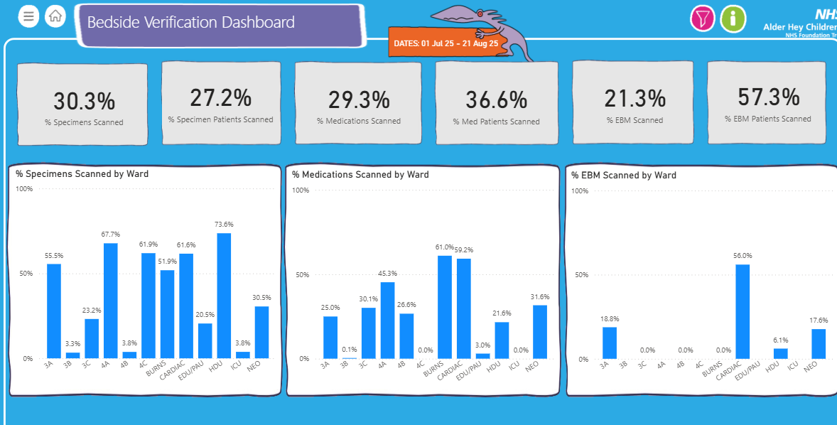
Dashboard and competition between wards
Our experience tells us that a bit of healthy competition between ward improves compliance.
With the data available we have, there is indication that administration errors are higher in wards where BMV compliance is LOW.
DASHBOARD

Slide 27
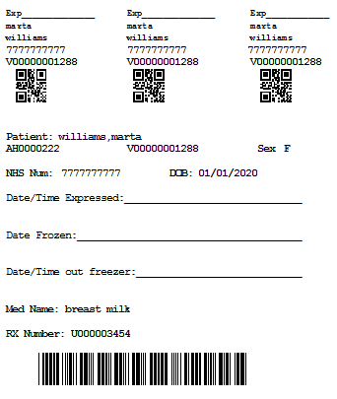
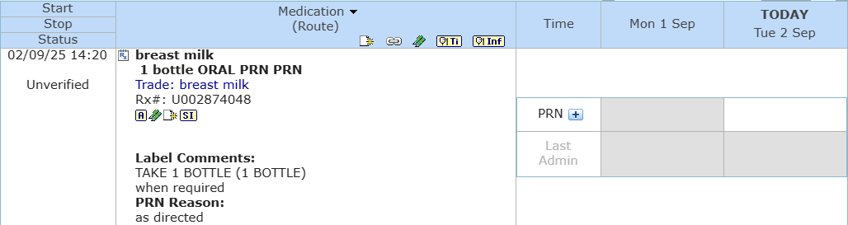
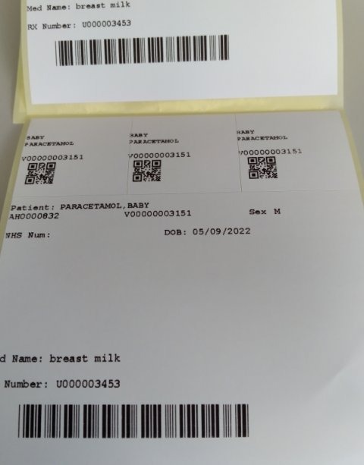
Breast milk
Breast milk is a dummy drug that flows to the MAR and allows nurses then to print a requisition form with labels to give to the mum for EBM.
The milk is scanned on administration in the MAR

Slide 28
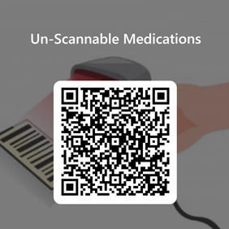
Feedback from nurses
Creation of a sharepoint formulary for nurses to upload the prescription and a picture of the box that is not scanning.
Although we try our best, there are always some barcodes that escape the net

