Slide 1
Electronic Anaesthetic Records: Why We Need Them Now
Presented by:
Dr. Mark Ryan
Consultant Anaesthetist

Slide 2
Introduction
The Case for Change: Why Do We Need an AIMS
Defining Success: User Requirements
Next Steps & Lessons Learned

Slide 3
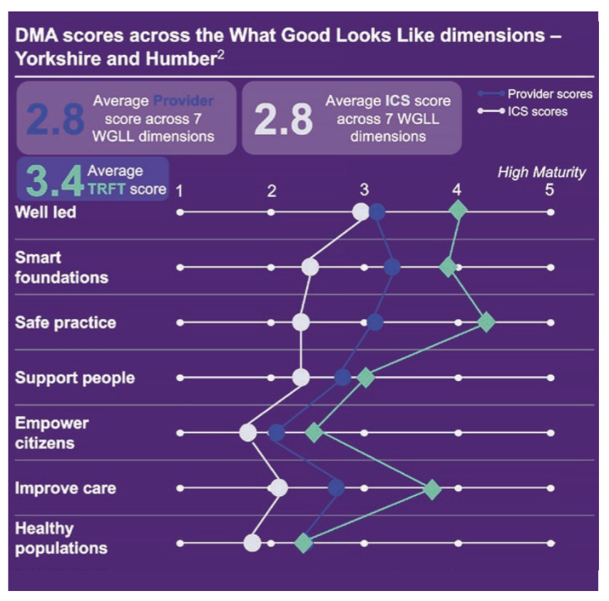


Introduction
Current State
The Rotherham NHS Foundation Trust (TRFT)
MEDITECH 6.x since 2012
Pre-op Assessment on Meditech Document
Wards and PACU fully live with assessments/documents EPMA
Presentation Objectives
Review current state challenges
Provide an overview of why we are looking to digitise
Detail user requirements
Share lessons learned

Slide 4
The Case for Change
Paper Documentation Challenges and Manual Process Inefficiencies
Duplicate data entry across systems
Risk of documentation errors and omissions
Time burden on clinical and administrative staff
Communication gaps between care team members
Digital Strategy
TRFT Digital Strategy
Darzi Review
NHS Plan
Why do we need an Anaesthesia Information Management System (AIMS)?
EHR System Limitations
Electronic → Transcribe Paper → Scan → Electronic
Workflow Issues
Data Flow Issues
Patient Safety Hazards
Drug administration records
Incomplete documentation
Lost records
Analytics & Quality Improvement Gaps
Absence of meaningful KPIs and performance metrics
Limited ability to track outcomes and identify trends
Notes:
Quick, non-published, internal audit over 1 week highlighted at least 24% of local records don’t have sufficient information direct from theatre to be scanned in

Slide 5
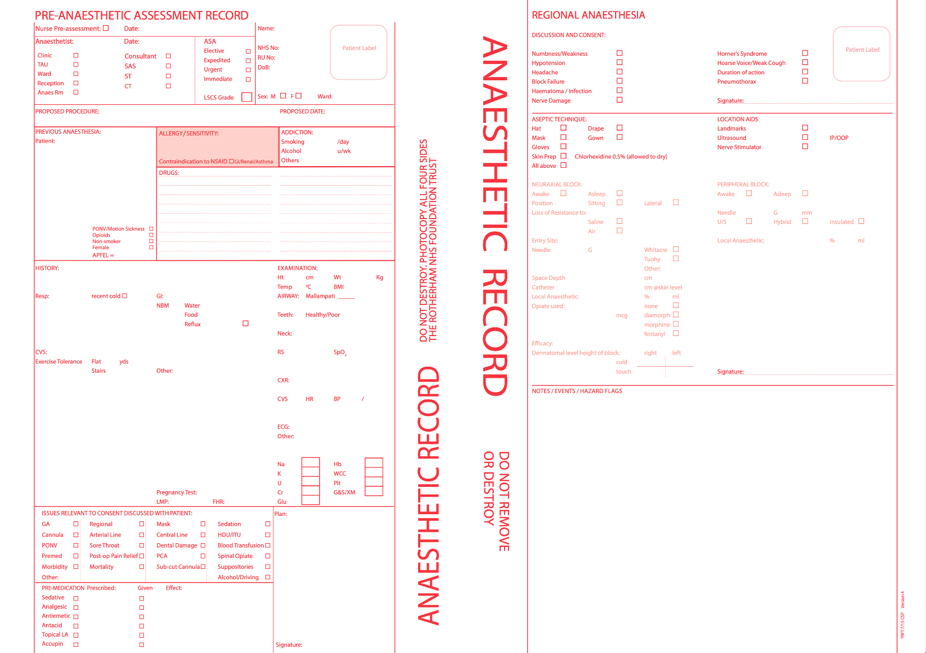
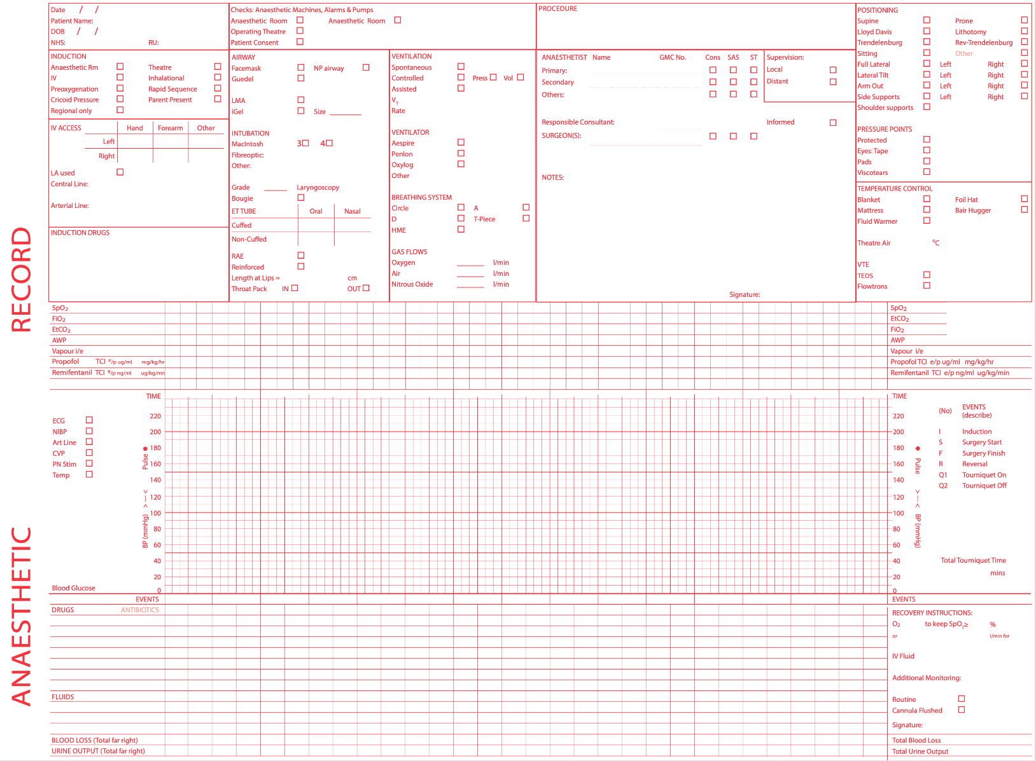
Current State

Slide 6
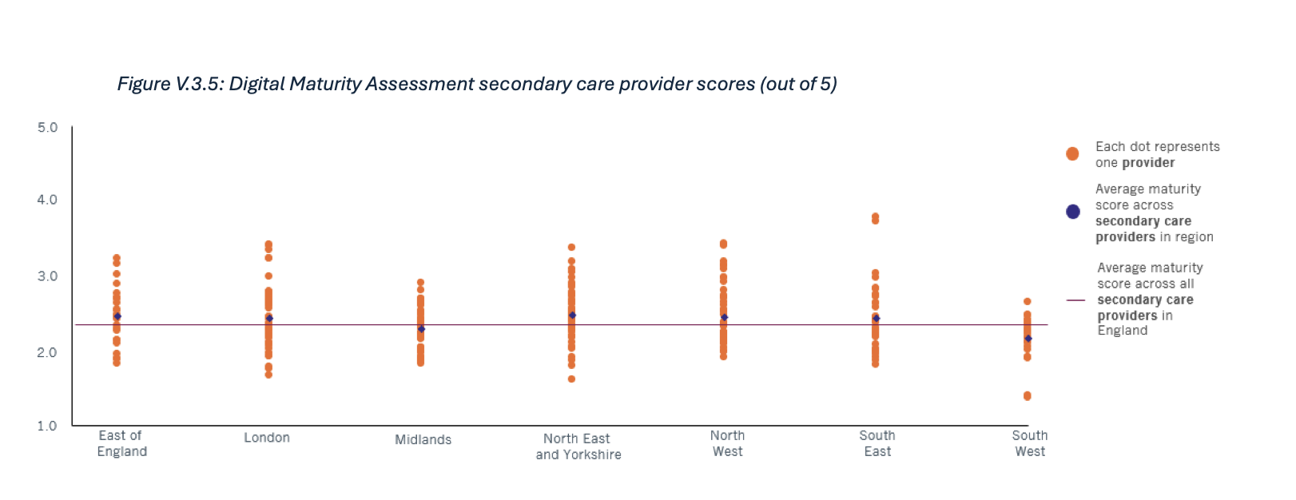
Professional Standards
GPAS Section 1.3:
"All anaesthetic records (paper and electronic) must contain the relevant portion of the recommended anaesthetic data set for every anaesthetic and must be kept as a permanent document in the patient's medical record."
RCoA GPAS
Association of Anaesthetists
Darzi Review (2024)
Standards of monitoring during anaesthesia and recovery (2021) Standard 10: "An anaesthetic record should be made with an accurate summary of information provided by all monitoring devices. We recommend automated electronic anaesthetic record systems and that these be integrated into the hospital's electronic health record system*.
“There will need to be a fundamental tilt towards technology”
*Association of Anaesthetists (2021): "We recommend automated electronic anaesthetic record systems and that these be integrated into the hospital's electronic health record system."
Klein AA, et al. Anaesthesia. 2021;76:1212-1223.
Notes:
https://www.rcoa.ac.uk/safety-standards-quality/guidance-resources/guidelines-provision-anaesthetic-services
Minimum Dataset from GPAS: Data completion requirements:
Patient name and unique identifier
Anaesthetist name and GMC number
Consultant supervisor recorded for non-consultants
Appropriate anaesthetic equipment check documentation
Appropriate monitoring from before induction through to post-anaesthesia care unit
Consent discussion recorded (risks, benefits, alternatives)
Patient agreement to intervention
Recording appropriate physiological data at recommended intervals
Monitoring data that should be captured:
Oxygen analysis
Airway pressure (when positive pressure ventilation used)
Vapour analysis (when volatile agents used)
Capnography
Pulse oximetry
Non-invasive blood pressure
Electrocardiograph data
Patient body temperature
Nerve stimulator data (when neuromuscular blocking drugs used)
Chapter 7 Darzi review 14. The NHS, in common with most health systems, continues to struggle to fully realise the benefits of information technology. It always seems to add to the workload of clinicians rather than releasing more time to care by simplifying the inevitable administrative tasks that arise. The extraordinary richness of NHS datasets is largely untapped either in clinical care, service planning, or research. As the chart below shows, digital maturity is still low across much of the NHS. 18. Similarly, we are on the precipice of an artificial intelligence (AI) revolution that could transform care for patients. A submission from the Royal College of Radiologists to the Investigation reported that 54 per cent of NHS trusts are already
using AI tools within radiology
From the discovery of new treatments to novel diagnostics and biomarkers to routine process automation, there are a multitude of ways in which the health service could see extraordinary change. With its deep and broad datasets, and the global AI hub that has emerged in the UK, the NHS could beat the forefront of this revolution with NHS patients the first to see the benefits. But to capture those opportunities, there will need to be a fundamental tilt towards technology.
Association of Anaesthetists (2021): "We recommend automated electronic anaesthetic record systems and that these be integrated into the hospital's electronic health record system."
Klein AA, et al. Anaesthesia. 2021;76:1212-1223.

Slide 7
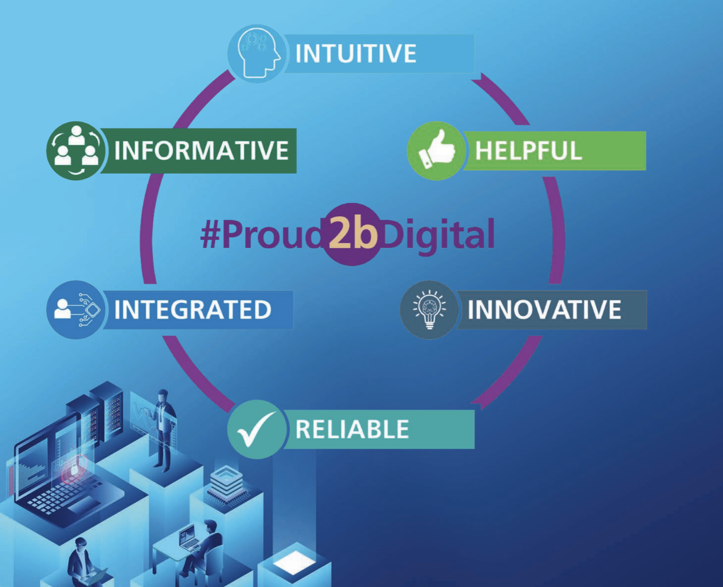
TRFT Digital Strategy
“There is increasing appetite clinical and non-clinic teams to obtain their own insights and support clinical research”
“Our digital systems and tools need to be intuitive and instinctive to use, with the minimal number of clicks and data input to get the job done”
“Staff, at times, must access several different systems to be able to obtain a total picture of a patient’s care”
“Our digital tools need to support and alleviate the mental burden, not add to it”
“Infrastructure and data needs to be exceptionally reliable and secure”
“We will look to establish digital innovation capability”
Notes:
INTUITIVE Our digital systems and tools need to be intuitive and instinctive to use, with the minimal number of clicks and data input to get the job done. Information about our patients needs to be readily available to our clinical teams from wherever and whichever organisation created it.
We will look to further enhance our clinical input into all our digital programmes, embedding and skilling teams in the principles of co-design. We’ll also consider where we can leverage emerging technologies such as AI-driven speech recognition, or machine learning with chatbots to drive our digital interactions for both our workforce and patients.
We will also prioritize digital patient inclusion as an integral part of intuitive ambition. Recognizing the importance of equitable access to healthcare services, we will aim to ensure that all patients can benefit from our digital initiatives., we will actively seek input and feedback of groups such as the Rotherham Digital Inclusion forum, to tailor our digital solutions to their needs. By considering factors such as accessibility, language diversity, and digital literacy, we will strive to bridge the digital divide and create intuitive inclusive digital platforms that empower patients to actively participate in their healthcare journey HELPFUL Our digital tools need to support and alleviate the mental burden, not add to it. Ideally, they will have embedded clinical decision support aiding our workforce and guiding them through a specific process. Our non-clinical processes are often overly complex to navigate and understand, often relying on antiquated systems or ways of working, making telephone calls to obtain updates, walking the estate looking for kit or manually copying information from sheets of paper into electronic systems. Patients and their carers increasingly want to digitally interact with our services and contribute to their own health record in a safe and secure manner and be kept updated about their own care, so they can choose well INNOVATIVE Within the Trust there is a powerful desire to continue to be digitally innovative and leverage our digital capabilities as a positive force for change. We will look to establish digital innovation capability where teams can bring transformative ideas and problems and after a process of prioritisation, work with digital experts to co-design scalable solutions
RELIABLE As our reliance and dependency on digital environment has grown, we recognise our whole digital portfolio, from systems, infrastructure and data needs to be exceptionally reliable and secure, and work seamlessly wherever and whoever we are. This will mean systematically and routinely investing in our infrastructure, transforming how we deliver applications, with embedded Single Sign-On (SSO), and put in place processes that routinely measure meaningful end-user metrics. In addition, being a relatively small organisation, we’ll need to accelerate our ‘cloud-first’ journey, outsourcing infrastructure management to global specialists, and invest training and culture of our digital support services to provide more self-services, self-healing systems an excellent and responsive customer service INTEGRATED Compared to other NHS organisation we do have substantial levels of integration between our internal and external clinical systems, which has raised our user’s expectation and there is more to do. Staff, at times, must access several different systems to be able to obtain a total picture of a patient’s care, and as we move to increased integrated and partnership working across the ICS (Integrated Care System), the expectation and demand on interoperable systems will rightly increase, and we will positively consider EPR alignment across the ICS as a way of achieving deep digital integration.
In addition, as we accelerate the adoption of smart medical machines across the estate or in patients’ homes, we need to ensure the data they produce is fully and automatically interoperable with our EPRs (Electronic Patient Record).
This Integration challenge also applies to our non-clinical systems and process, with staff also telling us they have multiple solutions to navigate, with duplication of information or antiquated ‘word’ forms that are cumbersome to complete.
We will be unwavering in our digital integration strategy, and follow national standards, which may mean hard choices in not progressing potential opportunities where there is a lack of integration capability INFORMATIVE We generate a tremendous amount of data daily as a by-product of the digital systems we use,and this is only going to increase exponentially. Whilst we’ve made significant strides in providing high quality data and information back into the organisation, access to this information is generally limited to a few individuals and teams and there is increasing appetite clinical and non-clinic teams to obtain their own insights and support clinical research. We will build upon our self-service data strategy, make more of our data transparent to those in and out of our organisation and explore establishment of our own internal Trusted Research Environment.

Slide 8
Why Not Directly in MEDITECH?
1
Fragmented Workflow ~ Different Modules
Review documentation → Reports/Notes
Prescribe → Orders
Administer → MAR
Observations Entry → Document – PCM/PCS
Narratives → PCM
2
Speed & Volume of Data Entry
3
Charting!

Slide 9







What Good Looks Like for Us…
User Experience
& Accessibility
Intuitive, inclusive design for optimal workflow
Safety & Governance
Comprehensive patient safety and regulatory compliance
Integration & Interoperability
Seamless data flow and system connectivity
Data Driven
Metrics for Quality Improvement
Clinical Excellence
Meeting professional standards and evidence-backed practice
Future-Proofing & Innovation
Adaptable platform for technological advancement
Operational Excellence
Strategic alignment and institutional benefit

Slide 10

User Requirements for an AIMS Solution
Defining Success
Clinical Workflow
Requirements
Ease of use and user experience → CRITICAL
Portability and mobility
Data Integration &
Accessibility
Clinical data access → CRITICAL
MEDITECH integration requirements
Analytics &
Reporting Capabilities
Key performance indicators (KPIs)
Quality and safety analytics
Care Team Visibility & Communication
Perioperative journey transparency
Notes:
https://safebraininitiative.com

Slide 11
Tiers of Requirements
Minimum Standards
Must-have for professional compliance
Complete Data Capture: All 130+ required fields (RCoA/PRSB standards)
MEDITECH Integration: Real-time data flow with current EPR
Clinical Safety: DTAC and DCB 0129 Clinical Safety Case
EPMA Integration: Bi-directional medication safety checking
Reliable Backup: 99.9% uptime with disaster recovery
Basic Accessibility: Readable in theatre lighting, glove-friendly interface
Best Practice
Should-have for clinical excellence
Real-time Alerts: Drug interactions, patient-specific warnings
Smart Templates: Procedure-specific documentation with clinical prompts
Mobile Access: Point-of-care information on tablets & phones
Advanced Reporting: Automated CQC/GIRFT compliance reports
Multi-user Access: Concurrent viewing by different clinical teams
Enhanced Accessibility: Colour blindness modes, adjustable fonts
Innovation
Could-have for digital leadership
AI Decision Support: Predictive risk assessment and recommendations
Research Platform: Structured data for clinical trials and quality improvement
Advanced Analytics: Population Health insights and benchmarking
Video Documentation: Laryngoscopy recordings for difficult airway cases
Voice Control: Hands-free documentation during sterile procedures
Notes:
🟡 BEST PRACTICE
Should Have - Clinical Excellence
Real-time alerts - drug interactions, patient-specific warnings
Smart templates - procedure-specific documentation with clinical prompts
Mobile access - point-of-care information on tablets/phones
Advanced reporting - automated CQC/GIRFT compliance reports
Multi-user access - concurrent viewing by different clinical teams
Enhanced accessibility - colour blindness modes, adjustable fonts
🟢 INNOVATION
Could Have - Digital Leadership
Voice control - hands-free documentation during sterile procedures
AI decision support - predictive risk assessment and recommendations
Research platform - structured data for clinical trials and quality improvement
Advanced analytics - population health insights and benchmarking
Wearable integration - continuous monitoring device connectivity
Video documentation - laryngoscopy recordings for difficult airway cases

Slide 12
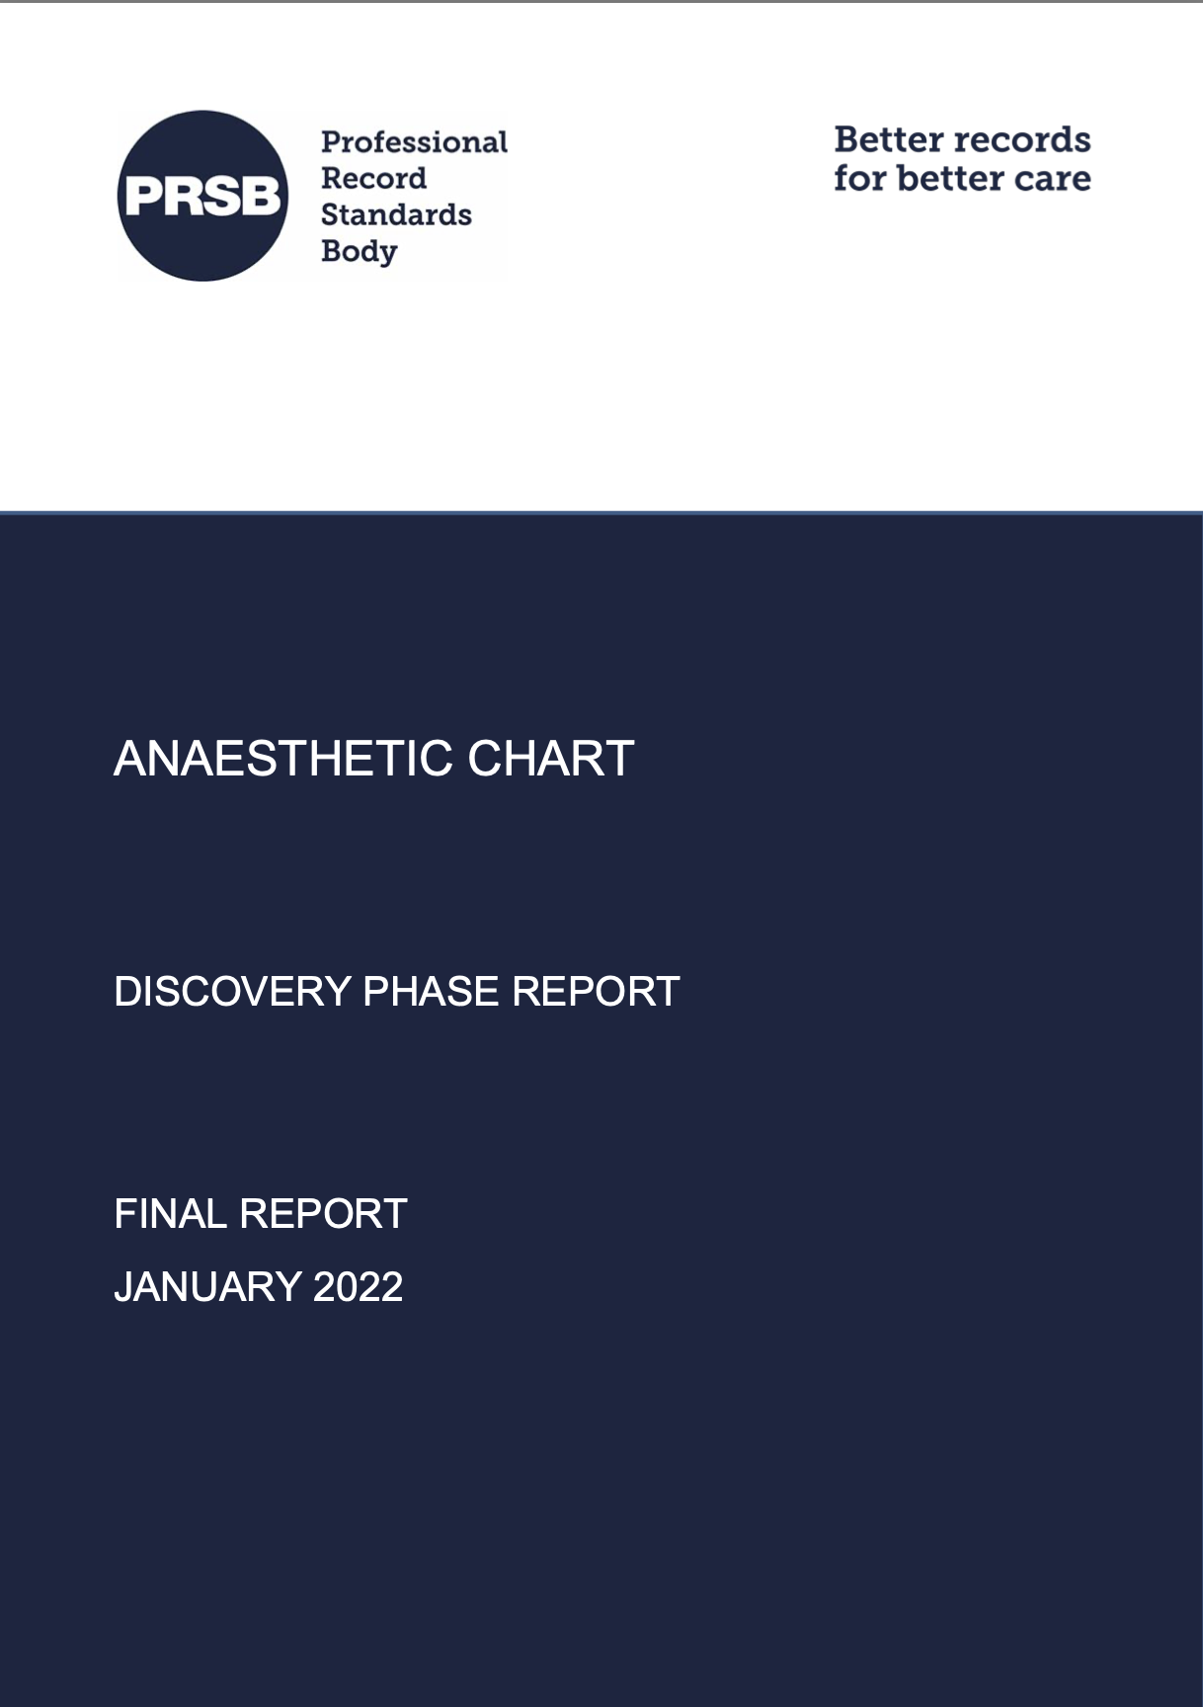
Five Mandatory Domains for Electronic Anaesthetic Charts Total: 130+ structured data items across all domains
📋 FIVE MANDATORY DOMAINS
PRSB National Standard
Domain | Key Requirements | Data Items | Integration
1. Anaesthetic Assessment | • Patient demographics (height, weight, BMI, ASA) • Medical history & allergies • Current medications • Airway assessment (Mallampati, dentition) • Vital signs & investigations • Blood results (FBC, U&E, clotting, group & save) | ~50 items | Auto-populate from EPR Auto-complete from e-prescribing
2. Consent | • Consent obtained for anaesthesia • Mental capacity assessment • Advance decisions (ADRT) • Lasting power of attorney • Safeguarding considerations • Specific risks discussed | ~20 items | Structured consent forms Legal compliance tracking
NHSX-commissioned national standard for all NHS providers
Bottom Line: Any vendor must deliver ALL five domains with full EPR integration to meet UK professional standards

Slide 13
Five Mandatory Domains for Electronic Anaesthetic Charts Total: 130+ structured data items across all domains
📋 FIVE MANDATORY DOMAINS
PRSB National Standard
Domain | Key Requirements | Data Items | Integration
3. Drugs/Observations/Events | • Real-time monitoring data capture • All drug administrations • Fluid management & blood products • Critical events & complications • Equipment used | ~40 items | Monitor integration EPMA bi-directional
4. Anaesthetic Technique | • Method of anaesthesia • Airway management details • Regional techniques • Equipment specifications • Technique-specific parameters | ~15 items | Structured templates Device connectivity
5. Handover | • Post-operative instructions • Pain management plans • Recovery requirements • Ongoing care needs • Discharge planning | ~10 items | Care pathway integration Team communication
NHSX-commissioned national standard for all NHS providers
Bottom Line: Any vendor must deliver ALL five domains with full EPR integration to meet UK professional standards

Slide 14
Benefits
Patient
Safety
Improved Trend Visualisation
Documentation Improvement
Enhanced Documentation Quality
Quality Improvement
Data for Audit
Benchmarking Capability
Professional Development
Enhanced Vigilance
Better Handover
Historical Record Access
Identification of Near Misses
Standardised Templates
Real-time Capture
Comprehensive Record
Project Support
CQC Evidence
Automated Logbooks
Case Mix Analysis
Evidence for Appraisal
Notes:
Patient Safety Benefits
Improved Trend Visualisation: The Electronic Anaesthetic Record System (EARS) will enhance the recognition of physiological changes over time, providing automatic charting and making visible trends available immediately 1.
Enhanced Vigilance: Automated recording will free the anaesthetist's attention for direct patient care, reducing distractions and allowing them to focus on patient care 1.
Better Handover: Comprehensive and legible records will improve information transfer during handovers, reducing the risk of missing critical information 1.
Historical Record Access: Previous anaesthetic details will be readily available for reference, ensuring immediate availability of anaesthetic assessments 1.
Identification of Near Misses: Structured recording of events will aid in pattern recognition and identification of near misses, helping to identify gaps in reporting 1.
Documentation Improvements
Enhanced Documentation Quality: The electronic system will improve the quality and accuracy of documentation, reducing the risk of errors associated with illegible handwriting and incomplete records 1.
Standardised Templates: The system will provide standardised templates and prompts to ensure all necessary information is captured consistently 1.
Real-time Capture: Automated recording of physiological data at precise intervals will provide a comprehensive representation of the anaesthetic narrative 1.
Comprehensive Record: The system will ensure complete documentation of the entire anaesthetic process, improving consistency and reliability 1.
Quality Improvement Benefits
Data for Audit: Easily extractable structured data for clinical audit and for evidencing outcomes for CQC 1.
Benchmarking Capability: The system will enable comparison of outcomes across practitioners and procedures 1.
Project Support: The infrastructure will support quality improvement initiatives 1.
Professional Development Benefits
Automated Logbooks: Accurate case logs for all practitioners, providing detailed information on cases performed and supporting appraisals 1.
Case Mix Analysis: Understanding of exposure to different techniques and procedures, helping to monitor changes in service provision 1.
Evidence for Appraisal: Objective data on clinical activity and outcomes, providing quantitative evidence for reflection and personal development plans 1.

Slide 15



Next Steps & Lessons Learned
Next Steps
Business Case about to be submitted
Evaluation of suitable products functionally
Safety Case Evaluation as part of DTAC
Recommendations for Similar Organisations
Start with clear problem definition and success metrics
Invest time in thorough requirements gathering
Plan for comprehensive change management
Common Pitfalls to Avoid
Underestimating integration complexity
Insufficient end-user involvement
Inadequate training and support planning

Slide 16
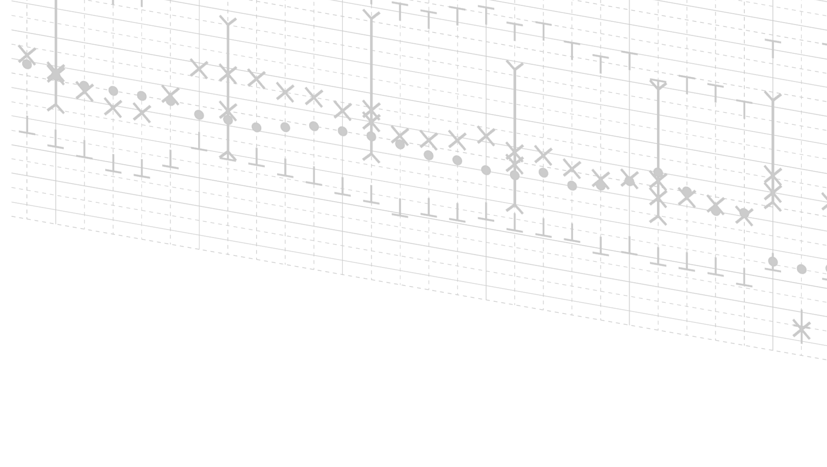
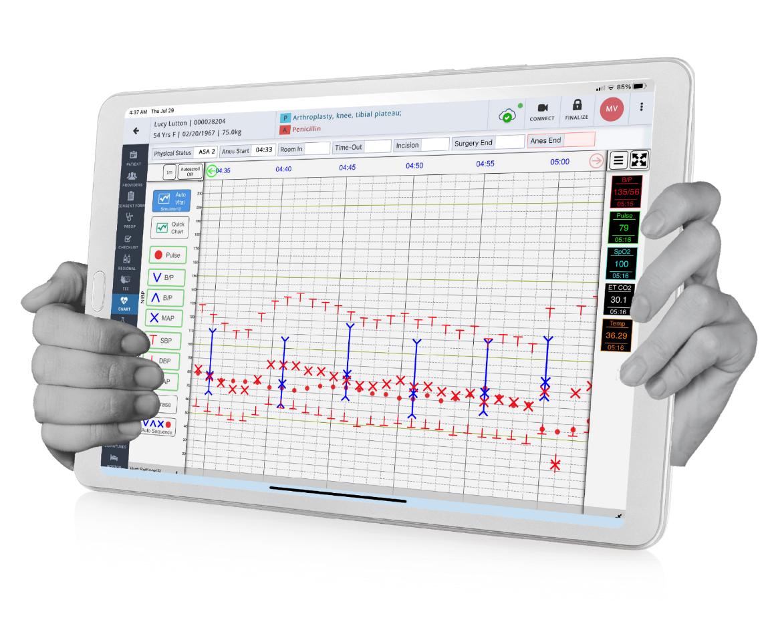
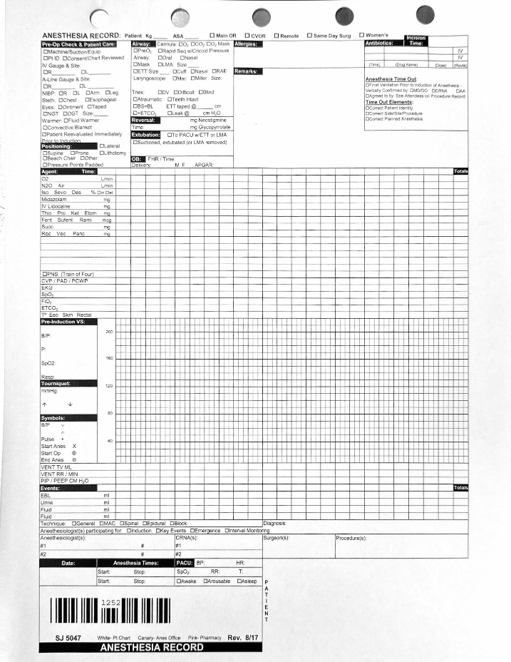



Provation iPro AIMS https://www.provationmedical.com/ipro-anesthesia/

Slide 17
Presentation Outline
Introduction
Current state overview
Presentation objectives
The Case for Change: What Prompted an AIMS Evaluation
Technology limitations
Paper documentation challenges and manual process inefficiencies
Analytics and quality improvement gaps
Defining Success: User Requirements for an AIMS Solution
Clinical workflow requirements
Data integration and accessibility
Analytics and reporting capabilities
Care team visibility and communication
Building the Business Case
Stakeholder engagement strategy
Value proposition development
Risk assessment and mitigation
The Evaluation & Selection Journey
Formal evaluation process
Decision making process and critical success factors
Next Steps & Lessons Learned
Where is the organization in the process
Common pitfalls to avoid
Recommendations for other organizations
Q & A

