Slide 1

Optimising MEDITECH Build and Configuration Using Data-Driven Power BI Solutions
Kelly Wright – Lead Application Specialist

Slide 2
Presentation Overview
Background
MEDITECH to PowerBi
Query and Dictionary Build
Monthly Reports
Account Management
Improvements Achieved and Benefits
Future Plans

Slide 3

Background
MEDITECH has great flexibility when it come to the customisation of:
Documents
Notes
Orders
That flexibility, however, comes with a cost of needing robust:
Inhouse SOPs
Guidelines
Checking build
Change Management board
Two main issues:
Standardisation
Risk Management
Notes:
Notes
Knew that data flowed into the Data repository but only recently realised the amount of dictionary and audit that data flowed. This made us realise how useful this tool could be.

Slide 4
1. Standardisation
When we brought in MEDITECH we had engagement issues, so had to customise to get buy in from end users.
We would build the same query multiple times i.e. Mobility for ED as free text, mobility for Therapists as a pick list etc.
Multiple system specialists working on various requirements.
Notes:
Notes
With multiple system specialists working on various requirements, it can be challenging to keep track of all builds and how they interact with each other.
Knew that data flowed into the Data repository but only recently realised the amount of dictionary and audit that data flowed. This made us realise how useful this tool could be.
Increased Time Spent on Workarounds - Specialists end up spending additional time manipulating data and developing workarounds.
Limitations of Built-in Reports - MEDITECH’s built-in reports are individual to each dictionary and often require exporting multiple reports to Excel to gather all necessary data.

Slide 5
2. Risk Management
Over the years risks and issues have occurred where process steps have been missed accidentally.
We have also had to implement daily/weekly checks that the specialists must undertake as a catch all.
MEDITECH’s built-in reports are individual to each dictionary and often require exporting multiple reports to Excel to gather all necessary data.
Specialists end up spending additional time manipulating data and developing workarounds.
​
Notes:
Notes
Knew that data flowed into the Data repository but only recently realised the amount of dictionary and audit that data flowed. This made us realise how useful this tool could be.

Slide 6
MEDITECH Build Dictionaries
MEDITECH dictionaries are the individual building blocks of the front end of MEDITECH.
Group Response – build pick list answers.
Query Dictionary - build individual questions.
Document Section – build individual pages.
Document Dictionary – pull all pages into one document.
Customer Defined Screens – Build order screens.
Order Dictionary – Build individual orders.
Query links – Triggers an order or assessment if certain answer is selected on a specific query.
Notes:
Notes

Slide 7
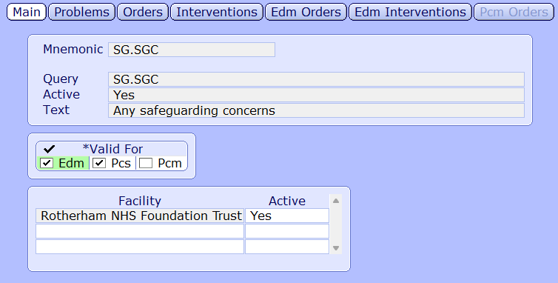
MEDITECH – Query and Dictionary Build Query Links
Dictionary contains all queries whether they have a query link or not.
Need to know the Mnemonic of the Query.
Hard to identify which documents/assessments this query link is active on.
Notes:
Notes
Query links link a query to an order or Intervention so they these are automatically tiggered if a specific answer is selected on that query. I.E. would you like to refer to district nurses Yes/No.
Multiple system specialists all building within MEDITECH. We generally end up picking up each others work. When looking into a document or assessment it can be very difficult to identify if any queries trigger a query link unless you add every query into the dictionary to investigate.

Slide 8
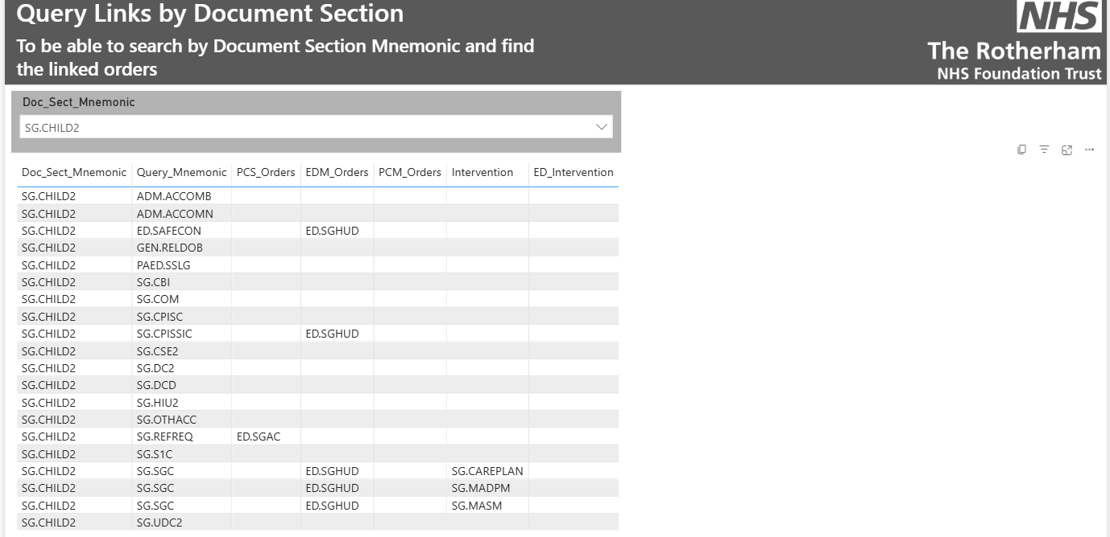
Power BI – Query and Dictionary build Query Links
Power BI meant I was able to pull the Query link data by Document Section, Order and Intervention.
Document Section
Shows all queries on that document section and which ones have query links attached.
Able to see whether it is an order or intervention attached to that query.
Notes:
Notes

Slide 9
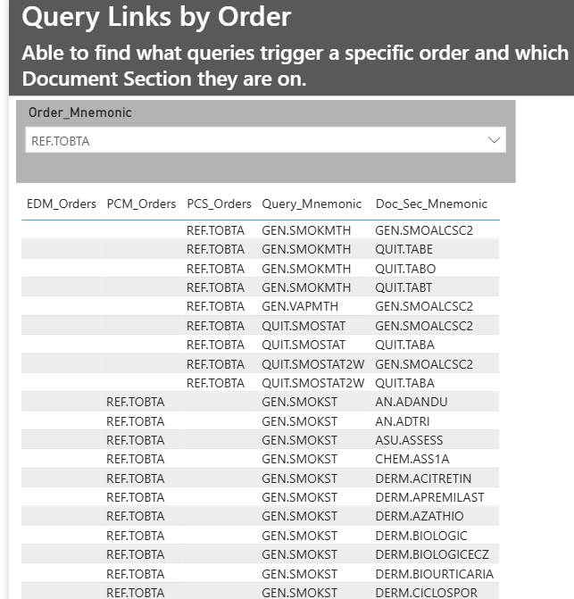
PowerBi – Query and Dictionary build Query Links
Orders
Shows all queries that has that order is attached.
Shows which document section that query sits on.
Notes:
Notes

Slide 10
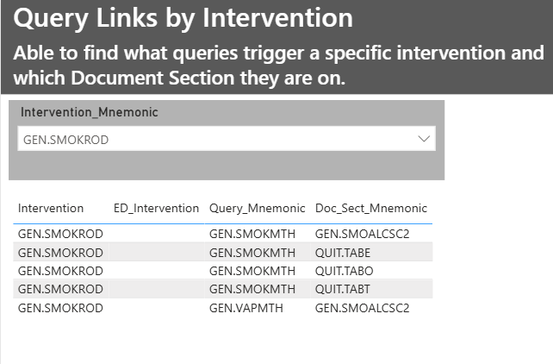
PowerBi – Query and Dictionary build Query Links
Intervention
Shows all queries that has that intervention is attached.
Shows which document section that query sits on.
Notes:
Notes
This means when one of the team picks up work another person has built, they are able to get a greater depth of knowledge of what they build does and how many other items it interacts with. Meaning we are less likely to break connections and uphold standardisation of build.

Slide 11
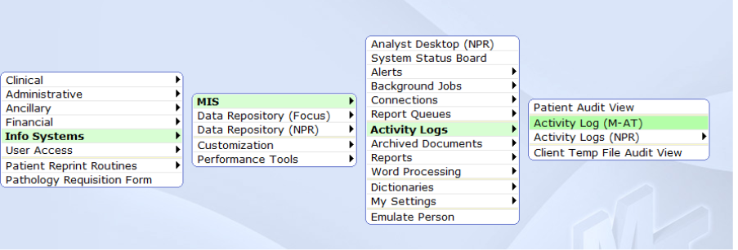
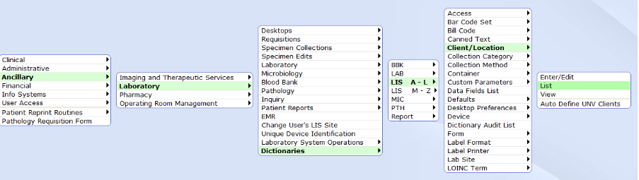
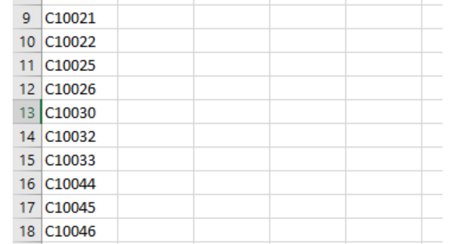
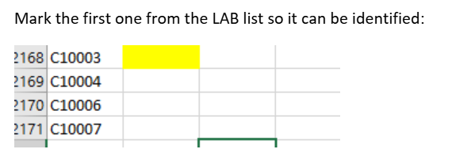
MEDITECH – Monthly Reports LAB Client Report Identifies devices that are used to order and if they are not set up to flow correctly to Labs.
Activity Report
Client List
Excel
Excel comparison to compare the two reports to find the devices that appear in one and not the other.
Notes:
Notes
Interface to a third-party lab system.
Takes a while to pull off both these reports and only can go back 90 days. Then have to pull both reports into excel delete all unrequired data – compare the required data.
6-page SOP just to pull the required data prior to fixing
Process is required as laboratory orders placed don't get sent to our external labs system unless each client is set up to set the LAB status to COLB
Activity report - shows which clients have been used in the last 90 days
Client List – Shows which clients have been set up to change status to COLB

Slide 12
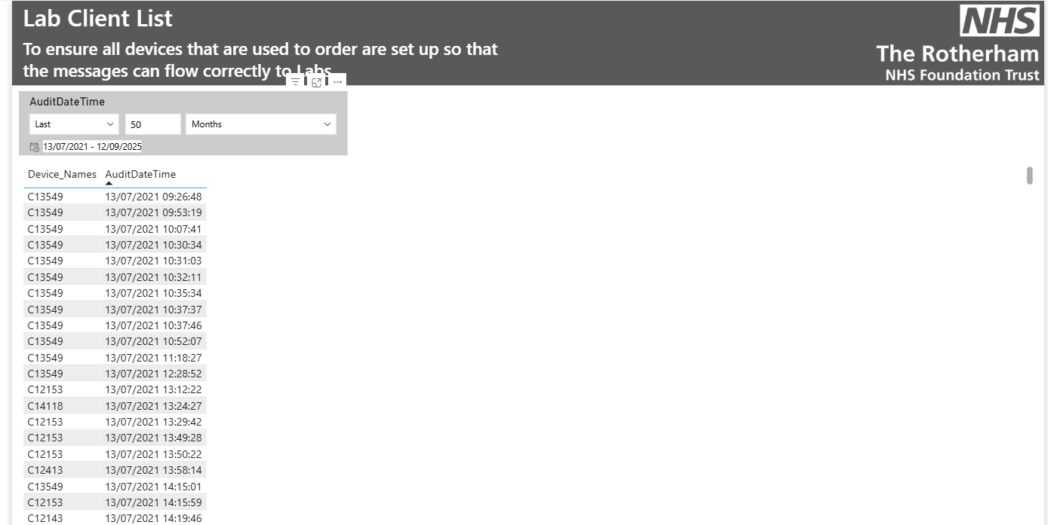
PowerBi – Monthly Reports LAB Client Report
Data requirements have already been written into the report.
Data goes back as far as required (when the data started flowing into the Data repository.
This data refreshes every day so action the report daily rather than restricted to monthly.
Notes:
Notes
Built a powerBi pulling just the required data into the tables. The multiple lines showing how many times that device is being used to order from. Date can be manipulated so we can tackle the most recent devices but can go back to the beginning of the data if required. Data refreshes daily so removes the restriction of only been able to action the issues monthly.
Has taken the time to run the report down by 75% as the data is at their fingertips straight away.

Slide 13
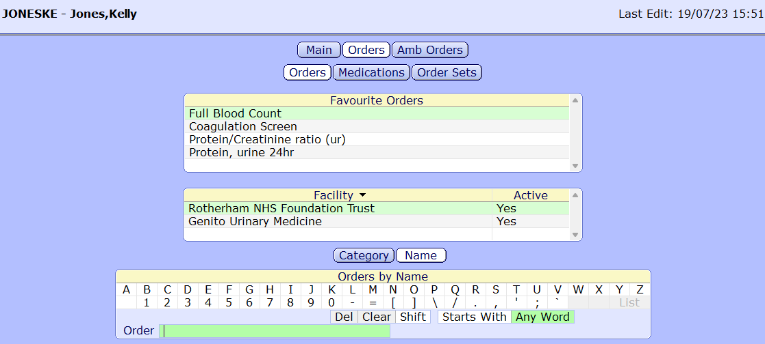
MEDITECH – Account Management Order Favorites
Must know clinician Mnemonic.
No way of telling if the removal of these order favourites have been missed prior to deactivation.
Cannot search by specific orders/medication.
Notes:
Notes
We clear order favourites as part of our account deactivation process.
Changes to orders/medication can happen at any time and saved favourites can be an old version of codes, frequencies etc. We found this is especially an issue when clinicians leave and come back.
This dictionary is very good if you are just wanting to search by specific user. So, for individual deactivation works well. Unable to have a catch all process if this step was accidentally missed.
Need to change or remove favourites by specific order. Unable to search by order/medication on this dictionary. We can pull reports but again this involves pulling the data and manipulating in excel which can take a lot of time.
Searching for favourites by order would be a great help when snomed changes are sent through.

Slide 14
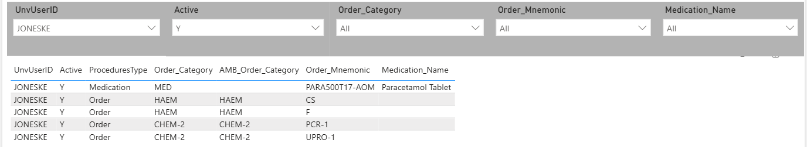
PowerBi – Account Management Order Favourites
Building the order favourites via PowerBi meant that we could pull User details, Active, Order Category / Name and Medication details all into one report.
Can still search for order favourites by individual or multiple staff member.
Notes:
Notes

Slide 15
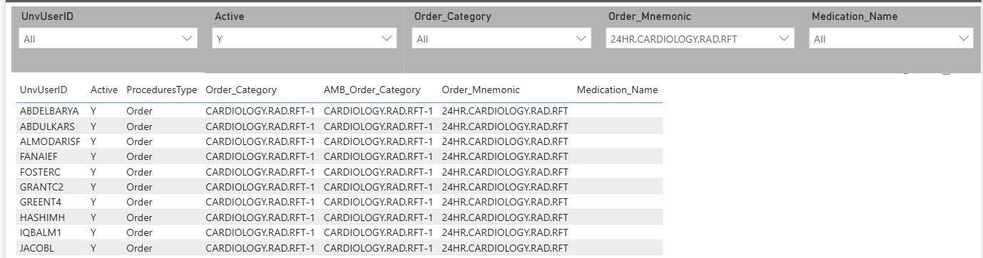
PowerBi – Account Management Order Favourites
Can also search by individual order or medication order.
Enabling the identification of individual staff accounts that have this favourite saved.
Notes:
Notes
This has been a great help with the last lot of snomed changes as we could gather a list of users that have the procedure order saved to their favourites and change the snomed procedure if they have saved this too. This was something we couldn’t really do until after the changes were made before.

Slide 16
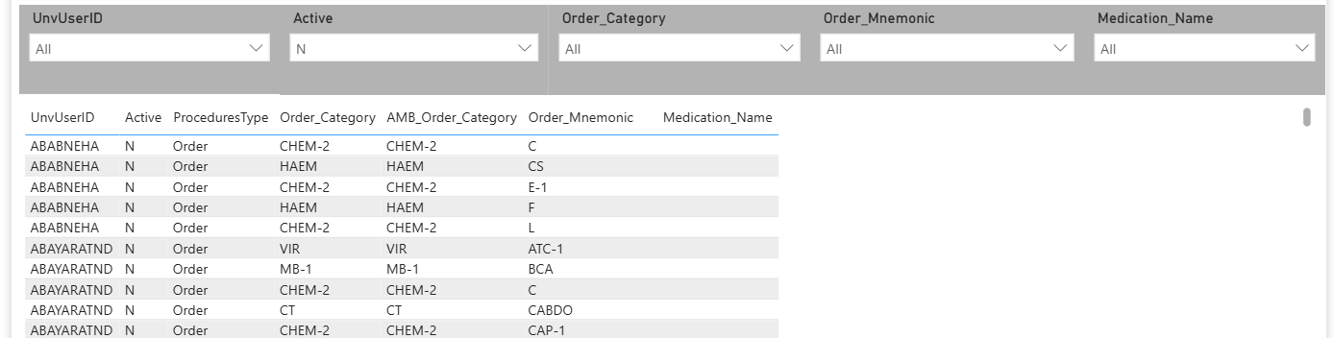
PowerBi – Account Management Order Favourites
Can also filter by inactive user accounts.
Allowing a catch all process in case deactivation was not followed fully and tidy up account prior to this process going live.
Notes:
Notes
Filtering by deactivated accounts allows safety net process and to be able to process historic accounts prior to this process being started. Meaning accounts favourites are a clean slate what clinician come back ensuring only the current order set ups back be added back into favourite lists. This report can be filtered in many different ways not just the three way I have shown. We have used this report multiple times to help us in various different scenarios to help us tidy accounts and update favourite orders/medications as required.
Further reports can be built as well to help with account build for example, we have another report telling us which clinicians do not have email addresses in the MEDITECH account.

Slide 17

Improvements Achieved and Benefits
Streamlined Issue Detection
Power BI dashboards provide a clear view of build and configuration issues, enabling faster problem identification.
Reduction in Manual Analysis
Automated data visualization decreases time spent on manual review, improving productivity and accuracy.
Enhanced Compliance Standards
Timely actions support adherence to compliance standards, ensuring safer and higher quality patient care.

Slide 18

Future Plans
Snomed Favourites
Working with MEDITECH to get Snomed favourites into the data tables so we can have similar processes to the order favourites.
Keep streamlining processes
Will keep identifying processes we can streamline with this method.
Investigate Datix/Risk Register
Some of these processes have been created on back of a Datix being raised, so will continue to review Datix reports and create processes where required.
Further efficiency for the service delivery
As we continue to streamline the processes this will allow us to tackle our routine reports sooner allowing less passing of time for errors to occur.
Notes:
Rotherham specific Snomed

Slide 19
Conclusion
Advancement in Reporting
Using the MEDITCH build data in this way allows for Streamlined build processes with multiple specialised staff members.
Improved Efficiency
These reports improve efficiency and streamlines processes for better service delivery.
Future Development Benefits
Ongoing development promises further benefits for the management of MEDITECH build and Accounts.
Notes:
Any body that has standardisation and Risk management issues this powerbi model can be used to improve and help your processes.

Slide 20

Any Questions?

