Slide 1
Driving Digital Transformation In Healthcare
Andrew Hine, Managing Director
October 2025

Slide 2
PUBLIC SATISFACTION WITH NHS IS DECLINING
Overall satisfaction with the NHS fell to 24% in 2023
Since 2020, satisfaction with the NHS has seen an unprecedented drop of 29%, and dissatisfaction is also at a record high of 52%
(%)
Note: The King’s Fund and Nuffield Trust analysis of NatCen’s BSA survey data. 2023 sample size = 3,374. Data has been weighted to minimise differences due methodology changes from 2020 onwards - Source: The King's Fund, Public Satisfaction with the NHS (2023)

Slide 3
A&E WAITING TIME PERFORMANCE HAS DETERIORATED OVER THE PAST DECADE
By March 2024, only 74% of A&E patients were seen in under 4 hours, falling short of the 95% target
In the last 4 years, there has been a 95% increase in the number patients waiting over 12 hours in A&E, rising to 141,693 in March 2024
% seen within 4 hours
Number of patients waiting over 12 hours
Mar-24
Jan-15
Jan-20
Mar-24
Jan-10
Jan-15
Jan-20
Jan-25
Percentage in 4 hours or less
95% Target
Number of people waiting 12 hours or more
Source: The King's Fund – A&E wait times (2024)

Slide 4
7.5 MILLION PEOPLE WERE WAITING FOR ELECTIVE CARE BY NOVEMBER 2024
The 18-week waiting time target has not been met since 2016
The number of long waits significantly increased during the pandemic & remains high
Only 59% of patients waited under 18 weeks for elective care in November 2024, falling short of the 92% target
As of November 2024, 221,899 people were waiting over 52 weeks between referral and treatment, ~3% of the total elective care wait list
% waits within 18-week target
% of those waiting over 52 weeks
Covid-19
Covid-19
3
Apr-18
Dec-18
Apr-19
Dec-19
Apr-20
Dec-20
Apr-21
Dec-21
Apr-22
Dec-22
Apr-23
Dec-23
Apr-24
Nov- 24
Jan-18
Jan-20
Jan-22
Jan-24
Nov-24
% waits under 18 weeks
% waits over 52 weeks
Source: NHS Referral to Consultant Wait Times (2024)

Slide 5
PATIENTS ARE FACING DIFFICULTIES IN ACCESSING CARE, WITH INCREASING GP WAIT TIMES
In 2024, 43% of all GP appointments took place on the same day as booking, 2% fewer since 2018
In this 7-year period, there was also a 2% increase in the proportion of those waiting 8-28+ days to see a GP
Waiting times as a proportion (%) of all GP appointments in England
100
4%
6%
Over 28 days
5%
5%
22-28 days
80
15-21 days
8-14 days
60
2-7 days
1 day
40
20
Same day
0
2018
2024
Source: NHS Appointments in GP (2024)

Slide 6
SIX GLOBAL CHALLENGES
Rising disease burden
Rapid technological advancement
Growing patient expectations
Workforce shortages
Post-COVID recovery
Financial sustainability

Slide 7
"SERIOUS TROUBLE" - THE DIAGNOSIS
The Impact of the Lansley Reforms
Lack of capital investment
COVID-19 and its aftermath
THE THREE SHIFTS – THE TREATMENTS
Sickness to prevention
Hospital to community
Analogue to digital

Slide 8



THE NEW GOVERNMENT’S ANALYSIS AND DIRECTION TO THE NHS IS CLEAR
I want to frame this plan around three big shifts – first, moving from an analogue to a digital NHS. A tomorrow service, not just a today service. Second, we’ve got to shift more care from hospitals to communities. And third, we’ve got to be much bolder in moving from sickness to prevention.

Slide 9


THE GOVERNMENT’S ANALYSIS AND DIRECTION TO THE NHS IS CLEAR
£29bn annual increase in NHS day-to-day funding.
Up to £10bn for technology and digital transformation.
£600bn to be invested over the next 3-4 years across public services.
Chancellor Rachel Reeves
We are investing £10 billion to bring our analogue heath system into the digital age, including through the NHS app, so patients can manage their prescriptions, get their test results, and book appointments all in one place.

Slide 10
HEALTHCARE IS THE LAST MAJOR INDUSTRY OVERDUE FOR FULL DIGITAL REINVENTION
“Healthcare remains one of the largest and most complex industries to have yet fully captured the productivity benefits of digitisation.”
McKinsey & Co.
“Healthcare remains the most complex and under-digitised major sector. Pressure is mounting for a dramatic acceleration in digital business transformation.”
Gartner®
“Healthcare organisations are just beginning to tap into the full potential of digital. It is among the last major sectors still undergoing foundational reinvention.”
Deloitte
“Healthcare has been a digital laggard. A systematic shift to digitisation, automation, and platform models is now non-negotiable for health system survival.”
World Economic Forum
“Healthcare is in the midst of an overdue digital revolution. Other industries made this leap decades ago.”
HIMMS
“Unlike banking, retail, and manufacturing, healthcare remains far behind in digital experience, data interoperability, and operational automation.”
Harvard Business Review

Slide 11
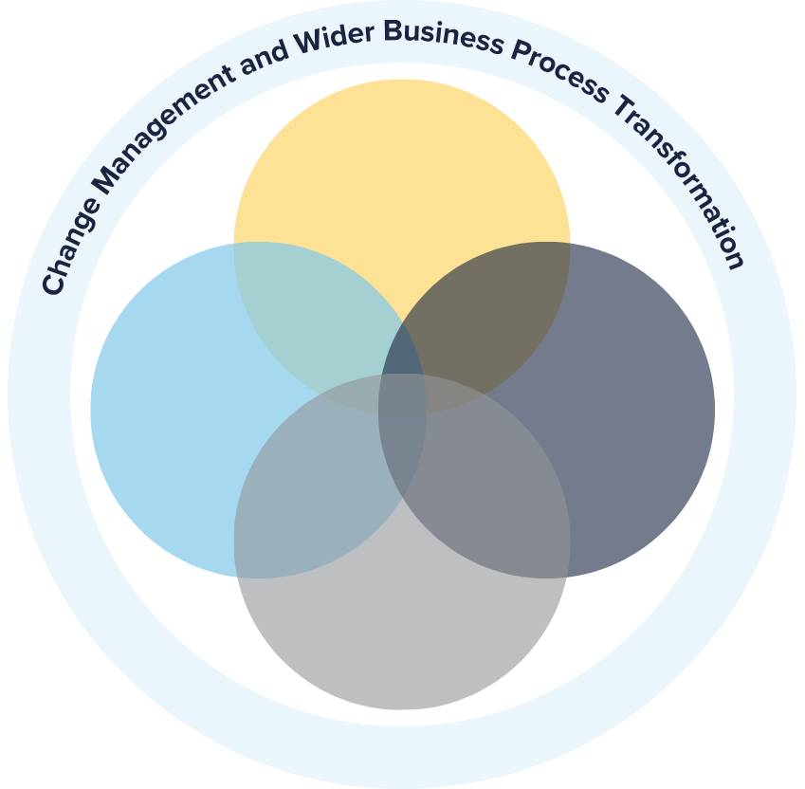
IT'S NOT ONLY ABOUT THE PRODUCT. IT'S ABOUT THE IMPLEMENTATION
EPR Adoption ≠ Success • ~90% of NHS providers have an EPR • Only 1 in 3 have integrated EPRs across care settings • ~55% have digitised all patient records (excluding historic)
Functionality Gap • ~30% use key features like SNOMED templates • Only ~40% report good clinician experience • Significant variation in use even with same vendor
Coverage
Implementation
Functionality
Maturity Misalignment • Achieving HIMMS EMRAM Stage 7 is absolutely possible with MEDITECH – yet, only 32% of NHS Trusts have reached Stage 5–7 • Only 12% achieved INFRAM Stage 5 or above
Adoption
Success comes from HOW you implement – not WHAT you implement.

Slide 12
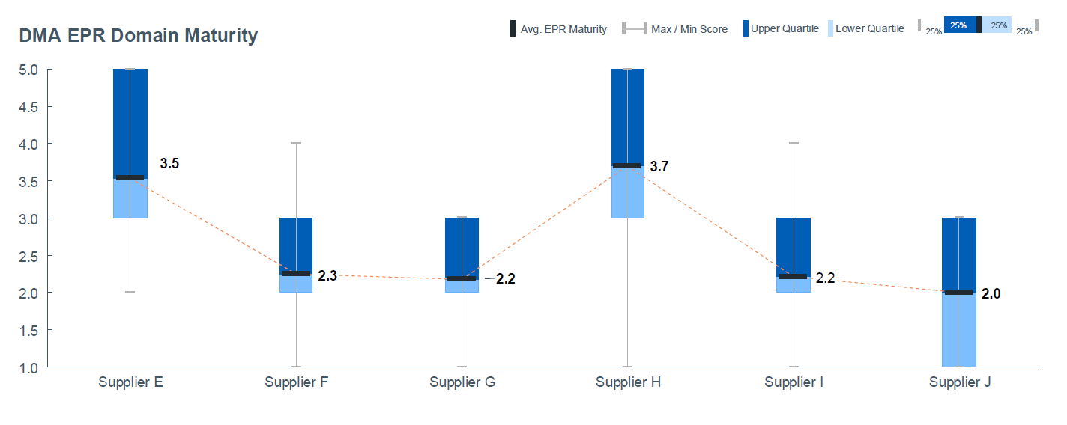
ACUTE: EPR DIGITAL MATURITY VARYING BY VENDOR
Results show variability in maturity across providers with the same supplier
Source: DMA Maturity Scores for EPR domain (July 2024);
Frontline Digitisation EPR vendor information (September 2024).

Slide 13



UNMATCHED MEDITECH EXPERIENCE
ABOUT
CERECORE
INTERNATIONAL
Healthcare Organisation at Heart and Part of HCA Healthcare UK.
Incomparable Worldwide Experience: Experts in all MEDITECH products, backed by decades of hands-on experience.
Pioneering Leadership: First to implement MEDITECH Expanse in the UK and involved in all MEDITECH Expanse projects for the NHS.
As MEDITECH's largest customer globally through HCA, we bring unmatched insight and lead the largest Expanse project in the country through HCA UK.
Proven Success: >300 successful MEDITECH implementations in the US and UK, and daily support to >50 MEDITECH facilities.
Client-Centric Approach: Bespoke solutions from design to go-live and beyond.
MEDITECH EXPERTISE
& LEADERSHIP
Globally, no other provider has delivered more successful implementations than we have.
© CereCore® | CONFIDENTIAL – Contains proprietary information. Not intended for distribution.

Slide 14
HOW WE CAN HELP
Key best practices we can help you with:
STRATEGIC APPROACH
GOVERNANCE MATTERS
INTEROPERABILITY
CHANGE MANAGEMENT
CONTINUOUS IMPROVEMENT
We can help you develop a clear strategy for standardisation to ensure alignment with organisational goals.
We can help you implement structured governance to oversee decision-making and track progress.
We can help you provide continued improvements to interoperability as well as application rationalisation over time.
We can help you engage stakeholders early and manage changes effectively to ensure smooth implementation.
We can help you monitor and evaluate systems to drive ongoing improvements in operational efficiency and patient care.

Slide 15
OPTIMISATION: REALISING LONG-TERM VALUE
Go-live is just the beginning. Our optimisation offering can help you unlock lasting value from your MEDITECH investment by driving adoption, addressing inefficiencies, and improving outcomes.
Targeted system assessments
Data-driven strategy
Expert-led, partner model
Quick wins, sustained progress
>20 Assessments/Optimisations in the last 2 years

Slide 16
KEY TAKEAWAYS
Having a modern EPR is essential. However, selecting an excellent product is just the beginning.
Similar systems can lead to very different outcomes. Success depends on how well they have been implemented.
No other provider globally has delivered more successful implementations and optimisations than we have.

