Slide 1

TEKNICOR
Zero Downtime
Making it a Reality in MEDITECH Hospitals
Insights from Teknicor’s Implementations within NHS MEDITECH hospitals
Mo Eisen
CTO Teknicor
MUN 2025
October 1st & 2nd
Titanic Hotel Liverpool

Slide 2


TEKNICOR
WHAT WE DO
Teknicor is a provider of secure best-of-breed data center infrastructure, data protection & managed cloud solutions for NHS trusts.
WHY WE DO IT
Our clients trust us to deliver fiscal responsibility, reduced risk, business continuity, lower complexity and increased agility.

Slide 3


About Teknicor
Definition Matters
Planning
Implementation
Windows Update Plan
Key Takeaways
AGENDA

Slide 4


UK Healthcare compliance requirement
DEFINITION MATTERS
Downtime means different things to different NHS organisations / stakeholders (ex. non-redundant printer reboots) .
High Availability Approach [HA] (ex. predictable limited service outages such as lab analyzers) vs. Traditional Approach (ex. MEDITECH service downflags).
reduction
0
1 hour
2 hours
4 hours
6 hours

Slide 5
UK Healthcare compliance requirement
PLANNING
ASSESSMENT
The current environment is assessed in order to ensure comprehensive understanding (ex. compatibility, server contents/roles, processes etc.).
This process must include the right people, including non-IT personnel.
It will be determined where HA can be effectively utilized, where it cannot, and how it can be appropriately managed to support patient care goals.
Costs (such as Windows licensing) will be mapped out.
OPTIONS WITH IMPACTS
Options are provided, with impacts identified for each.
These options will be reviewed with the NHS hospital for approval.
DECISIONS
A change request or proposal will be created detailing the decisions made, with a high-level implementation plan that highlights associated costs.

Slide 6
UK Healthcare compliance requirement
Implementation
A final detailed plan is created, outlining the changes to be made in the environment and the number of downtimes required to implement those changes.
The downtime will involve all teams to ensure that a thorough test of the system is completed post change. Any areas for immediate troubleshooting are identified.
Typically only one downtime is required to complete the implementation, but this is highly dependent on the size and complexity of the environment. A second downtime is recommended to be held as a placeholder in case it is needed to resolve any final items.
Ex. Separating synchronous and asynchronous machines, working with MEDITECH.

Slide 7
UK Healthcare compliance requirement
WINDOWS UPDATE PLAN
A Windows update plan is created.
This plan outlines step-by-step what is going to occur at each and every stage of Windows updates, hour-by-hour (such as failover).
The new plan must include estimates of service interruptions during failovers, and what users can expect in support of hospital communication.
Ex. Some servers such as labs/ interfaces may be isolated for separate maintenance window.

Slide 8
UK Healthcare compliance requirement
Go live & support
For many organisations this will be the first Windows update with no downtime, using high availability.
Teknicor’s team – ex. engineering, project management – are engaged and available to support where needed.
Feedback is collected for future updates.
The timing of the next update will be scheduled to allow planning to start.
Ex. Some servers such as labs/interfaces may be isolated for separate maintenance window.

Slide 9
Key Takeaways
Consider the benefits of zero / reduced downtime for your organisation relative to patient care objectives and cost/benefit requirements.
A high availability (HA) approach can keep your services up-and-running, avoiding the certain downtime associated with a traditional approach.
You’re not alone. Teknicor has worked directly with MEDITECH and NHS hospitals and has optimized this process through real-world deployments. Learn from these.
TEKNICOR
QUESTIONS & DISCUSSION
Mo Eisen
CTO, Teknicor

Slide 10
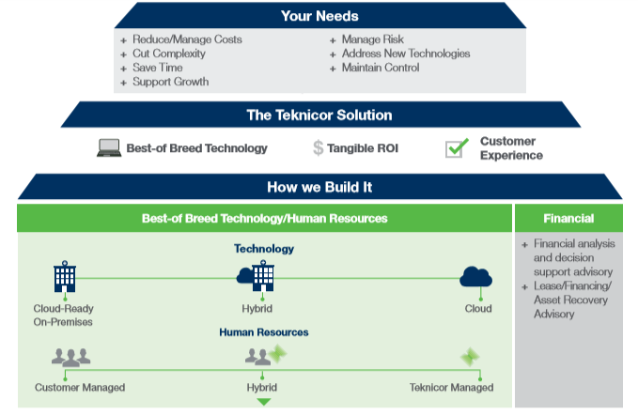

LEVERAGING THE RIGHT TECHNOLOGIES & PROCESSES
OUR APPROACH– HOW WE CAN HELP
+ Reduce / Manage Costs
+ Manage Risk / Security
+ Ensure Business Continuity
+ Cut Complexity
+ Save Time
+ Support Growth
+ Address New Technologies
+ Maintain Control
+ Financial analysis and decision support advisory
+ Lease/Financing/
Asset Recovery Advisory
Core Infrastructure
Data Protection
Professional Services & Support
State-of-the-Art Storage • Compute • Data Center Management / Automation • VDI • Offsite Data Archiving • HIS
Backup & Recovery • Data Replication • Disaster Recovery (DR) & High Availability • Backup Vaulting • Air Gapped Backup
Infrastructure Assessment • Architecture/Implementation • Procurement Advisory • Software Selection/Implementation • MEDITECH • Strategic Planning • PMO • Crisis Management • Premium Support • Managed • Hosted
Security
Business Continuity • Consulting Services • Data Center and Edge Security • Next Generation Firewall • Privileged Access Management • Managed Security

