Slide 1
A customer view: “The CDR is our 2nd most important strategic investment after MEDITECH Expanse”
Georgina Hurst
Vice President Sales, EMEA
Notes:
Intro
This is not a product pitch — it’s about sharing customer perspectives on some of the strategies they have adopted to make the transition to MEDITECH Expanse (and other systems) for more smoothly, quickly, whilst tackling some of their issues

Slide 2
MEDITECH Expanse
The Problem Of Data!

Slide 3


When Rolling Out MEDITECH Expanse…
…There Are Important Questions Healthcare Organisations Face Regarding Data
What data do we need to bring into our MEDITECH Expanse EPR?
What type of data should we bring in and from which applications?
How do we get this data into the system?
How long will the data migration take?
Who will do the migrations?”
Notes:
- Applies to MEDITECH Expanse but also other EPRs & key systems

Slide 4

The Wish List
In A Perfect World, Healthcare Organisations Want:
The new EPR to be the single source of truth for patient information
All of their data from all of their systems (live and legacy) in the new EPR or connected to it (interoperable)
Notes:
Source: Powerpoint stock image

Slide 5


The Reality
A ‘Minimal Necessary Dataset’ Is Migrated Into The EPR
Usually only a few years of history (e.g. 18 months – 2 years), plus “high-value” data elements that are structured enough to migrate safely
Enough data to support safe clinical operations on day one
But not a full historical ‘lift-and-shift’
Notes:
Source: Powerpoint stock image

Slide 6

The Reality
The ‘Minimal Necessary Dataset’ Typically Includes…
Active patients’ clinical records
Especially recent encounters/visits, problem lists, allergies, vaccinations, medications, test results, etc.
Open orders and scheduled procedures
Current inpatient/outpatient encounters
Critical longitudinal data
E.g. chronic condition summaries, oncology, etc.
Data from specific clinical disciplines
E.g. paediatric data
Plus all respective key demographics & identifiers
Notes:
Source: Shutterstock licensed image

Slide 7


Why This Matters For You
There’s Good Reason Not To Take Everything Over To Expanse
MEDITECH Expanse is likely your highest priority project
It is likely your most expensive, current IT investment
De-risk the project as much as possible
Keep Expanse lean (with only the core data needed for safe go-live)
Avoid unnecessary migration complexity and cost
Avoid burdening one migration vendor with too much
Avoid unnecessary delays to Expanse rollout

Slide 8

But That Does Leave Missing Pieces…
Data Commonly Left Behind
Older patient histories
Unstructured documents/scanned records
Departmental system data (cardiology, oncology, PACS, LIMS, etc.)
Paper records (digitised only if clinically required)
This can easily account for 70% of total patient data
Notes:
Source: Powerpoint stock image

Slide 9

So, What Happens To This Data?
Generally, Stays Where It Is – In The Source Application!
Continues to live outside of Expanse
Difficult to access
Does not readily formulate part of the patient record
Significant cost & resource to maintain
Cybersecurity risk
Difficult to leverage for secondary use:
E.g. analytics, AI, clinical research
Notes:
Source: Shutterstock licensed image

Slide 10

There’s Got To Be Another Way!!!
We recommend starting to build your decommissioning strategy
Notes:
Source: Shutterstock licensed image

Slide 11
Strategies Our Customers Adopted To Streamline Their MEDITECH Expanse Projects

Slide 12
The Solution Our Customers Chose
Clinical Data Repository (CDR)
A valuable, interoperable adjunct to MEDITECH Expanse:
Eases access to live clinical information for EPR users
De-risks and makes available legacy clinical data
Reduces exposure & increases resilience to cyber events
Enables secondary uses and analytics of clinical data
Removes the pain & expense of data migrations when replacing systems
A CDR brings together medical images, clinical reports, lab results, scanned documents and essential clinical information, making it accessible from the EHR in an easy-to-use interface
⬅ Interoperable Data ➔
⬅ Clinical Information ➔
HealthStore® Clinical Data Repository

Slide 13
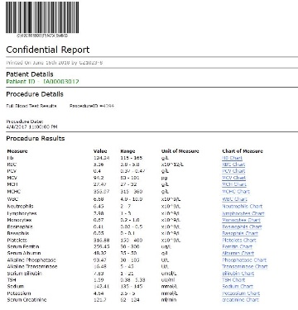

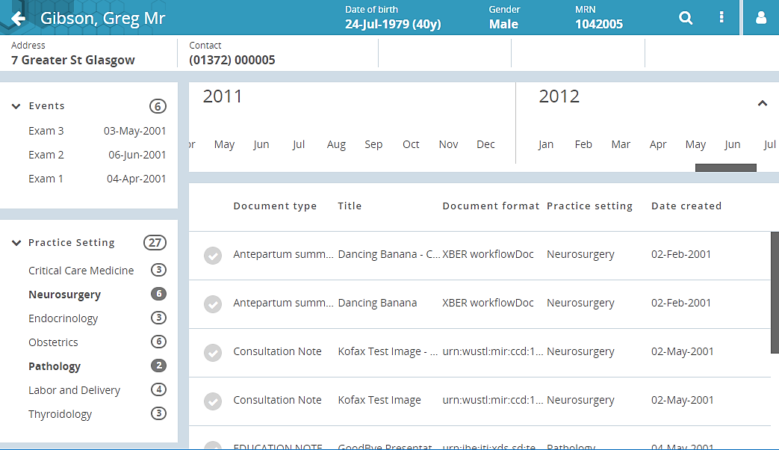


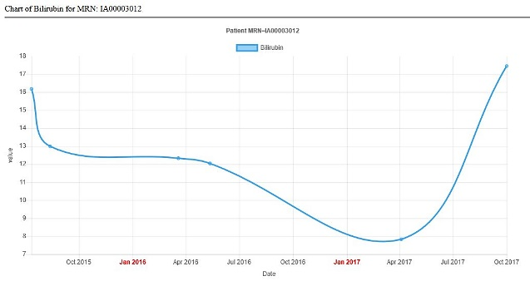



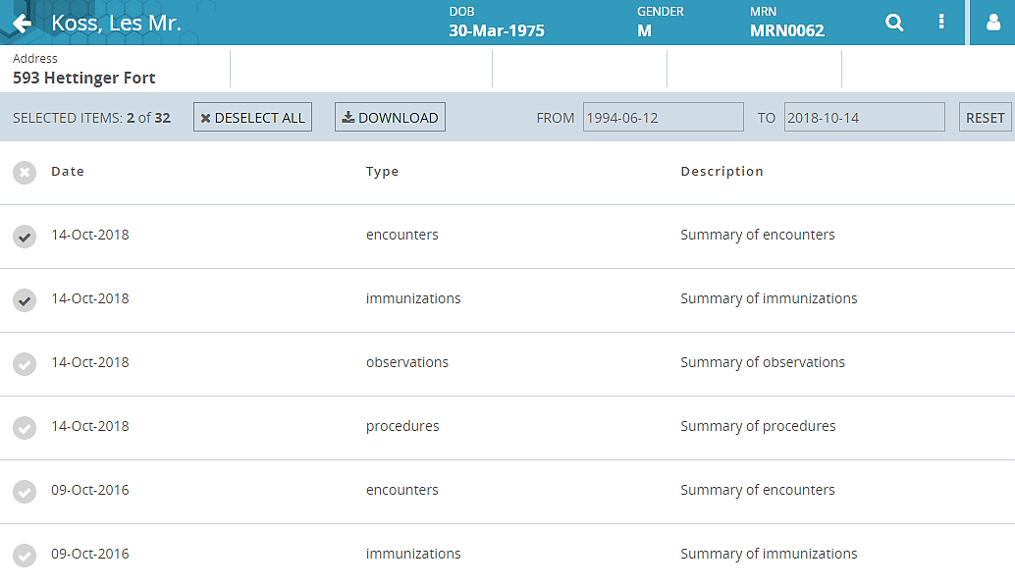

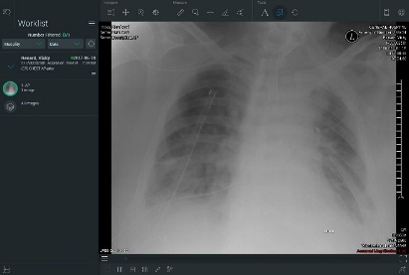


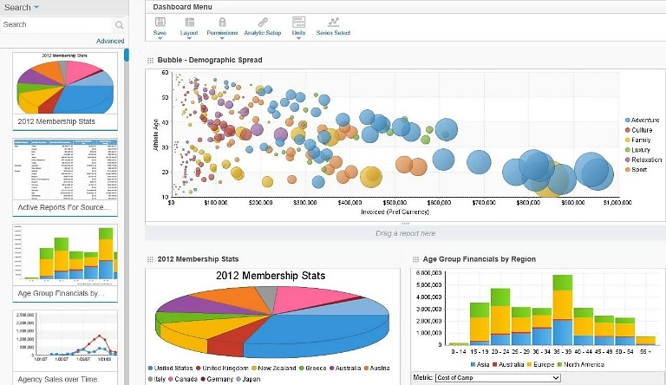

How A CDR Works
Extract data from other applications
Ingest all types of data
Centralize, store and protect data
Access, view, share data & provide standards-based interoperability via FHIR, HL7 & DICOM
On-premise
Hybrid
Cloud
⬅ Interoperable Data ➔
Databases
⬅ Clinical Information ➔
HealthStore® Clinical Data Repository
Images
Documents
Screen Views

Slide 14



HCA Healthcare UK – Customer Journey
CDR Deployed To Underpin MEDITECH Expanse And Beyond
MEDITECH Expanse roll out underway
Enterprise-wide, international deployment
HealthStore® CDR has been adopted for HCA’s 4-year, multi-phase application decommissioning strategy
Initial phases include 8 legacy applications
HealthStore® will be integrated with MEDITECH Expanse offering a complete, longitudinal patient view
The CDR is our 2nd most important strategic investment after MEDITECH Expanse.
HealthStore® CDR
Dr Cliff Bucknall
Chief Medical Officer
HCA Healthcare UK
Strategic investment in a Clinical Data Repository as a home for data from decommissioned legacy systems as well as live data
MEDITECH Expanse
Enterprise-wide, international deployment of the MEDITECH Expanse System

Slide 15




Mid & East Cheshire NHS Foundation Trust
BridgeHead’s CDR Was Deployed Alongside The MEDITECH Expanse Rollout
The CDR provides a scalable, cloud‑based repository, consolidating data from legacy systems, after which they can then be retired
Phase 1: focus on migrating high‑value patient information and clinical correspondence from two legacy systems into the CDR with ‘in‑context’ access via the new MEDITECH Expanse EPR (awaiting sign off)
Phase 2: ingesting data from then decommissioning three theatre systems, patient flow software, and PAS assessment software (in progress – December)
Notes:
Further systems already in scope for future retirement include vital signs and nursing form applications

Slide 16
Mid & East Cheshire NHS Foundation Trust
The Decision To Implement A CDR Was Based On A Number Of Factors:
The Trust wanted to de-risk its MEDITECH Expanse EPR rollout – split the data project
To only bring in the core data required for a safe ‘go-live’ & keep Expanse lean
Separately, identify & migrate the remaining patient and clinical information into the CDR
This allowed the different workstreams to be carried out simultaneously avoiding any unnecessary delays to the EPR rollout
Long-term clinical data management solution for patient data residing outside of the EPR
The Result
Estimated savings for each system retirement varies depending on the size of the application and the amount of data it contains – spanning £400k per annum for a larger system; through to £30k per annum for the smallest application
Notes:
This reduced the cost and complexity of migrating data into the EPR – allowing its chosen migration partner to focus on that singular task

Slide 17

University Hospitals of Derby & Burton NHS Foundation Trust
CDR deployed as core platform for application decommissioning strategy
Initial phase focused on retirement of three high-risk systems
A legacy MEDITECH Magic EPR, Emergency Department system, and a patient administration system
Integrated CDR with its live MEDITECH 6.x & Lorenzo EPRs
Ensuring clinicians could access this historical information in ‘patient context’, from one entry point
The Result
the Trust saved close to £1m annually in licensing and support costs
An average £300k per application per year saving
These systems were removed from the Trust’s risk register
Quick and easy access to legacy data via the EPR
Transformed SARs & FOIs from manual to a three-click process

Slide 18



3 Key Takeaways
By Implementing A Clinical Data Repository, You Can:
Derisk & accelerate your MEDITECH Expanse rollout
Create a future-proof strategy for data residing outside of the EPR
Retire legacy applications – saving money & improving efficiency

Slide 19

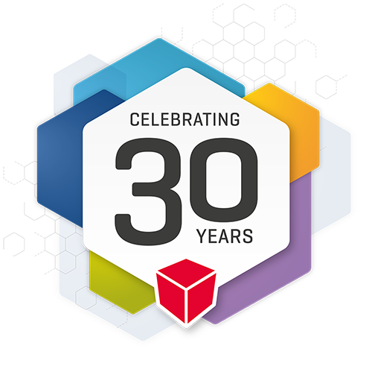



Why Trust BridgeHead Software?
1 in 5 NA hospitals use BridgeHead Software
A British Company – Global Provider Of Healthcare Data Management Solutions
+
hospitals worldwide
British Company
Founded in 1994 HQ in UK + US office
In 2024, BridgeHead celebrated its 30 year anniversary
Application, storage & hardware agnostic
Notes:
100% Healthcare Focused
100% Software Company
100% Data Management
UK HQ – Support & R+D
Strong Management Team
Innovative, Independent & Growing
1,200+ Hospitals Worldwide
20+ Years Experience in Data Management
Work With Hospitals’ Clinical Data
Hardware, Storage & Application Agnostic
Broad Range of Partners

Slide 20








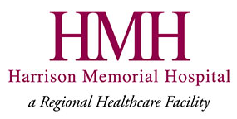


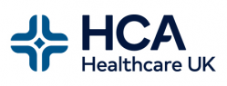







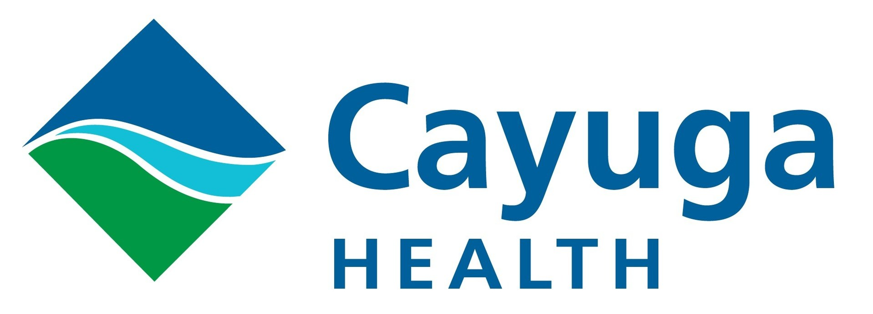














BridgeHead Customers
Notes:
Combination of HealthStore and RAPid customers worldwide

Slide 21
Next Steps
We’d Be Happy To Work With You On Your Decommissioning Strategy
A complimentary discovery session, where we’ll help you:
Map and prioritise your legacy estate
Identify opportunities for early savings and risk reduction
Explore how a CDR can deliver safe, decommissioning of your legacy systems while providing ongoing access to your clinical and patient data
A live demo of BridgeHead’s Clinical Data Repository, HealthStore®:
Explaining how the solution works
Options for deployment
Showing how HealthStore realises real benefits and ROI for your organisation
Notes:
Learn more on how NHS Trusts are using HealthStore® to support their legacy retirement strategies Improving clinical efficiency, reducing risk, freeing up money and resource, and bringing them closer to a more resilient, digitally mature future

Slide 22
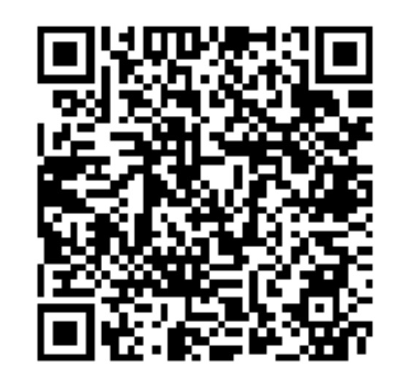
Questions?
Georgina Hurst
Vice President Sales, EMEA
georgina.hurst@bridgeheadsoftware.com
Scan QR Code to Connect with Georgina on LinkedIn

