Slide 1
Beyond the AI Hype: Building a framework for responsible healthcare innovation
Christian Reid - Business Development Manager, Solventum
Anthony Owen - Solution Sales Engineer, Solventum

Slide 2

Notes:
Helping to solve some of the Healthcare problems and driving with momentum

Slide 3




Four business segments
Creating breakthrough solutions for our customers’ toughest challenges
Medical Surgical
Helping care providers restore lives
1.6M hard-to-heal wounds treated annually with our solutions
Dental Solutions
Reimagining oral care delivery
2B+ dental restorations worldwide using 3M™ Filtek™ Universal Restorative
Health Information Systems
Driving efficiency, improving outcomes
89% of NHS hospitals use our data solutions
Purification & Filtration
Streamlining the innovation process
25M dialysis treatments performed annually using our lifesaving membrane
Notes:
Solventum are apart of 4 business segments:
MSurgical Tegaderm, negative pressure 1.6 million wounds treated annually
Dental Solutions: 2billion restorations world wide
Purification and Filtration: Treat over 25 m dialysis treatments annually
We fall under the Health Information Systems : Driving efficiency and improving healthcare outcomes
89% in the NHS from a coding perspective and 25% of the market in our front end speech solutions.

Slide 4

Solventum at-a-glance
70+
year history of innovation
7,300+
patents issued
22,000+
employees
Market-leading positions
Trusted & recognized brands
$8.2B
2023 Revenue
© Solventum 2024. All rights reserved.
4
Notes:
“A new company that you know well”
70 year innovation history
22000 employees world wide
8.2 billion in revenue.

Slide 5


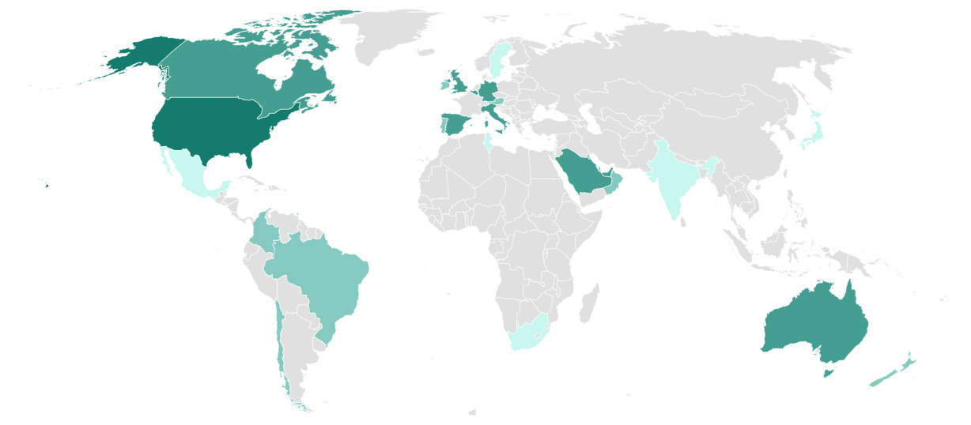





Health Information Systems by the numbers
40 years leading healthcare’s transformation to a future that is more automated and based on value
400,000+
300+
Clinicians at any one time use our cloud based speech solutions
EHR certified integrations
3,000+
34
countries
Hospitals send data through our AI-based NLP/NLU engine every day*
use our solutions
495+
32
million
states
clinical documents processed every month*
use one or more proprietary methodologies for payment, reporting, risk adjustment or quality measurement
40
years
of medical coding and payment expertise
clinical and
75%
of US hospitals use Solventum’s software
89%
of NHS hospitals use Solventum’s software
partnership
content experts
to leverage conversational, generative AI in healthcare
applying consistency, clarity and guidance in engine tuning, etc.
5
Notes:
We’ve become the leading coding and reimbursement vendor in the world.
3,000 hospitals 75% US market adopts our technology and here in the UK 89% of NHS Trusts using our products
495 million documents processed every month
Similarly with speech at any one time there are over 400,000 clinicians using our cloud based speech products and integrate with over 300+ clinical/EMR systems Epic, Cerner, Meditech, Allscripts, System C etc
Why is this important because AI learns by processing big data and if your looking at speech or auto coding you need a supplier that has scale.

Slide 6
The problem
Notes:
Whats the problem we and how we solve it?

Slide 7




The need of the hour
Transform the patient-doctor relationship
Improve patient and clinician well-being
Enable higher quality of care at lower cost
Combat burnout, attrition and staffing shortages
Reduce clinician cognitive overload and emotional exhaustion
Improve quality, efficiency and timeliness of clinical documentation
Drive growth with scalable and innovative technology
Optimize the EHR experience and usability
Leverage foundational technologies
Notes:
Deliver higher-quality care at lower cost
Address burnout, attrition, and staffing challenges
Ease cognitive load and reduce emotional exhaustion for clinicians
Enhance accuracy, efficiency, and speed of clinical documentation
Fuel growth with scalable, innovative technology

Slide 8

Administrative burden and cognitive overload on clinicians
According to a recent survey:
49% of clinicians feeling burned out
20% of clinicians feeling depressed
56% of female physicians experience burnout
44% of male physicians experience burnout
15% Emphasis on profits over patients
Survey rated the medical specialties experiencing most burnout:
63% Emergency medicine
53% OB-GYN
53% Oncology
51% Pediatrics
51% Family medicine
51% Radiology
Medscape Physician Burnout & Depression Report 2024: 'We Have Much Work to Do”
https://www.medscape.com/slideshow/2024-lifestyle-burnout-6016865#7
Delivering high quality patient care
Delivering High Quality Care
EPR and anything that distracts from interaction with the Patient
Things that distract from patient care
BURNOUT
Notes:
This survey shows that according to a recent survey shows :
Clinician Well-Being: Key Survey Findings
49% of clinicians report feeling burned out
20% of clinicians report feeling depressed
56% of female physicians experience burnout
44% of male physicians experience burnout
15% cite an emphasis on profits over patients
Specialties Most Affected by Burnout
63% Emergency Medicine
53% OB-GYN
53% Oncology
51% Pediatrics
51% Family Medicine

Slide 9

Focus on delivering care, not documenting it
Notes:
Doesn’t just impact the Hospital or clinicians it also impacts the patient
Drawing by 7 year old girl visiting doctor
Doctor Distracted by Technology
This is what technology is doing not helpful from patient experience or efficiency

Slide 10
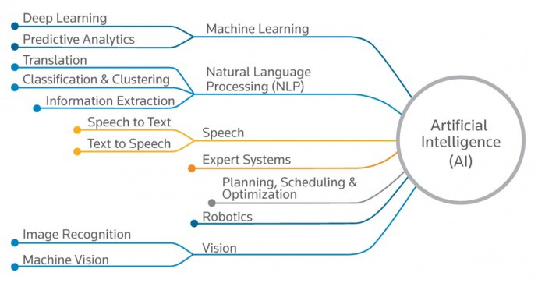
The next step in Gen AI
Large Language Models (LLMs)
Use a type of machine learning called deep learning to understand how characters, words, and sentences function together
Involves the probabilistic analysis of massive amounts of unstructured data to recognize distinctions between pieces of content without human intervention
Source: Cloudflare.com
Source: Becoming Human: Artificial Intelligence Magazine, What is Artificial Intelligence (AI), Sanket Garbhe
Incremental Solventum technology
Notes:
AI is the latest buzz word and in the LLM space we have seen an explosion following chat GPT and others
For the last 10 years we have been building out our NLU and AI capabilities overlaying our clinical content into our native and partner LLM

Slide 11

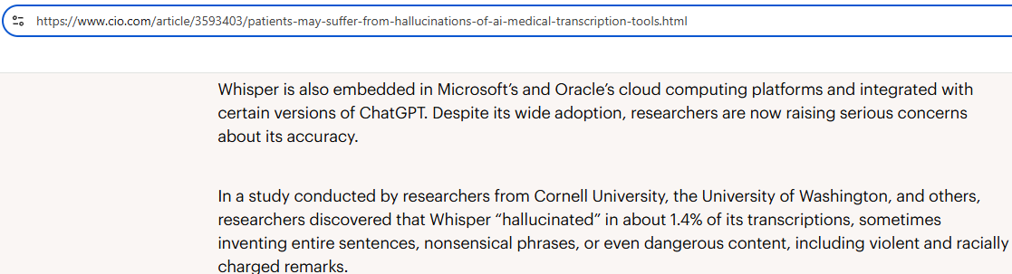
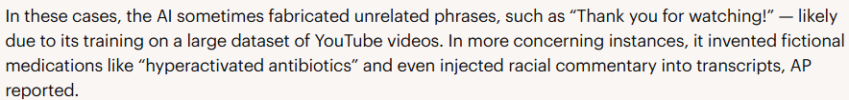
Why a thoughtful approach
Market has exploded with new startups - creating confusion - enticing free products
AI Hallucinations credible
“Eyes and nose continue to be within normal limits” (I & O)
“History of sick as hell disease” (sickle cell)
“Patient is alert and oriented, sedated on Propofol”. (alert and oriented as well as sedated?)
Notes:
Healthcare has seen this market transform overnight from future AI tech into commodity based technology with clinicians often purchasing or using free gen AI tools on your patient data.
On facebook I regularly get adverts from dozens of start up companies offering me free technology to transcribe patient conversations a lot of these do not have local compliance or locally hosted meaning your data on your patients is leaving the UK. Driving pressure for you as healthcare leaders to act
Then we have AI hallucinations

Slide 12
Solventum approach

Slide 13




Most health systems…
and technology solutions…
silo these workflows.
Documentation capture
Coding and income
Quality improvement
Notes:
Most health systems – and to be honest, most tech companies – silo these workflows.
They look at is as three separate workflows, teams, responsibility chains – and that’s why we have this proliferation of bolt-on solutions, because your CMO wants to make documentation easier for clinicians, but your coding and BI teams are using a different process to manage queries – and the reality is you don’t get the ROI you’re looking for – because when these workflows are disconnected, patients face risks, care costs go up, and burnout worsens, because all teams are focused on re-work.

Slide 14

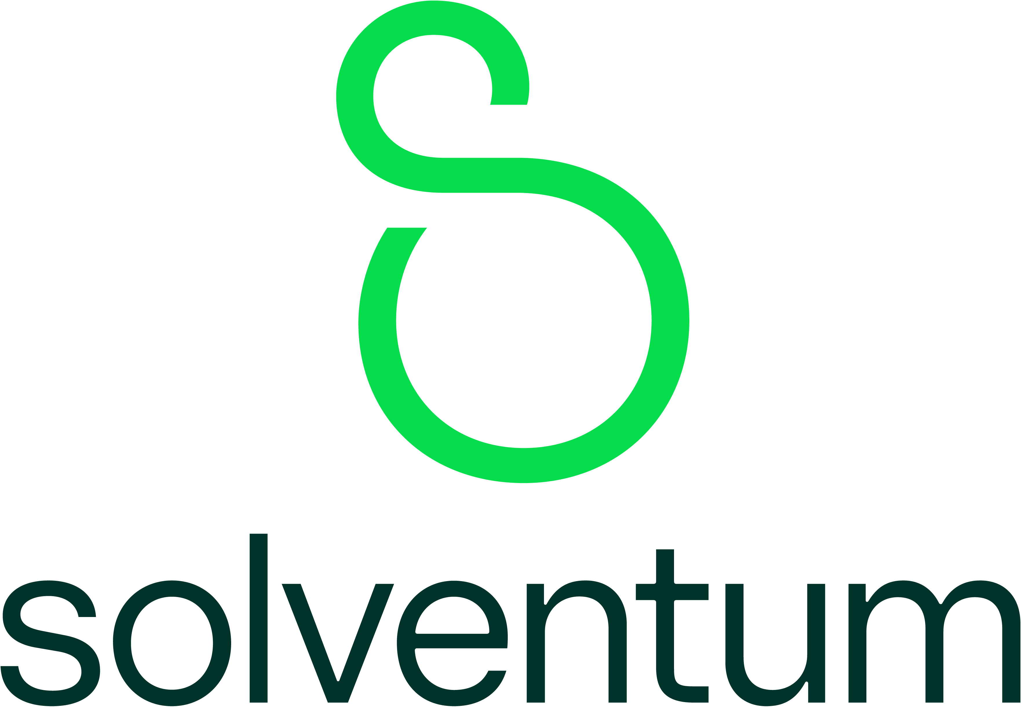


Clinical documentation
Cost and financial performance management
Quality care and outcomes
Notes:
But when we think about each of these segments not as individual workflows but as one holistic workflow, then we know where to strategically intervene across the enterprise and close gaps that disconnect clinical care and revenue integrity.

Slide 15
Clinical content and advanced technology, right from the start
Clinical expertise and a content-first approach to reduce rework
Clinical content and expertise
Nosology
Patient classification and grouping
Quality
Compliance
Reimbursement models
Consulting, education, change management
Clinical economics
Disease diagnosis and treatment
Advanced technology
Conversational AI
Generative AI
Machine learning
Automation
Predictive analytics
Cloud-hosting
Security
Analytics and reporting
Notes:
Solventum are leading the way with our portfolio of AI technology.​
We have 300+ clinical and content experts that have for decades been dedicated to developing deep clinical, operational, and reimbursement expertise to deliver solutions our customers can trust. This content and expertise is strategically woven into cutting-edge AI technology

Slide 16







Ensuring maximum value creation Leverage intelligence and insight upstream
Capture
Code
Payment Integrity
Quality
Value
Coding
CDI
CAPD
Ambient
Speech
Physician Documentation
Clinical Documentation Integrity
Medical Coding
Income Integrity
Notes:
The result of all of this is we offer a clinically rich enterprise solution and because it is all connected we offer greater value across the organization –
Enter Enter
The earlier we’re pulling all those clinical insights in the process; we’re preventing the gaps from occurring in the first place. The later a failure, the greater the cost.
As you can see at the bottom of this slide – all these phases interplay, and it’s not so much one individual workflow to one individual workflow, it’s about the system as a whole and connecting the intelligence across teams to deliver insights to the right person at the right time.

Slide 17
The complete solution Content-driven, technology-enabled insights from capture to code
Capture
Code
Payment Integrity
Quality
Coding
CAPD
CDI
Ambient
Speech
Infused quality content facilitates documentation capture to accurately represent acuity and quality outcomes
Expert-guided coding technology consumes final documentation to automate high confidence cases and expedite the coding of complex cases
Predictive analytics identify denials risk and mitigates within existing workflows
Value
Intelligent CDI consumes documentation to prioritize CDI review for quality and financial impact
Conversational and generative AI accelerate documentation to transform the experience of care
AI-driven CAPD reasons across the record and addresses documentation gaps in real-time and creates a feedback loop of insights
Multiple speech modalities give clinicians flexibility
Physician Documentation
Clinical Documentation Integrity
Medical Coding
Income Integrity
Create time to care and improve outcomes
Receive full reimbursement and eliminate revenue cycle waste
Leverage smart automation and efficient workflows
Achieve accurate quality ratings and build a reliable healthcare data set
Notes:
And that’s why this solution, with bilateral communication and a holistic view of clinical care and revenue integrity as one cohesive workflow, is so effective.
Ambient and speech solutions transform care experiences Computer-assisted physician documentation addresses documentation gaps in real time Smart CDI solutions prioritize workflows for quality and financial impact Coding tools automate and expedite even complex cases Predictive tools identify and mitigate denial risks And quality content underpins the entire workflow to ensure better, smarter, safer healthcare for systems like yours.

Slide 18
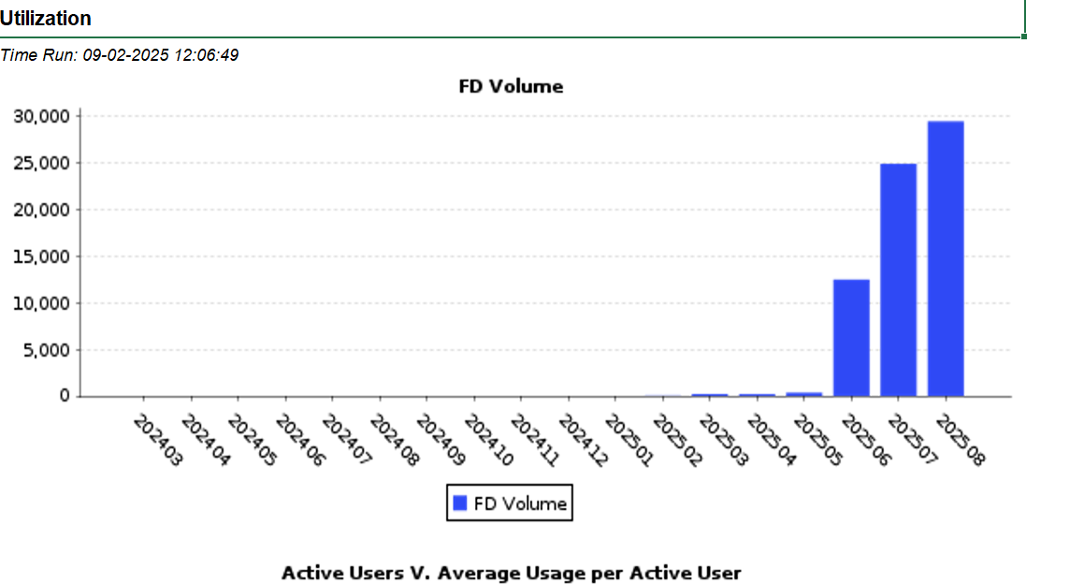








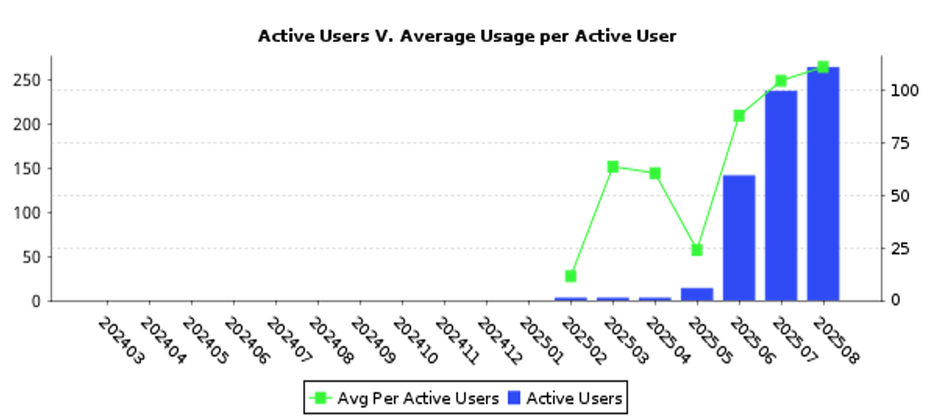
Meditech NHS Partnership
We’re proud to support a growing network of NHS hospitals using Meditech.
Adoption Rate:
Together, we’re driving digital transformation and improving patient care with Meditech.
Notes:
We are a proud partner of Meditech where we are Working closely with meditech to drive driving transformation and improving patient care.

Slide 19
Solventum Revenue and Data

Slide 20
Introducing connected, cumulative value from capture to code
Capture
Code
Clinician documentation
Clinical Documentation Integrity
Medical Coding
Payment Integrity
Ambient
Speech
CAPD
CDI
Coding
Payment Integrity
Quality
Conversational and generative AI accelerate documentation to transform the experience of care
Multiple speech modalities give clinicians flexibility
AI-driven CAPD reasons across the record and addresses documentation gaps in real-time and creates a feedback loop of insights
Intelligent CDI consumes documentation to prioritize CDI review for quality and financial impact
Expert-guided coding technology consumes final documentation to automate high confidence cases and expedite the coding of complex cases
Predictive analytics identify coding reimbursement gaps and mitigates within existing workflows
Infused quality content facilitates documentation capture to accurately represent acuity and quality outcomes
Notes:
By deploying these technologies up stream to drive accurate data capture this supports a more efficient and accurate second half of the slide.
ENTER
3M now Solventum invented coding and grouping 30 years ago. Today over 89% of NHS Trusts use Solventum’s coding products, which codes clinical data to provide accurate HRG’s .
HRG’s help NHS Trusts understand their activity in terms of the types of patients they care for and the treatments they undertake. This then supports benchmarking, planning and commissioning and provision of services.

Slide 21
A path to incremental innovation and automation
AI ‘Real time’ CDI
Time Management: Pinpoint spells with the greatest potential for coding or quality improvements
Enhance documentation quality real-time: ensuring accuracy and completeness to support better patient outcomes and compliance
CDI consultancy
Empowering teams to improve care, reduce costs and drive clinical documentation improvement to accurate reimbursement
Semi-Autonomous coding
Focus on coding of complex cases
Focus on accuracy, compliance and improvement of case mix
Autonomous Coding
National shortage of coders
NLU automates routine high-volume cases, freeing up staff time to focus on data quality, validation and documentation
Clinical coding with intelligent nudging
Maximise data quality and reimbursement accuracy. Coder prompts to reduce incidence of errors ensuring data is Right First Time
Audit
Real time or retrospective
Catch coding errors
Recommends corrections and missed coding opportunity based on documentation
Notes:
Strong coding pedigree
National shortages of coders impacting quality and reimbursement – CAC completes the simple spells allowing the remaining coders to focus on the complex spells
Consultancy services – We are currently working with a number of leading hospitals on Clinical Documentation improvement assessments. Coders cannot code what is not documented which is having a major impact on quality and reimbursement
If we can get all of this right it then leads to good data fully understanding the patient population and burden of illness to support redesigning of services for modern healthcare needs

Slide 22


The need for action!
Breakdown between the two
Two separate languages
Physician documentation is received in clinical terms
Documentation for coding, profiling & compliance requires specificity in diagnosis terms
Improving documentation is the foundation !!!!
Notes:
22
In the U.S we have a CDI team was invented back in the 80’s, Whilst physicians document specialties, they don’t have necessarily document the info that coders need to accurately code or have clear diagnosis terms. This breakdown between clinical language and coding language is why we have gaps in clinical reimbursement and coding opportunities. In the US there is a CDI team ( Intermediary between Clinician and Coder) who look at the record that look for gaps in the documentation that get queried back to the clinician to improve it so by the time it goes to coding to code all of the important information is in there.
Clinicians don’t care about the coding. But they do care about mortality and how they look as an individual clinical. We also focus on benchmarking look at specialties and no-one wants to let the department down by active reimbursement.

Slide 23


Advancing Coding and Clinical Documentation Transformation (ACT)
Combining People, Process and Technologies to Achieve Better Outcomes
Advanced Coding and Clinical Documentation Transformation brings a comprehensive improvement approach with consulting, technology, education, optimizing workflow and data analytics reporting in one program
Multi-phase approach to identify, implement and sustain changes to meet your goals and demonstrate the impact that Coding, CDI, and improving quality programs can have
Optimize and achieve a strong return on your technology and services investment
Real Results.
Improved Outcomes.
Partner to make sustainable improvement in case mix index (CMI), revenue, workflow, process, productivity and quality.
People
ACT
Inpatient
Process
Quality
Technology
Notes:
ACT- Advanced Coding and Clinical documentation transformation is about People Clinicans, CDI Coders change processes and how we can use technology to query and used technology nudge clicians to improve that quality of documentation.
Carry out a data analysis and coding review. We pull our nursing teams and clinicans to see where the gaps are. This leads into a portfolio of projects:
Physician education and building out a CDI team or provide an outsourced service :
Firstly we do a historical matching sample of Day cases Elective and non elective: Look at last 12 months of cases and take a sample of these say 150 and use a percentage to extrapolate this to work out what your total burden of documentation quality is and identify what you haven’t hit in revenue recognition. So the audit

Slide 24




What Does A Typical ACT Program Look Like?
Solventum’s Advanced Clinical Documentation Services provides sustainable increases in ROI that is typically cash flow positive within months of implementation (with software).
Follow Up Visits/Audits with education on findings
Educational Retrains each year
Physician Education
Dedicated advisors for data analysis and coaching
Revenue and Performance Metric Reports
Revenue and Performance Metric tracking
Onsite follow-up visits with Audits and Continued Education on Audit findings
Trusted advisors to provide data analysis and coaching
Education for CDI and Coding on high impact and focus areas
Clinical hands-on training for CDI
Physician education by specialty department
Installation of Technology Solutions
MHA
DQA
Medicode 360
Data Analysis & Daycase, Elective and Non-Elective Record Review
Design CDI Program
Staffing Analysis for CDI Program
Develop custom plan for Implementation
Refine Revenue Opportunities
Phase I – Assessment
Phases II - Implementation
Phase III – Evaluation and Performance Data Monitoring
Ongoing Support
(Years 2-5)
Notes:
We run the MHA data we carry out a DQA Data analysis and record review- We pull in our nursing team and clinicans to review the documentation to see where the gaps are from this we can show you the opportunity that you are leaving on the table.

Slide 25
Potential HRG opportunities
Summary from facility chart review- example results
Opportunity | HRG Changes | Spell HRG change rate
Day case | 13 | 8.6%
Non-elective Cases | 49 | 32.6%
Elective cases | 28 | 18.6%

Slide 26
Potential total opportunities by domain type
Summary – Example Results
 | Financial opportunity at 100% realization | Financial opportunity at 50% realization
Day cases | £6,225,313 | £3,112,656
 | Financial opportunity at 100% realization | Financial opportunity at 65% realization
Non-elective cases | £26,650,120 | £13,325,060
Elective cases | £7,824,420 | £3,912,210
Total | £40,699,853 | £20,349,926

Slide 27
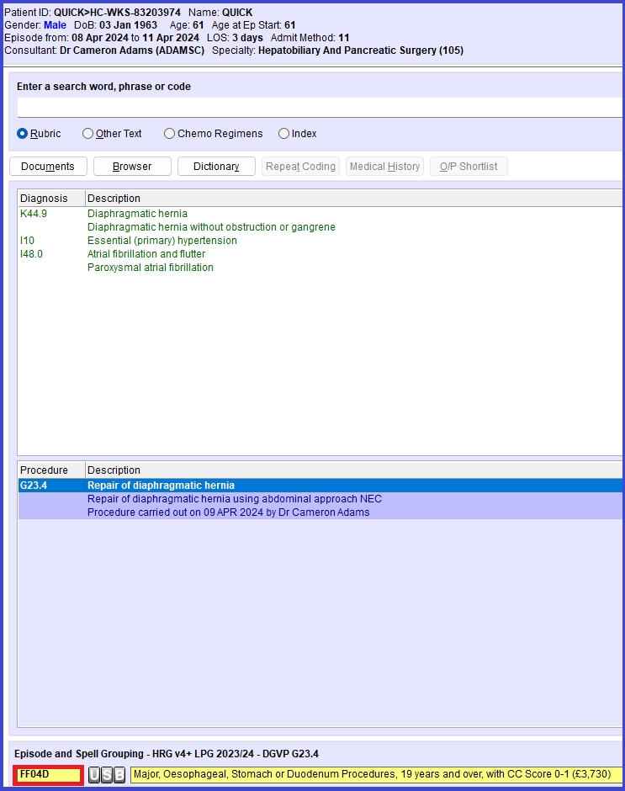
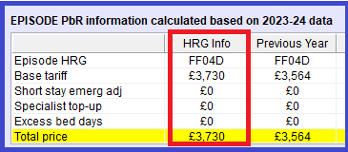
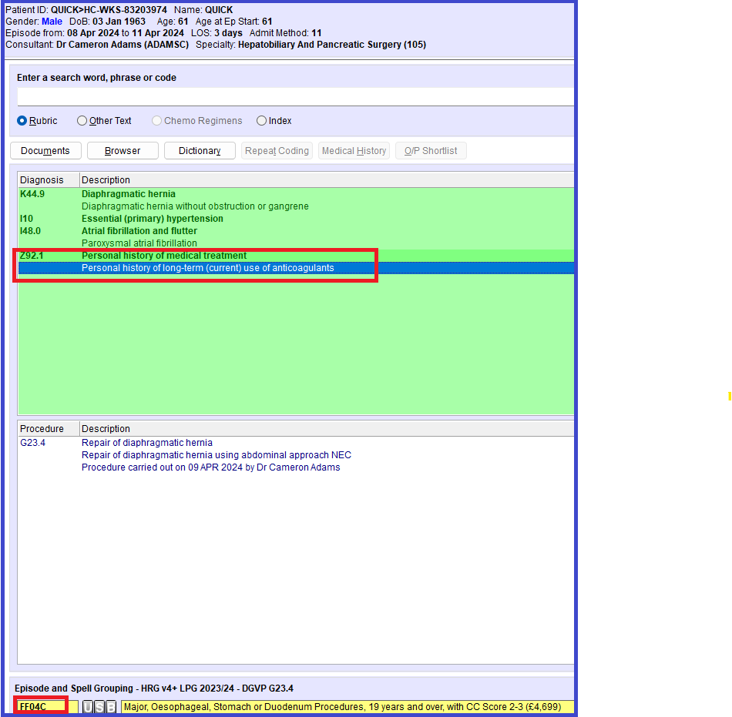
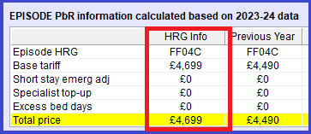
Clinical Coding and Data Analytics
If the use of anticoagulants (to treat the AF) is documented the coding prompt results in Tariff Uplift of
£969
Notes:
Solventum’s optional advanced analytic technology can validate the assigned clinical coding and resultant HRG and alert your coders of potential errors as they occur at the time of coding.
It can also ensure accurate recording of casemix by identifying relevant medical history and prompt the coder to further review patient records based upon the data previously recorded for that patient. This unique method of data capture reduces the incidence of data omission and inaccurate HRG thereby ensuring accurate reimbursement.
For example you can see here the prompt for pre-existing use of anticoagulants to treat AF is documented the coding prompt changes the results in uplift of tariff value of £969. If you than extrapolate this across all patient encounters you can understand how one Trust saw a tariff uplift of £1.5M on average per month.

Slide 28
Autonomous coding: Foundation for success
Layering capabilities for optimal performance
Additional tools
Chart confidence service
Optimal performance
Autonomous multi-dimensional approach
Payer specific rules
QA controls
Facility specific rules
Automation at the code level
New codes or low volume records
Coding guideline validation
Computer-assisted coding
Deep learning AI modeling
CDI integration
Actionable analytics
Notes:
Solventum’s autonomous coding isn’t a “black box” approach.
It is a multi-layered approach to ensure optimal automation paired while ensuring accuracy.
Deep learning AI models by themselves may provide certain accuracy but adding the other factors on top increasingly improves accuracy and this is our differentiator. Solventum adds in additional toolsets and features to provide a complete and stable foundation for success.

Slide 29








Comprehensive, total solution
Fully integrated 3M 360 Encompass approach
Autonomous
Solventum™ Catalyst processing
All OP visits
All professional documents
QA workflow
EMR
Semi-autonomous
Solventum 360 Encompass
document interface
Final coded ready – billing process
Updated documents
Customer controls
Solventum™ Enterprise
Workflow or on-premises worklists*
*Solventum Enterprise Workflow is available for outpatient facility coding. On-premises worklists are available for professional services coding.
Notes:
High level diagram of how it works.
Differentiators
Autonomous coding fits in with end-to-end Solventum products
Qualifying automation opportunities across OP
Integrated expert coding workflow with QA and explainers
Purposeful autonomous and semi-autonomous workflows across outpatient and professional services coding

Slide 30
The complete solution Content-driven, technology-enabled insights from capture to code
Capture
Code
Payment Integrity
Quality
Coding
CAPD
CDI
Ambient
Speech
Infused quality content facilitates documentation capture to accurately represent acuity and quality outcomes
Expert-guided coding technology consumes final documentation to automate high confidence cases and expedite the coding of complex cases
Predictive analytics identify denials risk and mitigates within existing workflows
Value
Intelligent CDI consumes documentation to prioritize CDI review for quality and financial impact
Conversational and generative AI accelerate documentation to transform the experience of care
AI-driven CAPD reasons across the record and addresses documentation gaps in real-time and creates a feedback loop of insights
Multiple speech modalities give clinicians flexibility
Physician Documentation
Clinical Documentation Integrity
Medical Coding
Revenue Integrity
Create time to care and improve outcomes
Receive full reimbursement and eliminate revenue cycle waste
Leverage smart automation and efficient workflows
Achieve accurate quality ratings and build a reliable healthcare data set
Notes:
And that’s why this solution, with bilateral communication and a holistic view of clinical care and revenue integrity as one cohesive workflow, is so effective.
Ambient and speech solutions transform care experiences Computer-assisted physician documentation addresses documentation gaps in real time Smart CDI solutions prioritize workflows for quality and financial impact Coding tools automate and expedite even complex cases Predictive tools identify and mitigate denial risks And quality content underpins the entire workflow to ensure better, smarter, safer healthcare for systems like yours.
Thinking back to our health system focus areas – we can layer on some of those priorities to the solutions our portfolio provides. From creating time to care and improving patient outcomes, to better revenue capture, to smarter, more efficient workflows, to achieving accurate quality ratings that speak to the value your system provides its patients and communities.

Slide 31
Notes:
Thank you.

Slide 32
A path to incremental innovation and automation
Ambient clinical documentation
Make clinical documentation a by-product of the patient-physician encounter
Conversational virtual assistant
Automate everyday tasks and conversationally place orders
AI-powered proactive CAPD
Nudge clinicians within EHR workflow to close gaps in real time
Real time speech understanding
Speech enable the EHR for faster, better note creation
Notes:
Lets break this workflow down into segments focussing on speech first

