Slide 1



Implementing Meditech Expanse
– The Continuation

Slide 2





Ireland’s largest private hospital group
4000+ Employees
500+ Consultants
400,000+ Patients Annually
5 Hospitals
1 Care Village

Slide 3




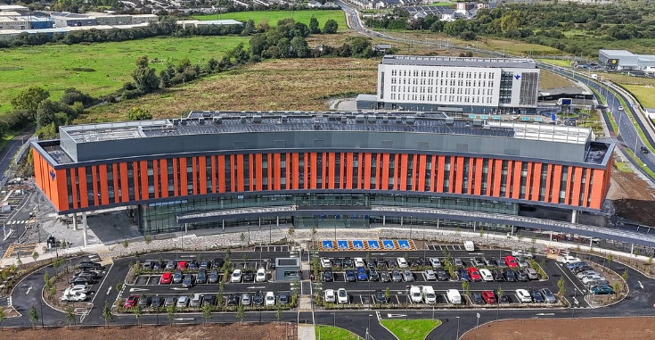


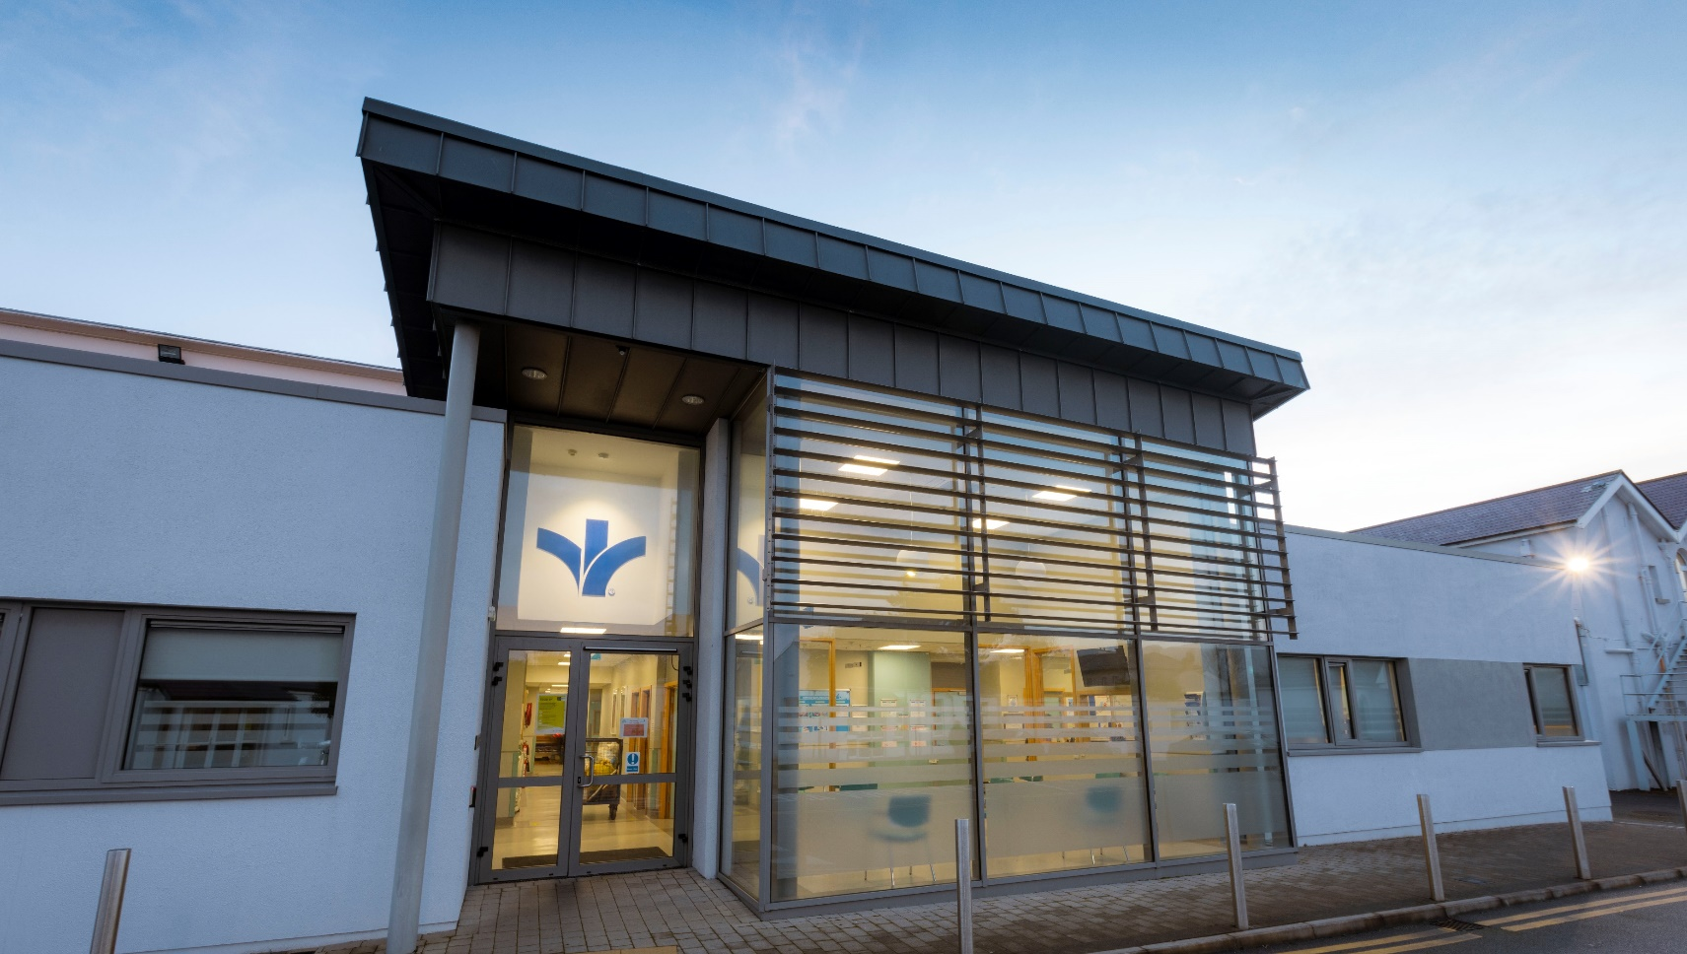
Hospital Network
GALWAY
DUBLIN
LIMERICK
CORK
TRALEE

Slide 4
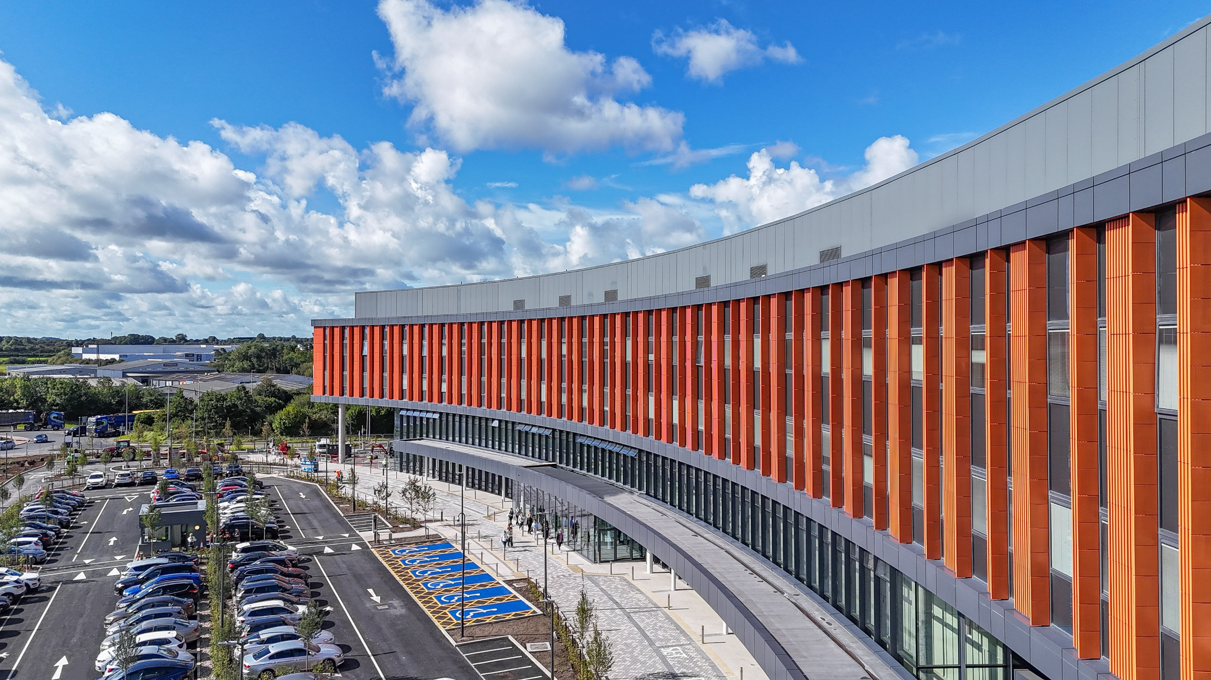
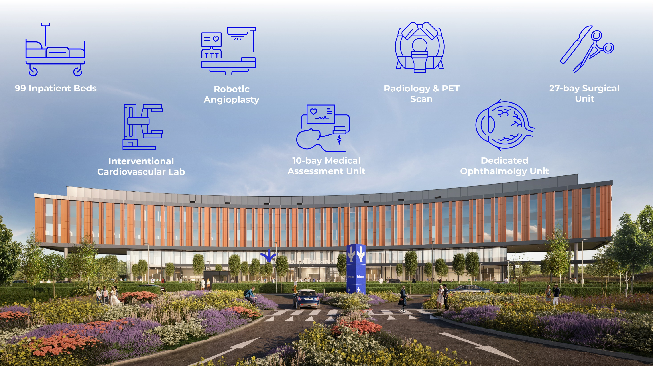

New Limerick Hospital – Now Open
Notes:
Some of the key services of the new hospital include
99 inpatient rooms
A cath lab
Medcial Assessment unit
And dedicated ophthalmology unit

Slide 5

GOVERNANCE
Executive
Governance
Board Finance Committee
The Programme Board provides strategic oversight of the programme and approves any changes including timelines, budget, or scope. Membership includes the Group CEO, CFO, CRO, Chief Nursing, Quality & Patient Safety Officer, and BSHL’s Chief Clinical Information Officer.
Board Finance Committee
BonsConnect Programme Board
BonsConnect Programme Board
BonsConnect Steering Committee
The Steering Committee provides operational oversight of the delivery of the programme, overseeing resourcing, contracting, project status reporting, and other matters of programme execution. Membership includes the CIO, CCO, Hospital CEOs, Finance, Stream Leads, Compliance, the Programme Directors together with Vice President Information & Technology, Bon Secours Mercy Health.
BonsConnect Steering Committee
Project
Management Office
Margaret McHugh
Programme Executive Sponsor
Cliona Byrne
Programme Director
Alison MacDonald
Nordic Consulting Lead
PMO Team
Stream Leads (Revenue, Technical, Clinical & Pathology)
Project Managers (Revenue & Clinical)
Clinical Transformation Lead
Communications Manager
Training Lead
BON SECOURS MERCY HEALTH
Director of Internal Audit
Project Management Team
Weekly meetings between Meditech and BonsConnect Project Management Teams
Stream
Leads
Revenue Cycle
David Scannell & Derek Kirwan
Technical
Darragh McNally
Clinical
Dr Hannah Ryan
Clinical Steering Committee
Clinical Standards, Interprofessional Assessment, Documentation, Workflows; Order Sets and P. Doc
Stream
Project Managers
David Hingston
Janine Higgins
Geoffrey Cordner
Working
Groups
Revenue Cycle
Systems Integration
Data Migration
Infrastructure
Reporting and Business Intelligence
Security / Compliance & Data Protection
Radiology
Inpatient Medicine
Medical Records (HIM)
Nursing & HSCP
Oncology
Pathology
Patient Access
Pharmacy
Theatre
Outpatient and Diagnostics
Programme specialists and analysts

Slide 6




Taking Stock
Notes:
When I spoke last year we were planning for a Go live in June of this year and this did not come to pass.
Early this year we found we were not were we hoped nor expected to be and it became clear we need to pause and take stock

Slide 7
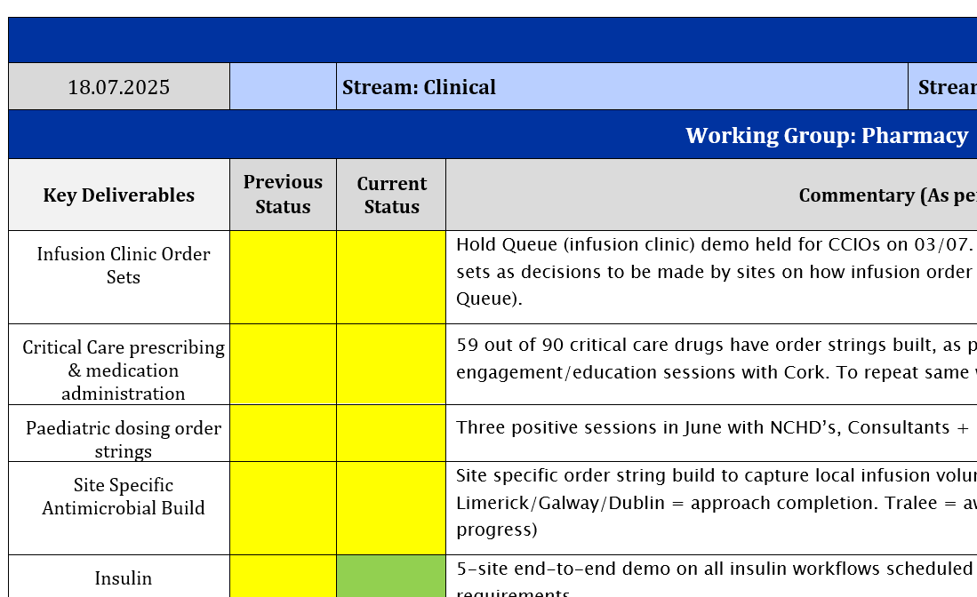
Programme Team Taking Stock
Scope Review
Each Working Group undertook a Deliverables Review individually
Deliverables Review as a Team
Critical Path Review
Timeline Review

Slide 8
Programme Team Taking Stock
Challenges
Volume of Build Remaining
Groups working in silos
Decisions and Standardisation taking longer than anticipated
User Acceptance Testing
Running events in parallel; Future State / UAT / Prep for Training
Strengths
Teams Knowledge of the System
Positive Engagement
Level of build completed for some groups
Commitment to the Programme

Slide 9
Organisational Change Management

Slide 10
Actions to Improve Organisational Readiness
Stakeholders required understanding of the deliverables
Involvement of Management Teams from Sites in deliverables
Working Group Leads report into Stakeholders
Increase Membership of the Steering Committee
Site Readiness Focus Increased
Testing Feasibility of the Proposed Timelines

Slide 11
Main Factors Resulting for Taking Stock
Build Freeze Date Agreed
Critical Path Consolidation
Reviewed Timeline Accepted
Site Order Reviewed and Accepted
Additional Resources Secured – Internal and External
Programme Team Contract Lengths Extended
User Acceptance Testing Event for 5 Hospitals Agreed
Regular in-depth reviews with all Stakeholders

Slide 12
TIMELINE
Progress to date
Project Phase
Preplanning
Standardisation
Build & Test
Train & Go Live
Stabilise & Optimise
2025
May | June | July | Aug | Sept | Oct | Nov | Dec | Jan | Feb | Mar | April | May | June | July | Aug | Sept | Oct | Nov | Dec | Jan | Feb | Mar | April | May | June | July | Aug | Sept
Year
2023
2023
2024
2024
2024
2025
Phase
Gates
1
2
3
4
5
6
7
Phase
Objective
Programme
Alignment
Standardise Clinical and
Business Content
Configure & Test System
Training
Post Go-Live Support
Work Plan
Charter
Team
Governance Model
Kick-off
Contract Vendor
Recruitment & Resources
Establish working groups
Guiding Principles
Standards and templates
Begin Workflow and Process Re-design
Launch Change Management Programme
Train working groups
System configuration
Conversion & Interface
Testing
Change Management
E-learning
Classroom Training
Verify Production Readiness
System In Production
Go-Live
Above base staffing
Personalisation
Service to Support Handover
Go-Live Support
Issue Resolution
Lessons Learned
Transition to Operational Model
Deliverable
Highlights
Phase
Gate
Detail
1
Programme Approval
3
Guiding Principles
5
Prototyping 3
7
Go Live 1 & 2
2
4
Project Team Training Commences
6
Readiness Assessment
(180 days)
Kick off

Slide 13
TIMELINE
Where we are
Project Phase
Standardisation
Build & Test
Training
Go Live
Jan | Feb | Mar | April
Oct | Nov | Dec | Jan | Feb | Mar | April | May | June | July | Aug | Sept | Oct | Nov | Dec
2025
2024
2025
Year
1
2
3
Gates
3
4
5
Phase
Objective
Standardise Clinical and
Business Content
Configure & Test System
Training
Go-Live
System Build
Conversion Testing
Interface Testing
Unit Testing
User Acceptance Testing
Targert Testing
Revenue I Testing
Copy to Live
E-learning
Classroom Training
Video Content
Cribsheets
Training Cirrculum
Super User Training
End User Training
Site Readiness
Cut Over Planning
Activation Planning
Go-Live Planning
Migration
Cut Over
Go Live
Workflow Standardisation
What Remains on Paper
Policies and Procedures
Organisational Readiness
Deliverable
Highlights
Critical Path
1
2
3
Test to Live Copy
Build Freeze
User Acceptance Testing
Go Live 1
Gate 3 - Light Up of System Interfaces & Full Data Conversion Migration
Gate 4 - Governance for post go live arrangements
Gate 5 - Pre Go Live – Data Protection and Security tests.
Gates
3
4
5

Slide 14
User Acceptance Testing

Slide 15
User Acceptance Testing
UAT for all 5 hospitals – 2 weeks onsite in Tralee
Week #1
UAT Phase: Week 1 – Core UAT Surgical/Medicine/Critical Care Scenarios
Date Range: 8th - 12th September
Sites Tested: Tralee & Limerick
Workflows Tested: Pre-assessment, Medical Assessment Unit, Medical Inpatient, Surgical Inpatient, Critical Care, Medical Day Unit, Surgical Day Unit
In Scope: Registration, Admissions, Scheduling, Nursing, NCHD, Lab, Pharmacy, Physiotherapy, Orders, Revenue Cycle, Medical Records & Transfusion Administration Record (TAR)

Slide 16
User Acceptance Testing
UAT for all 5 hospitals – 2 weeks onsite in Tralee
Week #2
UAT Phase: Week 2 – Endoscopy, Cath lab and Outpatient Clinics
Date Range: 15th - 19th September
Sites Tested: Tralee & Limerick
Workflows Tested: Endoscopy, Radiology, Minor Ops, CNS Led Clinics, Cath lab, Physiotherapy, Deictics, Cardiology, Occupational Therapy, Respiratory Clinics
In Scope: Registration, Admissions, Scheduling, Nursing, NCHD, Lab, Physiotherapy,
Radiology, Occupational Therapy, Cardiology, Respiratory, Revenue Cycle,
Medical Records, CVIS & EndoRaad

Slide 17
Questions ?

