Slide 1

Advancing Clinical Decision Support & Precision Medicine
FDB Health putting the patient at the heart of clinical decision support
Amy Smith
Secondary Care Market Manager
amy.smith@fdbhealth.com

Slide 2
What is Precision Clinical Decision Support?
Medications
Patient
Genomics
Clinician
Precision CDS
Labs
Care Setting
History

Slide 3
What does it mean?
1
The Right Information
2
To the Right Person
3
In the Right Format
4
Via the Right Channel
5
At the Right Time
Inclusive
Intelligent
Interpretable
Integrated
Impactful
Interoperable

Slide 4
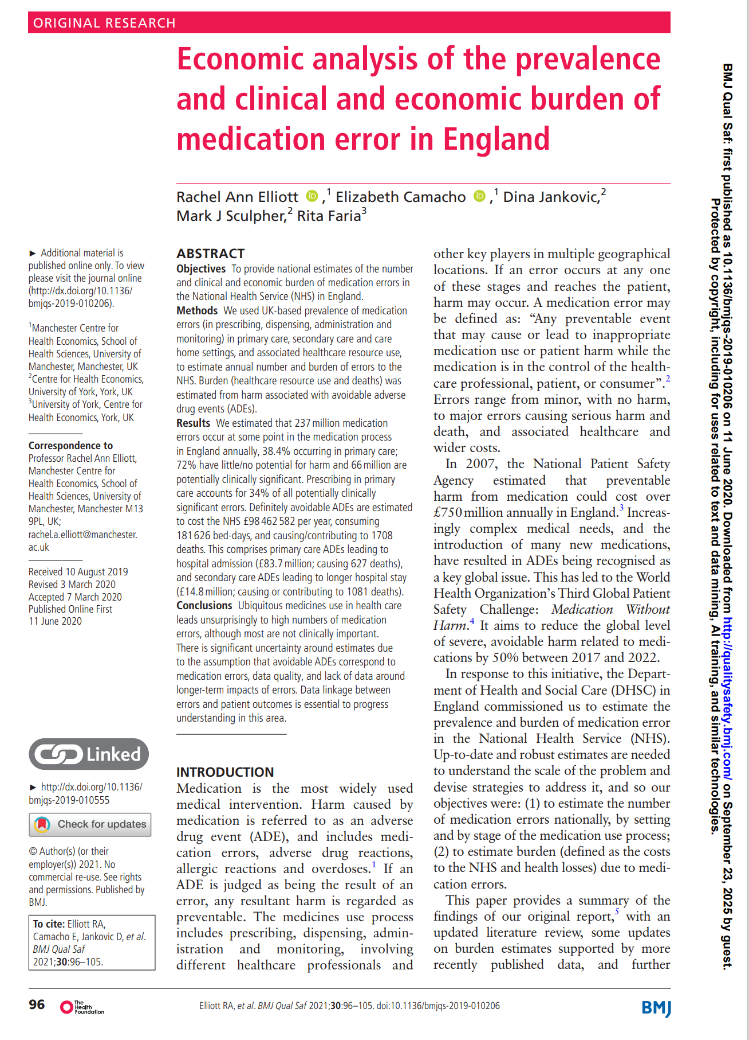
Why does it matter?
Estimates on volume of Medicine Safety Errors
~ 237 million medication errors annually across all care settings
~ 66 million of those errors are potentially clinically significant
~ 1,708 deaths per year in England from avoidable adverse drug events
~ 181,626 bed-days per year
*Elliott RA, Camacho E, Jankovic D, et al; Economic analysis of the prevalence and clinical and economic burden of medication error in England; BMJ Quality & Safety 2021;30:96-105

Slide 5
Leveraging the assets of technology
We have at our fingertips today better…
Cloud Computing
Networks & Interoperability
Artificial Intelligence
Data
than ever before……

Slide 6

AI Agents in Clinical Decision Support

Slide 7

Consultations
Ambient listening allows clinicians to engage more with their patients
Ambient listening technology helps record valuable patient information in real-time.
When finished, it leaves a summary or transcript of the encounter.
FDB is creating an impressive new feature in this area to highlight medicines intelligence derived from this emerging technology.
​

Slide 8
Agentic CDS for Ambient Listening
80%
80%
45%
50%
45%
50%
Clinicians overwhelmed by the volume of information in patient encounters
Patient consultations where recommended care in line with clinical guidelines was not provided
Recommended preventative services are not delivered during patient visits
Ambient Voice consultations enable FDB’s CDS to interact with Clinicians earlier in the workflow and guide towards better patient care.

Slide 9







The Workflow
Developing an AI CDS agent for ambient listening environments
Free Text Input
Map to dm+d & Snomed
Context-Aware Output
Structured Data Conversion
Agent Processing

Slide 10
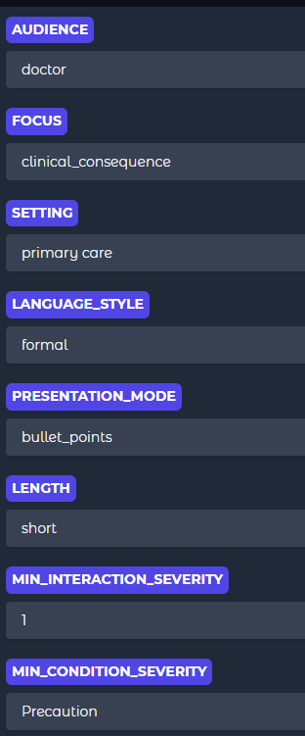
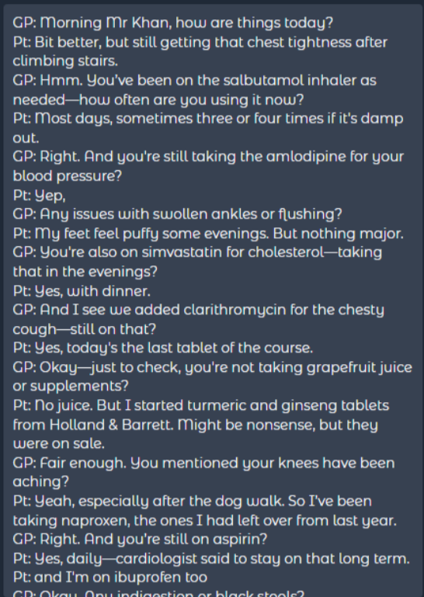


Ambient Listening CDS Agent
Setup environmental parameters and establish narrative feed
Set system parameters
Review transcript from ambient listening encounter

Slide 11

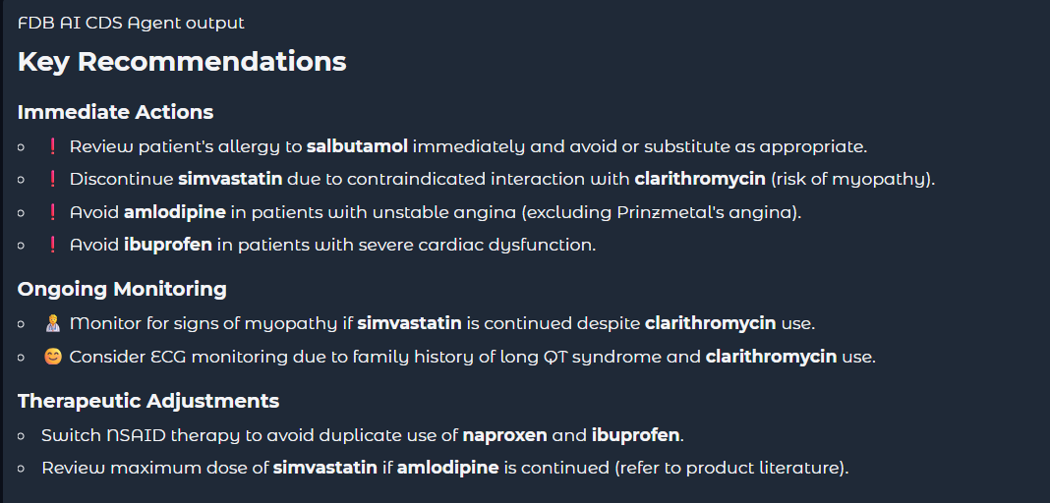
Ambient Listening CDS Agent
System automatically creates output
Run Medicines Intelligence
Grounded Actionable Clinical Recommendations
Tuned by LLM to target audience language style and other parameters like clinical consequence
Actionable output for user, communications/documentation and/or EHR updates

Slide 12
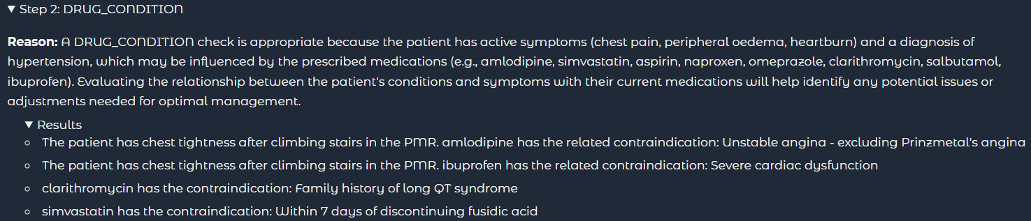
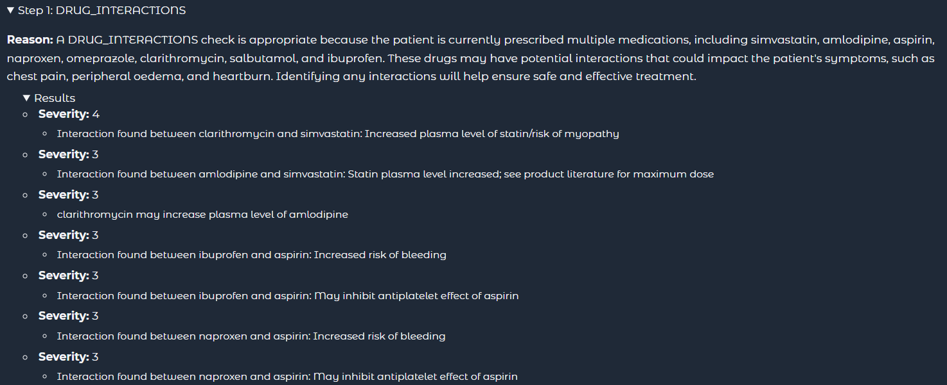
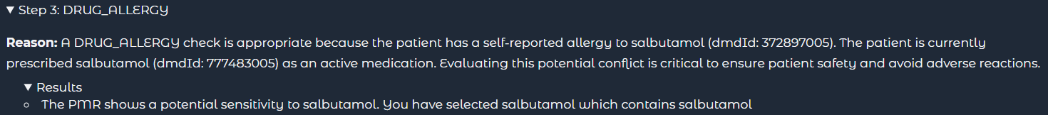
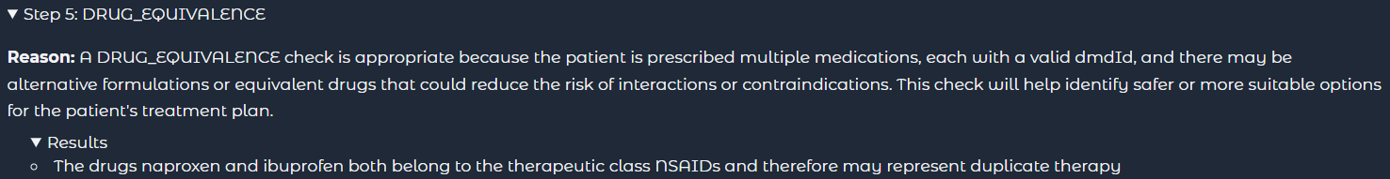
Ambient Listening CDS Agent
Logic is captured throughout, therefore output is explainable

Slide 13
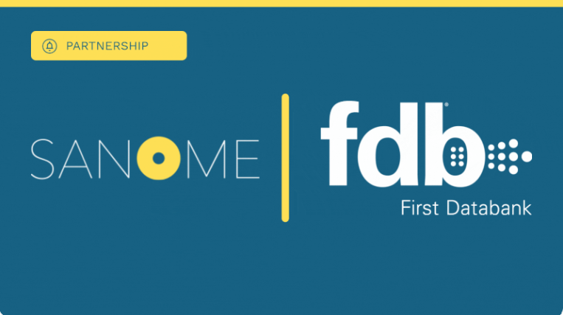
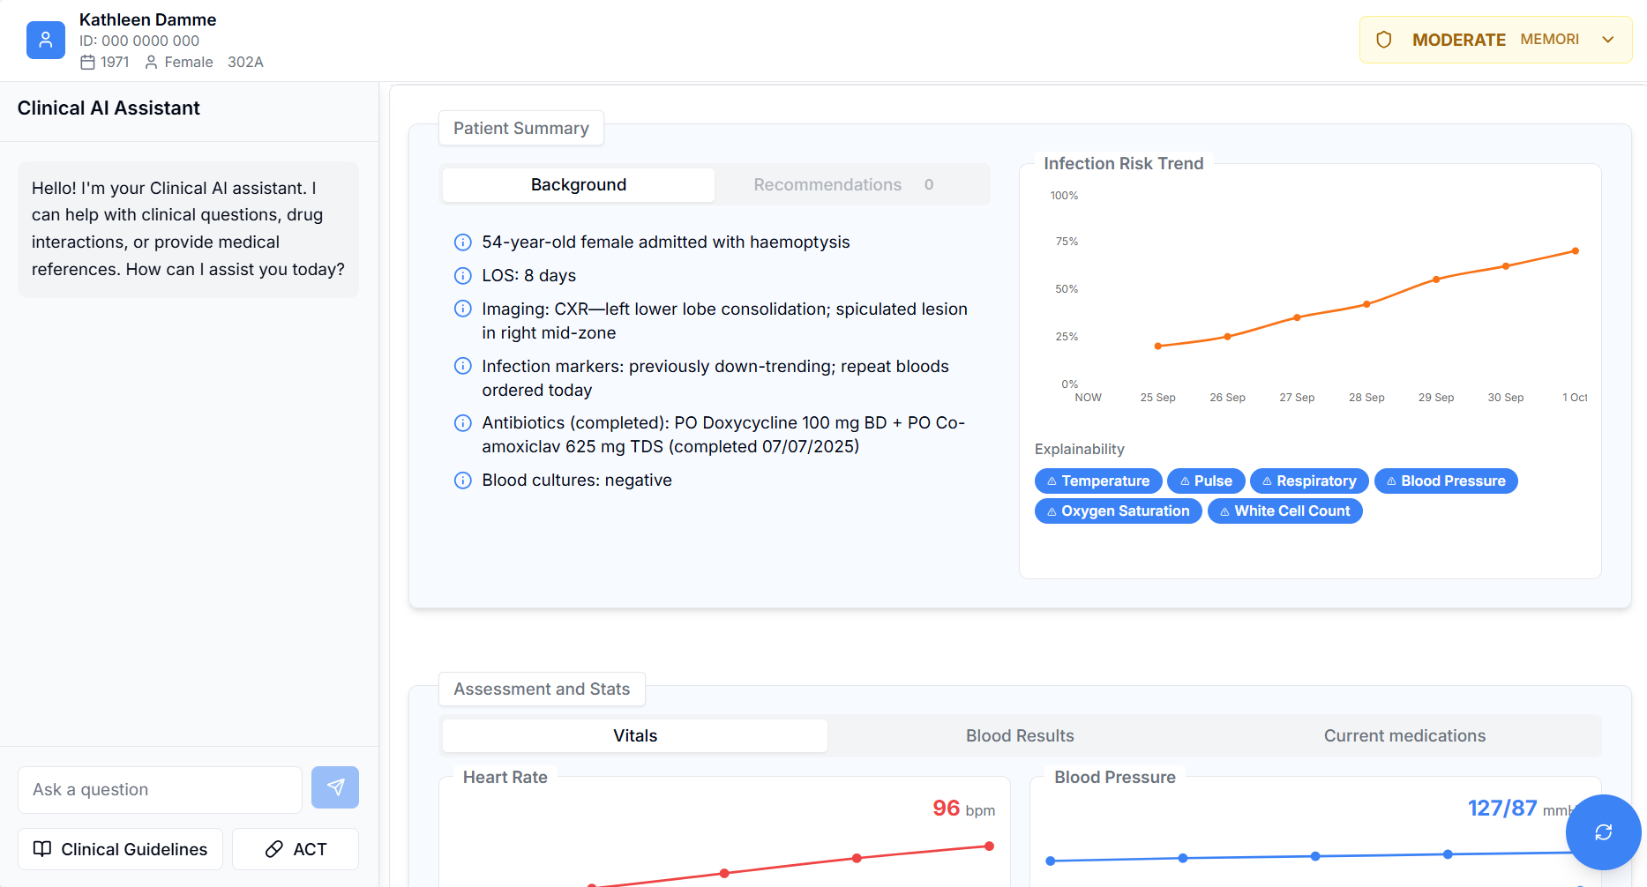
Clinical Co-Pilots
🟡 Faster decisions: patient summaries cut time to decision from 20 mins to 5 mins.
🟡 Safer care: earlier detection of risk (e.g. infection, sepsis) enables timely intervention.
🟡 Reduced cognitive load: one clear view of vitals, labs, meds, and notes in the EPR.
🟡 Confidence in use: clinically co-designed, regulatory-approved, and already live in hospitals.
🟡 More time with patients: automation of routine data gathering gives clinicians >10% productivity gain.

Slide 14
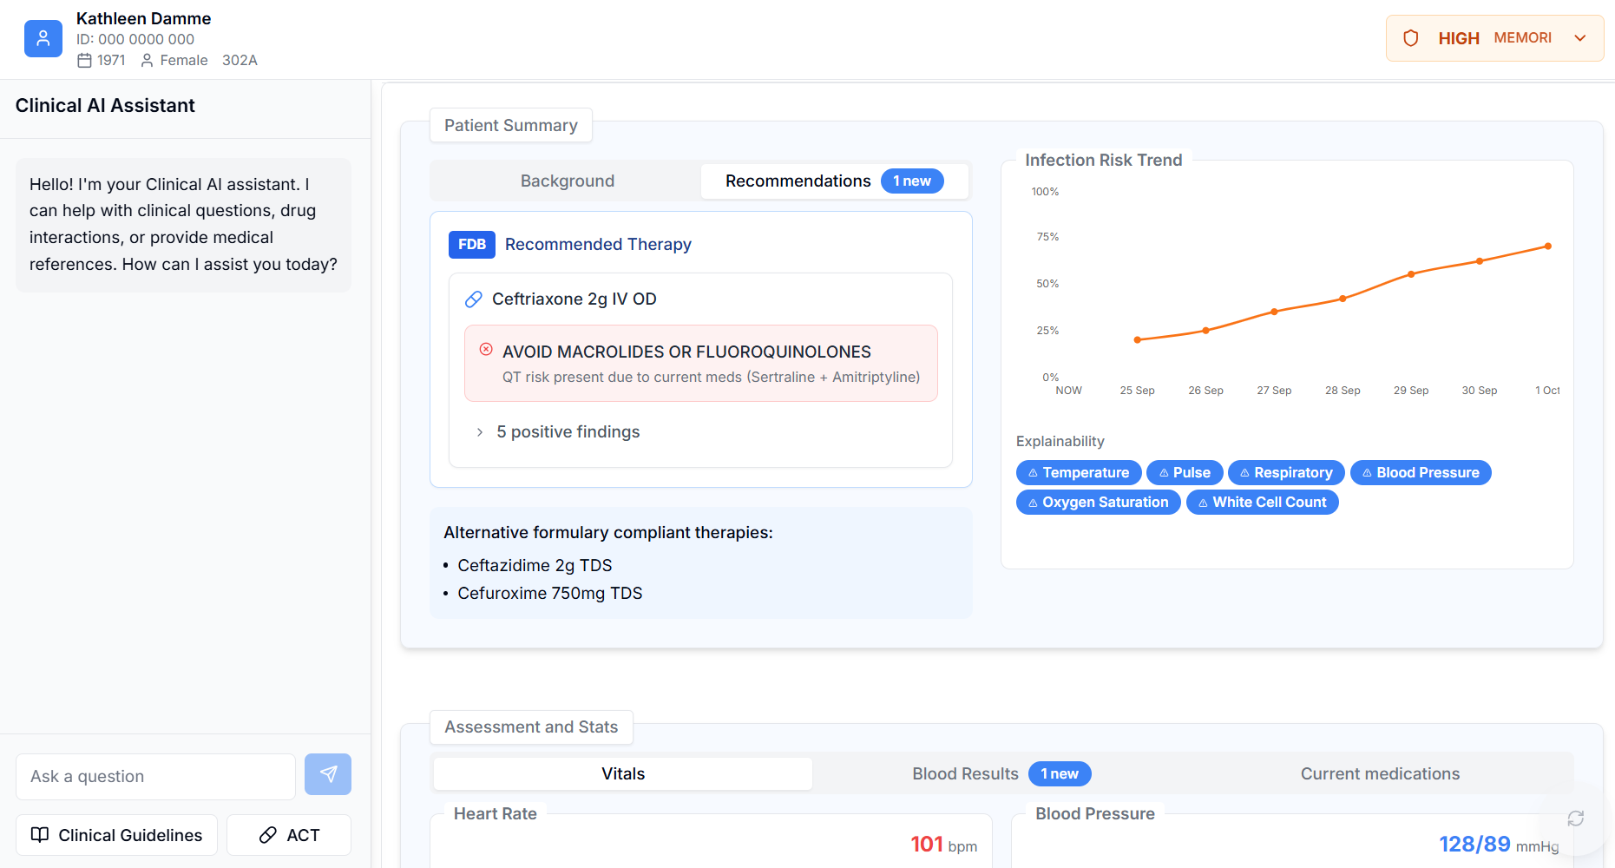
Co-design and innovate with us to unlock immediate impact on patient care
🟡 Validated prescribing: every recommendation is clinically safe, appropriate, and evidence-based.
🟡 Locally aligned care: treatment options tailored to local formulary and guideline approvals.
🟡 Specialty-focused reconciliation: medicines lists checked and refined for the current clinical setting.
🟡 Safer transitions: discharge letters enriched with accurate medicines reconciliation advice.
🟡 Risk anticipation: early alerts for emerging adverse drug reactions to prevent harm.
🟡 Instant support: real-time medicines Q&A at the point of care.

Slide 15
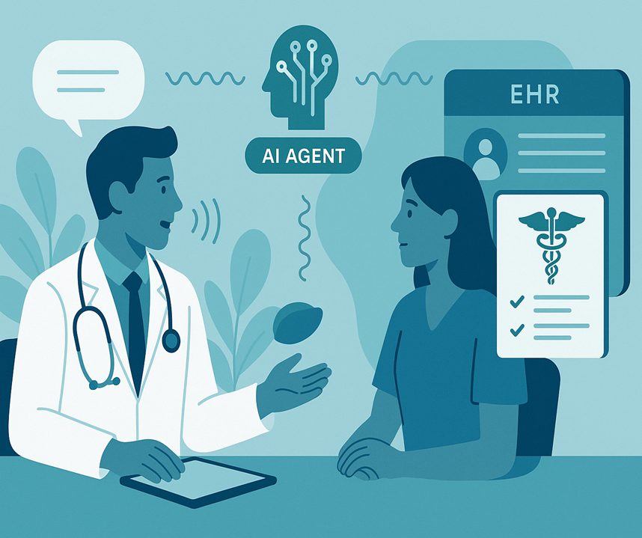
Benefits of Agentic CDS in Ambient Listening and Clinical Co-Pilots
Enhanced Clinical Efficiency
Reduced Cognitive Load
Context-Aware Recommendations
Holistic View of Clinical Guidance
Improved Accuracy and Safety
Continuous Learning and Improvement

Slide 16

Genetics Meets Medicines Intelligence
PGx & Agentic CDS
Personalised
Predictive
Preventative
Powerful

Slide 17
About FDB

Slide 18
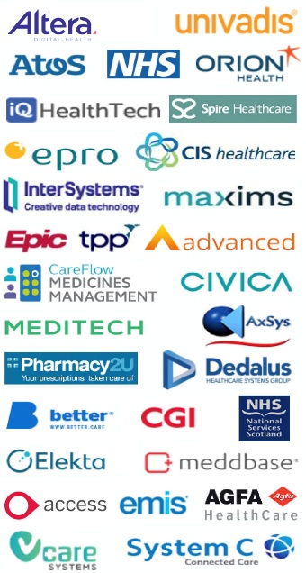











FDB Portfolio
Comprehensive drug database supporting prescribing, dispensing and administration
Comprehensive drug database in use across a broad range of countries
Real-time in workflow decision support for acute or repeat prescriptions
Proactive ongoing medicine optimisation at a patient & practice level
Strategic coordination platform for ICB medicines optimisation initiatives

Slide 19





Multiple Touchpoints Across Healthcare Ecosystems
+ Community Pharmacy
+ Self Care
+ Self Management
+ Prevention Behaviours
+ Carers
+ Care Homes
+ Walk in centre/A&E
+ OOH
+ Primary Care
+ Mental Health
+ Community Care
+ Virtual Wards
+ Hospital Inpatient Care
+ Mental Health Inpatient
+ Tertiary
+ Hospital Pharmacy
+ Outpatients
Triage,
111 or 999
Referral,
Triage,
Advice & Guidance
Cohorts
System / Cross Organisation - Integrated Neighbourhood Teams
Home Care
Primary Care
Out of Hospital Sector
Acute Care

Slide 20
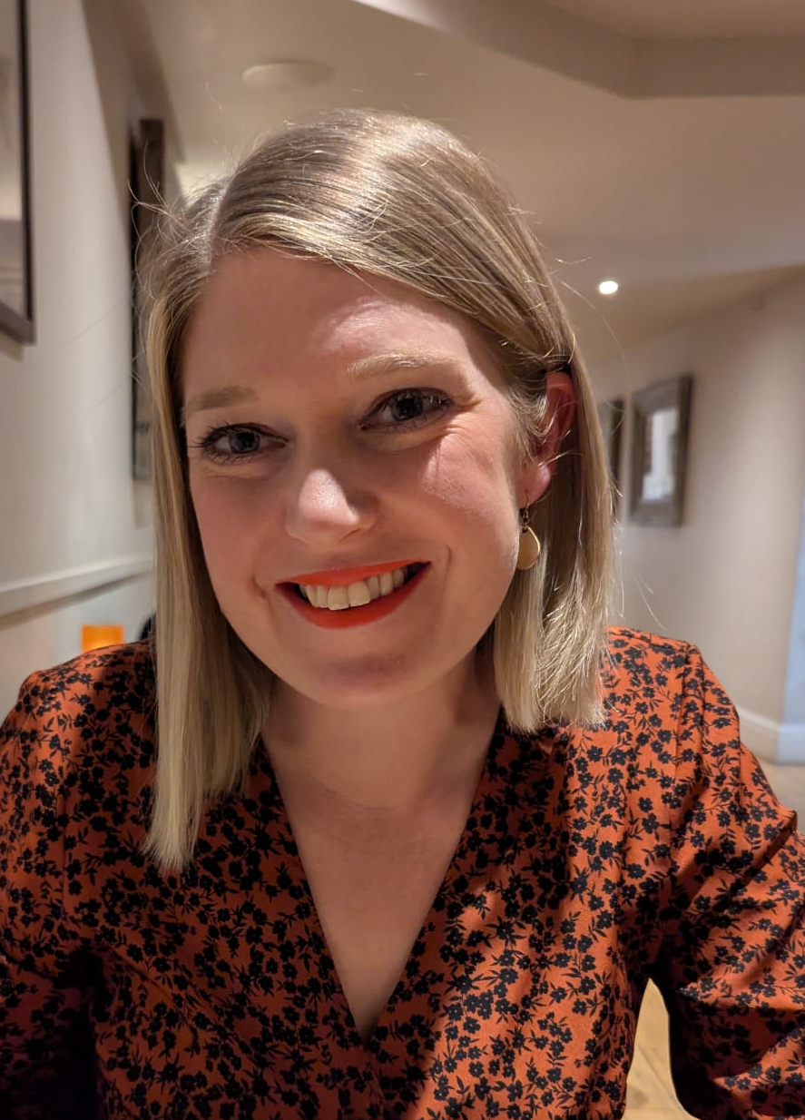
Amy Smith Secondary Care Market Manager amy.smith@fdbhealth.com
Notes:
LINKEDIN qr code

