Slide 1

Breaking Down Barriers
with External Data
Kristen Martino, MSHM, BSN
Product Manager, Physician Products & Home Care
kmartino@meditech.com
Notes:
Kristen Intro

Slide 2

Breaking Down Barriers with External Data
Session Overview
Barriers and Breakthroughs
Why Traverse Exchange?
Overview
Network Metrics
Key Areas of Impact
Notes:
Kristen

Slide 3
Turning Barriers…
Risk of Medical Errors
Redundant and Unnecessary Care
Delayed and Inefficient Care
Poor Care Coordination
Increased Administrative Burden and Provider Burnout
The Consequences of Fragmented Data

Slide 4
…into Breakthroughs
Improved Patient Safety and Reduced Medical Errors
Enhanced Care Coordination and Continuity
Greater Efficiency and Lower Costs
Empowered Patients
Advanced Clinical Decision Support
The Benefits of Complete Patient Data Access

Slide 5






Null Object - DO NOT DELETE
AN INTELLIGENT INFRASTRUCTURE
Data Collection & Normalization
Semantic Interoperability
Network-based exchange
FHIR-first, Beyond US Core
APIs
SMART app launches
Meaningful Exchange
Nationwide
FHIR-first
Beyond US Core
Industry Standard Data Structures
JSON
SQL
Cloud Based
Flexible, Scalable, Secure
Ease of Deployment:
Apps & Platform
AI-Enabled
Mobile Native
Smart Phones
Tablets
Forward Looking
Empower AI Models and Data Analytics
Notes:
SPEAKER NOTES
MEDITECH, as we built Expanse, invested heavily in our intelligent infrastructure
With Foundational concepts that focus on how data is being exchanged, utilizing the formats and schemas that drive health IT
With tools within the EHR that enable data to be codified and normalised
Ultimately understanding that the data that is being shared is the root of semantic interoperability
The Method in which we store data is scalable - utilizing the cloud for storage
And Cloud technology then empowers deployment of our solutions at scale while also supporting a mobile native approach to data sharing
Moreover the infrastructure allows for taking advantage of nationwide networks, and with our intelligent infrastructure, we can bring FHIR-first solutions to the table
Temporarily caching data instead of long-term data storage not only saves on space but it also allows us to deduplicate and normalize that data
And the investments that we’ve made and continue to make in this intelligent infrastructure is forward-looking, and optimized for empowering AI models and data analytics
** Have all except network fade out **

Slide 6
Null Object - DO NOT DELETE
AN INTELLIGENT INFRASTRUCTURE
Data Collection & Normalization
Semantic Interoperability
Network-based exchange
FHIR-first, Beyond US Core
APIs
SMART app launches
Meaningful Exchange
Nationwide
FHIR-first
Beyond US Core
Industry Standard Data Structures
JSON
SQL
Cloud Based
Flexible, Scalable, Secure
Ease of Deployment:
Apps & Platform
AI-Enabled
Mobile Native
Smart Phones
Tablets
Forward Looking
Empower AI Models and Data Analytics
Notes:
SPEAKER NOTES
Today we are going to be focusing on how this continued investment has powered meaningful exchange

Slide 7

Mission Statement
The mission of Traverse Exchange is to advance data access and usability by providing powerful, intuitive, intelligent tools that seamlessly integrate external healthcare data into the MEDITECH EHR, whether sourced from other MEDITECH organizations or other EHR vendors.

Slide 8

Epic Site(s)
PointClickCare
11 healthcare instances across
40+
hospitals
300+ long-term care sites operating the PointClickCare® EPR
Individual MEDITECH Organisations
Canada
Oracle HIE
Provincial Assets
Drug Data
Lab Database
Notes:
MEDITECH in it’s core has been an open and accessible EPR, interoperability is foundational to everything we do.
In Canada, we were the first to introduce a national interoperability platform…
Connecting MEDITECH acute EPRs to instances of Oracle, Epic, and long-term care sites using PointClickCare

Slide 9

CommonWell
Carequality
110+
HEALTH
SYSTEMS
LIVE
ACROSS
39
U.S. STATES & TERRITORIES
U.S States & Territories
Individual MEDITECH Organisations
eHealth Exchange
Qualified Health Information Networks aligned with TEFCA
Notes:
Given our successes in Canada, we brought that same solution to the states…

Slide 10
Private Hospitals
Regional HIEs
Public Trusts
Individual MEDITECH Organisations
National Platforms
Notes:
Given the successes we’ve had in Canada and the United States…

Slide 11

Empowering Clinicians:
Streamlined External Data with Traverse Exchange
| Hospital Course Narrative
Problem Statement
Solution
Benefits
Slow and manual processes
Data Quality Issues
Fragmented Data
Impeded decision making
Increased burden
Potential for suboptimal outcomes
Instant access to a unified view of external patient data with Traverse Exchange
A seamless, deduplicated, searchable, and filterable experience
Ensuring clinicians have the complete picture for optimal patient care.
Enhanced Efficiency and Time Savings
Improved Data Quality and Reliability
Comprehensive and Holistic Patient View
Reduced Administrative and Clinician Burden
Potential for Enhanced Patient Outcomes
Notes:
Empower informed decisions with instant access to a unified view of external patient data. Traverse Exchange and the consolidated patient summary provide a seamless, deduplicated, searchable, and filterable experience, ensuring clinicians have the complete picture for optimal patient care.

Slide 12

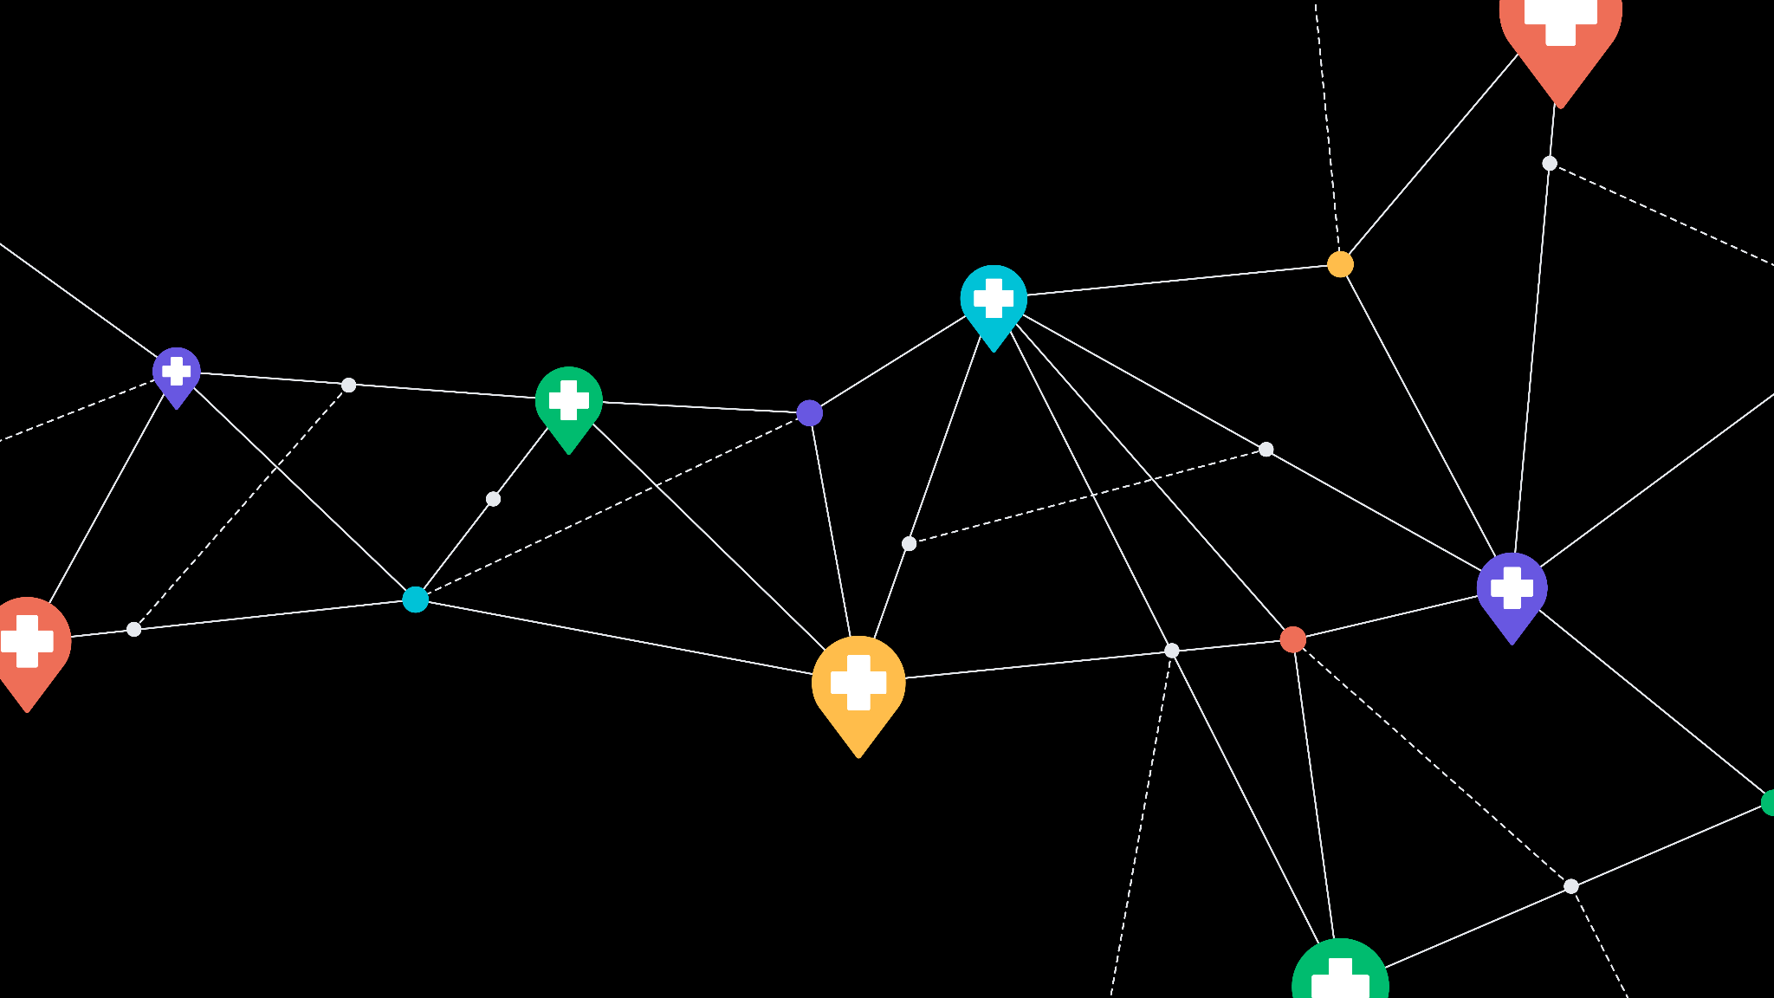

Charlotte’s Healthcare Journey
Mental Health
Oncology
General Practitioner
Obstetrics
Hospital
Notes:
Kristen

Slide 13


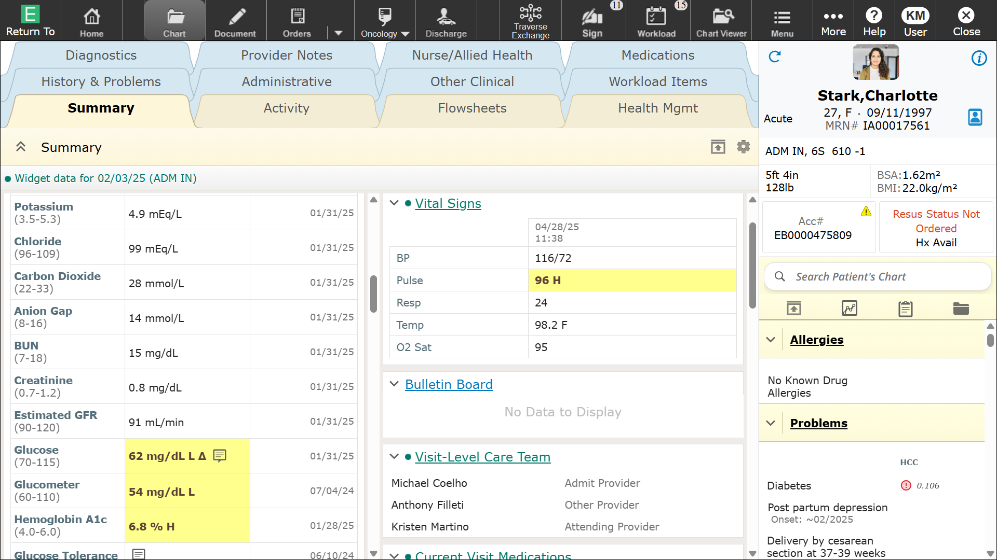
Connect. Exchange. Care.
Streamlined Workflow
Improve data usability with powerful, intuitive, intelligent new tools for accessing, viewing, and incorporating data from outside of your organization.
& within
Workflow
Notes:
Kristen
Currently in EA with plans to expand the viewing enhancements into the Canadian market later this year

Slide 14
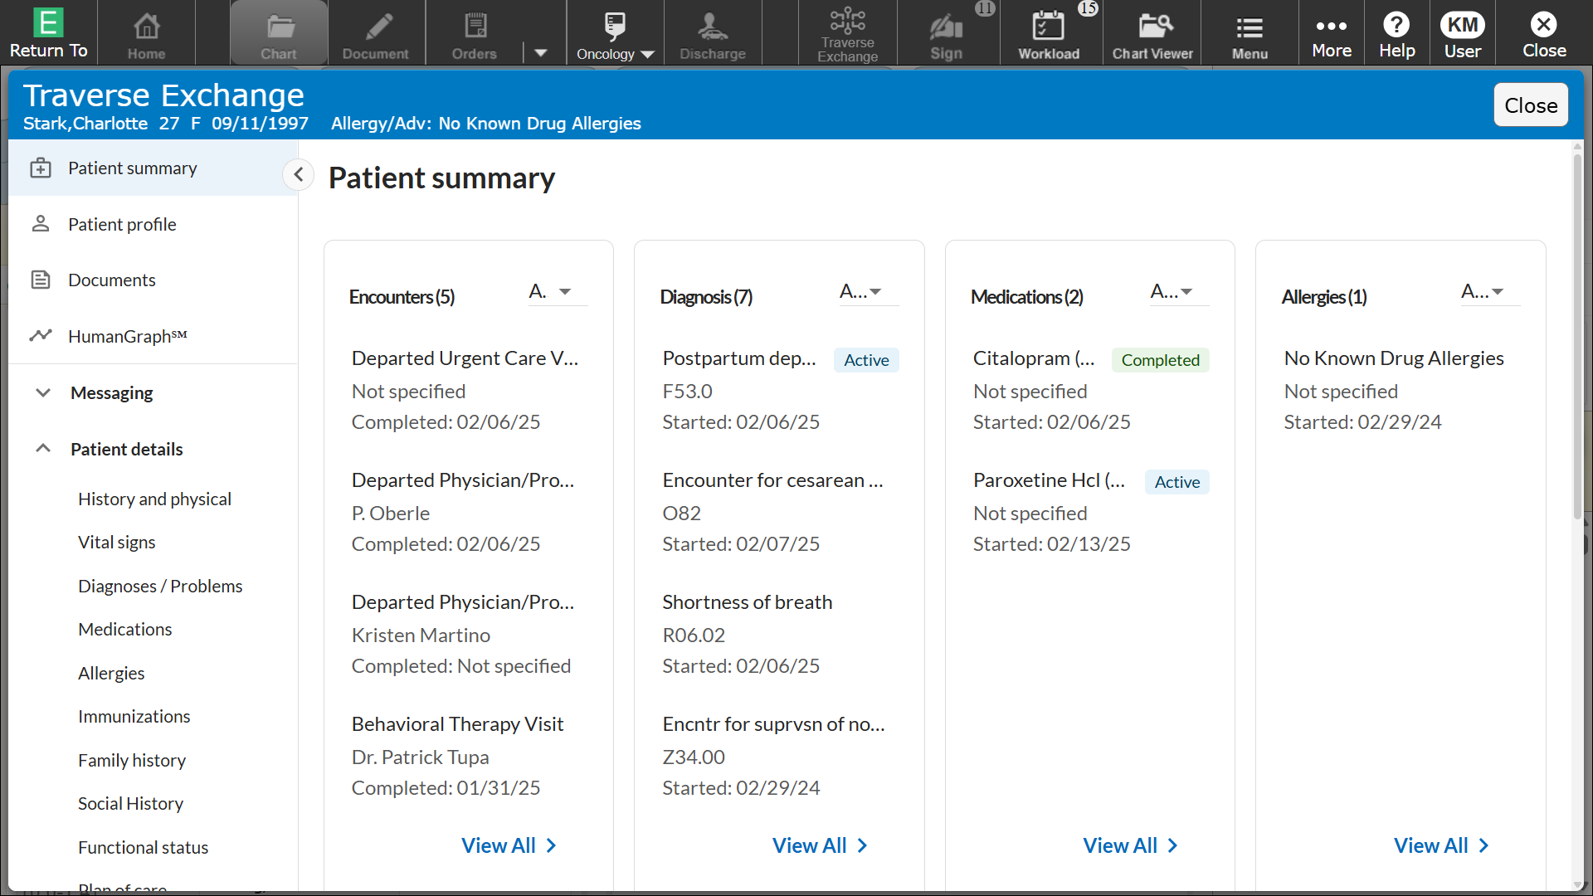
Connect. Exchange. Care.
Improve Data Usability
Searching Traverse Exchange network
Temporarily caching data in a FHIR Structure
Presenting a consolidated summary within workflow
Deduplicated.
Searchable.
Filterable.
Notes:
Allie

Slide 15
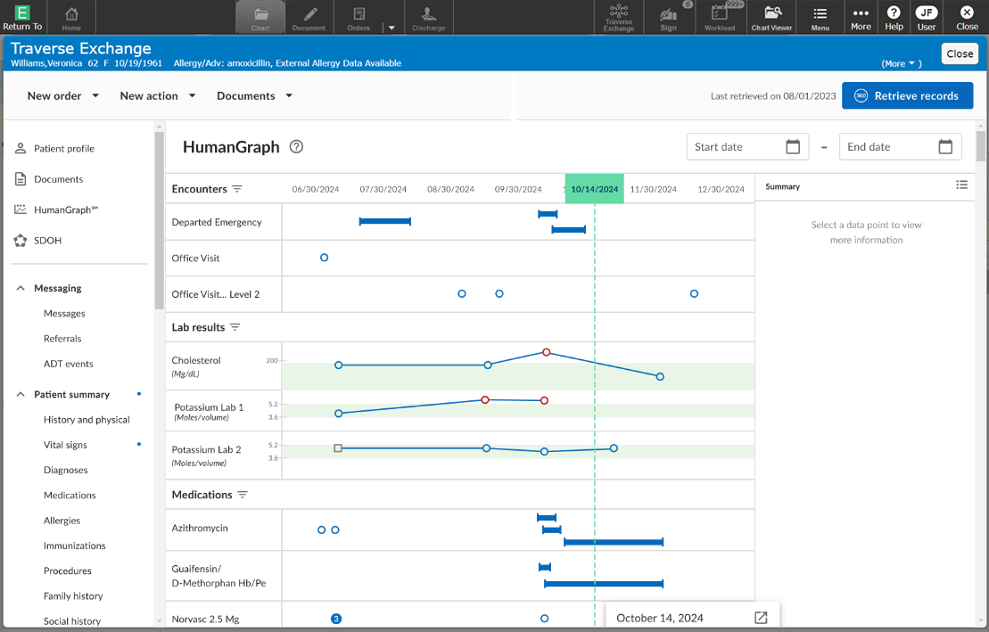
Connect. Exchange. Care.
With the ability
to graph
and track
trends utilizing a patient’s external data
* Image shown is conceptual and may not represent the final product
Notes:
Kristen - Or LIVE Demo

Slide 16
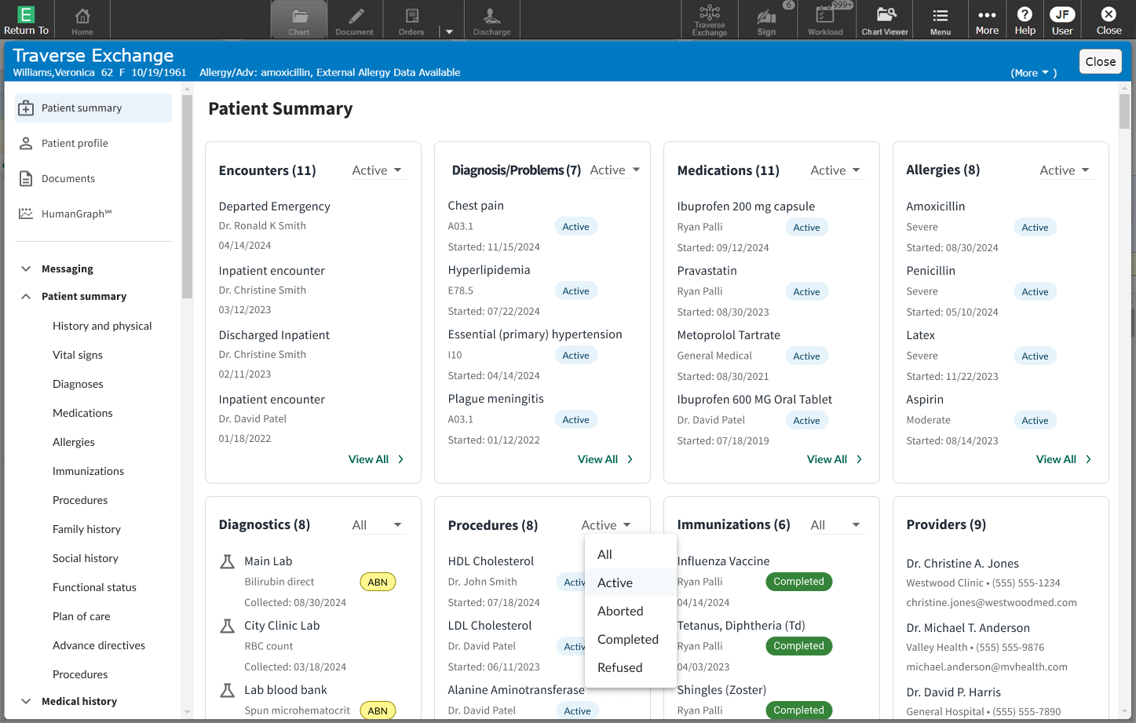
Receiving a consolidated document with all data
Discreetly consuming Problems, Allergies,
Medications &
Immunizations
Notes:
Kristen

Slide 17
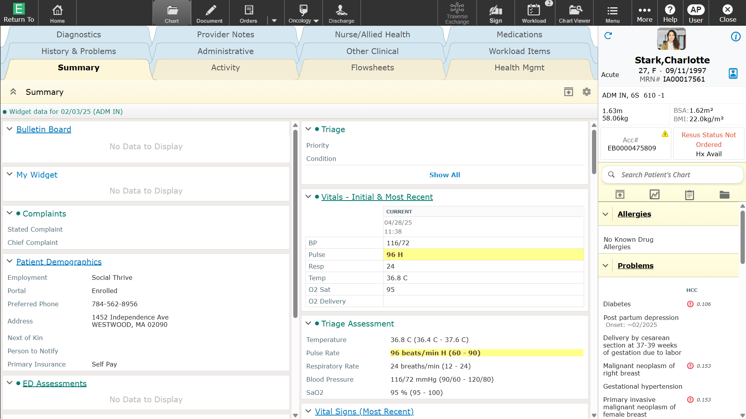
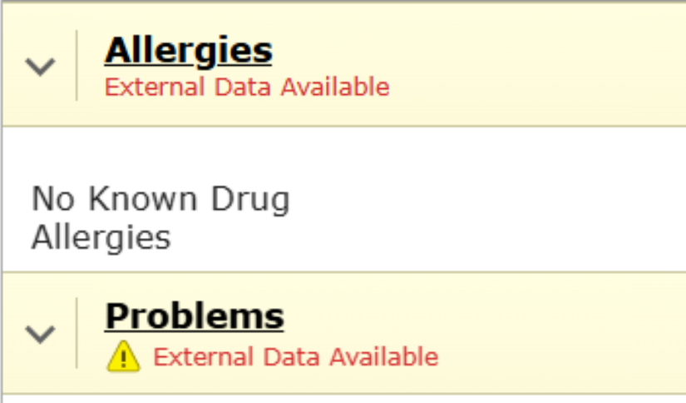
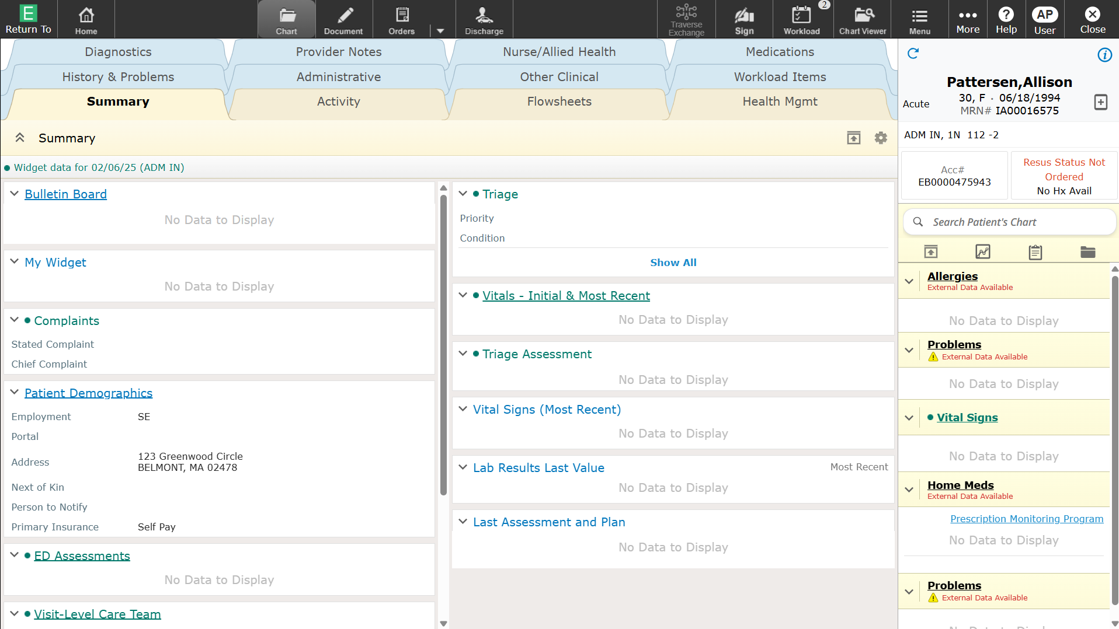
Connect. Exchange. Care.
Search Traverse Exchange network
Receive consolidated document
Improved
Reconciliation Workflow
Relevant, deduplicated data
* Image shown is conceptual and may not represent the final product
Notes:
Kristen

Slide 18
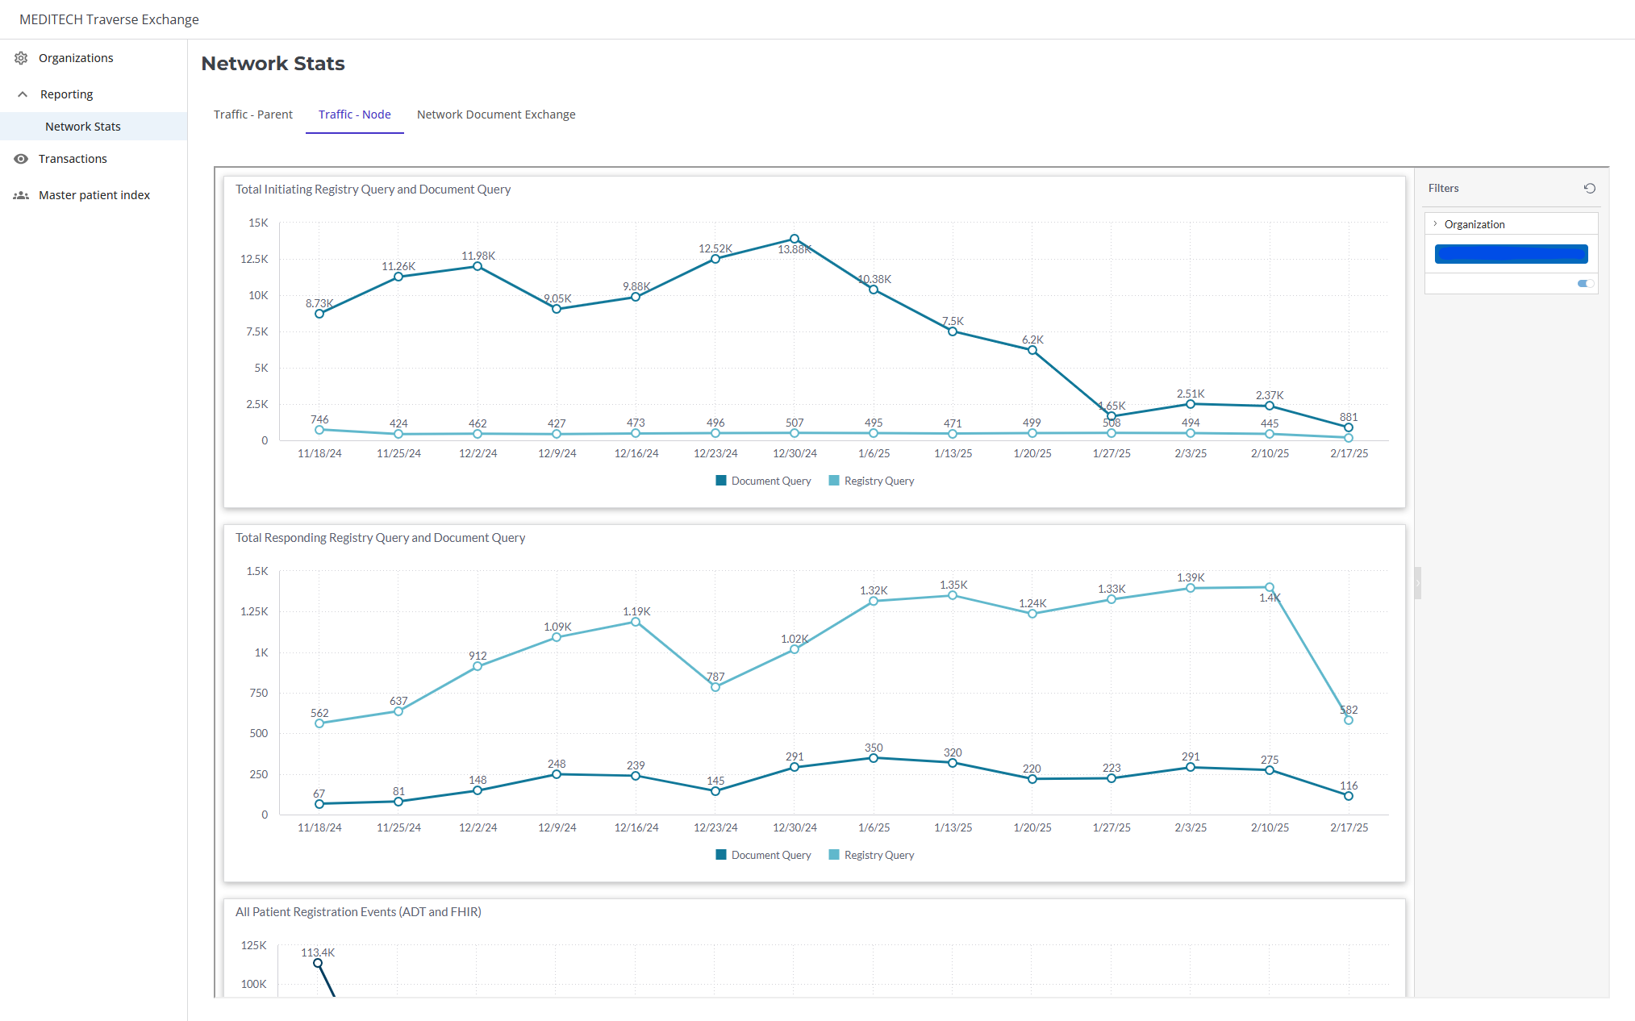
Connect. Exchange. Care.
Network
Metrics
highlighting
Network
traffic
Exchange
partners
Notes:
Allie

Slide 19
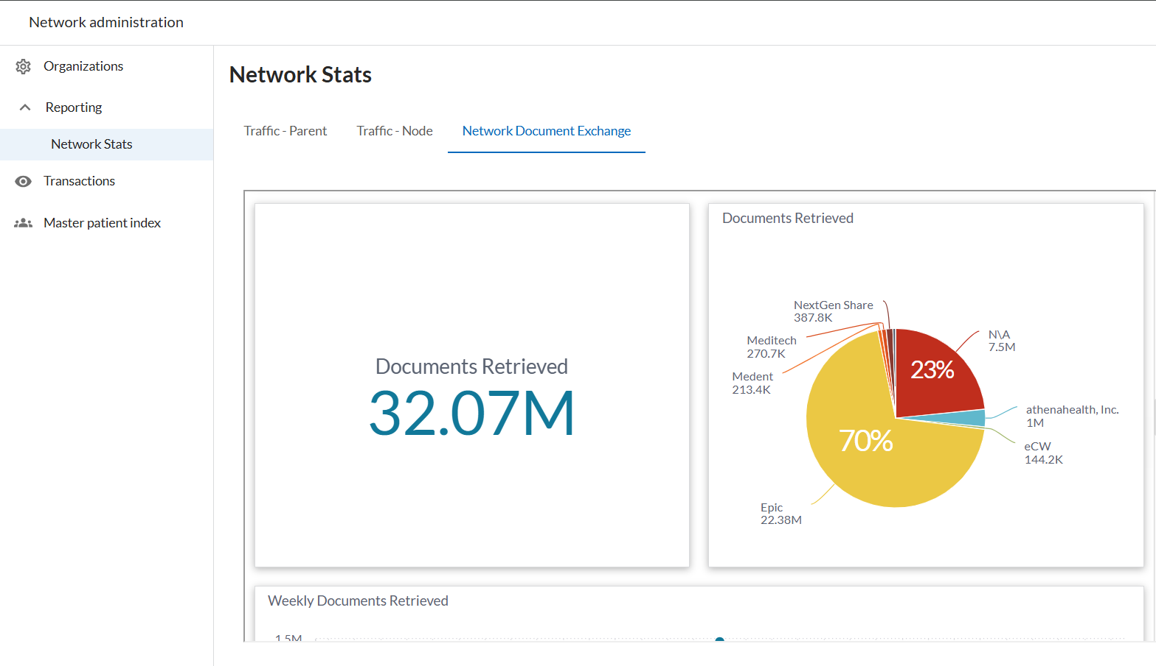
Connect. Exchange. Care.
Network
Metrics
highlighting
Network
traffic
Exchange
partners
Notes:
Allie

Slide 20


Empowering Patients
Meet patients where they are whether they seek care locally or nationally
Strengthening Data
Leverage Data to enhance Care
Reducing Clinician Burden
Not just access to data - access to the RIGHT data
Creating an Open Ecosystem of Innovation
Scalable & Future-Proof
5 KEY
Areas of Impact
Improving Efficiency & Outcomes
Identify targeted treatments Reduce duplicate testing Improve patient outcomes
Notes:
Allie

Slide 21


Thank You!
Notes:
Kristen

