Slide 1
Creating an IT Strategy for Your MEDITECH EHR An Open Discussion

Slide 2


Panel Presenters
Creating an IT Strategy for your MEDITECH EHR
Nassim Abouzeid, Director, System Technology
MEDITECH
Jacob Wheeler, Director, Sales Engineering
CloudWave

Slide 3
Panel Discussion Topics
Creating an IT Strategy for your MEDITECH EHR
Introductions
Lessons Learned – MEDITECH Deployments
Cybersecurity Considerations
Secure Network Infrastructure
Cloud and On-Premises Options

Slide 4
Types of Attacks – Managed Cloud Services Customers
MDR Detection | 67%
SIEM Detection | 33%

Slide 5
Most Recent Attack Vectors and Detections
Lack of MFA on VPN
Unpatched VPN devices
Drive-by downloads
SEO Poisoning
Privilege Escalations/SIEM
Malicious Files/MDR
3. Scanning Tools/MDR

Slide 6
CloudWave Top 5 Controls based on Observations for Prevention
Identity and Access Management
Privileged Account Management
MFA for all access
Vendor Account Management
Service Account Management
Implement MDR on all endpoints
EPP with EDR is a minimum necessary
24/7 Managed Detection and Response
Vulnerability and Patch Management
Release Management Plan - Keep Perimeter Devices Updates (load balancers, VPN devices, firewalls, perimeter devices)
Scanning and Remediation/Patch Cadence
Pen Testing
Software Updates
4. Real-Time Monitoring
Identify your critical assets
Domain controllers
Perimeter devices
DMZ
MiOT devices
SIEM-centralized log collection
Correlation with threat intel
Critical Incident Response Plan
5. Network Segmentation
Micro-segmentation

Slide 7
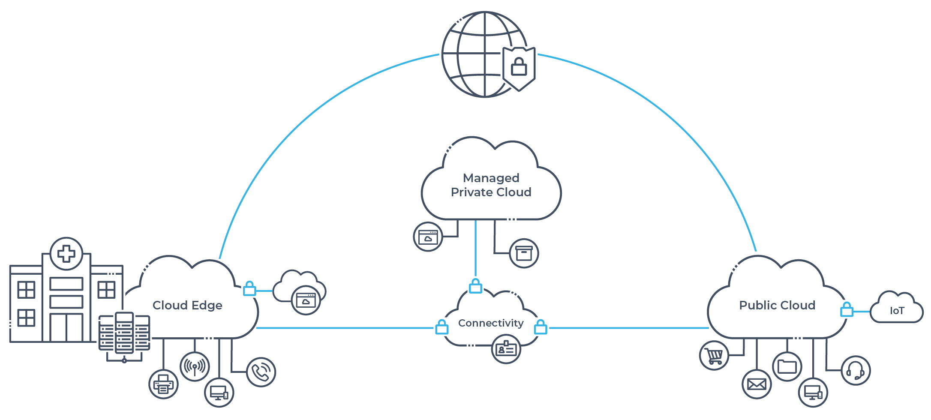

Slide 8
Q & A
Open discussion

