Slide 1


The Cloud Team
Driving Innovation for Effective Decision Making
2nd October 2025
Kimberley Manley Technical Account Manager, Cloud

Slide 2
Agenda
Meet The Cloud Team
What We Do
Achievements This Year
Disaster Recovery
Notes:
Agenda

Slide 3
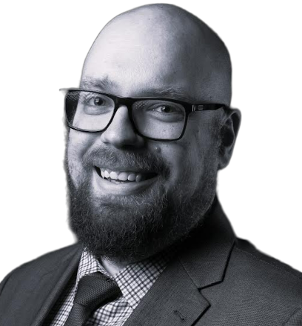
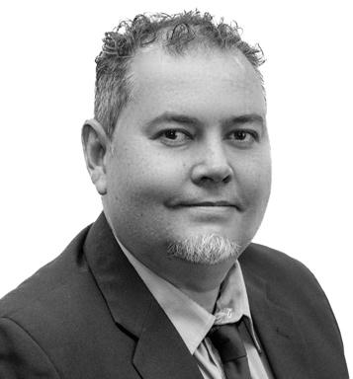
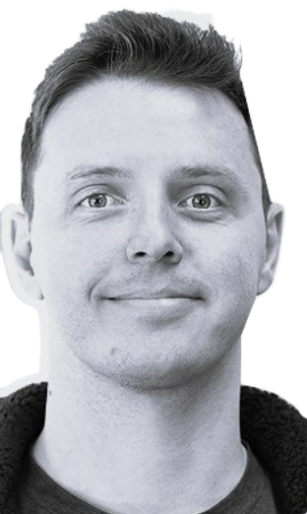
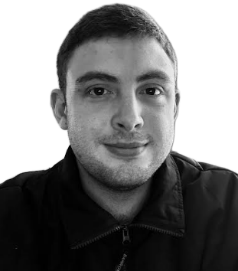
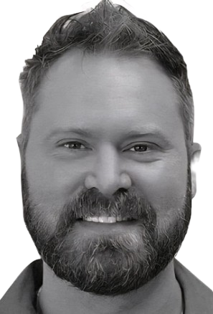
Meet the Cloud Team
LEAD CLOUD ARCHITECT
Lawrence van Jaarsveldt
TECHNOLOGY EXECUTIVE
Werner Roux
SENIOR IMPLEMENTATION ENGINEER
Stephan van der Westhuizen
IMPLEMENTATION ENGINEER
Ockert Roos
IMPLEMENTATION
ENGINEER
Marcel Dreyer

Slide 4
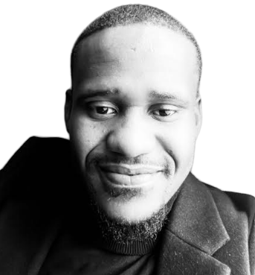
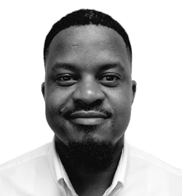
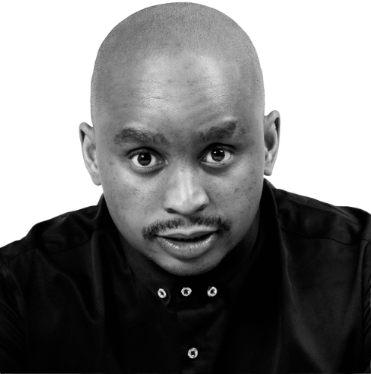

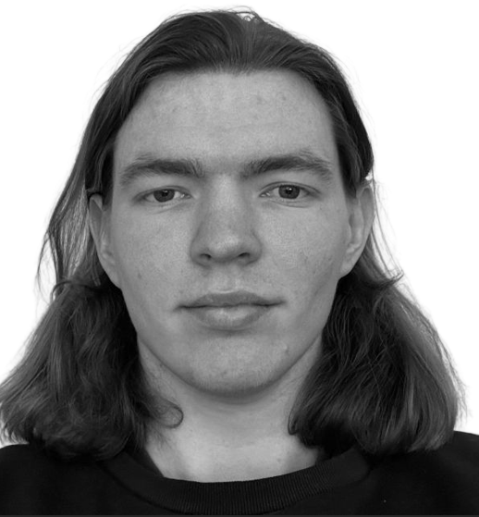
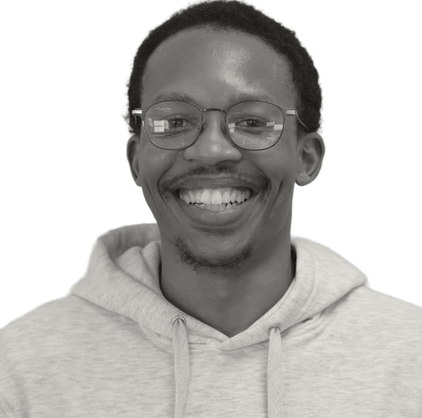
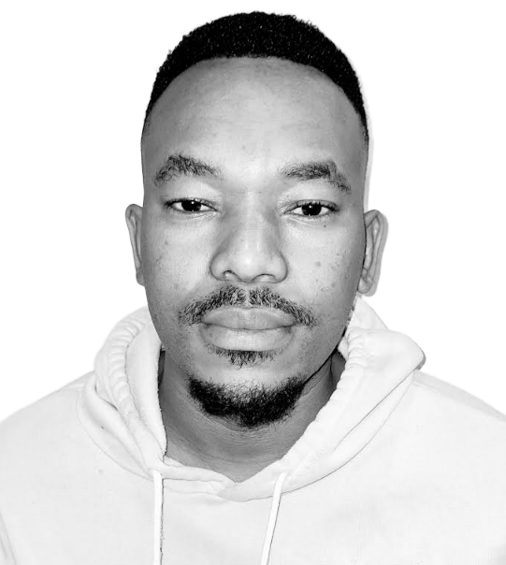
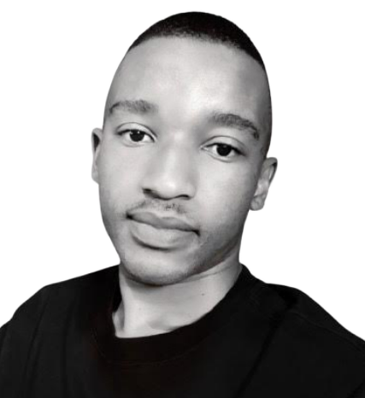
Our Support Team
SUPPORT
ENGINEER
Floyd Lithuge
SUPPORT
ENGINEER
Karabo Segonote
JUNIOR SUPPORT
ENGINEER
Kholofelo Maphanga
CLOUD CLIENT SERVICES
TEAM LEADER
Sumari van Niekerk
SUPPORT
TECHNICIAN
Michael Schmulian
SUPPORT
TECHNICIAN
Wandile Hlophe
SUPPORT
TECHNICIAN
Thulani Nhlabathi
SUPPORT
TECHNICIAN
Katleho Motjope

Slide 5
Our Support Team
PATCHING AND MAINTENANCE
Perform pre-patching on both TEST & LIVE environments
Perform patching (downtime for TEST)
Perform patching (no-downtime for LIVE)
Ad-hoc maintenance
24/7 MONITORING
12- hour shift rotations
Incident escalation
Perform troubleshooting
Provide RCA’s for incidents
Reporting
Perform daily checks
Weekly monitoring reporting
Monthly patch reports

Slide 6
Our Implementation Team
SENIOR IMPLEMENTATION ENGINEER
Stephan van der Westhuizen
IMPLEMENTATION ENGINEER
Ockert Roos
IMPLEMENTATION
ENGINEER
Marcel Dreyer

Slide 7


Our Implementation Team
TEST BUILD
DOCUMENTATION
SIGN ON
PEN TEST (STC)
INTEGRATION
LIVE BUILD
PEN TEST (STC)
DISASTER RECOVERY TEST

Slide 8
Innovations this year…

Slide 9
ISO27001:2022 CERTIFICATION
4 Aug 2025
29 Aug 2025
12 Sept 2025
ISMS submitted to consultants at International Management Systems Marketing (IMSM).
Completed the Stage 1 audit, a comprehensive readiness review that provided a clear path to final certification.
Successfully completed the stage 2 audit, a seven-hour deep dive into our ISMS.

Slide 10

NULL Object - Do NOT Delete.
Requirements Gathering & Standards Alignment
Documentation Framework
Creating the Documents
Central Repository & Access Control
Ongoing Review & Updates
Ongoing Review & Update
BCDR

Slide 11
Disaster Recovery

Slide 12
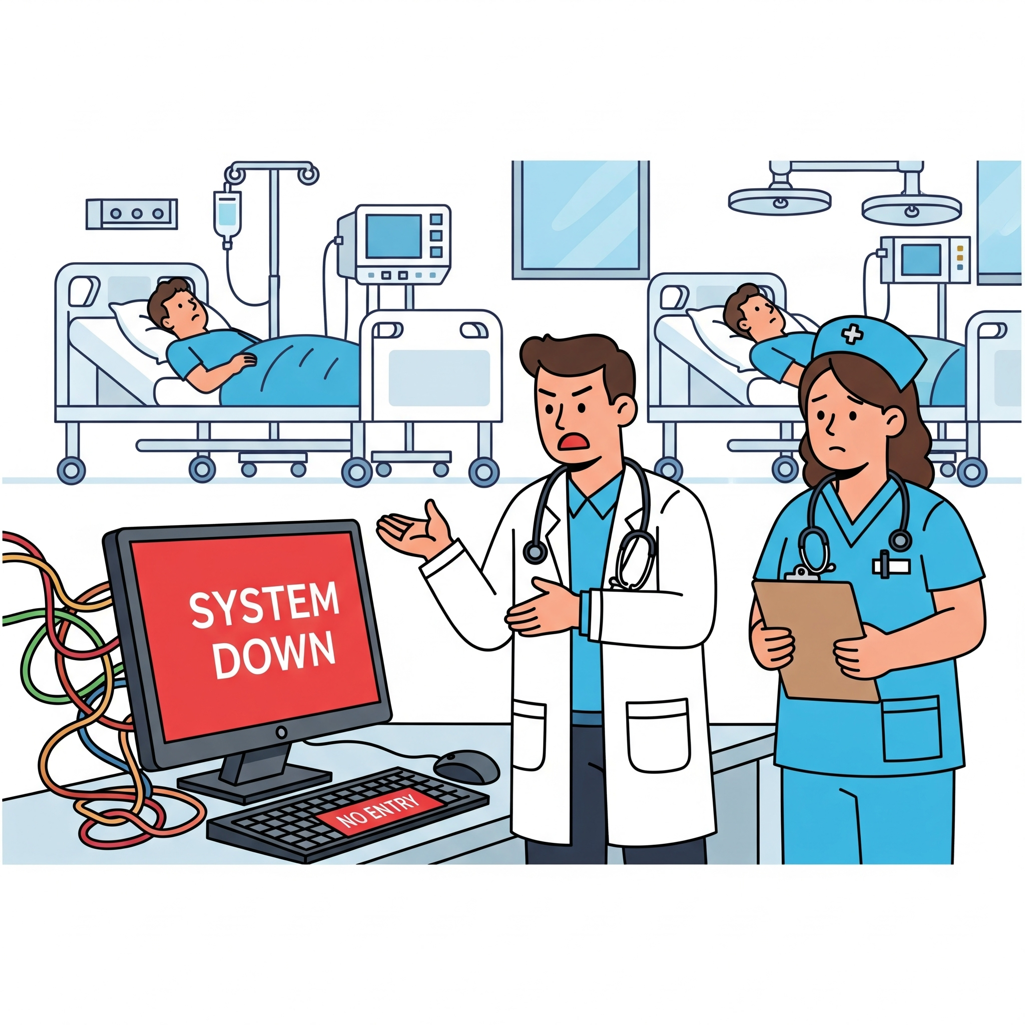
Definition of Disaster
Critical applications unavailable affecting patient care / operations / business processes
*Image generated by artificial intelligence

Slide 13
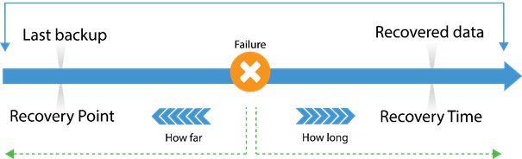
Disaster Recovery Process
RPO
1 hour
RTO
4 Hours

Slide 14
Disaster Recovery Process
Process | Frequency | Purpose
GCP Snapshots | Every Hour | Ensures minimal data loss (RPO)
Image backups | Every 24 Hours | Full out of sequence backup of the environment, which is air gapped and protected against ransomware, kept up to 9 years.
Terraform script | Every Hour | Created by the Cloud team, this program automatically creates Google Cloud resources by defining them in scripts containing metadata about the resources, such as VM names, IP addresses, CPU counts, and RAM amount, referencing the latest backup.

Slide 15
Disaster Recovery Test Planning
Planning Sessions
Review Runbook
Dry Runs
Refine Comms
Assemble Technical Team

Slide 16

Technical Team Assemble
Lead
Cloud Architect
Technical Account Manager
Cloud Engineer
Technical Team
Security Engineer
Technical Support
Systems Engineer
Infrastructure Engineer
Network Engineer
*Image generated by artificial intelligence

Slide 17
Full Disaster Recovery Test Schedule
Start Time (UK) | Step | Assigned to | Duration
9:00 AM | Internal Go/NoGo | Cloud Team, MEDITECH Inc, CloudWave | 25 mins
9:25 AM | Comms: Go/No/Go Decision | Cloud TAM | 5 mins
9:30 AM | Production Powered Down | MEDITECH Inc, Cloud Team | 30 mins
10:00 AM | Comms: Restore Commenced | Cloud TAM | 5 mins
10:00 AM | Restore Environment Starts | Cloud Team, MEDITECH Inc, CloudWave | 4 hours (RTO)
 | MEDITECH Inc Smoke Testing | MEDITECH Inc | Concurrent with above step
12:00 PM | Comms: Restore Update | Cloud TAM | 5 mins
2:00 PM | Handover to Customer for Testing | Cloud Team, MEDITECH Inc, Customer | 1 hour
2:00 PM | Comms: Restore Complete, Handover to Customer for Testing | Cloud TAM | 5 mins
3:00 PM | Restored Environment Powered Down | Cloud Team
3:00 PM | Comms: Customer Testing Complete, Failback to Production Initiated | Cloud TAM | 5 mins
3:00 PM | Production Powered Up | Cloud Team | 2 hours
 | MEDITECH Inc Smoke Testing | MEDITECH Inc | Concurrent with above step
5:00 PM | Handover to Customer For Testing | Cloud Team, MEDITECH Inc, Customer | 1 hours
5:00 PM | Comms: Production Environment Handed Over to Customer for testing | Cloud TAM | 5 mins
6:00 PM | Comms: Disaster Recovery Test Complete | Cloud TAM | 5 mins
Notes:
Some things you can mention if you want to:
Terraform restore takes between 14-17 minutes to recover everything in a separate datacenter
The team will power up the servers in the correct boot sequence and set down flags in 10-15 minutes
and then get various parties to do health checks.
The team is quite competitive and likes to go for record times
So maybe you can mention that the fastest time we achieved for this was 24 minutes, and our slowest was 42 minutes.

Slide 18
Post Disaster Recovery Test Review
Attendees | The Technical Team, Senior Stakeholders
Format | Open collaborative session
Agenda | Review timeline of events Was the RTO/RPO met? What went well? Lessons learned? Process improvements? Assign future actions
Outcome | Post Disaster Recovery Test Report
*Image generated by artificial intelligence

Slide 19
KEY METRICS
TEST DATE: 01/03/2025
TEST DATE: 02/09/2025
SERVERS RESTORED
SERVERS RESTORED
217
318
RECOVERY POINT (1HR RTO)
RECOVERY POINT (1HR RTO)
15 mins
15 mins
RECOVERY TIME (4HR RPO)
RECOVERY TIME (4HR RPO)
1 hr 57 mins
1 hr 58 mins
SUCCESS RATE
SUCCESS RATE
100%
100%

Slide 20
Thank You

