Slide 1



Driving Digital Transformation with our MEDITECH Expanse CPOM Project
MUN Annual Conference 2025 1-2 October
SAM FIELDING, CHIEF INFORMATION OFFICER OCTOBER 2025

Slide 2

Abstract
Southlake Health originally went live with Expanse 2.1 without computerized provider order entry. As part of a larger initiative to drive digital transformation, we adopted the terminology CPOM (Computerized Provider Order Management) instead of CPOE (Computerized Provided Order Entry).
This reflects our commitment to transition away from paper-based processes and prioritizing the complete end-to-end flow of orders throughout the project through:
‒ Implementation of projects with diligence and accountability
‒ Innovation with deliberate activities and actions
‒ Optimisation of existing processes and technologies

Slide 3

Agenda
Overview
Implement
Innovate
Optimise
Key Insights

Slide 4


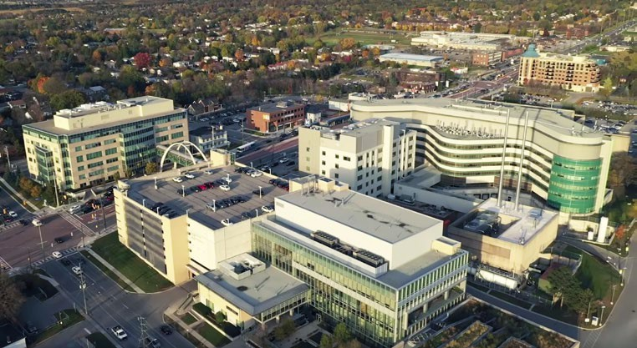
Southlake Health
Providing Leading Edge. Close to Home.
Southlake Health has just celebrated 100 years. We deliver a wide range of healthcare services to the communities of northern York Region and southern Simcoe County. This includes regional Cancer Care and Cardiac Care that serves a broader population across the northern Greater Toronto Area and Greater Toronto Area (GTA) and into Simcoe-Muskoka.
Our team of nearly 6,000 staff, physicians, volunteers, students and Patient and Family Advisors are committed to creating an environment where the best experiences happen.
Southlake has received the highest distinction of Exemplary Standing from Accreditation Canada.
With an annual operating budget of over $600 million (₤320 million), we care for one of Ontario’s most rapidly growing (<8% annually) and aging populations and have developed an exciting plan for new facilities to serve our communities.
Southlake is proud anchor partner to the North York and South Simco Ontario Health Team, working with partners to deliver connected care across the region.

Slide 5
Transformation Journey with MEDITECH Expanse
Expanse Platform Refinement / Optimization
Patient Portal
BPMH Integration at Admission with DrFirst
1st Web Ambulatory Clinic (Diabetes Education Clinic)
Optimise for Improved care, safety & efficiency
Transition to paperless workflows
Expanse Pathology / TAR (Transfusion Admin)
Expanded electronically clinical data sharing
Integration of clinical equipment (IV pumps)
Improved experience/features (Expanse 2.2)
2018
2019
2020 - 2021
2022 - 2023
2024 - 2025
2025 & Beyond
MEDITECH Expanse Live with SHINE Partners (Oak valley Health, Stevenson Memorial Hospital)
Virtual Visits and Rapid Expansion Virtual Care
Patient Pre-Registration & Check in
Front End Provider Dictation
CPOM (Computerized Provider Order Management)
Handheld devices enabling point of care at bedside
Expand Web Ambulatory
Connectivity & Interoperability (Long Term Care, Hospitals and Ontario Health) with Traverse Exchange Canada

Slide 6

CPOM
Order Management
vs.
CPOE
Address paper-based processes
Consider end-to-end order management workflows beyond just provider order entry
Notes:
Presenter Notes
2025-09-22 21:23:36
--------------------------------------------
CPOE is Computerized Provider Order Entry which enables physicians, NPs, nurses, Allied Health to input orders for: medications, diagnostics, laboratory tests, and other treatments
Southlake is adopting the terminology CPOM (Computerized Provider Order Management) instead of CPOE (Computerized Provided Order Entry) as a reflection of the commitment to transition away from paper-based processes and ensure that the end-to-end flow of orders is considered throughout the project.

Slide 7
Agenda
Background
Implement
Innovate
Optimise
Key Insights

Slide 8
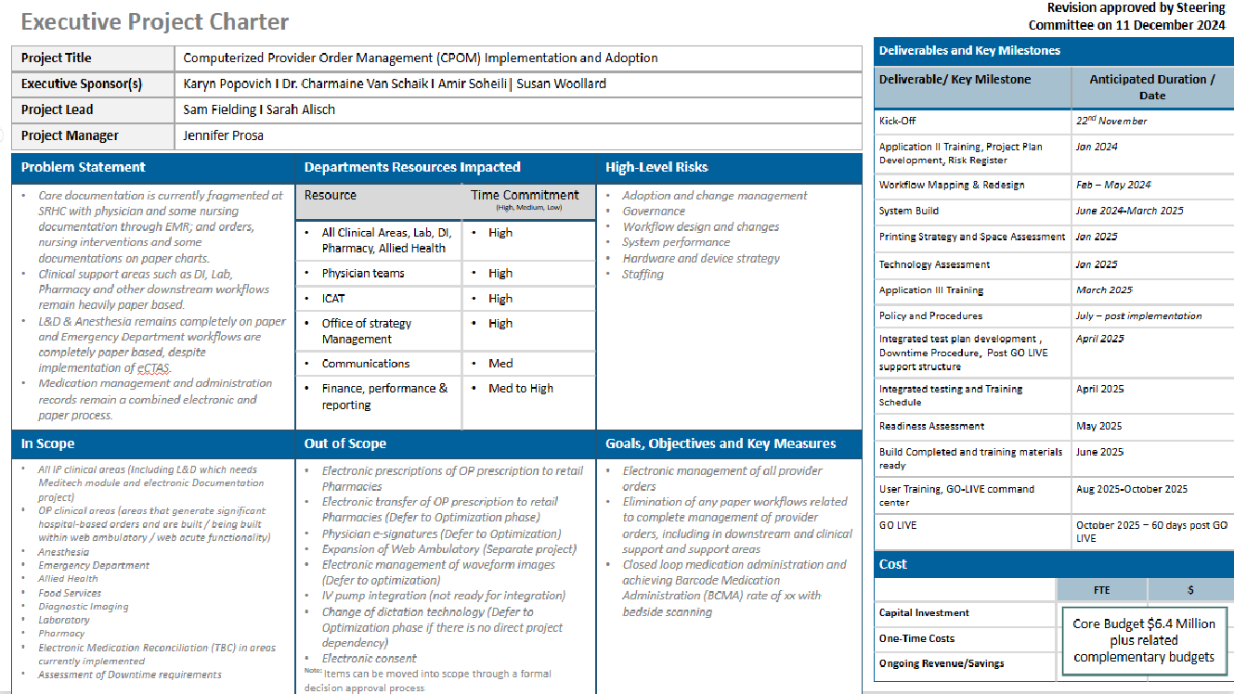

Implement. Executive Project Charter
Foundation for activities
Larger sub-projects had their own executive charters (labour & delivery, single patient encounter, ambulatory care)
Major decisions and implications:
‒ Decision documents
‒ Risk Assessments and mitigation strategies
Notes:
Presenter Notes
2025-09-22 21:23:36
--------------------------------------------
Project Goal: Transform clinical processes by replacing paper-based and hybrid order management workflows with electronic order management.​
​ Benefits:​ Streamline order management workflows​ Enhance clinical efficiencies for medical staff and staff​ Reduce patient safety risks​ Embed best practices into everyday clinical tasks to support safe, evidence-based care​
​
Project Timeline: On-track to GO LIVE on October 28, 2025

Slide 9

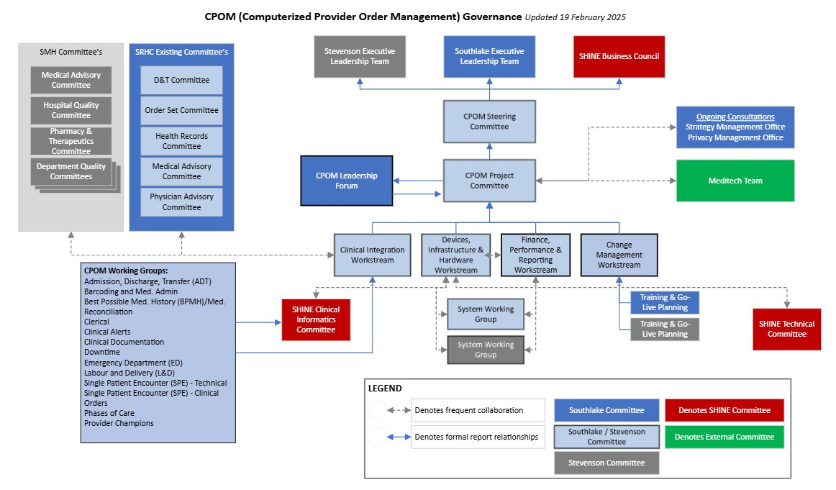
Implement. Strong Governance Model

Slide 10
Implement. CPOM Guiding Principles
CPOM is a clinical transformation project aimed to enhance patient care, safety and quality, enabled by technology.
Committed to transition electronic workflows throughout the organization, not simply implementation of CPOM.
Enable the entire ecosystem (order entry, upstream and downstream processes) for success.
Support teams through difficult changes / decisions that are needed but not shy away from them.
Workflows and content are developed by using best practice and are evidence informed.
Workflows and content are supported by enablers to hardwire success and sustainability.
Clinicians are key in designing future workflows, care pathways and change management; therefore, explicit focus is placed on end-user participation in process design and workflow engineering to foster clinician satisfaction.
Change management focus from the beginning to build and maintain consensus on the need for change.
Patient experience informs workflows.
Foster clinician satisfaction and efficiency.
Notes:
Presenter Notes
2025-09-22 21:23:37
--------------------------------------------
In a project like this, there are lots of tough decisions that will take significant change management, This reinforces the need of a change manager

Slide 11
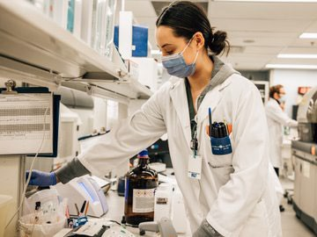

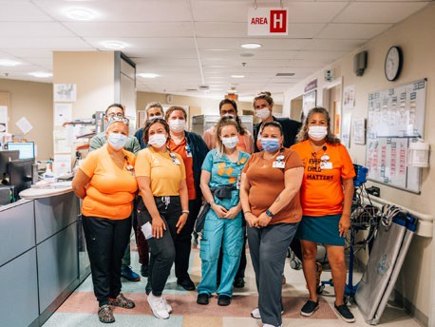
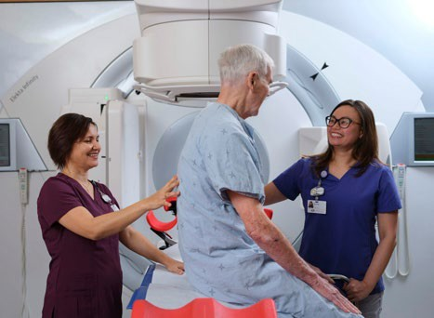
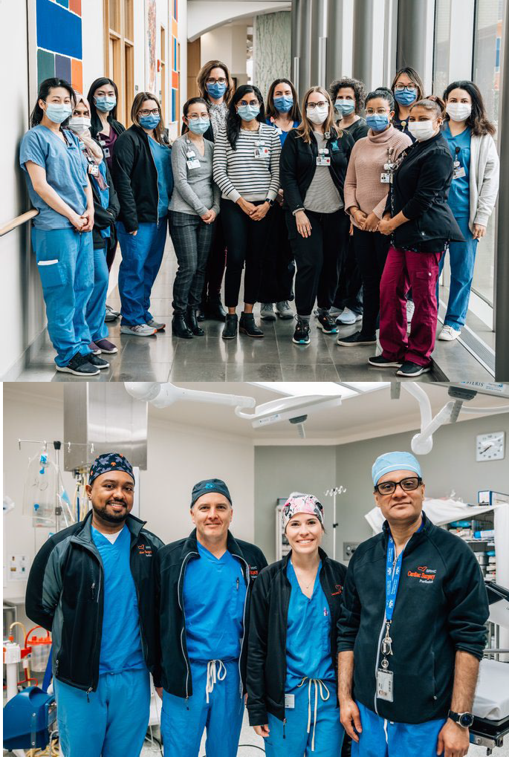

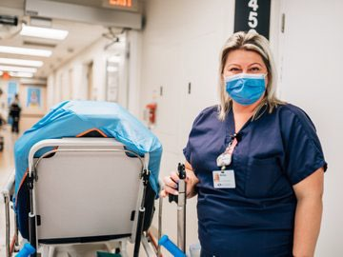








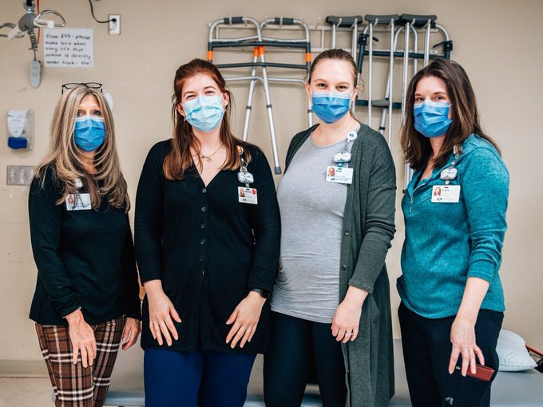


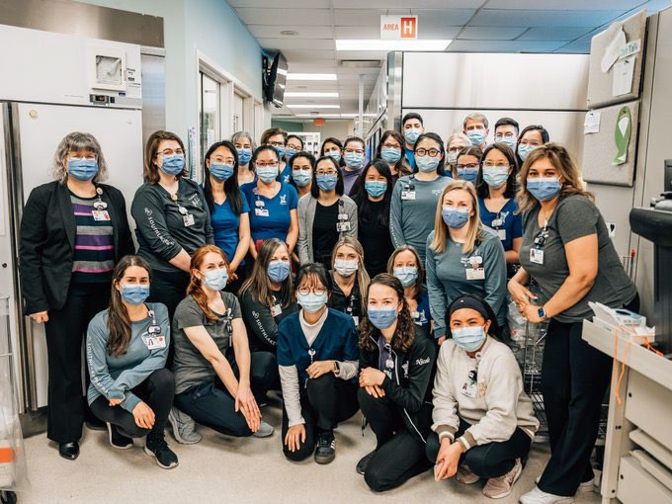



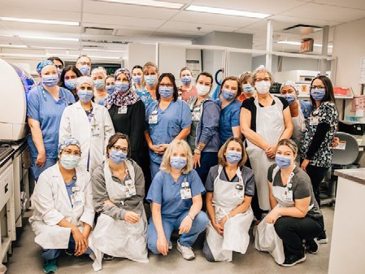
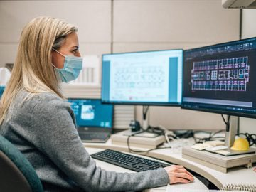

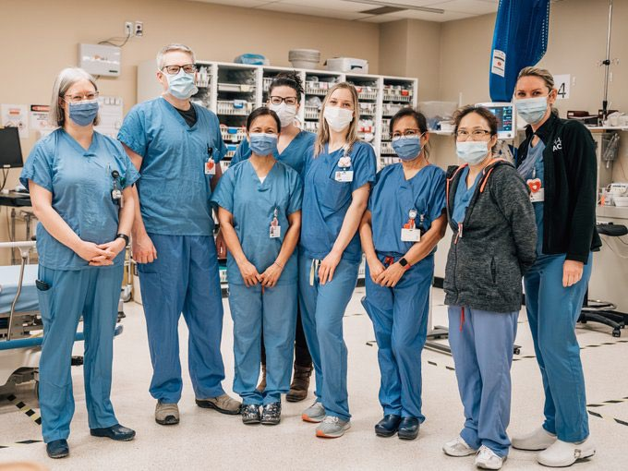
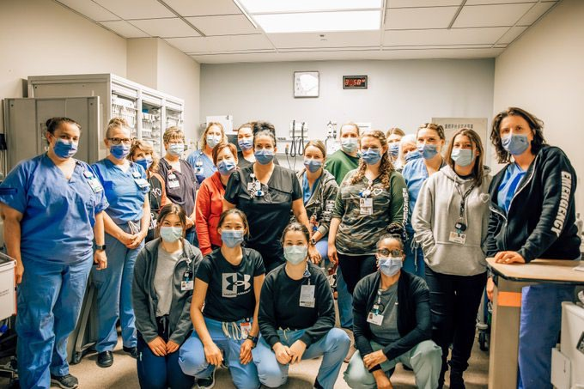
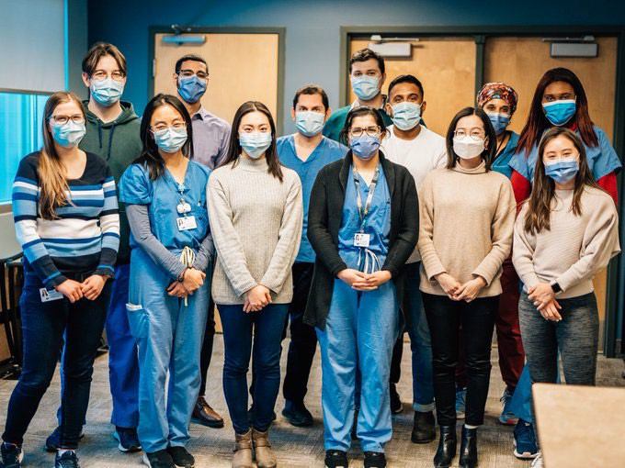
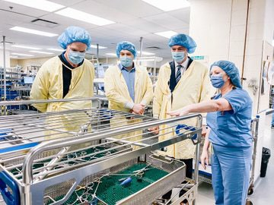
Implement. Impacted by the Project

Slide 12
Implement. Change Management Strategy 3 Pillars
Preparing
The Project Team
Preparing
Accountable Leaders
Preparing End Users
Provide timely and accurate
information
Provide meaningful
emotional/psychological support
Prepare the project team to provide information and support to accountable leaders and end users
Provide timely and appropriate information
Provide meaningful emotional / psychological support to ensure buy-in
Prepare leaders to provide information and support to end users through recognized change leadership approaches
Emphasize soft skills regarding change leadership, to increase change resilience in leaders & staff
Provide timely and appropriate information
Provide meaningful emotional/psychological support to ensure buy in
Deliver events and activities that model and influence desired behaviours
People Support Plan Provider Champion Plan Leadership Plan Communication Plan
Super User/Change Coalition Plan
Notes:
Presenter Notes
2025-09-22 21:23:38
--------------------------------------------
Integrated Methodologies:
Prosci ‘ADKAR’ Model​ Kotter’s 8-Step Process​ Kubler-Ross Model​ Nudge Theory​ COM-B​ Theory​

Slide 13



Implement. Scope & Approach
Parallel Enablers
Core CPOM
Planned Roadmap
VDI Replacement
VDI Optimization
SAN Replacement
Central Fetal Monitoring (with L&D Integration)
Policy & Procedure Platform
Intranet Replacement
Replace Dictation Platform
Single Patient Encounter
Downtime System
Comprehensive Workflow Mapping
Order set review / development
MEDITECH Labour & Delivery
Inpatient Electronic Documentation & Provider Order Entry
Ambulatory Care Electronic Documentation & Provider OE
Workstation Assessment & Expansions
Handheld Devices & Tablets
Mobile Device Management
Documentation Solution, Process Review, and Best Practice Alignment
Comprehensive Change Management
Clinical Printing Strategy
Metric and KPI Development
Vital Sign Integration
IV Pump Integration
MEDITECH Expanse 2.2
Expanse Pathology
Transfusion Administration Record
MEDITECH Expanse Now
Anesthesia Information Management System
Oncology EMR (Radiation & Medical Oncology) Refresh
Patient Summary (Traverse Exchange Canada)
Notes:
Presenter Notes
2025-09-22 21:23:39
--------------------------------------------
The terminology of CPOM or Computerized Provider Order Management reinforces a broader scope and inclusion of related projects as part of the overall success.

Slide 14
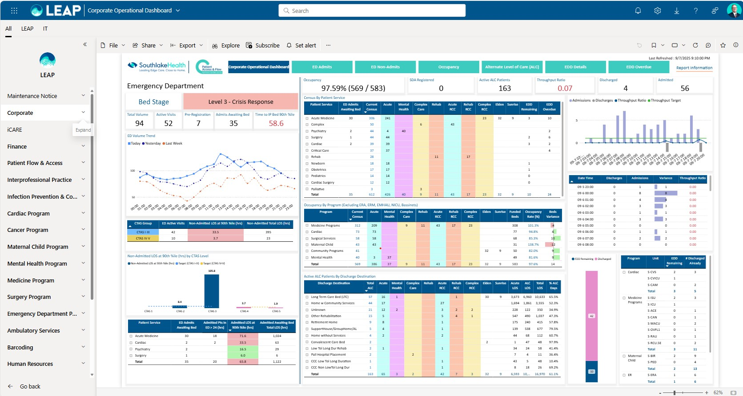
Implement. Measuring Success with LEAP
Southlake Health: Leading Edge Analytics Platform

Slide 15
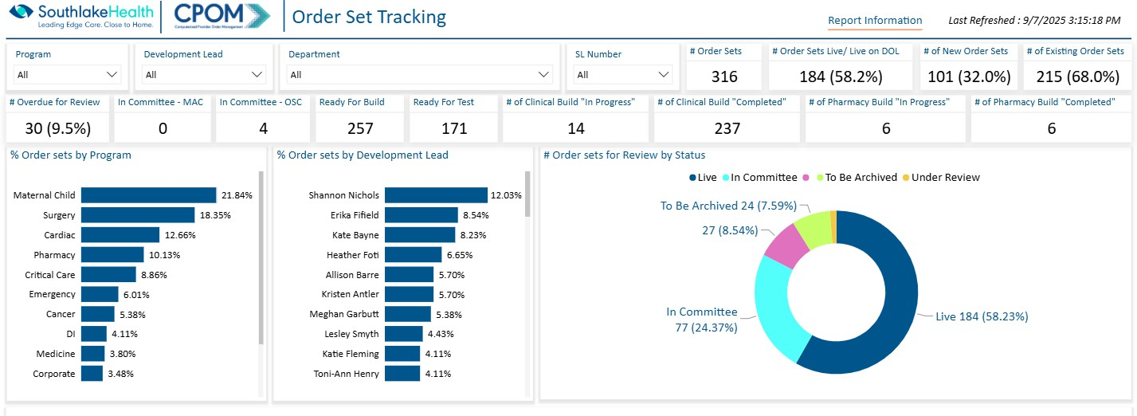
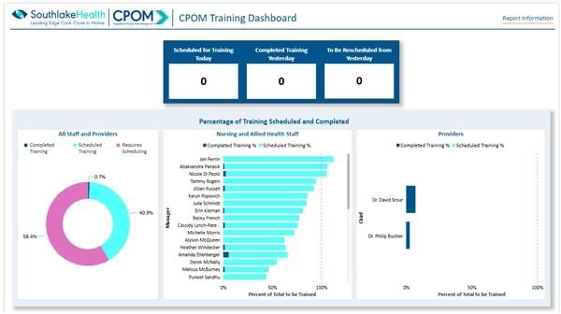
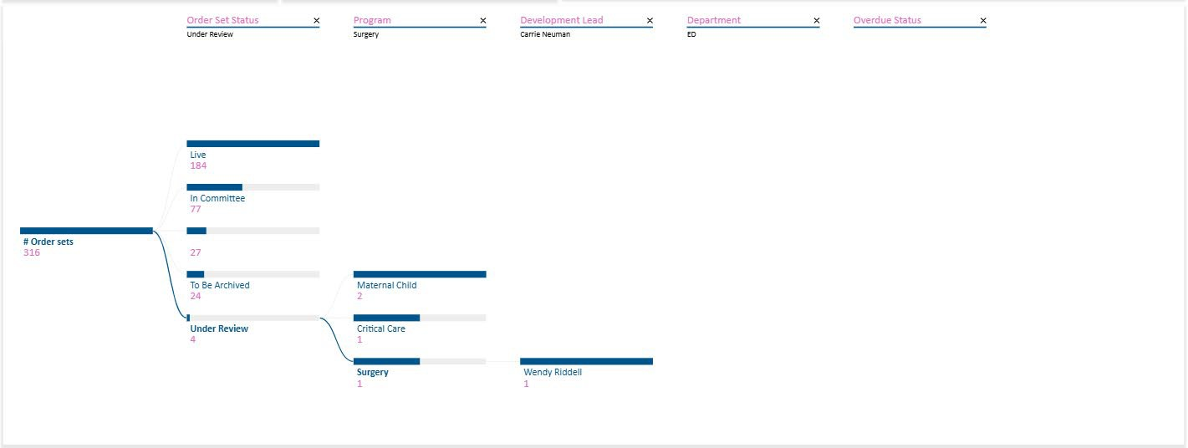
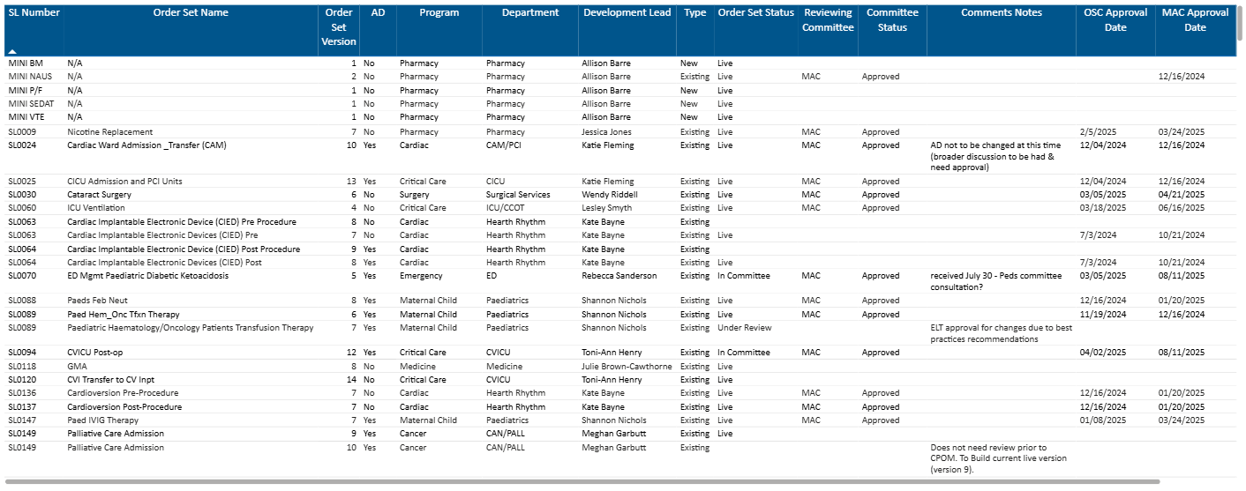
Implement. CPOM Focused Dashboards

Slide 16
Agenda
Overview
Implement
Innovate.
Optimise
Key Insights

Slide 17
Innovate. A Matter of Perspective
New
New to Us

Slide 18
Innovate. Types of Innovation
Product Process Disruptive Continuous Sustaining Business Radical
Downtime (Platform and Registration & Bed Management)
Workflow Redesign
Handheld Nursing ^{Case Study}; Provider Order Entry
Process Refinement; Provider Engagement ^{Case Study}
Preparation, Transition, Reinforcement
Finances / Funding; Single Patient Encounter ^{Case Study}
New Approaches / Concepts

Slide 19
Innovate. Provider Engagement
Situation:
Effective engagement of providers is the critical to the success of project.
Many providers are self employed (fee-for-service).
Approach:
Establish provider champions with general target of 1 per program (up to 25).
Providers funded on a stipend model that is based on expected time and administrative compensation rate (required due to size and complexity of the project).
Defined duties, responsibilities, and expectations.

Slide 20
Innovate. Provider Engagement
Principle Expectations:
Provider Champions progress the CPOM project forward by working directly on the project or on committees/working groups.
Project team relies on Provider Champions for sharing information within their local teams to build awareness and create desire for CPOM and the future state.
The Provider Champion role is paid by the CPOM Project team (8 hours/month).
Core Activities:
− Design, Build, and Testing of Order Sets
− Championing and Sponsorship of project related activities
− Support adoption and change management
− Support training sessions for other providers

Slide 21
Innovate. Nursing Handhelds
Situation:
Barcode scanning compliance across the organization was below target of 92%.
Clinical staff are experiencing a variety of barriers to scanning, with access to appropriate equipment as the top challenge.
Mobile devices with scanning capability recommended by Barcoding Working Group (BWG) to enable medication administration and specimen collection at the bedside.
Options:
Implement nursing mobile devices prior to CPOM go-live.
Implement nursing mobile devices alongside CPOM go-live (Selected).
Mobile device is not implemented at Southlake.

Slide 22

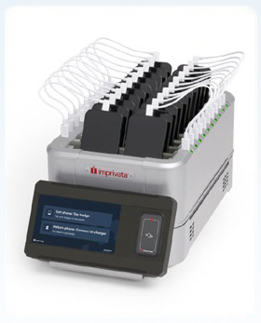
Innovate. Nursing Handhelds
Outcome:
Goal is to improve patient safety by reducing medication administration and specimen collection errors and enhanced patient identification processes at the patient bedside.
Vital sign documentation at the bedside was enabled with the use of handheld devices.
Solution:
Procured and deployed HC50 devices for nursing (Handhelds).
Incorporated Imprivata mobile device management (“Toasters”).
Leveraged existing Imprivata Tag-n-go for sign in & out.
Incorporated multiple user cases including secure clinical messaging.

Slide 23
Innovate. Single Patient Encounter
Situation:
Patients can be admitted under one of four different services; Acute, Rehab, Complex, or Mental Health. Each service type has a different funding type. Depending on clinical need, a patient may require transfer from one service type to another during their stay.
When an inpatient changes service (i.e., Acute to Rehab or Mental Health) they receive a new encounter visit number. The change in services creates a discharge of the account and a readmission under the new service with a new encounter number.
This process was historic standard practice in Ontario hospitals and was intended to assist with financial reconciliation upon discharge.

Slide 24
Innovate. Single Patient Encounter
Outcome:
Single Patient Encounter (SPE) visit number for the entire stay of an inpatient visit in the hospital regardless of the service (Mental Health; Acute; Rehab or Complex Care).
Implement prior to CPOM Go Live (as this affects the processes).
Implications:
Improve clinical experience, enablers transfers and not discharge / readmit.
Extensive changes needed for administrative, technical and reporting focused functions (Health Records, Integration, Decision Support / Reporting, Finance).

Slide 25
Agenda
Overview
Implement
Innovate
Optimise.
Key Insights

Slide 26
Optimise. Post Go-Live Activities
During this transformation, it was understood that not everything could be completed. In some cases, functionality was enhanced in Expanse 2.2.
The following are examples of planned activities in the months post go-live:
− Transition Bili clinic into MEDITECH Community Wide Scheduling (CWS)
− Extensivist clinic care plan
− Fracture clinic status board
− Allied Health documentation optimization
− Automate Hemodialysis reporting
− Pregnancy, Lactation and Gestational Age alerts
− Pharmacy Patient Care System (PCS) Interventions
− Review of orderable interventions
− Add “priority” order sets following go-live

Slide 27
Optimise. Core Roadmap Opportunities
As part of the larger Digital Health plan, more significant planned activities will enable both optimization and expansion of capabilities:
Upgrade to MEDITECH Expanse 2.2 (Web Interface with process improvements)
Implement Expanse Pathology Module (replace legacy platform with new processes)
Implement Electronic Transfusion Administration Record (TAR)
Upgrade Labour & Delivery (transition to a Web Interface with process improvements)
Integrate Central Fetal Monitoring with MEDITECH Labour and Delivery
Patient Front Door Activities (Upgrade Portal and related functionality / processes)

Slide 28
Optimise. Core Roadmap Opportunities
And the list continues…
Measurable Insights / Benchmarking (across multiple organizations)
Ambulatory Care Expansion and Refinement of Existing Clinics
Device / Remote Care Integration
Environmental Services / Transport / Bed Management
Patient Summary Viewer (Part of Traverse Exchange Canada)
Ontario Health Mandatory Activities (largely based on provincial integration / interoperability) including integration into provincial newborn registration, lab and drug repository, and eReferral network

Slide 29
Optimise. Balancing Priorities
CPOM has deferred and delayed many activities.
Effective validation of requirements and prioritization will be important.
Resources and future capital budget can affect larger activities.
Need to resist immediate changes to electronic order processes / changes unless they represent a clinical risk (vs. not adapting to the change).

Slide 30
Agenda
Overview
Implement
Innovate
Optimise.
Key Insights

Slide 31
Key Insights.
Ensure strong governance, executive support, and core project team.
Subject Matter Experts are critical to the success of the project include them as part of the project team early on.
Define the role of expectations of Directors / Managers and make them leads on certain workstreams.
Resistance related to a large clinical transformation is expected. A dedicated change manager is essential.
Training and education must be practical.

Slide 32
Key Insights.
Provider champions are essentially to direct involvement.
Be prepared to make tough project scope decisions.
Extensive process mapping was important for engagement.
Order set review and development needs to start early on as this will become critical (took almost 18 months and 1 designated FTE).
Deliver on your commitments.

Slide 33
Contact Information
Sam Fielding
Chief Information Officer Southlake Health
Email: sfielding@southlake.ca Website: Southlake Health
Coordinated Go-Live: Southlake Health, Stevenson Memorial Hospital, and Oak Valley Health all go live on October 28, 2025.

Slide 34
APPENDIX
Supporting Reference Material and Examples of Project Material

Slide 35
Appendix. Contents
Decision Document
Comprehensive Mapping Sessions
Workflows
Status Reports
CPOM Provider Champions
Change Management

Slide 36
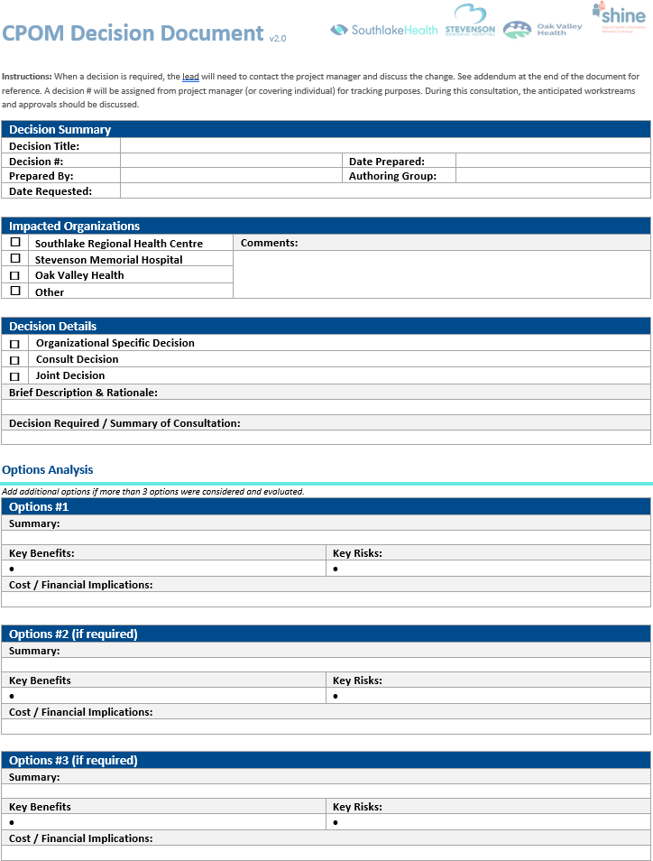
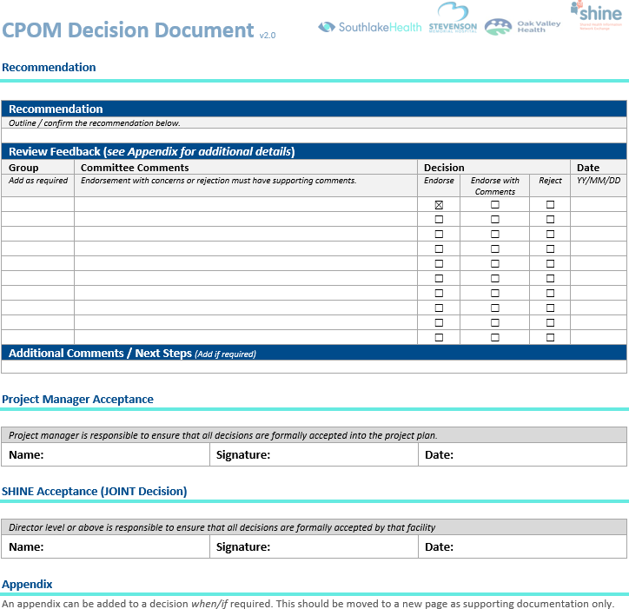
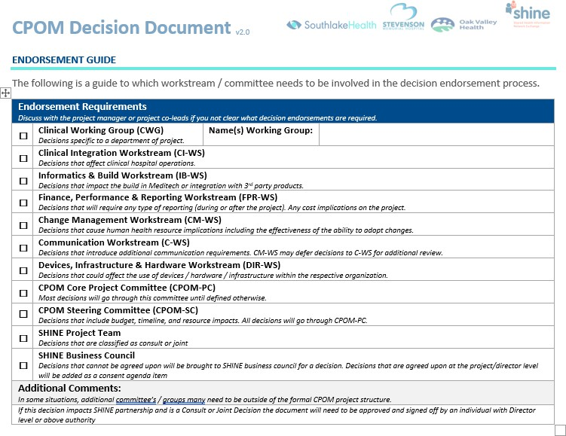
Appendix A. Decision Documents

Slide 37
Appendix A. Decision Documents
As of September 2025
DECISION # | TITLE | AUTHOR
1 | Single Patient Encounter | Clinical Informatics
2 | Meditech Labour and Delivery Module implementation | Clinical Informatics
3 | Order Set Style Guide | Clinical Informatics
4 | Use of Zynx Subscription | Clinical Informatics
5 | Standard of Care and Nursing Orders | Clinical Informatics/ Professional Practice
6 | Diet Order Management | Clinical Informatics / Professional Practice
7 | Anesthesia Information Management System (AIMS) | Clinical Informatics
8 | Up to Date Subscription | Professional Practice
9 | Separation of Meditech Dictionary Builds (not PHA) | Clinical Informatics
10 | Separate DMD (Dictionary Management Desktop) Replays and CPOM Go-Live Dates | Clinical Informatics
11 | Southlake and Stevenson Drug Dictionary Separation (PHA Module) | Pharmacy
12 | Optimal Approach for IV (Intravenous) Admixture for Intermittent IV Dosing Medication Builds: "Drug Dictionary" vs "Order Strings" Build | Pharmacy
13 | Disable Range Dose Parameters in MIS Toolbox Parameters | Pharmacy
14 | Orderable Interventions | Clinical Informatics/ Professional Practice
15 | IV (Intravenous) Admixture eMAR Process & Component Scanning | IDEAS / Barcode
16 | IV (Intravenous) Admixture: Barcode Scanning for eMAR Documentation | IDEAS / Barcode
17 | Use of Existing Training Platform (Name Removed) | Project Team
18 | SRHC and SMH Drug Dictionary Rebuild Process (PHA Module) | Pharmacy
19 | Standardizing IV Fluids, Volumes, and Rates of Administration for IV Medications | Pharmacy
20 | IV (Intravenous) Premix Bags Builds | Pharmacy
21 | TAR (Transfusion Administration Record) | Professional Practice
22 | Recommended Orders- Consulting Providers | Professional Practice
23 | Unit Clerks & Activate Orders | Professional Practice
24 | LAB - Mobile Device for Nursing | Professional Practice
25 | LAB - Print Lab Label Function | Professional Practice

Slide 38
Appendix A. Decision Documents
As of September 2025
DECISION # | TITLE | AUTHOR
26 | LAB - Management of Lab Orders- Decision document archived. | Professional Practice
27 | Utilizing Hold Queue for Phases of Care | Professional Practice
28 | Recommended orders- Nursing/ Allied Health | Professional Practice
29 | Interventional Cardiology Documentation | Clinical Informatics
30 | Nursing Mobile Devices and Roll Out Timeline | Professional Practice
31 | Labelling of Patient Own Medication | Pharmacy
32 | Protocols | Professional Practice
33 | Infusions and Titrations Module: Roll Out Timeline | Professional Practice
34 | Internal Clinic Referral Management | Clinical Informatics / Professional Practice
35 | Physician Consults | Clinical Informatics / Professional Practice
36 | Should SRCC (Cancer Centre) use TAR (Transfusion Administration Record) or not? | TAR Working Group / Practice
37 | Order Set Personalization | Angela/Becky
38 | Recommendation on Current Barcode Scanner | Professional Practice/Barcoding
39 | Physician Compensation for CPOM Go-Live | Victoria Pereira
40 | Provider Training to be mandatory | Jennifer Prosa
41 | Sandbox (Test Environment) | Project Team
42 | Vital Sign: One Intervention | Clinical Informatics / Professional Practice
43 | Inpatient Chemo Administration | Professional Practice/ Pharmacy
44 | Weight Based Order and Soft Stop | Professional Practice
45 | Discontinue use of eLearning Module platform | Victoria Pereira
46 | Secretaries Entering Orders in Private Offices | Professional Practice
47 | MRN (Medical Record) generation in private provider office | Professional Practice
48 | Approach to MEDITECH Access Changes | Professional Practice/ Clinical Informatics
49 | Missing Weight and IV (Intravenous) Continuous Medications | Pharmacy / Professional Practice / Clinical Informatics

Slide 39
Appendix B. Comprehensive Mapping
To address the entire order management process:
− Map out current and future state processes
− Allow an opportunity to comprehend, evaluate, and design our ideal workflows.
− Sessions followed a structured approach integrating lean principles, ensuring efficiency and efficacy while always prioritizing the patient's centrality in our processes.
Session Structure:
− Most clinical areas will undergo two full 8-hour day sessions—one for current state and the other to the future state.
− For providers, we allocated two-hour blocks within each session specifically focusing on provider workflows.

Slide 40
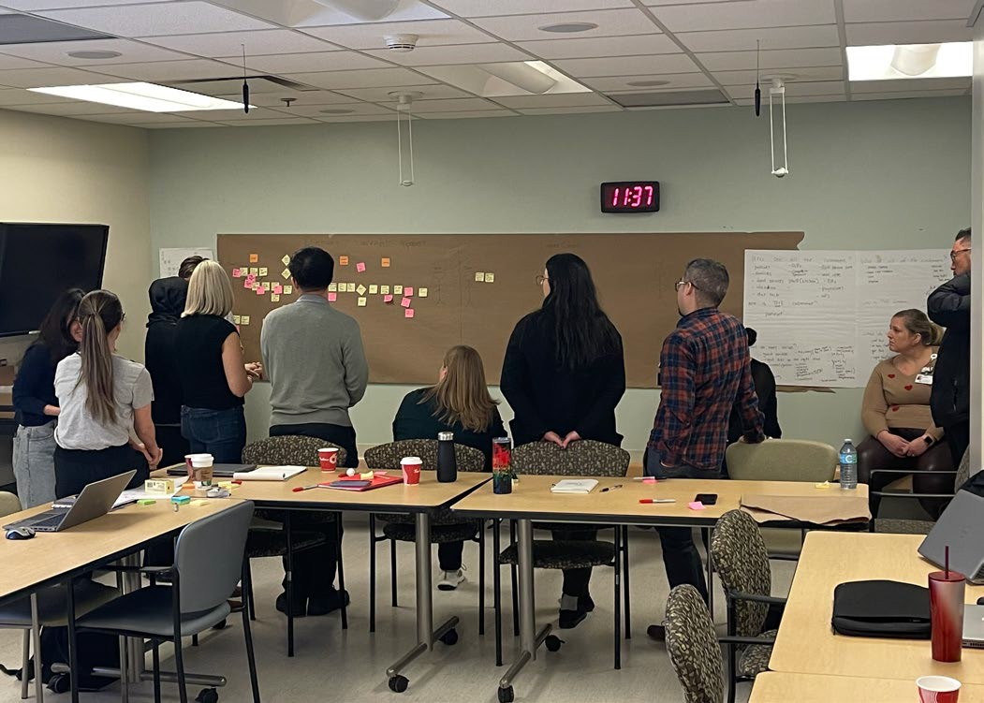
Appendix B. Comprehensive Mapping
Mapping Sessions
CAM & Cardiovascular Surgery Example:
Anesthesia
Birthing & Postpartum
CAM & Cardiovascular Surgery
Critical Care
Dietary
HRIS & Structural Heart
Information Technology
Laboratory
Medicine & Surgery
Mental Health Inpatient
Mental Health Outpatient
NICU & Paediatrics
Oncology
OR & CVOR
Pathology
Pharmacy
Pre & Post -Operative
Categories | Work activities to be completed to take us from current state to future state
Hardware/Equipment | 6
Meditech Improvements / New Build / Integration | 27
Operational Opportunities | 8
Process/ Workflow Optimization | 27
Grand Total: | 68

Slide 41

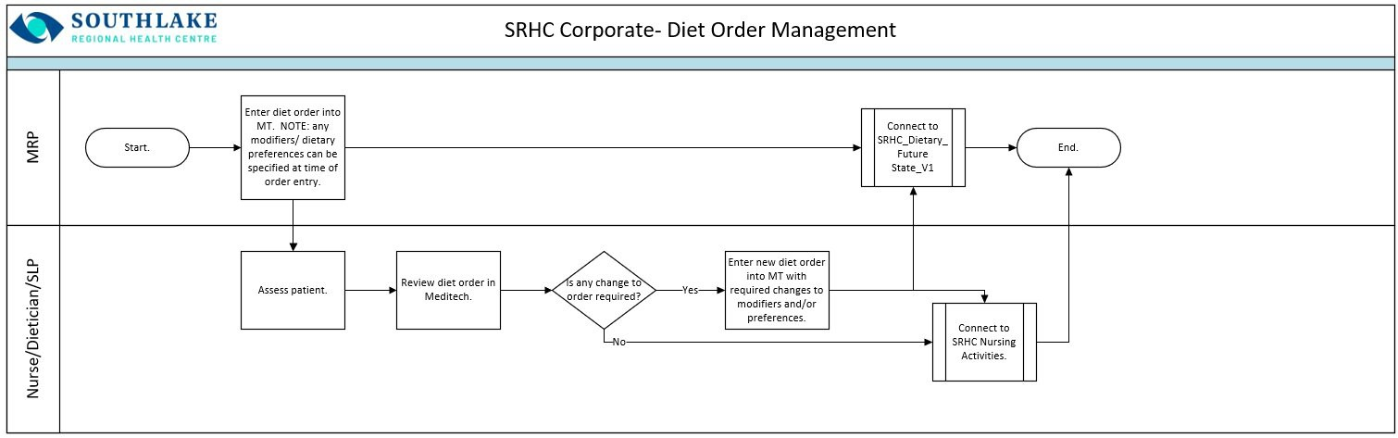

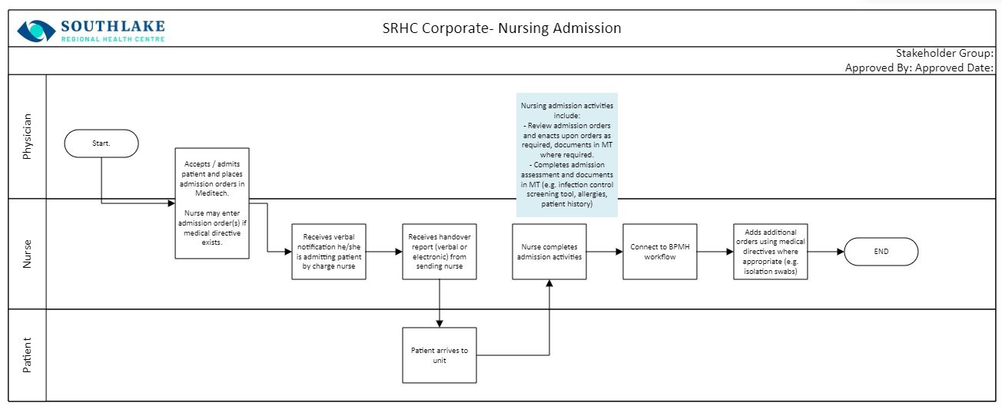
Appendix C. Workflows
Examples:
Diet Order Management
Nursing Admission

Slide 42
Appendix C. Workflows
Nursing Order Management | Hospital Referral (Phases of Care) | Medication Administration (4)
Admission prior (Phases of Care) | Infusions - Titrations (CADD) | Non-Provider Driven Transfer
Anesthesia (intra op) (Phases of Care) | Infusions - Titrations (Chemo) | Nursing Admission
Anesthesia Clinic (Phases of Care) | Infusions - Titrations (continuous and intermittent) | Nursing and Allied Order Management
Block Room | Infusions - Titrations (PCA/PCEA) | Nursing Handover
Blood Product Administration (2) | In-Pt Chemo Order Management | Nursing Specimen Collection and Order Management (+5 other workflows)
BPMH & Med Reconciliation - Transfer (2) | In-pt going into procedures (Phases of Care) | Office Referral (Phases of Care)
BPMH & Med Reconciliation - Admission (4) | In-pt referral to cardiac (Phases of Care) | Outpatient Follow Up Appointments
BPMH & Med Reconciliation - Discharge (2) | Inpt Return to Floor post procedure | Outpatient Same Day Bloodwork by Phlebotomist Workflow
Cardioversion (Phases of Care) | Internal Clinic Referrals | Outpatient Same Day DI Workflow
Cath Labs (Phases of Care) | Intra op (ADC/MAB) | Out-pt procedure prep (Phases of Care)
Consulting Provider Order Management | Intra op (Phases of Care) | PACU (Phases of Care)
Delayed or cancelled procedures | Intra op blood (Phases of Care) | Pathology
Diet Order Entry | Intra op Breast Bx (Phases of Care) | Pharmacist Initiated Medication Order Modifications
Direct Admit from External Facility | Intra op CV OR (Phases of Care) | Phase 2 (ADC/MAB)
Direct Admit from SL Clinic | Intra op Labs (ADC/MAB) (Phases of Care) | Phase 2 (Phases of Care)
Discharge - IP | Intra op Labs (Cardiac) | Planned admission (Phases of Care)
Discharge Deceased Patient | Intra op Labs (IR) (Phases of Care) | Pre-op clinic (Phases of Care)
ED to cardiac procedure | Intra op labs (Phases of Care) | Pre-op Structural Heart Assessment and Consultation Clinic (Phases of Care)
ED to Inpatient Admit | Intra op Meds (ADC/MAB) (Phases of Care) | Pre-op structural heart clinic (Phases of Care)
ED to procedure | Intra op Meds (Cardiac) | Provider Driven Transfer
ED to procedure (cardiac) (Phases of Care) | Intra op Meds (IR) (Phases of Care) | Radiology Minor Procedures (Phases of Care)
ED to procedure (Gen surg) (Phases of Care) | Intra op Meds (Phases of Care) | SDA (ADC/MAB) (Phases of Care)
Enteral Feed and Infant Feeding Administration | Intra op pathology (Phases of Care) | SDA (nurse activate) (Phases of Care)
Escalation Process for procedures | IR- Inpatients (Phases of Care) | Structural Heart (Phases of Care)
External Referral | IR- Outpatients (Phases of Care) | Unplanned Admission (ADC/MAB) (Phases of Care)
Finch/Elden/Sunrise IP Readmit | Lab Tech Specimen Collection | Unplanned admission (Phases of Care)
Heart Rhythm (Phases of Care) | Medical Codes - Documentation
Heart Rhythm Device Clinic | Medical Directives
Holding Meds Pre-Procedure | Medical Learners

Slide 43
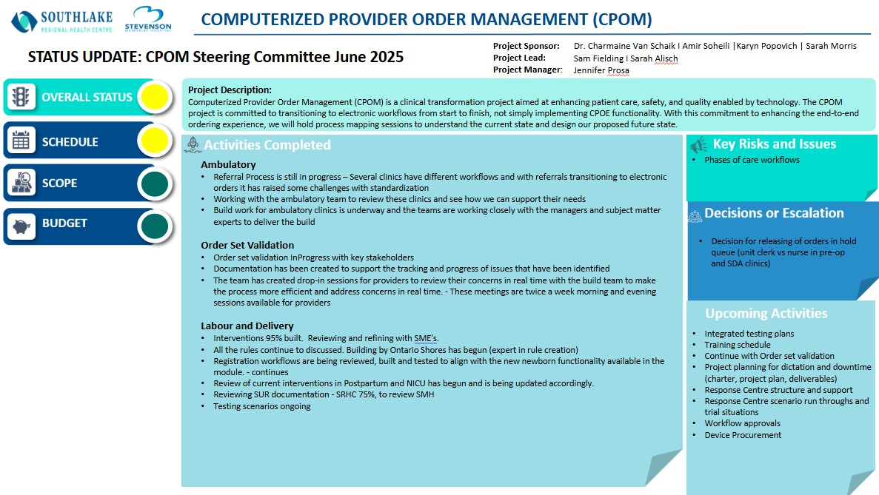
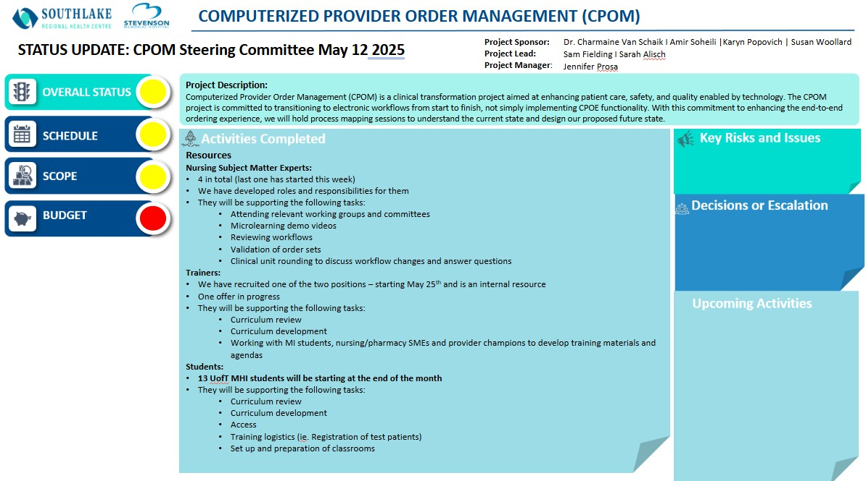
Appendix D. Status Reports
Biweekly reporting on all major project elements and clear awareness of overall status, schedule, scope and budget.

Slide 44
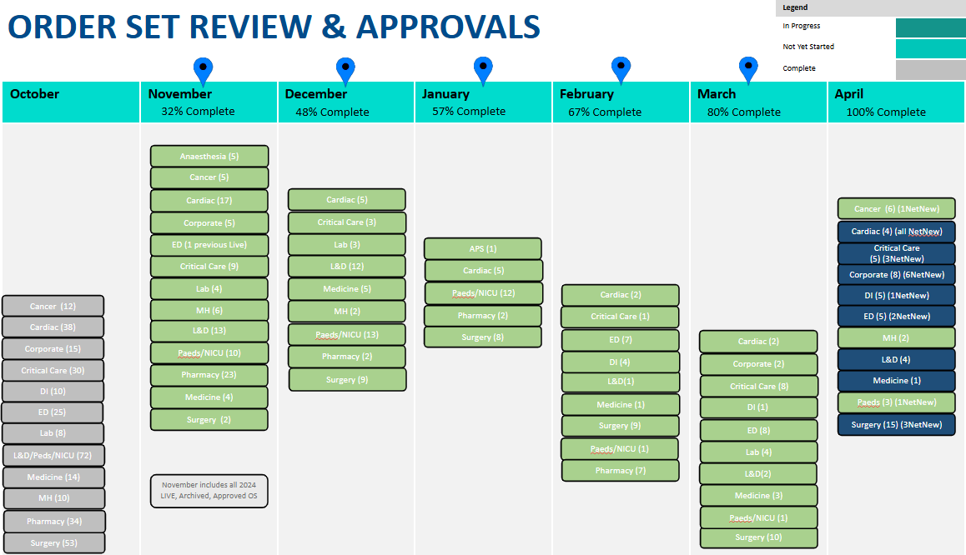
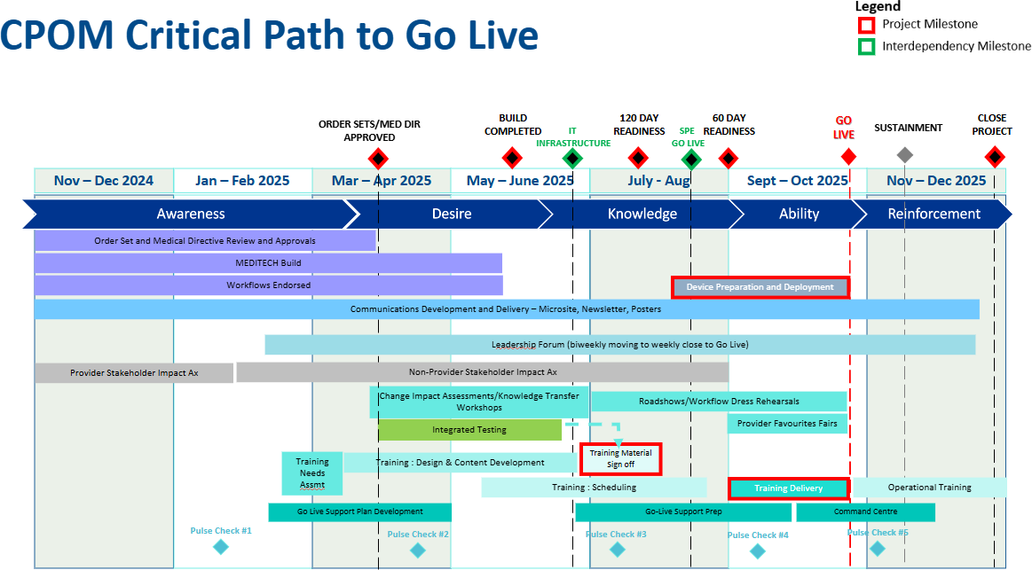
Appendix D. Status Reports
Incorporated all critical information including roadmaps and timelines

Slide 45
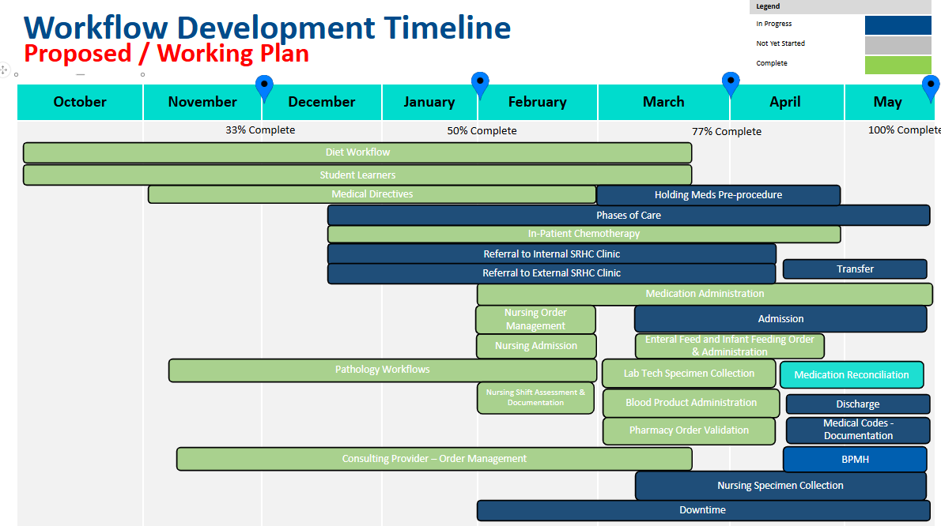
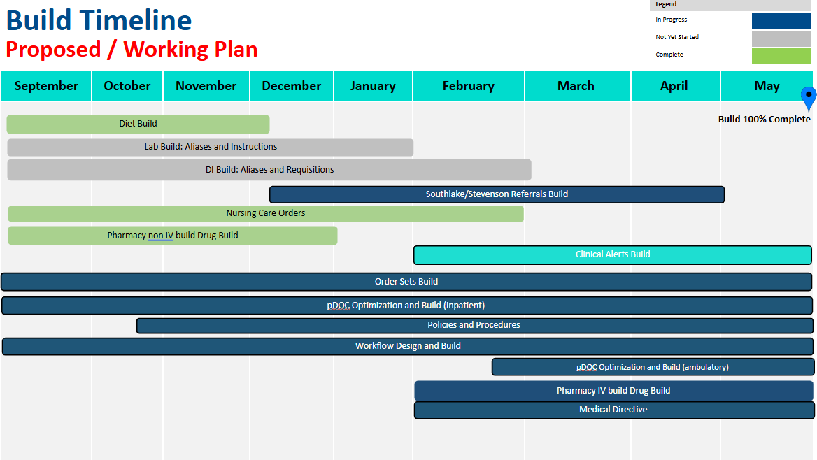
Appendix D. Status Reports
Incorporated all critical information including roadmaps and timelines

Slide 46



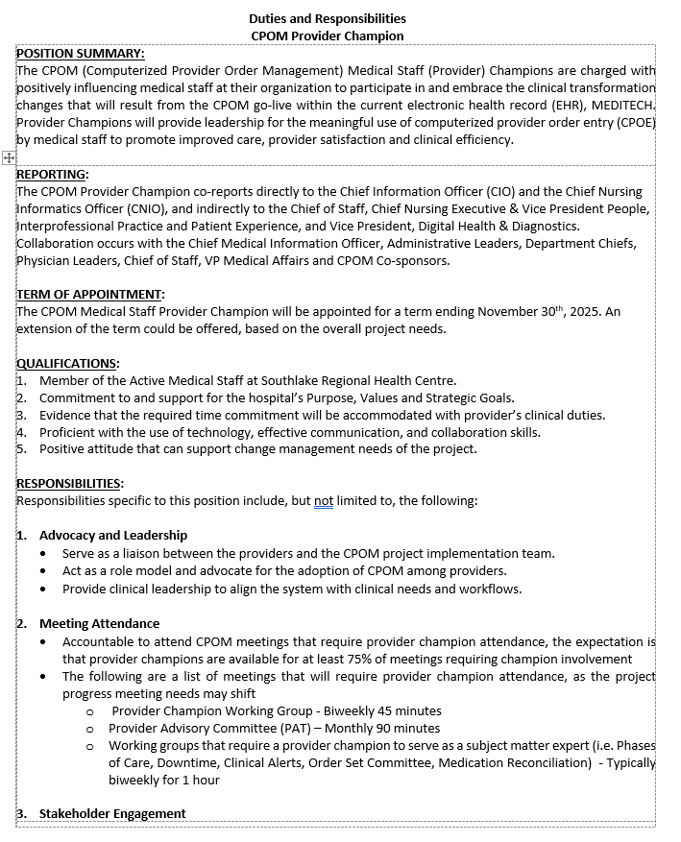
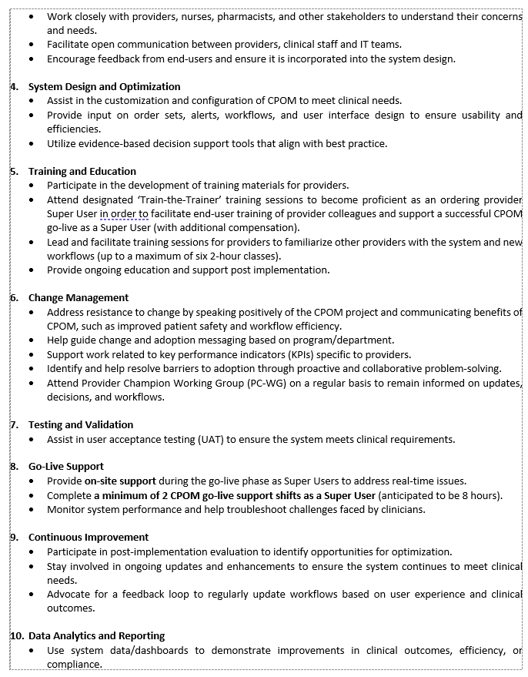
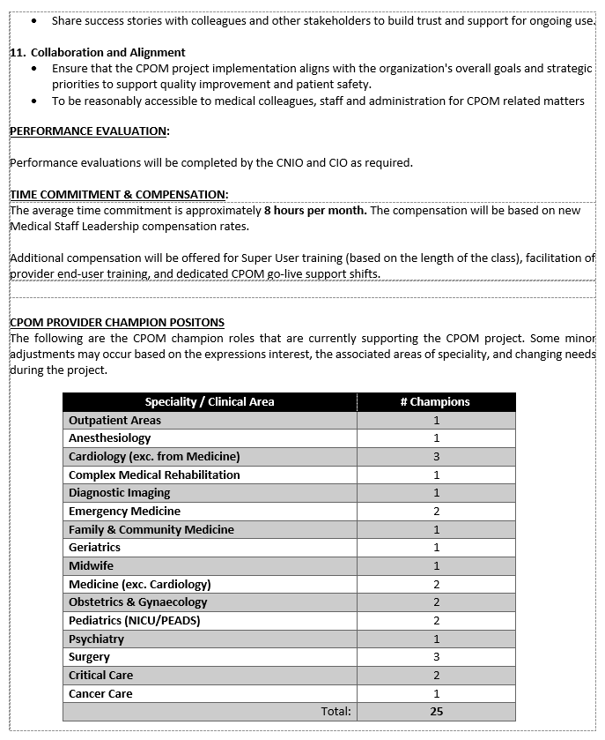
Appendix E. CPOM Provider Champions

Slide 47
Appendix F. Change Management
SOUTHLAKE’S CHANGE MANAGEMENT S.A.F.E MODEL
Attention Facilitate
A F
Setup
Encourage
S
E
In this step, you will:
Understand why the change is needed
Identify stakeholder groups
Identifying roles
Assess engagement needs
In this step, you will:
Identify change impacts by stakeholder group and any anticipated resistance
Understand stakeholder culture
Develop an engagement and communications plan
Understand learning and knowledge gaps
Develop a training plan to impact learning requirements (if required)
In this step, you will:
Understand any gaps between the current state and the desired state
Understand and address employee resistance
Identify workforce transition plans
Implement communications, training, and workforce transition plans
Monitor and adjust all plans according to feedback
Develop evaluation criteria to measure change effectiveness
In this step, you will:
Reinforce behaviours consistent with the desired state (Close Loop)
Diagnose gaps and continue to manage resistance
Measure change management adoption
Implement corrective action and celebrate successes
Develop sustainment plan
Signoff on knowledge transfer and transition change management ownership
Tools
Elevator Pitch
Stakeholder impact Assessment
Communications & Engagement Plan
Training Plan
Stakeholder impact Assessment – Readout
Resistance Management Plan
Change Plan
Change Readiness Assessments
Sustainment Plan
Measurement & Metrics (KPIs)
Sustainment Plan
Knowledge Transfer and Transition to sustaining ownership
Slippage Plan

Slide 48

Appendix F. Change Management
Due to the complexity of the transformation, CPOM needed to be supporting by a combination of change management methodologies. These helps to shape the Change Strategy and Change Management Plan.
Prosci ‘ADKAR’
Model
Kotter’s 8-Step Process
Kubler- Ross Model
Nudge Theory
COM-B
Theory

Slide 49
Appendix F. Change Management
Prosci ADKAR Change Model:
ADKAR was created by the Prosci Institute and is defined by Prosci as “a powerful yet simple model for facilitating individual change…based on the understanding that organizational change can only happen when individuals change. The ADKAR Model focuses on individual change – guiding individuals through a particular change and addressing any roadblocks or barrier points along the way.”1
The word ADKAR is an acronym for the five outcomes an individual needs to achieve for a change to be successful: Awareness, Desire, Knowledge, Ability and Reinforcement.
Kotter 8-Step Process:
The Kotter 8-step process, also known as the Kotter Change Model, is described as “a framework for managing and implementing organizational change. Developed by John Kotter, the model consists of eight distinct steps that organizations can follow to successfully navigate major changes.”2
Establish a sense of urgency
Form a powerful coalition
Create a vision for change
Communicate the vision
Empower others to act on the vision
Create short-term wins
Consolidate gains and produce more change
Anchor new approaches in the organization’s culture
These eight steps are:
Citations:
1 The Prosci ADKAR® Model | Prosci
2 Kotter’s 8 Steps for Leading Change in Organizations | Splunk

Slide 50
Appendix F. Change Management
Kubler-Ross Change Model:
The Kubler-Ross Change Model was initially developed by Elizabeth Kubler-Ross to describe the human response to learning of terminal illness. It has since been expanded to a full change model to describe normal human reactions to change.
The five stages in the Kubler-Ross Model are:
Denial
Anger
Bargaining
Depression
Acceptance
Nudge Theory:
The ‘Nudge Theory’ revolves around presenting change in a compelling way, to be more readily accepted by stakeholders.
This involves:
Clearly define your changes
Consider the changes from your
[stakeholder's] point of view
Use evidence to show the best options
Present the changes as a choice
Listen to feedback
Limit obstacles
Keep the momentum up with short-term wins
COM-B Theory/Model of Behaviour:
The COM-B model of behaviour is widely used to identify what needs to change for a behaviour change intervention to be effective.
It identifies three factors that need to be present for any behaviour change to occur: Capability, Opportunity and Motivation.³
Citations:
³ A brief introduction to the COM-B Model of behaviour and the PRIME Theory of motivation [v1] - UCL Discovery

