Slide 1

Expanse Order Sets: The New Frontier
Douglas A. Janowski, M.D.
Sr. Physician Advisor for I.T and CIN
October 2, 2025

Slide 2

Objectives
Understanding of a comprehensive approach to design and architecture of order sets to drive:
Best practices for clinical care
Achieve Quality Measures
Intended Audience
Analyst Team: OM, PCS, SUR, PHA
Clinical Informatics Team: Physicians, Nursing
Leadership

Slide 3

Willis Knighton Health
Four acute care hospitals
The James K. Elrod Rehabilitation Institute
  Inpatient and Outpatient Rehab
  Behavioral medicine
20 Specialty Centers including Cancer Center, Heart and Vascular Institute, and Eye Surgery Center
Extended Nursing Care and Retirement Living
To continuously improve the health and well-being of the people we serve.
Prepared by or for Willis Knighton Health and provided here as reference only. All rights reserved.

Slide 4
A Comprehensive Approach to Advanced Order Sets
Governance
Definition of Advanced Order Sets
Guidelines to define order sets / orders best served by advanced order set configuration
Guidelines to establish parameters that must be achieved by advanced order set build
Essential partnership between Clinical Stake Holders and Expanse Team (Clinical Informatics, OM, PHA, PCS analysts)

Slide 5
Advanced Order Sets: The Devil is in the Details
Architectural construct
  Rules
  Convenience Sets
  Standardization to structure and appearance across sets
Principles
  Guided ordering for requirements of:
    Best practices
    Quality standards

Slide 6
Design Principles
Define “goals” of the set
Understand clinical workflows for all impacted groups:
  Providers
  Nursing
  Pharmacy
  Lab
  Radiology
  PT / OT / SLT / RT
Keep the flow simple even if the build is complex
  Single-select
  Supporting orders
Apply literature supported best practices
Build out the order strings

Slide 7
It’s All About the Rules. . .
Rules are not necessarily sacred, principles are. There are no rules of architecture for a castle in the clouds. Hell, there are no rules here – we are trying to accomplish something
. . . Martin Luther King, Jr

Slide 8
Build the Right Team
There is no “I” in Team . . .
Multi-disciplinary and Multi-Contributor
Provider I.T.
  Douglas Janowski, M.D.
OM
  Tammy Goldsmith
  Shramik Maddineni
PHA
  Michael Rydberg
  Wes Tarver
  Alicia McPherson
PCS
Nursing I.T.
  Jason Johnson, R.N.
  Tony LaSuzzo, R.N.
  Lilith Choate, R.N.
  Christie Huff, R.N.
Respiratory
  Robben McMullen
Susan Cheek
Robert Conn
Lab
Quality
  April Edwards, R.N.
  Stacey Robinson, R.N.
  Kelly Davis
  Jenna Strecker
David Simmons
Mike Brewer
Gary Wilson

Slide 9
Ready? Set? Go!!!
Where do you begin?
  Quality initiatives
  Provider Efficiency
  Nursing / Pharmacy / Ancillary Workflow
What are you intending to achieve?

Slide 10
Quality and Safety:
Living Examples of Advanced Order Set Success
Order Sets
Unfractionated Heparin Infusions
Pain Management
  Acute Medicine
  Acute Surgical
  Geriatrics
Sepsis
EKOS
Impact
Monitoring of Order Set Utilization
Clinical and operational impact for Providers, Nurses, Pharmacy, Lab

Slide 11
Unfractionated Heparin – Where it All Began
What?
Structured, intelligent order set for the ordering and administration of Unfractionated Heparin
Why?
Multiple Heparin gtt protocols with variance of nomogram guidance and weight-based dosing
Facilitate nursing management of concurrent multiple patients on different Heparin infusions
  Queue up appropriate orders for:
    Dose Adjustments
    Serial labs

Slide 12
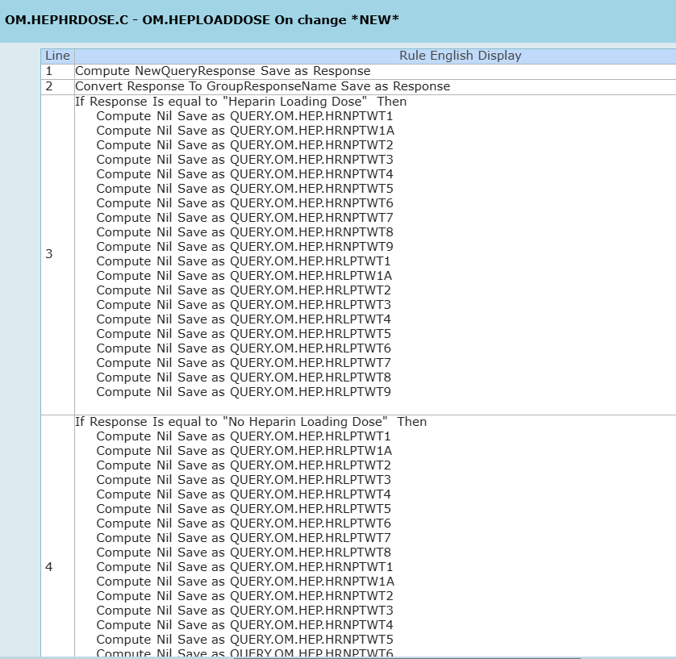
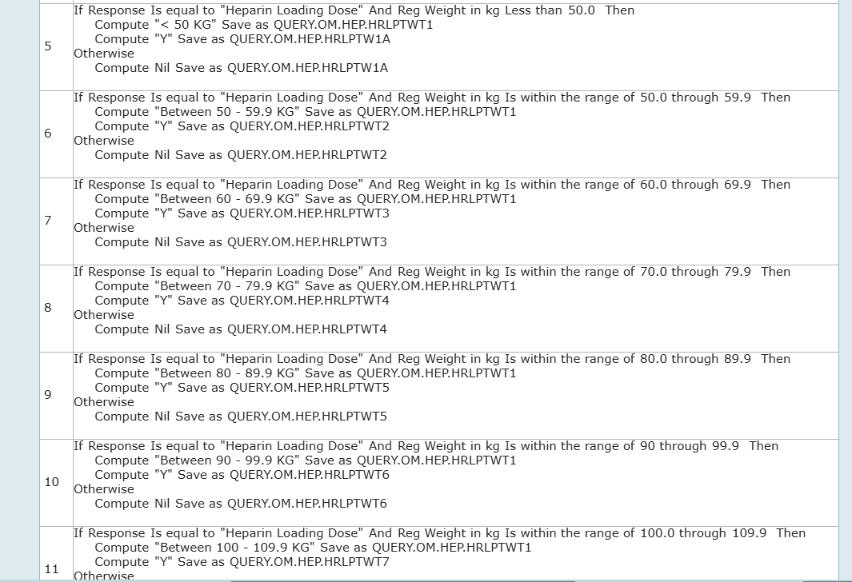
Heparin Rules

Slide 13
Pain Management – More than just “prn pain”
What?
Comprehensive approach to ordering Pain Management in the Acute Setting
Configured by Patient Type / Specialty
  Medicine
  Surgery
  Obstetrics
  Geriatrics
Why?
Improve quality metrics of pain management through guided approach to comprehensive regimen
Reduce untoward outcomes
Prevent duplicate orders

Slide 14
Sepsis Antimicrobials – We know you like Vancomycin and Zosyn, but. . . .
What?
Guided approach to “best practice” antimicrobial regimens upon presentation of Sepsis
Why?
Improve outcomes of Morbidity / Mortality
Incorporate best-practice and latest antibiogram data in real-time orders
Queue up Pharmacy engagement and opportunity for de-escalation / antimicrobial monitoring

Slide 15
Sepsis Fluids:
Since we already had you at “Sepsis Antimicrobials”
What
Facilitate the STOP-Sepsis standard of 30mL/kg of intravenous fluids
Why?
Ensure compliance with the Sepsis fluid measure
Present compliant, “therapeutic” options of intravenous fluids in facilitated manner for selection
Context of required total volume

Slide 16
The Fine Print. . .
Educate!
  Educate!!
    Educate!!!
Track Order Set Utilization
Review order sets
  At a minimum:
    Standing orders – annually
    All other order sets – every 3 years
      High volume, high impact sets no less than annually

Slide 17
To Our Friends and Colleagues at Meditech
Requests to further optimize order set build:
Allow for single select within the native architecture
Allow for sets within sets with architecture that still respects the rule of “Do not check for duplicate conflicts”
Facilitate sharing of order sets across the Meditech Community
Continued optimization of “Personalized” order sets to allow for application to Advanced Order Sets without corruption of content (i.e.: Preop Order Sets)

Slide 18
Additional Thank You to Our Friends and Colleagues at Meditech
Order Management
Amanda Ranieri
Kevin Judge
Melanie Mullis
Physician Support
Andrew Burchett, M.D.
William Gustin, M.D.

Slide 19

Thank you!
Would you like to collaborate? Here is our contact information:
Douglas Janowski, M.D.

