Slide 1


IMPACTFUL DATA:
Powering the Future of Healthcare Through Scalable Innovation
Notes:
My name is Mike Cordeiro and I’m the Senior Director of Interoperability Product Market Strategy at MEDITECH.
For today’s conversation, I’ll be focusing on:
how the right data,
shared the right way,
can reshape the future of healthcare.

Slide 2

Vision
To advance digital health record technology so every patient and their consultants can access their health information and participate in care.
Notes:
Today I want to talk about the importance of scalable innovation, intelligent infrastructure, and interoperable data exchange.
But none of that matters unless it’s being implemented:
on the ground,
in real care settings,
with real outcomes

Slide 3
Adoption of the EPR continues to grow
throughout the UK in both private and public sectors
HCA International
Christie Hospital NHS Trust
Queen's Hospital Romford
The Wellington Hospitals
The Harley Street Clinic
The Portland Hospital
The Lister Hospital
The Wilmslow Hospital
London Bridge Hospital
London Bridge Hospital
at Guy’s Hospital
HCA Laboratories
University Hospital Birmingham
Harley Street at University College Hospital
The Princess Grace Hospital
NHS Foundation Trust
Sunderland Royal Hospital
Sunderland Eye Infirmary
South Tyneside District Hospital
Gateshead Regional Laboratory
Elmhurst Intermediate Care
NHS Foundation Trusts
Queen's Hospital Burton
Samuel Johnson Community Hospital
Sir Robert Peel Hospital
The London Clinic
New Victoria Hospital
Liverpool Women's Hospital NHS
Foundation Trust
Alder Hey Children’s NHS
Foundation Trust
South Tyneside and City Hospitals Sunderland
University Hospitals of Derby and Burton
The Rotherham NHS Foundation Trust
The Clatterbridge Cancer Centre NHS
Foundation Trust
Congleton War Memorial Hospital
Macclesfield District Hospital
Leighton Hospital
Notes:
In those care settings, across the UK, MEDITECH is proud to support a growing network of NHS Trusts and independent consultants who are leading the way in digital maturity.
From acute hospitals to community care settings,
these organisations are using our EPR platform to reduce administrative burden,
improve patient engagement,
and unlock real-time insights.

Slide 4
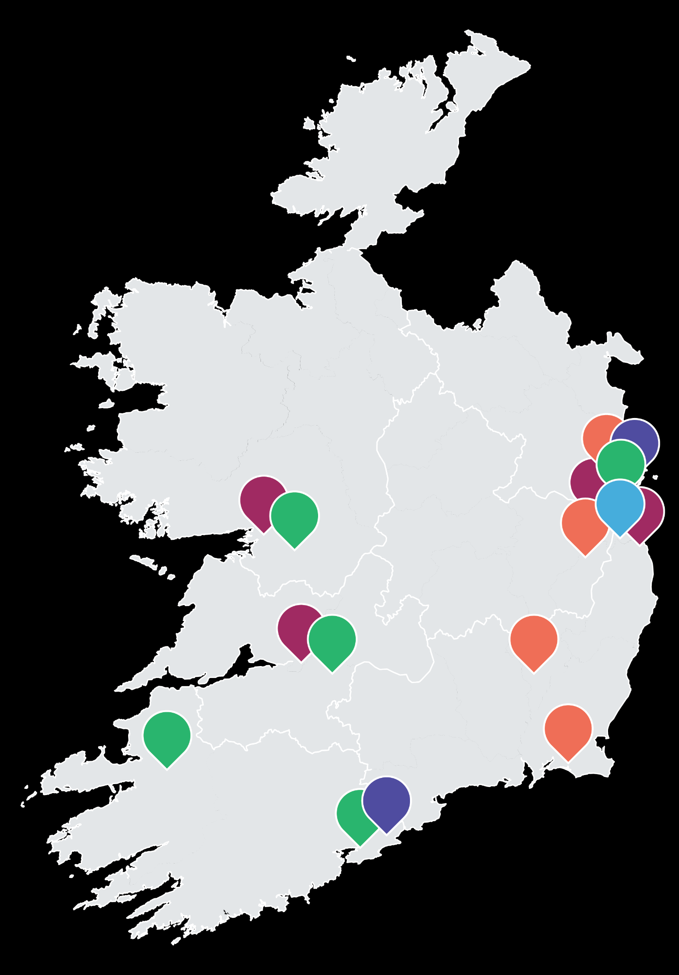
is the EHR supplier to more than 80% of the private healthcare
market in Ireland, including all of the country’s largest private healthcare systems.
HSE WEST AND NORTH WEST
Bon Secours Health System
Blackrock Health Group
HSE MIDWEST
Bon Secours Health System
Blackrock Health Group
HSE SOUTH WEST
Bon Secours Health System
Mater Private Network
HSE DUBLIN AND THE NORTH EAST
Bon Secours Health System
Mater Private Network
UPMC Ireland
HSE DUBLIN AND THE MIDLANDS
Blackrock Health Group
UPMC Ireland
HSE DUBLIN AND THE SOUTH EAST
Blackrock Health Group
UPMC Ireland
Beacon Hospital
Notes:
And in Ireland, we’re seeing similar momentum
with MEDITECH’s footprint in private sectors,
supporting integrated care pathways
and enabling clinicians to make faster, more informed decisions

Slide 5
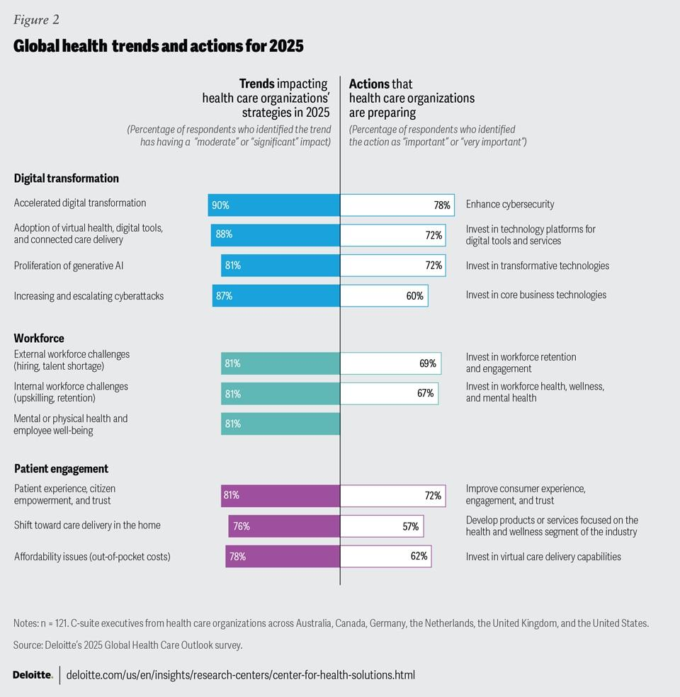
Primary Global Health Trend:
Accelerated digital transformation
90% of C-suite Executives expect the use of digital technologies to accelerate, with half expecting a significant impact on their strategies
Notes:
Having seen how MEDITECH is driving digital maturity and integrated care across the UK and Ireland,
let's now broaden our perspective and examine the primary global health trends that are shaping the future of healthcare in 2025.
This data from Deloitte’s global survey of health care executives shows a clear trend: digital transformation is no longer optional—it’s foundational.
Nearly 90% of executives anticipate accelerated digital technology use, with half expecting significant strategic impact, including EPR, cloud, and AI.
—---------------------------------------------------
Let’s take a look at what health system leaders around the world are prioritizing in 2025
Globally (Deloitte survey of c-suite execs in UK, Canada, US, Netherlands, Germany), health systems are focusing on digital transformation, the workforce - (retention, wellbeing), and patient engagement. Access, affordability and keeping care at or close to home are top priorities. The Canadian experience of patients wanting to have care tailored to their needs and preferences and to be active participants in their care is something that we see resonating in all of the markets we serve.
https://www.deloitte.com/us/en/insights/industry/health-care/life-sciences-and-health-care-industry-outlooks/2025-global-health-care-executive-outlook.html
https://policyoptions.irpp.org/2025/03/health-digital/
Globally, health systems are focused on digital transf, improving the way, streamlining workforce and operations and engaging patients
These trends

Slide 6
Healthcare Delivery Objectives
Throughout the UK and Ireland
From sickness to prevention
From hospital to community
From analogue to digital
NHS 10 Year Health Plan:
Receiving the right care,
in the right place, at the right time
Healthy communities
Strong foundations
HSE Corporate Plan 2025-2027:
Notes:
What’s striking is how closely these global priorities mirror the objectives of the UK and Irish markets:
improving operational efficiency,
reducing clinician burden,
and enhancing patient engagement.
In fact, the UK and Ireland are ahead of the curve in many respects—
investing in intelligent EPR platforms,
integrated care pathways,
and real-time data exchange.

Slide 7
Healthcare Delivery Objectives
Throughout the UK and Ireland
Integrated and Coordinated Health Systems Delivering Care Locally
Person-Centered Proactive Care
Digital Transformation and Innovation
A Unified Aim
Notes:
This alignment reinforces a key point:
the strategies we’re discussing today aren’t just relevant locally
they’re resonating globally.
And MEDITECH is proud to be part of that movement.

Slide 8

Turning Universal Barriers…
Clinician burden
Diminished patient trust & engagement
Population health inequities
Notes:
Across every health system—whether in Liverpool, Boston, or Dublin—we encounter the same stubborn barriers. Operational strain. Fragmented care. Patient disengagement. But these aren’t just obstacles. They’re invitations to innovate.
In order to meet these global objects, and your national objects
We need to solution for clinician burden and help support care teams as they deliver care
Increase patient trust and engagement
Solve for disparate health inequities
And proactively build healthier communities

Slide 9

Data is the Opportunity
30%
of the world’s data is generated by the healthcare industry…
97% goes unused
80%
of the healthcare data is unstructured
Notes:
Healthcare technology is only effective as a tool if we’re leveraging data to enable each of those breakthroughs
Data is a foundational element in the advancement of healthcare technology.
Data is no longer passive or just a byproduct of care, data is active, interoperable, transformative
Need to find stat attribution
30% of data is healthcare data: https://www.rbccm.com/en/gib/healthcare/episode/the_healthcare_data_explosion
97% goes unused: https://www.weforum.org/stories/2024/01/how-to-harness-health-data-to-improve-patient-outcomes-wef24/
80% is unstructured: https://www.datavant.com/risk-adjustment/healthcares-great-data-problem

Slide 10

Positively Impacting the Healthcare Ecosystem
Infrastructure Powers the Intelligent Platform
Intelligent Platform Automates Patient, Workforce and Clinician Experience
Data Powers the Infrastructure
Notes:
The way in which data is impacting how you are delivering care, engaging your patients and optimizing your operations is a direct result of the investment we’ve made in Expanse as a platform
Foundationally, the robustness of the toolsets we offer, are only made available because of our investments in our infrastructure
Keeping in mind that data, and the insights realized from it, are derived by the infrastructure, and I’m going to spend a little time today talking about those investments and how the infrastructure powers our platform.

Slide 11


Epic Site(s)
PointClickCare
11 healthcare instances across
40+
hospitals
300+ long-term care sites operating the PointClickCare® EPR
Individual MEDITECH Organisations
Canada
Oracle HIE
Provincial Assets
Drug Data
Lab Database
Notes:
MEDITECH in it’s core has been an open and accessible EPR, interoperability is foundational to everything we do.
In Canada, we were the first to introduce a national interoperability platform…
Connecting MEDITECH acute EPRs to instances of Oracle, Epic, and long-term care sites using PointClickCare

Slide 12

CommonWell
Carequality
110+
HEALTH
SYSTEMS
LIVE
ACROSS
39
U.S. STATES & TERRITORIES
U.S States
& Territories
Individual MEDITECH Organisations
eHealth Exchange
Qualified Health Information Networks aligned with TEFCA
Notes:
Given our successes in Canada, we brought that same solution to the states…

Slide 13
Private Hospitals
Regional HIEs
Public Trusts
Individual MEDITECH Organisations
National Platforms
Notes:
Given the successes we’ve had in Canada and the United States…

Slide 14
An Intelligent Infrastructure
Data Collection & Normalisation
Data Collection & Normalisation
Meaningful Exchange
Meaningful Exchange
Industry Standard Data Structures
Industry Standard Data Structures
Utility
Utility
Cloud Based
Cloud Based
Mobile Native
Forward Looking
Mobile Native
Forward Looking
Notes:
Data only becomes a valuable tool when it can be leveraged
Our investments in interoperability tooling…

Slide 15
Null Object - do not delete
The intelligent Platform
An Open Ecosystem of Innovation
Expanse Navigator
Automated clinical documentation
Leveraging Tech Through Innovation
Reducing Clinician Burden
Access to the RIGHT data
Integrated Care Systems (ICS)
Empowering Patients
Meet patients where they are
National Apps (NHS, HSE, etc)
Improving Efficiency & Outcomes
Capacity management / Advanced analytics
Streamlining & Optimising Processes
Resource Allocation
Supporting Integrated Care
Supporting Data Convergence
Integrated Care Systems (ICS)
Notes:
From Jen: add more than just streamling/time save - tie at times to the NHS digital strategy - breaking down walls and silos of care. sweat the assest/optimisation piece as part of the autonomy discussion.

Slide 16

AI is changing everything…
Are you ready?
Notes:
Technology isn’t static it continues to advance
This next generation of technology is unlocking greater insights within data
As technology advances, we have been taking the steps to

Slide 17
AI
Agentic
Adaptive, independent agent that can set goals, plan actions, and decide how to solve problems
Requested By | Joe Hutnak
Created | 5/18/2023
Graphics Updated | 9/29/2023
Content Updated/Reviewed | 3/4/24
Overarching term for teaching computers to think and act in
a human-like way
Natural Language Processing
Field of AI that involves training computers to understand (Natural Language Understanding) and generate (Natural Language Generation) spoken and written word
Machine Learning
Type of AI that uses large datasets to train models to identify patterns, make predictions
Generative AI
AI models that identify and use patterns and relationships in data to create new content
Deep Learning
LLM
Type of Machine Learning, defined by artificial neural networks used for internal processing and pattern extraction; requires very large volumes of data
A type of model that uses an understanding of language to generate content
Notes:
Before I get into wow’ing everyone with the AI solutions we have to offer, I wanted to provide some context on this overarching term for various forms that AI can take

Slide 18

MEDITECH and AI:
Our Mission
MEDITECH’s mission is to provide technology that enables healthcare organisations to deliver safe, efficient, and impactful care; our approach to incorporating AI into EHR solutions is thoughtful, deliberate, and driven by an understanding that it should safely enhance the experience for patients, care teams, and healthcare organisations.
Notes:
With these advancements comes responsibility - our mission
NHS AI policy - which I think just got released this year and can be found here (may want to mention how we are in line with that or will be growing in line with that) - https://transform.england.nhs.uk/information-governance/guidance/artificial-intelligence/

Slide 19

Patient Connect
MyHealth assistant
AI
Patient
Gen AI: hospital course & nurse handover
Ambient scribe
Navigator
Expanse chatbot
Expanse Now voice interaction & schedule prep
Clinicians
Appointment no show
Claim denial agent
Analytics: auto dashboards
Online helper chatbot
Online helper chatbot: DR schema
Transformation
in Expanse
Operations
Notes:
What we have been building toward is an agentic user experience within Expanse. We have focused deeply on improving the workflows for clinicians, patients, and all facets of the organisation. We have committed to building an architecture that allows data to move and be leveraged in impactful ways. We have built a robust interoperable data exchange network, and are infusing new technology to address challenges. As we look at the Expanse platform, we are working on significant enhancements for patients, clinicians and the workforce as a whole. In addition to some of the AI based features you have already heard us talk about, we are working on a chatbot within the MyHealth portal, a chatbot within Expanse, voice interaction and schedule prep within Expanse Now, a claim denial agent, features to auto-create dashboards within BCA, and an online helper chatbot that will assist with answering user questions about Expanse and finding tables within the DR schema. We’re introducing these features across the patient, clinician and operational domains. We’re happy to show you any of these in the MEDITECH lounge during breaks, but we’ve picked some highlights to share with you all, right now.
Rather than you have to continue to listen to my voice to explain some of these to you, I would like to show you a video that can explain and show you what I mean.
We’ve exemplified this by

Slide 20

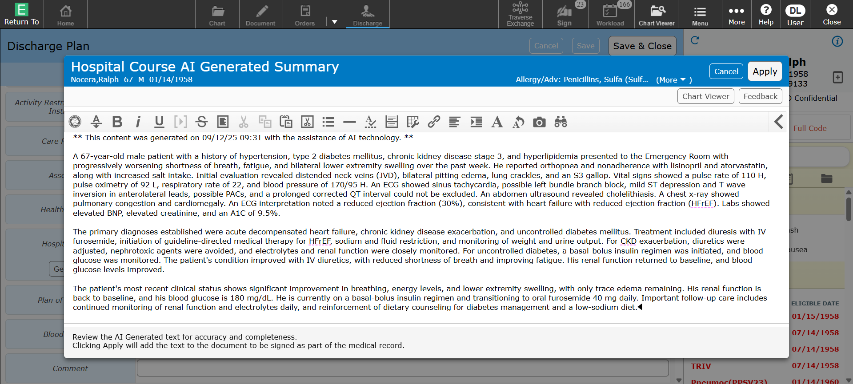
Empower with Generative AI:
Hospital Course Summary
AI-Generated summary directly within workflow.
Transparent language and timestamp indicate AI assistance.
Prompts clinician to review, enhancing accountability.

Slide 21



Real-World Impact:
GenAI Hospital Course Summary at Fraser Health
Prior to AI
With AI
1000+ AI-generated Summaries
12.5
5.5
Min on Average
Min on Average
~7 Min Saved per Discharge
117 Hours Saved Over 1000 visits
Time Spent Documenting Hospital Course Summary
~117 Hours Reclaimed
Data and analysis provided by Fraser Health Authority
In just over 1k generations (including some new users), they are reporting that on avg it took 12.5 mins to do the summary prior to AI, and now is taking 5.5 mins with AI. 7 mins saved per discharge x 1000 generations and he says we have saved them 7k minuts
6.95 minutes on average, rounded up to 7 minutes per discharge. If multiplied by 1000 visits, then that is 7000 minutes saved total, not per discharge.
Notes:
In just over 1k generations (including some new users), they are reporting that on avg it took 12.5 mins to do the summary prior to AI, and now is taking 5.5 mins with AI. 7 mins saved per discharge x 1000 generations and he says we have saved them 7k minuts
6.95 minutes on average, rounded up to 7 minutes per discharge. If multiplied by 1000 visits, then that is 7000 minutes saved total, not per discharge.

Slide 22

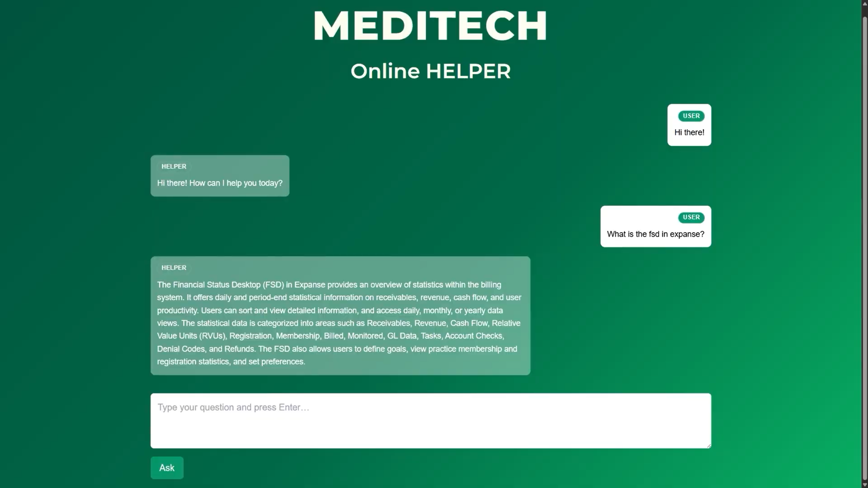
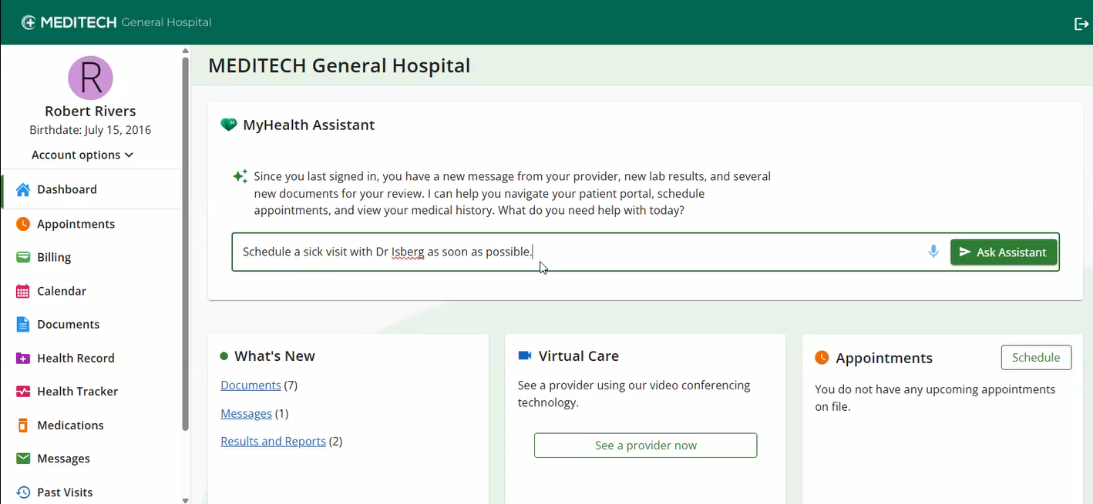
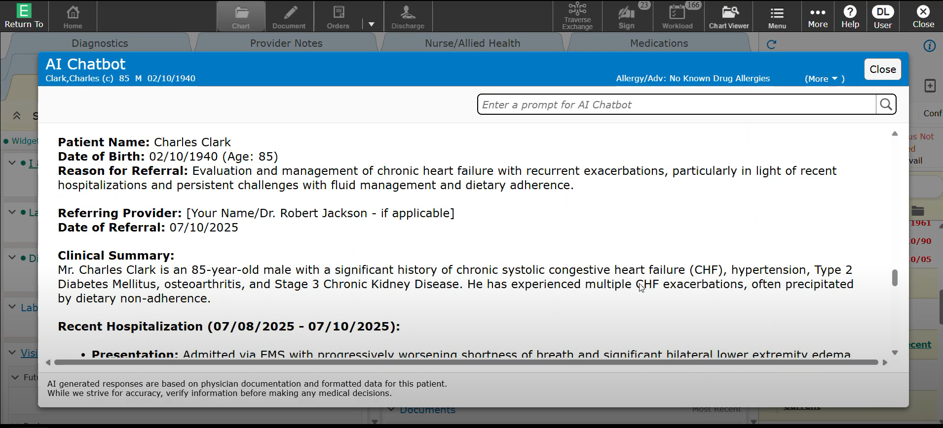
Chatbots
draft a referral to cardiology
Empower users with instant, context- specific support
Support patient portal navigation and scheduling
Engage with the record to summarise, synthesise, and act

Slide 23
“We think of agents as systems that combine the intelligence of advanced AI models with access to tools, so they can take actions on your behalf and under your control.”
Sundar Pichai, 2025
Notes:
Many people ask what is an Agent? Well here is how Sundar defined it at I/O.
We think of agents as systems that combine the intelligence of advanced AI models with access to tools and data, so they can take actions on your behalf and under your control.
[[ VIDEO ON NEXT SLIDE]]
I’d like to show you a video that was previewed at our conference a few weeks ago, I know some of you were there in person, but for those that were not, I’d like to show the art of the possible in what your organisations, public and private can leverage.

Slide 24
Wednesday 1st Oct
11:00-11:30
The Intelligent EPR - Expanse
Mike Cordeiro, Senior Director - Interoperability Market & Product Strategy
Kristen Martino, Product Manager
LEARN MORE
11:35-12:05
Breaking Down the Barriers: How Traverse Exchange Facilitates Innovation and Optimisation in Clinical Workflows
Kristen Martino, Product Manager
12:10-12:40
Transform how Clinicians Work with Microsoft Dragon Copilot
Dr Simon Wallace, CCIO, Director of Business Strategy & Pierre Meyblum, International Healthcare Partner Leader, Microsoft
Mike Cordeiro, Senior Director - Interoperability Market & Product Strategy, MEDITECH
Breakout
Sessions
15:25-15:55
From Data to Decisions: Implement, Innovate, and Optimise with MEDITECH Analytics
Kristen Martino, Product Manager

Slide 25
Thursday 2nd Oct
LEARN MORE
10:00-10:30
Ireland’s Journey Toward Connected Care and Digital Transformation
Alastair Allen, Partner, Head of Healthcare Technology, EY
Mike Cordeiro, Senior Director - Interoperability Market & Product Strategy, MEDITECH
Breakout
Sessions
14:15 - 14:45
Unlocking Patient Engagement: A Look at MyHealth and Beyond for Building a Better Patient Experience
Kristen Martino, Product Manager
Siobhan Warner, Product Manager

Slide 26


T H A N K Y O U

