Slide 1

WELCOME TO
2025

Slide 2

IMPLEMENT.
INNOVATE.
OPTIMISE.

Slide 3










DELEGATE SPEAKER PRESENTATIONS

Slide 4











VENDOR SPEAKER PRESENTATIONS

Slide 5
INVITE-ONLY MEETINGS
STATUTORY CHANGE GROUP
Point of Contact: Daniel Short – MEDITECH
Location: MEDITECH Boardroom
Time: 11am - 12pm
MUN EXECUTIVE
Point of Contact: Darragh McNally – Bon Secours Health System
Location: MEDITECH Boardroom
Time: 12.40pm - 1.40pm
IRISH CUSTOMER FORUM
Point of Contact: Raphael Jaffrezic – Blackrock Health
Location: MEDITECH Boardroom
Time: 1.40pm – 2.40pm [Note: Date and time change from the programme]

Slide 6


MUSE SPEAKER PRESENTATIONS

Slide 7
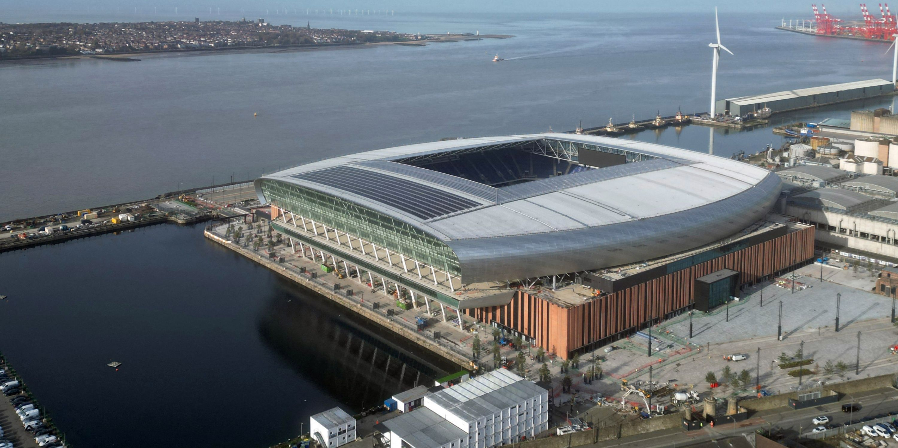
EVENING RECEPTION
Tonight - 6pm
Hill Dickinson Stadium
All Delegates & Vendors are invited

Slide 8


MUN FUN RUN
📅 Date: Thursday 2nd October 2025
🕗 Time: Meet at 7:45am, run starts at 8:00am
📍 Start/Finish: Hilton Hotel – Liverpool One
📏 Distance: 5.1K
👉 All abilities welcome!
💜 Donate: https://www.justgiving.com/page/meditech-uk-and-ireland-10
📝 Register here: https://MUNFunRun25.eventbrite.ie
This run will be fundraising for the Owen McVeigh Foundation - a wonderful local charity to Liverpool that supports children with cancer and their families, helping create lasting memories and moments of joy.

Slide 9
WELCOME TO
2025

