Slide 1





EPMA Go Live
Cutover Week
Presented by Nikita Jain

Slide 2



Who are we?
Digital Clinical System (DCS)
A joint project with Mid Cheshire NHS Trust - two Trusts which had been using paper prescriptions entirely for the prescribing and administration of medications.
Nikita jain
Momina butt
Ian johnson/ michael trimble
Principal Pharmacist EPMA
Lead Pharmacist for Digital and Medicines
Safety
Lead EPMA Pharmacy Technicians
Notes:
We are from East Cheshire NHS Trust, and our team consists of Nikita Jain – Principal pharmacist of EPMA
Momina Butt – myself the lead pharmacist for digital and medicines safety
And Ian/Mike the lead EPMA pharmacy technicians
This joint project with Mid Cheshire NHS Trust was named Digital Clinical System, and it marked a major transformation for two Trusts that had previously depended solely on paper-based prescriptions for prescribing and administering medications. By implementing Meditech, we replaced manual, paper-driven processes with a fully integrated digital platform,

Slide 3
Our Strategy
LEVEL 1
Maintain core clinical services and not detract from patient-facing clinical care
LEVEL 2
Create a dedicated, focused and skilled supplementary MDT (MEDITECH Super Users) who can carry out the cut-over process to ensure a smooth transition
LEVEL 3
Achieve this on a prioritisation basis with a rolling program of wards
LEVEL 4
Complete this successfully within a maximum 7-day period
LEVEL 4
LEVEL 3
LEVEL 2
LEVEL 1

Slide 4

Key Stakeholders
EPMA
+
DCS Cutover planning team
Trust On-call team
Trust Communication team
Operational team
General managers Directors/associates of Operations
Nursing team
Ward manager
Nurse in charge
Ward nurses
Medical team
Doctors
Pharmacy team
Pharmacists Technicians Dispensary staff
Notes:
To successfully carry out this project, it was essential to actively engage key stakeholders across all levels – initially started with the pharmacy team and the role they would play during cutover week. The medical team – doctors/clinicians
Nursing team – ward managers/NIC/ so they were aware of cutover and when it was taking place on their ward
When we were closer to GO live our non-clinical staff become more vital such as operational team who we could escalate any issues to and trust comms team who would to ensure clear and consistent messages were released about cut over
Trust on-call team – to liaise with for Out of hours plans

Slide 5
Plan
BAU Pharmacy Team to coordinate with ward lead to identify unwell patients
Cutover MDT implement on wards with 9am-7pm shifts, without impacting BAU
TEAM to identify themselves, review patients, review charts, and prescribe medications onto EPMA
Acknowledge earlier doses and schedule remaining doses on EPMA per treatment plan
communication sent Trust wide prior to Go live – including impact on out-of-scope areas
All paper-based areas to know processes when accepting EPMA patient
coordinate with dispensary, informing them of which prescriptions they expect to receive from which wards
all discharges across the hospital to be completed on MEDITECH regardless of ward cutover status
Notes:
Business as Usual (BAU) Pharmacy Team to consult with ward lead nurse and consultant to establish clinically unwell patients and those who require critical medications supplying, and ensure this is actioned in a timely manner
Cutover MDT needed to implement EPMA cutover on the wards working 9am-7pm shifts, not to detract from BAU MDT
Cutover MDT to make themselves known through communication and wearing ‘EPMA Cutover Team’ signs, identify patients who are live on MEDITECH, understand and interpret paper prescription charts, then prescribe all current visit medications and allergies onto EPMA
Acknowledge doses which have already been administered earlier that day, and schedule subsequent doses on EPMA in line with treatment schedule
From day 1, all discharges across the hospital to be completed on MEDITECH regardless of ward cutover status
Clear communication sent across the Trust prior to Go live regarding cutover plans and prescribing requirements i.e. Cutover MDT ward schedule
Impact on out-of-scope areas i.e. Critical Care, Paediatrics, Theatres, Recovery – ensure interactions with all areas and clear comms
All paper-based areas to know processes when accepting EPMA patient
DCS lead pharmacist to coordinate with pharmacy dispensary, informing them of which prescriptions they expect to receive from which wards (EPMA or paper)

Slide 6

consumer data
Resource Required
Ideal Team Structure
3 x Doctor (FY1/2 but ideally experienced SHO)
3 x Pharmacist
Doctor’s role:
Transcribe patient medication onto EPMA
Pharmacist’s role:
Clinically verify transcribed medications, check for accuracy and ensure supply continuity
Successfully secured finances to support this
Notes:
Our ideal team structure for cut over week was an MDT of 3 doctors and 3 pharmacists . 1 pharmacist and 1 doctor would be paired and complete a ward together. The doctor would transcribe all the medications onto Meditech and the pharmacist would then clinically verify all the transcribed medication to ensure accuracy and clinical safety. This plan was presented to the Board and finances for the extra resources were successfully secured early on.

Slide 7
Rationale
Time in Motion study – In April 2024 we carried out a time in motion study, and on average:
To transcribe one medication from paper to EPMA = 3 minutes
To transcribe one entire drug chart from paper to EPMA = 20 minutes
To transition a 28-bed ward from paper to EPMA = 9 hours (excluding breaks)
Note: Times are based on a specialised, skilled EPMA user with no wider clinical or professional responsibilities
Learning from other Trusts - In August 2024, we engaged with various Trusts to learn lessons from their EPMA cutover and incorporated this into our plan:
Lewisham and Greenwich NHS Trust
Bolton NHS Foundation Trust
Wirral University Teaching Hospital NHS Foundation Trust
MEDITECH UK & Ireland Users Network - We engaged with Trusts who specifically implemented MEDITECH EPMA

Slide 8
consumer data
Ward Priorities
Time frames considered ‘mop up’ time, sickness, potential errors made, and the positive impact of peer support
Backfill of locum pharmacists came in a couple of days before to be trained adequately, to release our pharmacists for Go Live cutover – finance secured
 | WARD/CLINICAL AREA
Low turnover High turnover | 10 E
 | 10 T
 | CCU
 | 7
 | ASTON
 | 9
 | 5
 | 11
 | 2
 | 3
 | 4
 | 1
 | MAU
 | A&E
3 x Doctor 3 x Pharmacist
Day | WARD
Mon 30th June | 10 E, 10 T, ASTON
Tues 1st July | 7, CCU, 9
Weds 2nd July | 5, 11, 2
Thurs 3rd July | 3, 4, 1
Fri 4th July | MAU, A&E
Ward priorities based on Business Intelligence reports from ECT analysing turnover time (based on admissions and discharges)
Notes:
Our ward order for cutover was based on Business Intelligence reports analysing patient turnover time. A key tip we learnt from other Trusts was to start slow and work our way up. So, the slowest at the beginning, and the busiest wards were at the end of the week . As shown above. 10E is our Orthopedic Elective ward, with a small number of patients and low turnover time, compared to the Emergency Department which is obviously the busiest.
Our time frames and plan considered sickness and potential errors which could be made. We developed a Whatsapp group each day with all the MDT team and ourselves and we all supported each other during the day. This also allowed us to keep track of how many patients were being transcribed throughout the day
.
We sent 1 team of a doctor + pharmacist to 1 area each day.

Slide 9
Rate Limiters
Rate Limiting Factor | Responsibility
All patients must be live in Meditech, placed in the correct ward and bed location | PAS team
All patients must be in the correct status, under the correct speciality, and correct clinician | PAS and Inpatients team
Paper drug charts on each ward must be available to the EPMA cutover team | Ward leadership team following Comms regarding ward scheduling
Availability and accessibility to hardware on wards | ECT Digital Services
Movement of other workstreams around the hospital who are also carrying out cutover | EPMA team to ensure collaborative working

Slide 10
consumer data
Troubleshooting
Communication
Verbal communication with nurses and clear signs above patient’s bed and in patient’s skinny file of notes to indicate when a patient has been transitioned to EPMA
Out-of-hours
EPMA cutover MDT on shift until 19:00 each night
Second tier pharmacist superuser on call overnight throughout cutover
DCS Floor walkers (no clinical advice, for sign-posting) on each ward
On-call DCS team member 24/7 for the first 30 days (no clinical advice, for sign-posting)
Notes:
How did we pre-empt any potential issues occurring?
During cutover verbal communication with nurses was key to ensure everybody was involved and aware of when their patients would be moving over to EPMA
We were adding stickers and signs on the drug chart and behind the beds. Getting everyone involved
Out of ours – Our cutover MDT were on shift until 7pm so could answer any queries on the ward until then
A second pharmacist super-user was on-call during the week for any EPMA questions
Floor walkers were on each ward 24/7, and an on-call team was in place for 30 days

Slide 11
Training Staff
Initial training
Multiple EPMA training sessions a week for the 4 months leading up to Go Live
Refresher sessions
Refresher sessions for all staff closer to Go Live
floorwalking
Nurse-led ward walk arounds covering all shifts
Super users
All Pharmacists trained as Super Users
How to videos
Training Videos tailored to various staff cohorts on key processes such as Prescribing and Discharges
E-learning
Created and launched simulated EPMA Competency Tests for Prescribing and Administration of Medications. Required 100% pass rate prior to Go Live

Slide 12
Cutover Week
Daily Operational Command TDS and in-house Pharmacy SMT meetings twice daily
EPMA team floor walked the whole week (including digital nurses and digital fellows)– received positive feedback from staff - Importance of being visible and present - on hand to address people’s fears, managed negativity
Tracker used to update Pharmacy Dispensary and daily comms sent to Trust
Tracker
On the floor
Oversight
Notes:
During cutover week
Operation Command Meetings held three times per day to monitor progress, address escalations, and coordinate cross-team actions.
In-House Pharmacy Senior Meetings conducted twice daily, enabling real-time decision-making, issue tracking, and continuous support for clinical teams.
Throughout go-live week, the EPMA team — including digital nurses and digital fellows — provided continuous on-site support through floor-walking. Their visible presence was key to building trust, addressing concerns, and managing any resistance to change. Staff responded positively, highlighting the value of having knowledgeable team members readily available to offer reassurance, answer questions, and ensure a smooth transition.
There was a tracker available for all pharmacy staff to see the progress for EPMA implementation on wards, and daily comms were sent to the trust

Slide 13
consumer data
Outcome
No use of Business Continuity Plan (BCP)
An average of 25-28 paper prescription charts per ward transferred onto EPMA by each Cutover team each day
All wards in-scope for EPMA successfully transitioned from paper prescriptions to Meditech within the timeframe planned
Patients continued to receive their medications in a timely manner
No impact on Discharge turnaround time or Dispensary KPIs

Slide 14

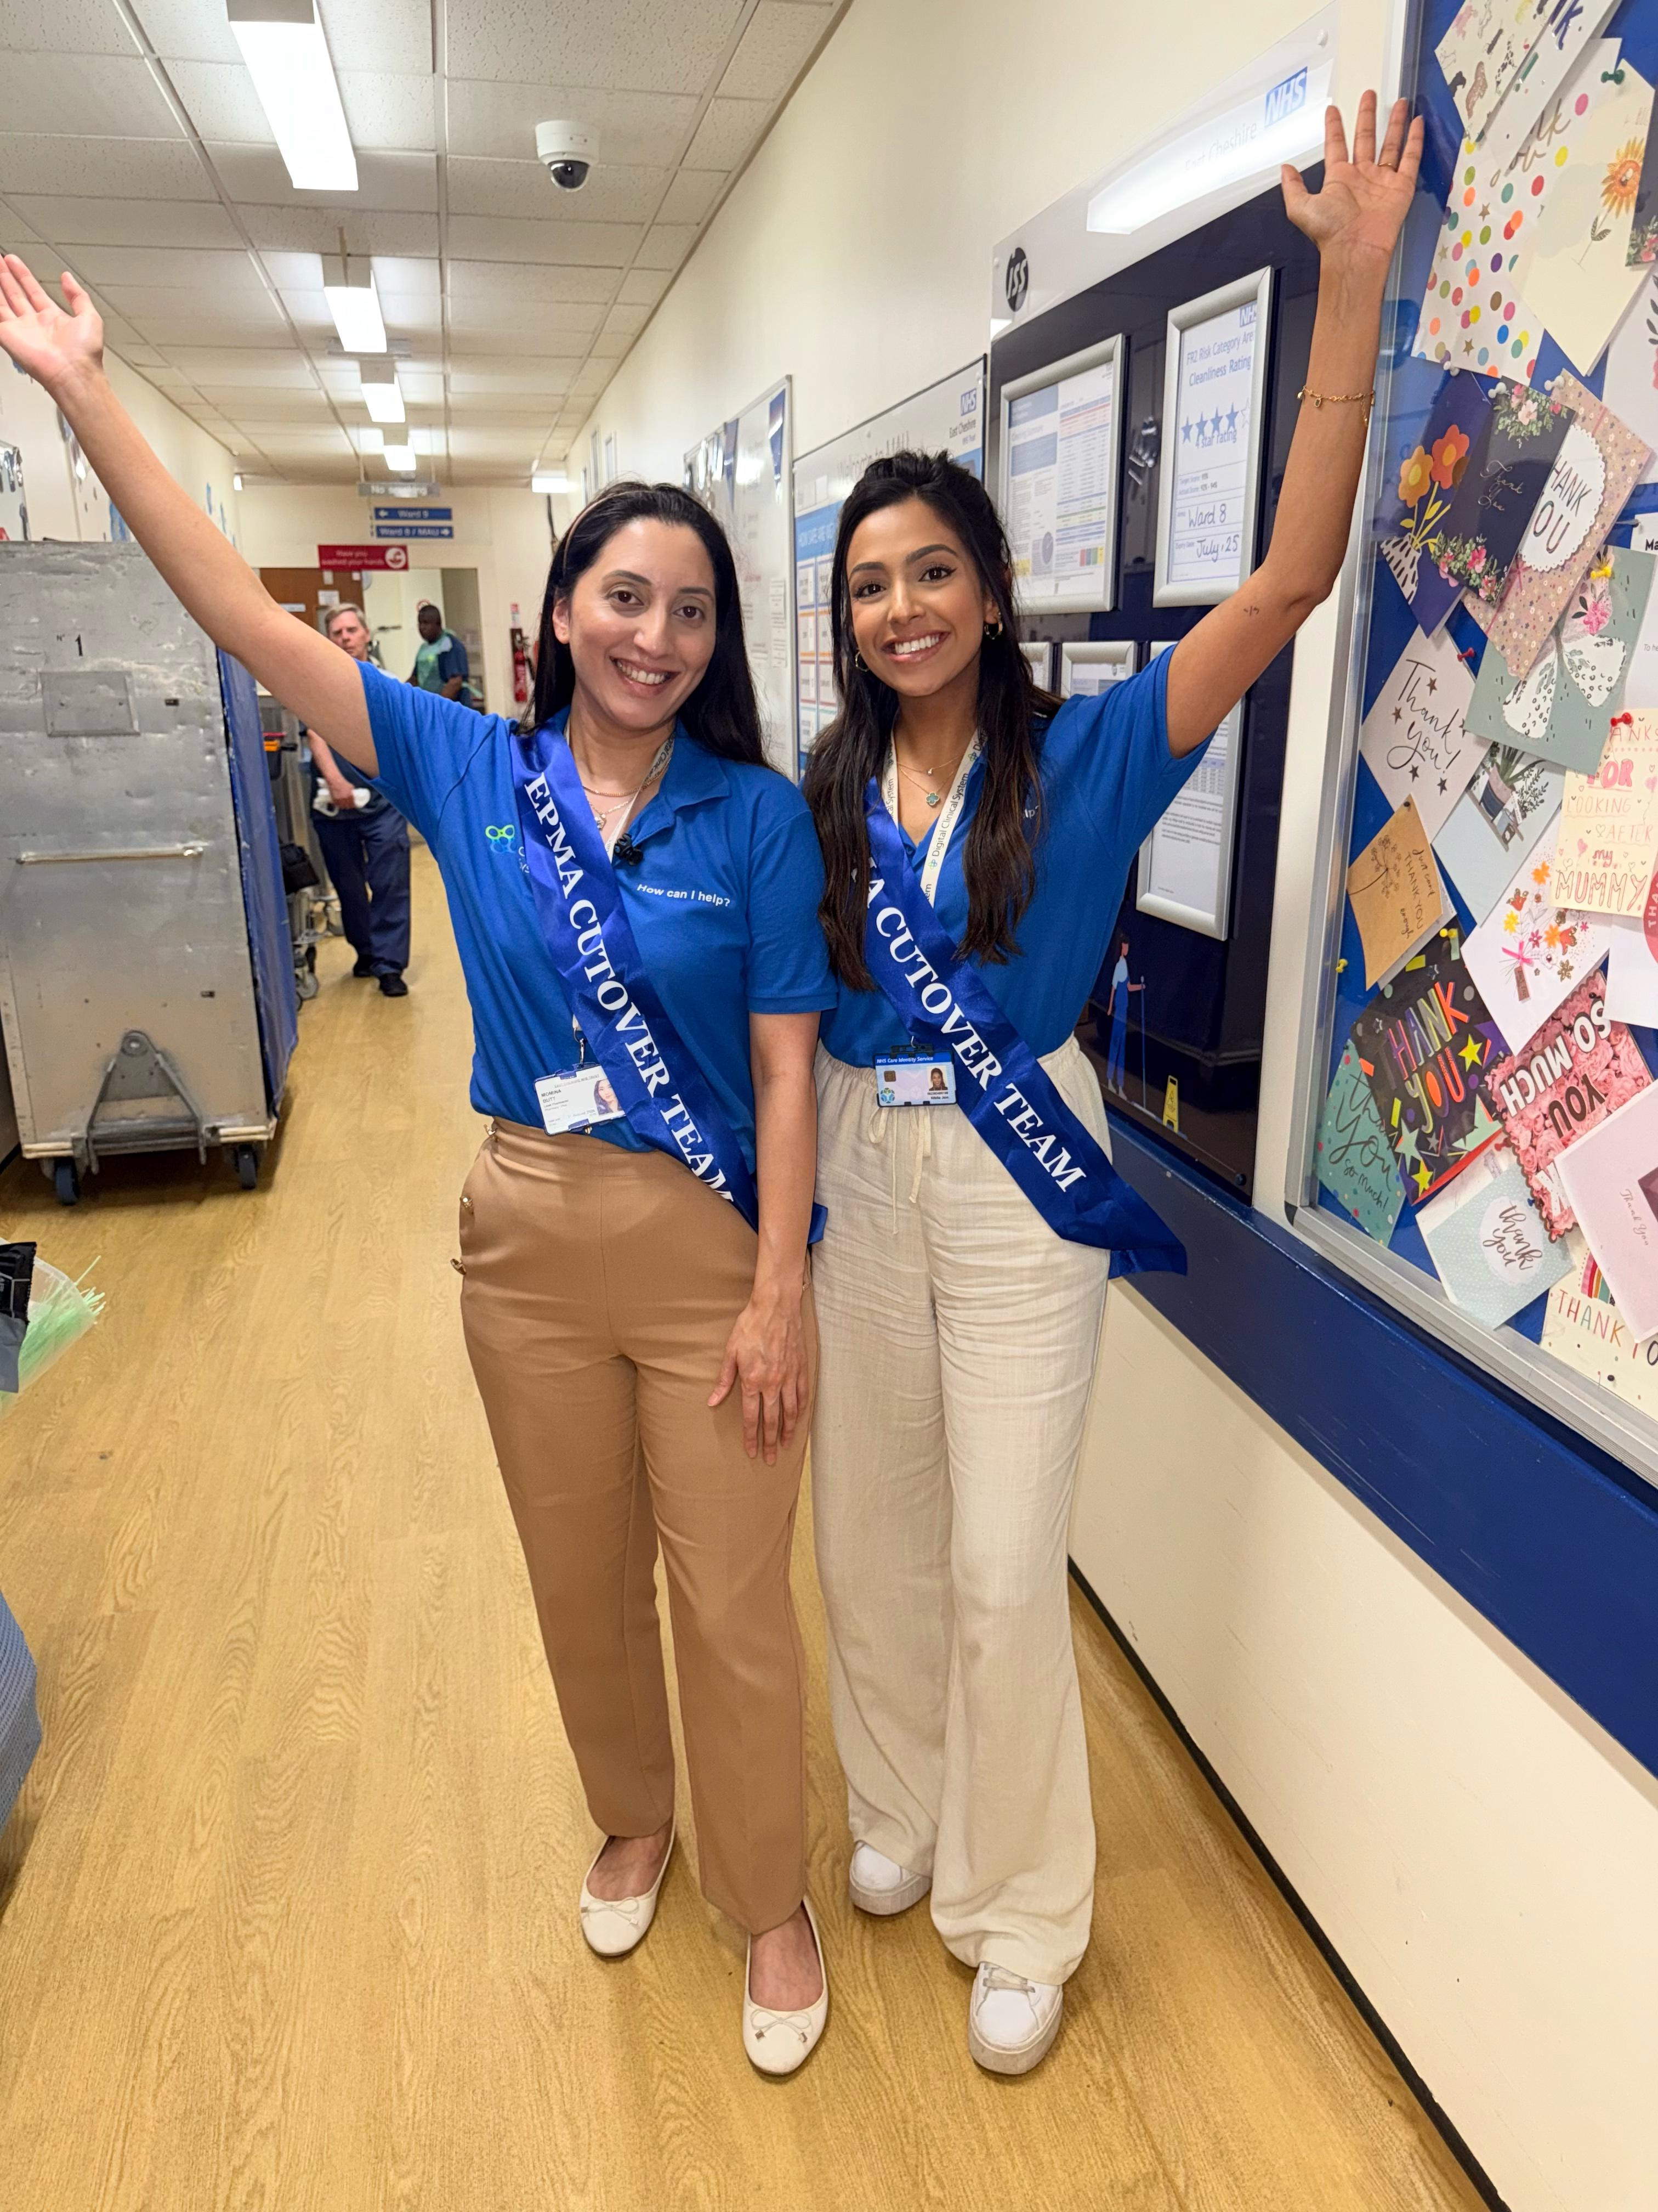
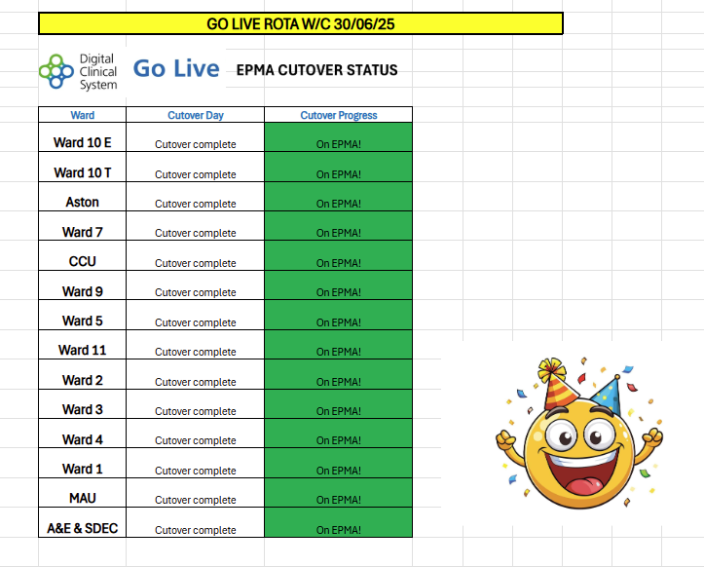
Notes:
We completed cutover within 5 working days (Mon-Fri) – an example of our tracker is shown with the wards and progress shown
A very happy pic of us after cutover was complete

Slide 15

What would we do different?
Training
Smaller groups (e.g. Specialist nurses, clinic staff, theatres staff) required extra 1:1 training
Would have refresher sessions led by EPMA pharmacists closer to Go Live
Patient Engagement
Recorded videos and had comms put out on the East Cheshire website for patients
Would engage patients on ward and explain more about what we are doing to put their minds at ease
Notes:
All in all, our EPMA go live week was successful, and our plan was executed almost perfectly, with no negative impact on patient safety.

Slide 16
Any Questions?

Slide 17
Thank you for your time and attention.
nikita.jain2@nhs.net
momina.butt1@nhs.net

