Slide 1

Care Boards: Real-Time Ward Intelligence
Powered by MEDITECH DR & Power BI
Notes:
Today I’ll show how we turned scattered ward data into one live Care Board that speeds flow, improves safety prompts, and aligns to CQC recommendations—built on MEDITECH DR and Power BI.

Slide 2
Why This Matters — Now
Post-COVID recovery: we need faster patient flow and clearer coordination under pressure.
CQC expectations: consistent visibility for safer handover and escalation.
Patient safety first: on-screen prompts for NEWS2/obs due, VTE, infection status, side-room need reduce missed observations and delays.
Better outcomes: earlier unblocking → more discharges before noon, fewer outliers.
One live view: beds, EDDs, blockers & safety—on screens, not hidden behind logins.
Early impact (so far): ↓ “where is X?” calls, ↑ timely escalations, clearer discharge planning.
Notes:
Post-COVID, recovery targets and winter pressures mean we can’t afford slow, hidden information. CQC expects consistent visibility and safer handovers. We built a single Care Board that puts the live truth on wall screens and desktops—

Slide 3
Before → After (60‑second tour)
Before
Data trapped on PCs — every check meant multiple logins.
Minimal overview screens — no real-time picture of the whole ward.
Slow and time-consuming — no timely single-patient view.
Result: more calls/emails, delayed escalation, variable handovers.
After
Care Boards on wall screens: live beds, EDD, blockers & safety prompts (NEWS2, VTE, infection, side-room).
One source of truth for wards, flow and executive huddles.
At-a-glance signals → faster decisions and timely escalations.
Early wins: fewer “where is X?” calls, improved observation compliance (NEWS2), better data quality.
Notes:
Tell a 30–60 second story from desk logins to wall‑screen clarity.

Slide 4

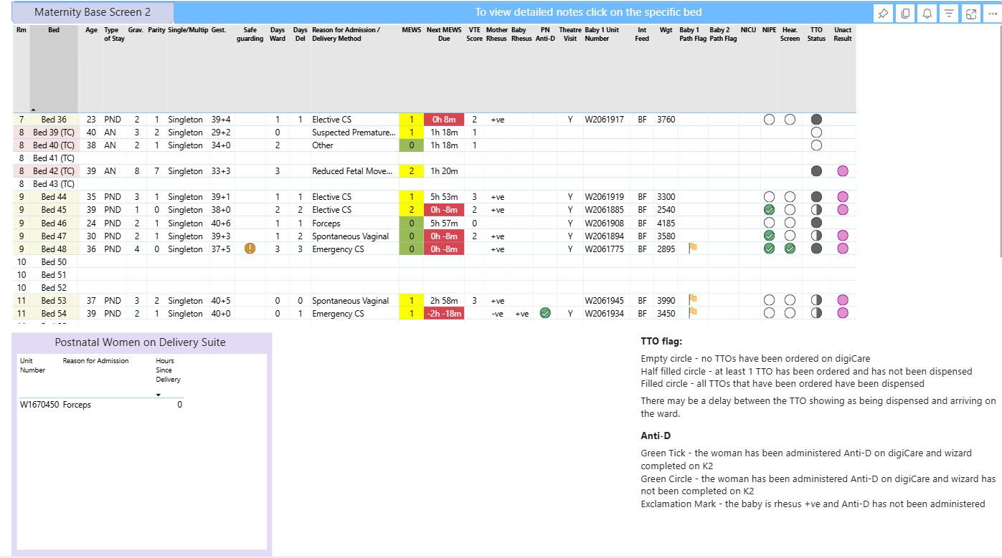
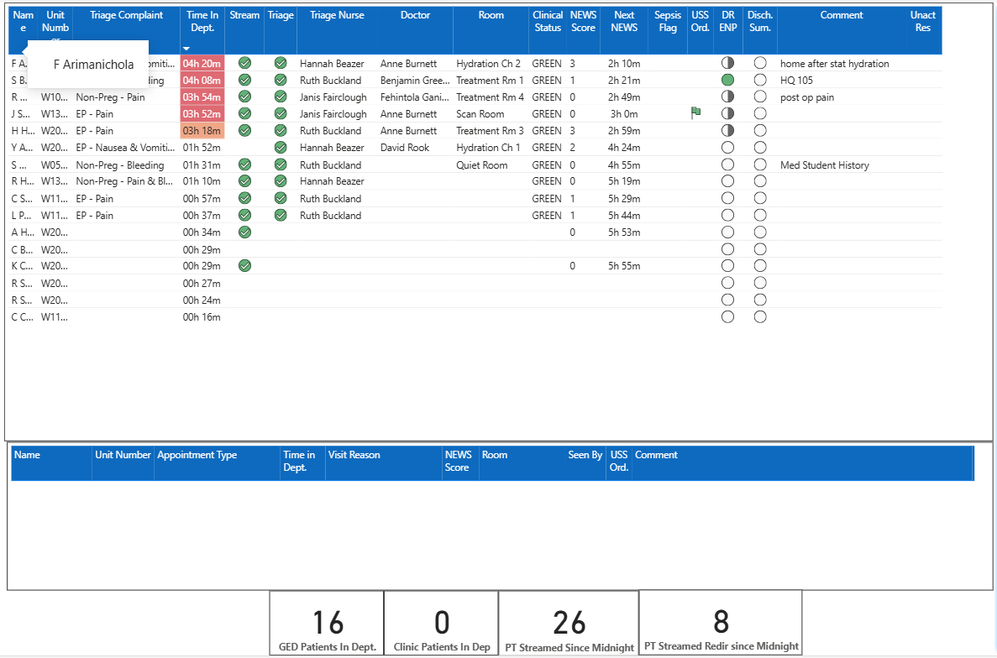
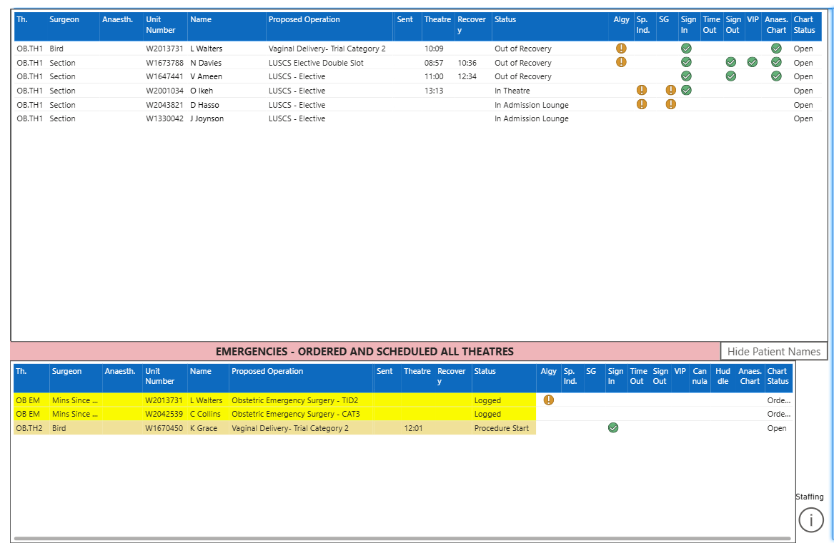
What We Built (Plain English)
Individual Care Boards for every ward — a live screen you can read from across the room.
Essentials at a glance: beds (occupied/vacant), EDD, blockers, and safety prompts (NEWS2/obs due, VTE, infection, side-room).
One truth, many views: wall displays on the ward, plus desktop and mobile for teams.
Designed for flow & safety: clear colour cues, big typography, consistent layout across wards.
Keeps itself fresh: auto-refresh every 2 minutes from MEDITECH DR with guard-rails for data quality.
Handover-ready: supports ward rounds and escalation pathways.
Notes:
Think of it as the ward’s control panel: live beds, EDD, blockers and safety prompts on one screen, refreshed every two minutes from MEDITECH DR. Same truth on the wall, desktop or mobile—so handovers and escalations run smoother.”

Slide 5
How It Works (Tech version)
Data Sources
No single source of the truth - MEDITECH DR + Expanse, Badger, K2
SharePoint lists & ward spreadsheets
Pipelines
SQL Server jobs: 2-min micro-refresh (facts), hourly/daily (dims)
Incremental loads, validation, alerts
Model
Star schema: Beds/Admissions/Safety facts
Link on NHS No / Unit No / Encounter / Location
Delivery
Power BI semantic model → Care Boards (wall/desktop/mobile)
RLS/SSO, Dev → Test → Prod
Resilience
Monitored jobs, retries, fallback to last-known-good
Notes:
Under the hood, we pull from MEDITECH DR plus Expanse, Badger and K2, and we round it out with SharePoint lists and ward spreadsheets so the picture is complete. SQL Server jobs run little micro-refreshes every two minutes for the ward-critical facts, with hourly or daily refreshes for slower-changing reference data. We load incrementally, validate, and alert on any failures. Everything lands in a simple star schema—beds, admissions and safety facts—linked on NHS number, Unit Number, encounter and location. Then we publish a single Power BI semantic model that drives the Care Boards on wall screens, desktops and mobiles. Access is controlled with RLS and SSO, and we ship through Dev, Test and Prod with monitoring and a fallback to last-known-good if a source blips

Slide 6
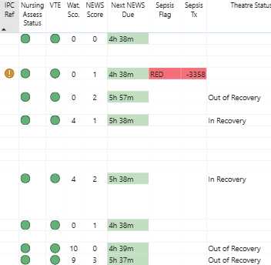
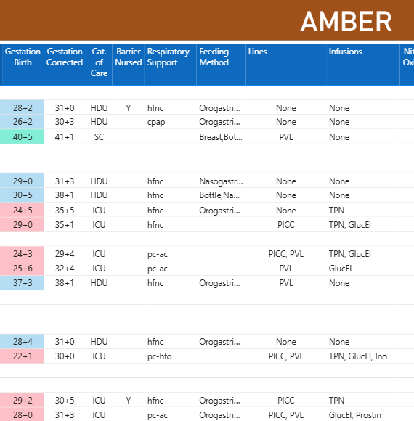
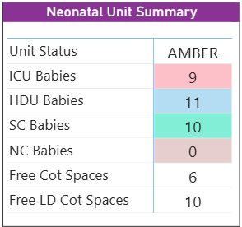
What’s On Screen — Today
Core across wards
  Beds & pipeline: occupied/vacant; admissions → discharges
  EDD & blockers: today/overdue, with reason codes to unblock
  Safety banners: NEWS2/obs due, VTE, infection status / side-room need
  Readable at distance: large type, simple icons, colour-blind-safe
Examples by specialty
  Maternity (Base Screen): Unit No, gestation, days on ward, reason for admission, MEWS / next obs due, VTE, rhesus / PN Anti-D, theatre visit, NIPE/hearing, TTO status (with legend)
  GED / Triage: Time in dept, complaint/stream, triage nurse/room/doctor, NEWS score & next NEWS, sepsis flag, ultrasound orders, discharge summary flag, bottom counters (patients in dept, streamed since midnight)
Ward-specific data
  Targeted stats and panels that aid patient management and flow (tuned per ward)
Notes:
“Every board shows the core elements—beds, EDDs with blockers, and safety banners like NEWS2 and VTE—in a layout you can read from across the ward. Then each specialty adds what matters locally: maternity includes MEWS, Anti-D and TTO; triage shows time in department, streams and NEWS with flags. We also include ward-specific stats to support day-to-day flow.”

Slide 7
Fast Wins & Early Impact
Unlocked data → visible to all: the live picture is on the wall, not hidden behind logins.
Shared awareness: wards, flow and doctors see the same truth, reducing back-and-forth.
Staff happier, less friction: fewer “where is X?” interruptions; clearer priorities at a glance.
Patient safety up front: NEWS2/obs due, VTE, infection flags are surfaced early, so action happens sooner.
More time to nurse: less screen-hopping and chasing info → nurses spend more time with patients.
Better patient experience: quicker decisions, fewer delays, clearer communication at the bedside.
Notes:
“The biggest win is visibility. Instead of hunting through systems, the live truth is on the wall for everyone. That reduces interruptions, helps us act on safety prompts sooner, and gives nursing time back to care. Patients feel the difference—faster decisions and fewer delays.”

Slide 8
What we’ve learnt
Build it with the wards: sit in, watch how it’s used, tweak little and often.
Start small: a “minimum board” first; only add what earns its place.
Make the right thing easiest: prompts appear where and when staff need them.
Keep it consistent: same layout across wards → less thinking, quicker use.
Data over decoration: reliable links and logic before fancy visuals.
Keep it tidy: regular data-quality checks; remove clutter when it creeps in.
Mind the practicalities: screen placement, brightness and stable kit matter for day-to-day use.
Notes:
“We kept this grounded by working on the wards, shipping small changes, and only keeping what’s genuinely useful. Consistency helps people move faster. And the practical bits—where the screen sits, how bright it is, and the kit staying up—make all the difference.”

Slide 9
The future
Safer medicines: surface missed doses and medicines prompts from EPMA/eMAR so wards can act quickly.
Faster results to the floor: flag when lab/imaging results land (e.g., abnormal/critical) so teams don’t have to chase.
Boards that move with the ward: not static — we’ll keep tuning layouts and prompts as pathways and patient needs change.
Continuous improvement: small updates, often — guided by ward feedback and real use.
Under the bonnet: simplify pipelines, improve stability and speed, trim complexity.
Plug in more data: ready to add additional sources (e.g., community, theatres, clinics, local trackers) as needed.
Keep it simple to use: only add what earns its place on screen
Notes:
“Next, we’ll bring medicines safety to the front by showing missed doses and prompts from EPMA/eMAR, and we’ll flag when key test results arrive so people aren’t chasing. The boards won’t be static — we’ll keep refining them with ward input. Behind the scenes we’ll simplify the plumbing for stability and speed, and keep the door open to new data sources where they genuinely help. The rule remains: only add what earns its place on the screen.”

Slide 10
Q&A

